Slide 1
Bright Smile Care Agency
An agency determined to reach homes to educate parents on how they can prevent caries for brighter smiles
Presented by:
Parvina Akhmadalieva
Michelle Fernandez
Nazwa Munia
Oluwanifemi Omoijuanfo
Thalina Urena Martinez

Slide 2
INTRODUCTION Oluwanifemi Omoijuanfo

Slide 3
What are cavities?

Slide 4
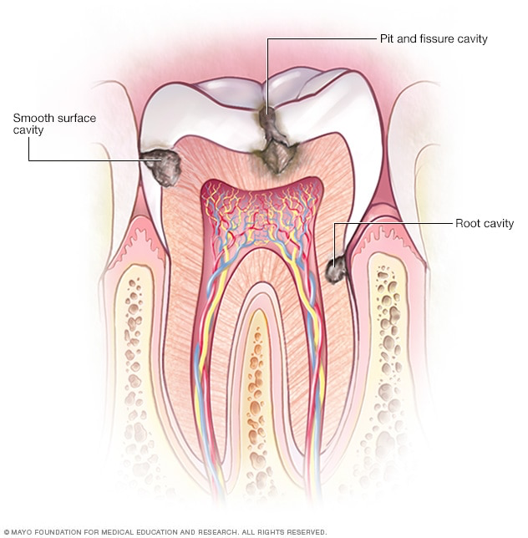
Dental cavities:
Cavities are permanently damaged areas in the hard surface of your teeth that develop into tiny openings or holes.
Cavities, are also called tooth decay or caries, are caused by a combination of factors, including bacteria in your mouth, frequent snacking, sipping sugary drinks and not having the correct oral hygiene.
Caries can occur throughout life, both in primary and permanent dentitions, and can damage the tooth crown and, in later life, exposed root surfaces.

Slide 5
How do cavities form?

Slide 6
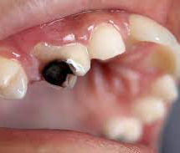
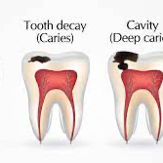
Cavities occur when a buildup of dental plaque eats at tooth enamel and causing a hole. Plaque is a sticky substance that covers teeth, and it forms when bacteria in the mouth.
Dental caries forms through a complex interaction over time between acid-producing bacteria and fermentable carbohydrate, and many host factors including teeth and saliva.
Risk for caries includes physical, biological, environmental, behavioral, and lifestyle related factors such as high numbers of cariogenic bacteria, inadequate salivary flow, insufficient fluoride exposure, poor oral hygiene, inappropriate methods of feeding infants, and low income.

Slide 7
Short Video On Prevention Of Caries: https://www.youtube.com/watch?v=iaDxTpipkjg

Slide 8
How can we prevent cavities?
Brush your teeth twice a day with a toothpaste that contains fluoride.
Use dental floss to reach those areas your toothbrush can’t reach.
Rinse daily with mouthwash that contains fluoride.
Drink plenty of water and reduce the consumption of sugary drinks.
Visit your dentist every 6 months to make sure everything is well.
Consider dental sealants and fluoride treatments.

Slide 9
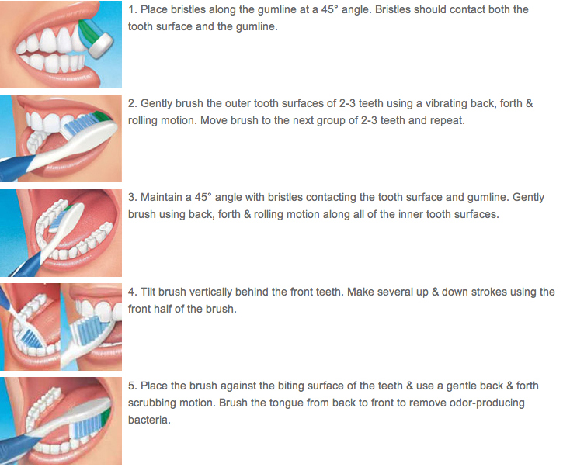
Brushing:
In addition, make sure to choose a soft-bristle toothbrush (it says it in the packaging when you purchase it) in order to prevent abrasion and gum recession.
Also, do not put to much pressure when brushing. You should be using 150 to 200 grams.

Slide 10
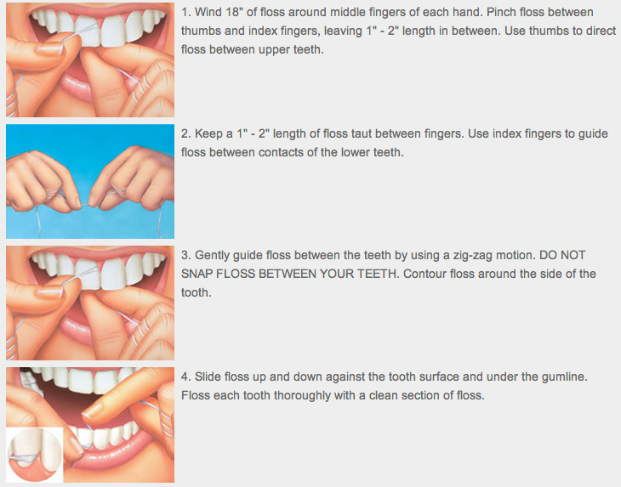
Flossing:
Furthermore, if do not think the standard floss is right for you we recommend trying the following options:
Super-flosses
Dental Tape
Soft-Picks
Disposable Floss-picks
Electric Water flossers

Slide 11
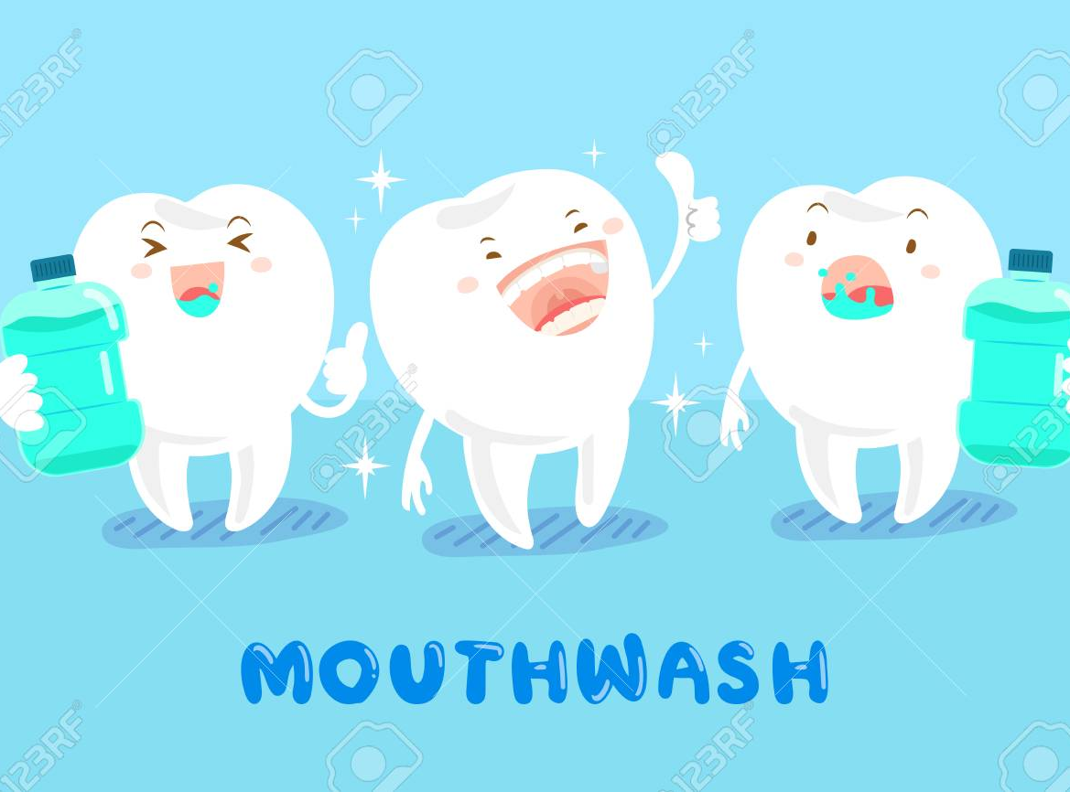
Mouthwash
Lastly, don’t forget to rinse with a fluoridated mouthwash before bed.

Slide 12
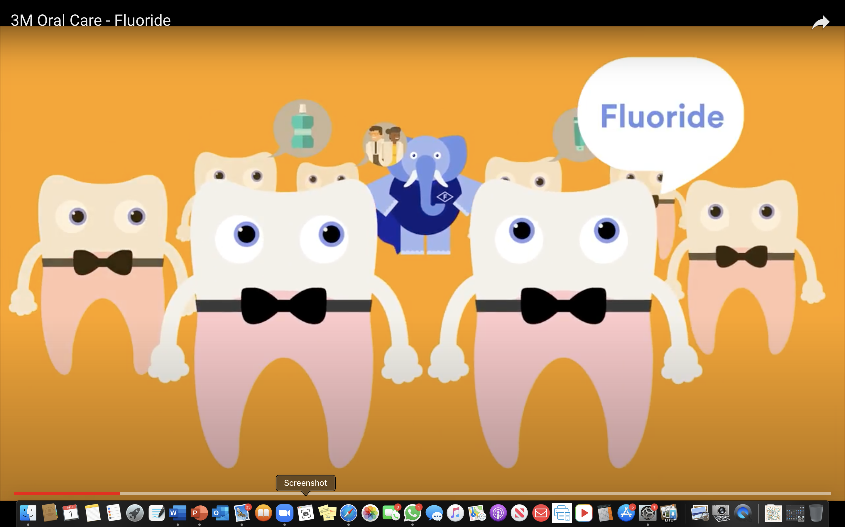
Preventing cavities one step at a time!
https://youtu.be/CCh8RRpWC90

Slide 13
Since the program will be conducted online, the needed materials include an accessible social media platform that all parents can easily use. Therefore, the twiducate is the most appropriate for this program. All the parents enrolled in the program will be provided with a code to log in. This will ensure that privacy is maintained because only those with the code can access the information posted. Questionnaires will also be developed that contain a question to be used during zoom sessions to assess each parent's progress. Therefore, each parent must be informed of the particular time when zooming will be conducted so that no one misses out.

Slide 14
Video courtesy- American dental association (ADA) https://youtu.be/kuLxz5IrZ6Y

Slide 15
Let’s check what we remember?
1. What is the appropriate age for children to start brushing their teeth?
A) 1 year old
B) As soon as teeth appear

Slide 16
Answer
B) As soon as teeth appear

Slide 17
What else we remember?
2. For children between the age of 3-6 years, how much toothpaste should be used?
A) Rice grain size
B) Pea size

Slide 18
Answer
B) Pea size

Slide 19
One more time…
3. At which angle toothbrush should be positioned for brushing?
A. 45-degree angle
B. 90-degree angle

Slide 20
Answer
A) 45-degree angle

Slide 22
Affordable Dental Prophylaxes
For parents who don’t have access to affordable dental care, we have provided educational facilities, hospitals or free clinics.
These affordable clinics and facilities prices ranges from $20-$80

Slide 23
Affordable Clinics
NYC Free Clinic
230 W 17th St
(212) 206-5200
Emergency Dentist NYC
100 E 12th St
(646) 336-8478
209 NYC Dental
209 E 56th St1st floor
(212) 355-2290

Slide 24
Services that will be provided
Head and neck exam
Oral cancer screening
Dental prophilaxys
Home care education
Fluoride treatment
Dental check-up by a dentist.

Slide 25
CONCLUSION Parvina

Slide 26
Q & A
Does anyone have any questions?

