Slide 1
Product Design
Janatan Ramdeen

Slide 2
Background
To create a visual for a culinary competition
Has to be New York City influenced
Has to have some elevation
Lights is a plus

Slide 3
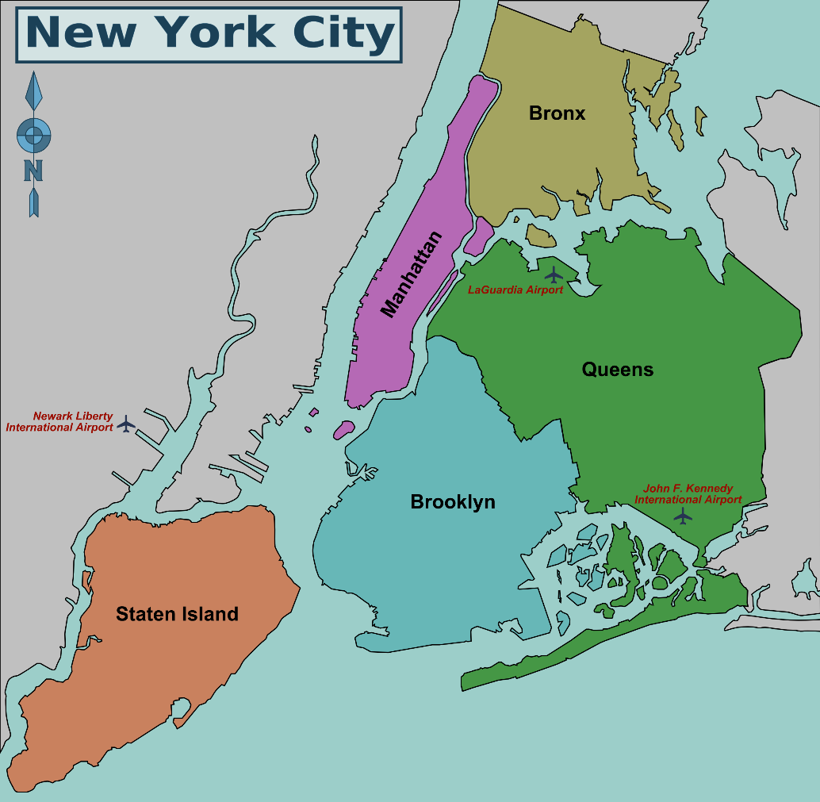
Brain Storm

Slide 4
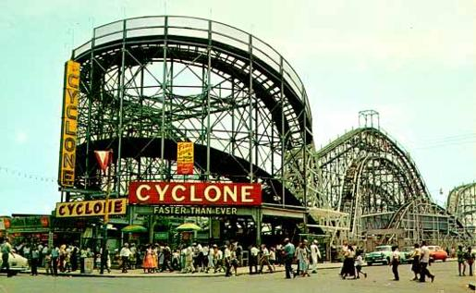
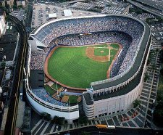
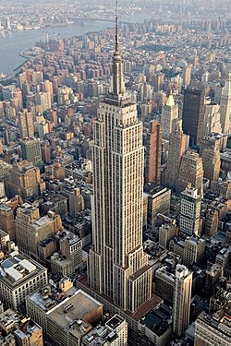
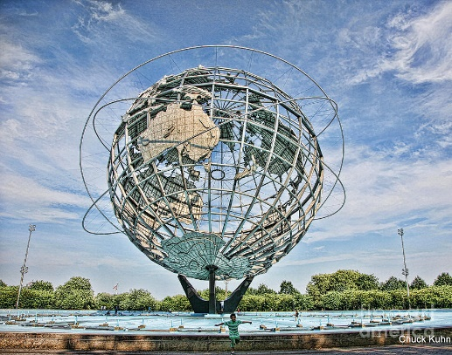
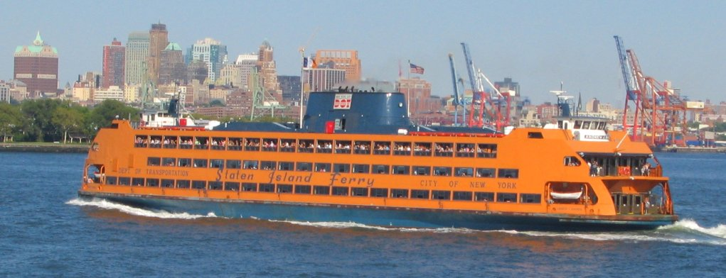

Slide 5
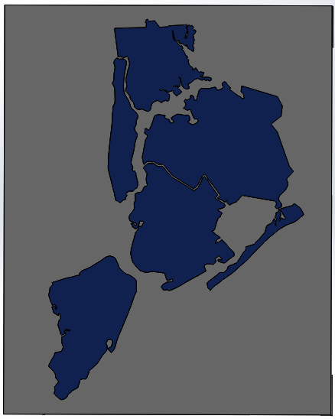
Design
Manufacture
CNC or Water Jet
3D print

Slide 6
Conclusion
Culinary competition
Problem with size
Easy to Manufacture
Has Elevation
How we can add lights.

