Slide 1
Lecture 1
Introduction

Slide 2
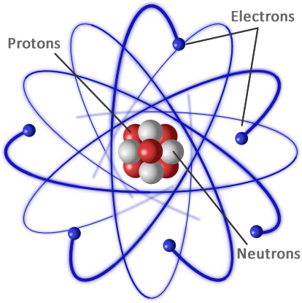
Todays goals
To be able to explain and draw atomic structure

Slide 3
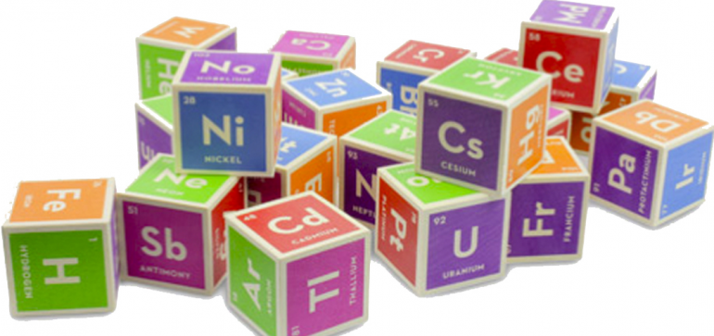
Elements
Elements are the building blocks of all matter on Earth
Elements are made up of atoms

Slide 4
Differences in elements
An atom is the smallest particle of an element that still has the properties of the element
The atoms in a piece of calcium are all the same, as are the atoms in aluminum – the atoms of each element are all identical
But calcium atoms are different from aluminum atoms – atoms of different elements are different from one another

Slide 5
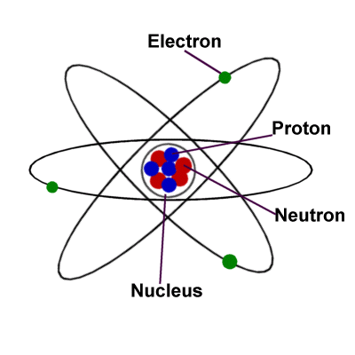
Atomic structure
Atoms are incredibly small and are made up of even tinier subatomic particles: protons, neutrons, and electrons

Slide 6
 | Proton | Neutron | Electron
Electric charge | positive (+) | neutral | negative (-)
Symbol | p⁺ | n⁰ | e⁻
Location in atom | nucleus | nucleus | outside nucleus in energy levels
Relative mass | about 1 | about 1 | about 1/2000

Slide 7
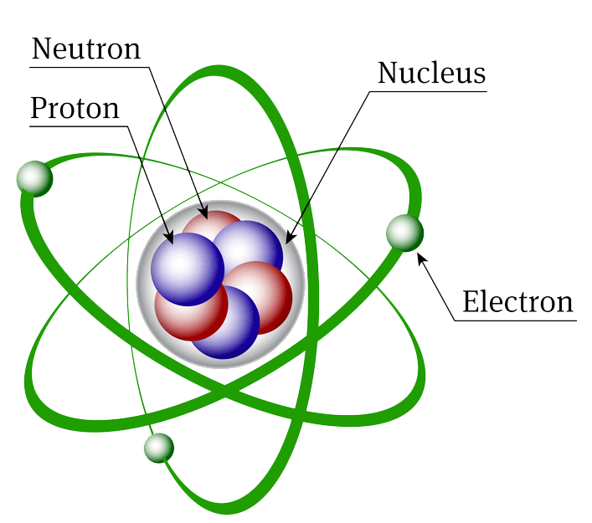
Atomic structure
The nucleus makes up nearly all the mass of an atom
The rest of the atom is mostly empty space

Slide 8
Differences in atoms
Each element has a unique number of protons
The atomic number indicates the number of protons
For example, calcium (Ca) has an atomic number of 20
This means each atom of calcium has 20 protons
In atoms, the number of protons and electrons is equal
An atom of calcium has 20 electrons outside the nucleus

Slide 9
Neutrons
The atomic mass is made of the number of protons plus neutrons, because protons and neutrons have a mass of 1
# of neutrons = atomic mass – atomic #

Slide 10
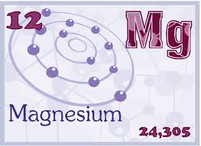
Neutrons
Magnesium has an atomic mass of 24.305, but we round to the nearest whole number of 24
Magnesium has an atomic number of 12
Using the formula:
# of neutrons = 24 – 12
# of neutrons = 12

Slide 11
Bohr-Rutherford diagrams
A simple drawing of the atom, showing the # of protons, neutrons, and electrons
Electrons are arranged in energy shells outside the nucleus
1st shell – 2 electrons; 2nd shell – 8; 3rd shell – 8

Slide 12
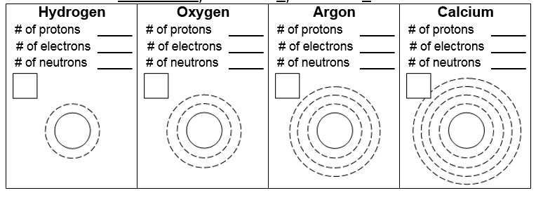
Bohr-Rutherford diagram
1
8
18
18
20
1
8
18
20
0
8
22
20
8
18
20
1
8
8
18
20
20
0
8
22
1
P1
8
P8
N8
18
P18
N22
20
P20
N20
P1
P8
N8
P18
N22
P20
N20

Slide 13
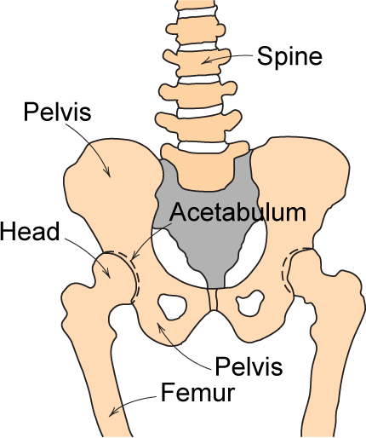
Hip Implant
Requirements
  mechanical strength (many cycles)
  good lubricity
  biocompatibility
Adapted from Fig. 22.24, Callister 7e.

Slide 14
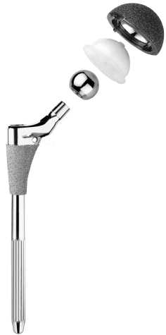
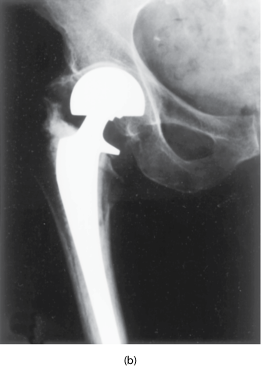
Hip Implant
Key problems to overcome
  fixation agent to hold
  acetabular cup
  cup lubrication material
  femoral stem – fixing agent
  must avoid any debris in cup
Ball
Acetabular
Cup and Liner
Femoral
Stem
Adapted from chapter-opening photograph, Chapter 22, Callister 7e. (Photograph courtesy of Zimmer, Inc., Warsaw, IN, USA.)

Slide 15
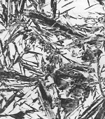
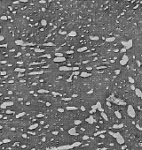
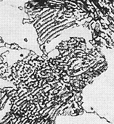
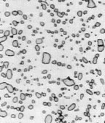
Structure, Processing, & Properties
• Properties depend on structure
ex: hardness vs structure of steel
(d)
6
00
5
00
30 μm
(c)
Data obtained from Figs. 10.31(a) and 10.32 with 4 wt% C composition, and from Fig. 11.15, Callister & Rethwisch 9e. Micrographs adapted from (a) Fig. 10.19; (b) Fig. 9.30; (c) Fig. 10.33; and (d) Fig. 10.21, Callister & Rethwisch 9e. (Figures 10.19, 10.21, & 10.33 copyright 1971 by United States Steel Corporation. Figure 9.30 courtesy of Republic Steel Corporation.)
4
00
(b)
(a)
Hardness (BHN)
3
00
4 μm
2
00
30 μm
30 μm
100
0.01
0.1
1
10
100
1000
Cooling Rate (ºC/s)
• Processing can change structure
ex: structure vs cooling rate of steel

Slide 16
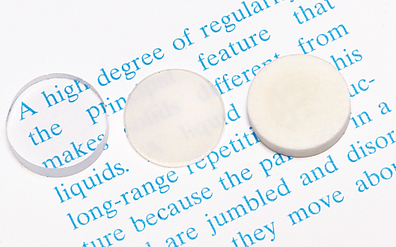
OPTICAL
• Transmittance:
-- Aluminum oxide may be transparent, translucent, or
opaque depending on the material’s structure (i.e.,
single crystal vs. polycrystal, and degree of porosity).
polycrystal:
no porosity
polycrystal:
some porosity
single crystal
Fig. 1.2, Callister & Rethwisch 9e.
(Specimen preparation,
P.A. Lessing)

Slide 17

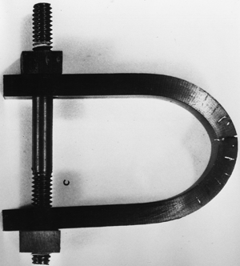
DETERIORATIVE
• Stress & Saltwater...
-- causes cracks!
• Heat treatment: slows
crack speed in salt water!
10⁻⁸
“as-is”
“held at
160°C for 1 hr
crack speed (m/s)
before testing”
10⁻¹⁰
Alloy 7178 tested in
saturated aqueous NaCl
solution at 23°C
increasing load
Fig. 17.21, Callister & Rethwisch 9e.
(from Marine Corrosion, Causes, and Prevention, John Wiley and Sons, Inc., 1975.)
Adapted from Fig. 11.20(b), R.W. Hertzberg, "Deformation and Fracture Mechanics of Engineering Materials" (4th ed.), p. 505, John Wiley and Sons, 1996. (Original source: Markus O. Speidel, Brown Boveri Co.)
Notes:
7178: MAJOR ELEMENTS ARE MAGNESIUM AND COPPER

Slide 18
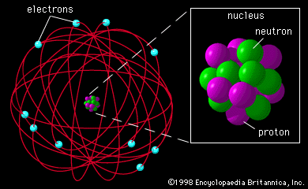
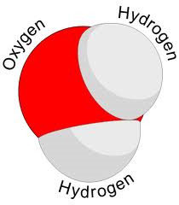
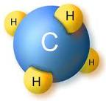
The Atomic Structures of Materials
Atom: Smallest part of an element that retains the properties of that element.
Molecule: Smallest particle of any substance that exist free and still exhibit all chemical properties of substance.

Slide 19
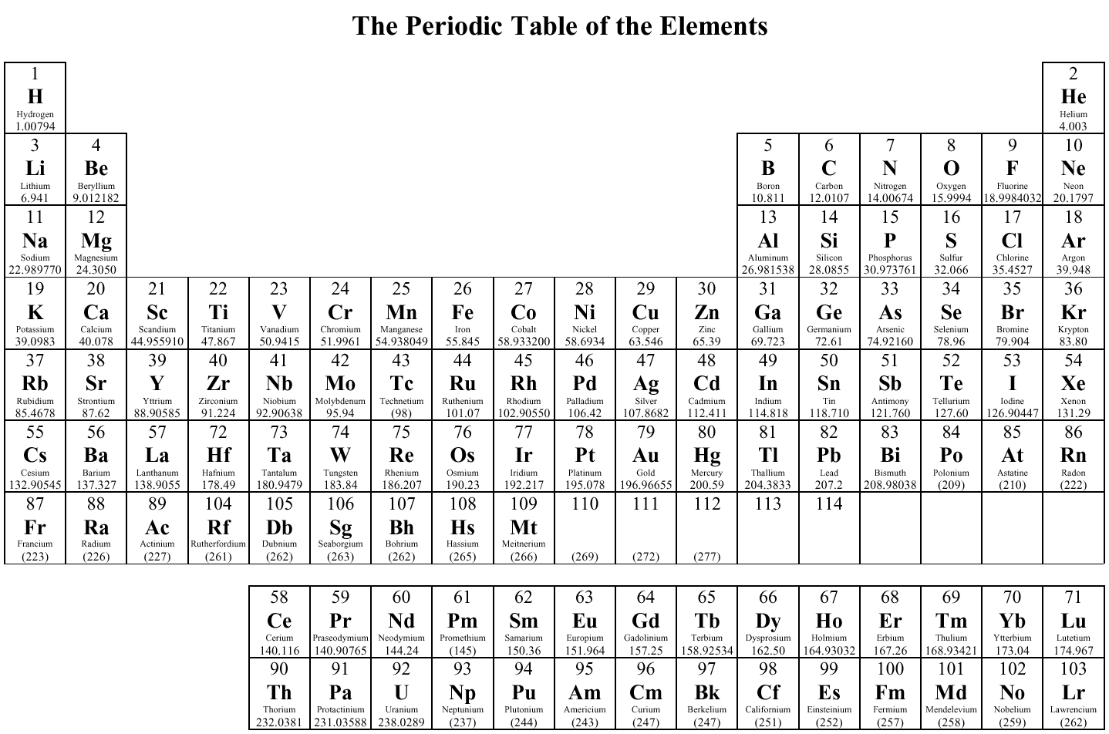
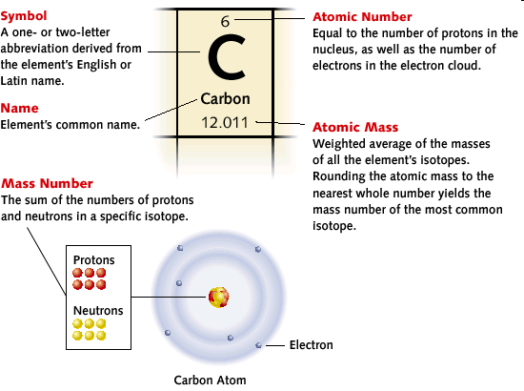
Groups
Periods

Slide 20
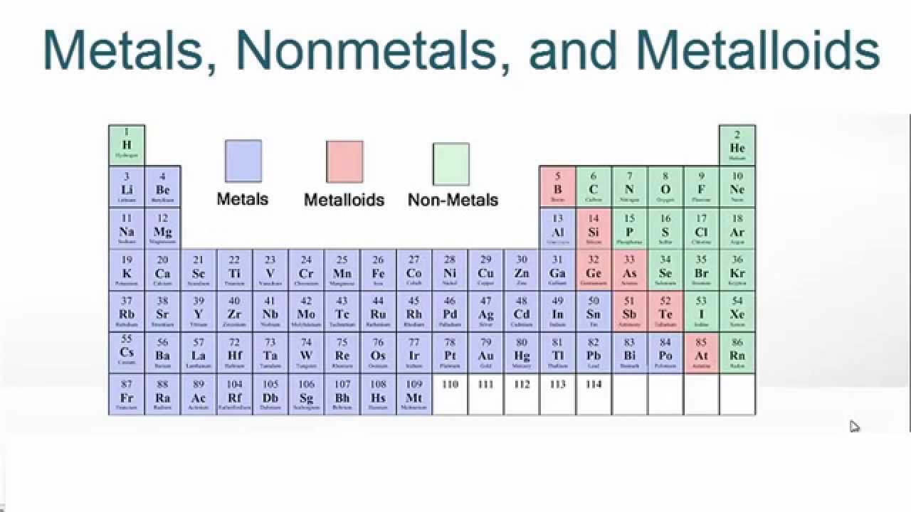
Periodic Table

Slide 21
Inert Gases
Light Metals
Low Melting
Nonmetals
Brittle Metals
Ductile Metals
Similar alloying elements to promote strength and hardenability
Ferromagnetic
Resistant to atmospheric conditions. High melting point
Similar crystal structure
Improve machinability

Slide 22
Atomic Bonding
All chemical bonds involve electrons
Atom becomes an ion when it is electrically non-neutral.
If an atom has only a few electrons in a shell, it will tend to lose them to empty the shell. These elements are metals.
When an atom has a nearly full electron shell, it will try to find electrons from another atom so that it can fill its outer shell. These elements are usually described as nonmetals.

Slide 23
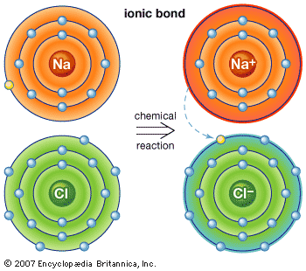
Atomic Bonding: Ionic Bond
Involves a metal and a nonmetal ion.
Generally, solid materials with ionic bond:
are hard because particles cannot easily slide past one another.
are good insulators because there are no free electrons or ions (unless dissolved or melted).
are transparent because their electrons are not moving from atom to atom and less likely to interact with light photons.
are brittle and tend to cleave rather than deform because bonds are strong.
have high melting point because ionic bonds are relatively strong.

Slide 24
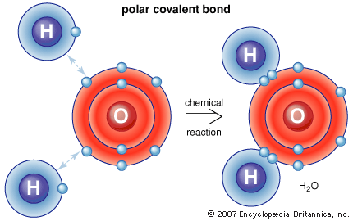
Atomic Bonding: Covalent Bond
Involves two or more non-metals
Electrons are shared.
Some common features of materials with covalent bonds:
Hard
Good insulators
Transparent
Brittle or cleave rather than deform

Slide 25
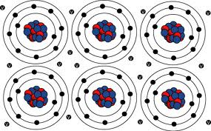
Atomic Bonding: Metallic Bond
Involves two or more metals, when some e⁻ in the valence shell separate from the orbit and exist in a free state “cloud”.
A common characteristic of metallic elements is they contain only one to three electrons in the outer shell.
Valence electrons have considerable mobility and are able to conduct heat and electricity easily.
The delocalized nature of the bonds, make it possible for the atoms to slide past each other when the metal is deformed instead of fracturing.

Slide 26
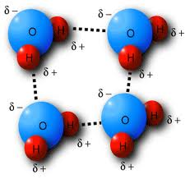
Atomic Bonding: Van der Waals Bond
The van der Waals bond occur to some extent in all materials but are particularly important in plastics and polymers.
These materials are made up of a long string molecules consisting of carbon atoms covalently bonded with other atoms, such as hydrogen, nitrogen, oxygen, fluorine.
The covalent bonds within the molecules are very strong and rupture only under extreme conditions.
The bonds between the molecules that allow sliding and rupture to occur are called van der Waals forces.

Slide 27
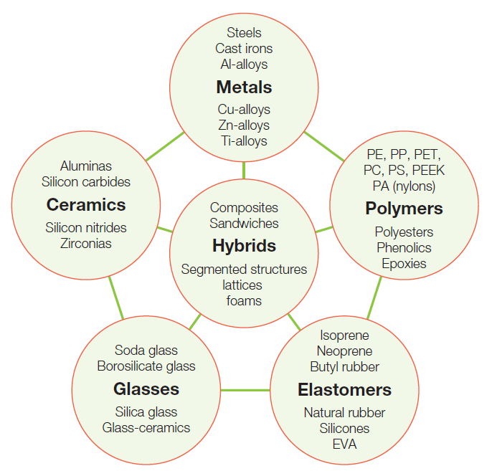
Menu of Engineering Materials
The members of a material family have certain features in common: similar properties, similar processing routes, and, often, similar applications
Figure 3.1

Slide 28
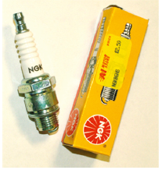

Ceramics
Stiff – high E
Hard
Good high temperature strength
Good corrosion resistance
Brittle
Glasses
Hard
Corrosion resistant
Electrically insulating
Transparent
Brittle

Slide 29
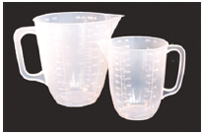
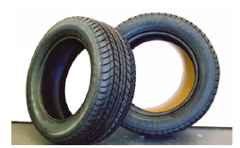
Polymers
Light – low ρ
Easily shaped
High strength per unit weight (σ/ρ)
Lack stiffness – low E (50X less than metals)
Properties highly sensitive to temperature
Elastomers
Lack stiffness – low E (500 – 5000X less than metals)
Able to retain initial shape after being stretched
Relatively strong and tough

Slide 30
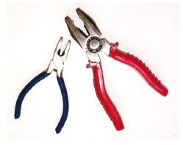
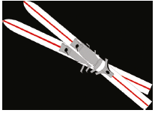
Metals
Tough
Stiff – high E
Wide range of strengths depending on composition and processing
Thermally and electrically conductive
Reactive – low corrosion resistance
Hybrids
Expensive
Difficult to shape and join
Properties dependent on combination of materials

Slide 31
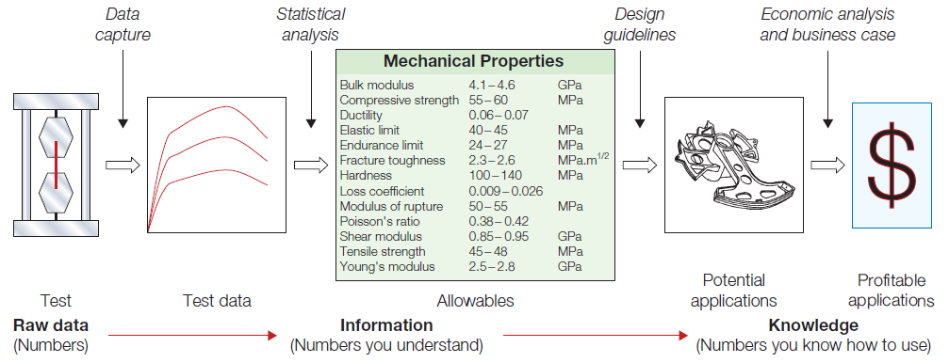
What type of materials information do
you need for design?
We are interested in the data in the center of the schematic; structured data for design allowables and information concerning the materials ability to be formed, joined, and finished
Figure 3.2

Slide 32
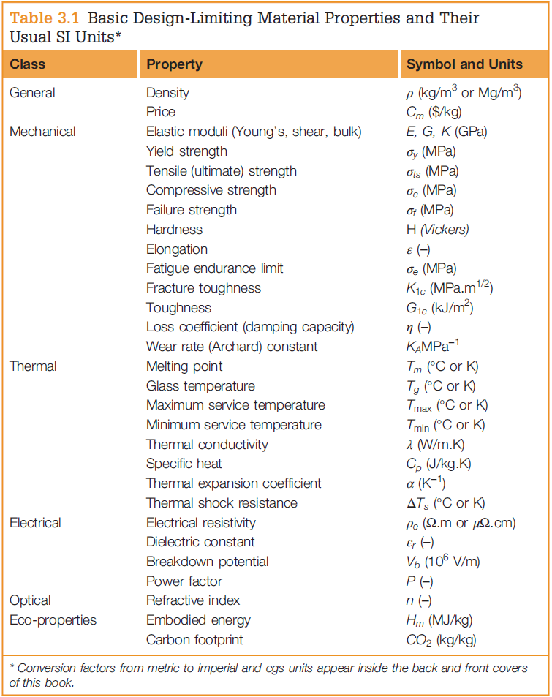
Material Properties and Their Units
Each material can be thought of as having a set of attributes or properties
The combination that characterizes a given material is its property profile
Figure 3.3

Slide 33
Assignment
Read Ch.1
Do problems 1.1-1.5, 1.8, 1.10, 1.12, 1.14, 1.16

