Slide 1
Chapter 5: Diffusion
ISSUES TO ADDRESS...
• How does diffusion occur?
• Why is it an important part of processing?
• How can the rate of diffusion be predicted for
some simple cases?
• How does diffusion depend on structure
and temperature?

Slide 2
Diffusion
Diffusion - Mass transport by atomic motion
Mechanisms
Gases & Liquids – random (Brownian) motion
Solids – vacancy diffusion or interstitial diffusion

Slide 3
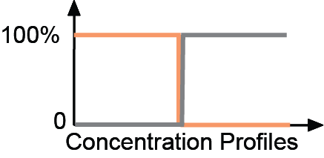
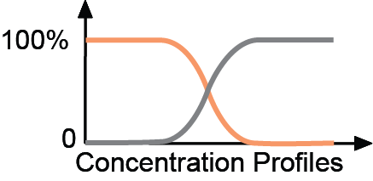
Diffusion
• Interdiffusion: In an alloy, atoms tend to migrate
from regions of high conc. to regions of low conc.
Initially
After some time
Figs. 5.1 & 5.2, Callister & Rethwisch 9e.

Slide 4
Diffusion
• Self-diffusion: In an elemental solid, atoms
also migrate.
Label some atoms
After some time
C
C
A
D
A
D
B
B

Slide 5
Diffusion Mechanisms
Vacancy Diffusion:
• atoms exchange with vacancies
• applies to substitutional impurities atoms
• rate depends on:
-- number of vacancies
-- activation energy to exchange.
increasing elapsed time

Slide 6

Diffusion Simulation
This slide contains an animation that requires Quicktime and a Cinepak decompressor. Click on the message or image below to activate the animation.
• Simulation of
interdiffusion
across an interface:
• Rate of substitutional
diffusion depends on:
-- vacancy concentration
-- frequency of jumping
(Courtesy P.M. Anderson)

Slide 7
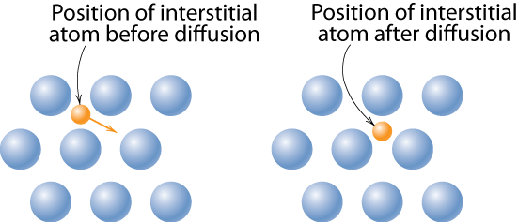
Diffusion Mechanisms
Interstitial diffusion – smaller atoms can diffuse between atoms.
Fig. 5.3 (b), Callister & Rethwisch 9e.
More rapid than vacancy diffusion

Slide 8

Processing Using Diffusion
• Case Hardening:
-- Diffuse carbon atoms
into the host iron atoms
at the surface.
-- Example of interstitial
diffusion is a case
hardened gear.
Chapter-opening photograph, Chapter 5, Callister & Rethwisch 9e. (Courtesy of
Surface Division, Midland-Ross.)
• Result: The presence of C
atoms makes iron (steel) harder.

Slide 9
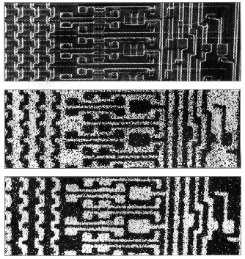
Processing Using Diffusion
• Doping silicon with phosphorus for n-type semiconductors:
• Process:
0.5 mm
1. Deposit P rich
layers on surface.
magnified image of a computer chip
silicon
2. Heat it.
3. Result: Doped
semiconductor
regions.
light regions: Si atoms
light regions: Al atoms
silicon
Adapted from Figure 18.27, Callister & Rethwisch 9e.

Slide 10
Diffusion
How do we quantify the amount or rate of diffusion?
Measured empirically
  Make thin film (membrane) of known cross-sectional area
  Impose concentration gradient
  Measure how fast atoms or molecules diffuse through the membrane
M =
mass
diffused
J ∝ slope
time

Slide 11
Steady-State Diffusion
Rate of diffusion independent of time
  Flux proportional to concentration gradient =
C₁
C₁
Fick’s first law of diffusion
C₂
C₂
x₁
x₂
x
D ≡ diffusion coefficient

Slide 12
Example: Chemical Protective Clothing (CPC)
Methylene chloride is a common ingredient of paint removers. Besides being an irritant, it also may be absorbed through skin. When using this paint remover, protective gloves should be worn.
If butyl rubber gloves (0.04 cm thick) are used, what is the diffusive flux of methylene chloride through the glove?
Data:
  diffusion coefficient in butyl rubber:
  D = 110 x10⁻⁸ cm²/s
  surface concentrations:
C₁ = 0.44 g/cm³
C₂ = 0.02 g/cm³

Slide 13
Example (cont).
Solution – assuming linear conc. gradient
glove
C₁
paint
remover
skin
C₂
Data:
D = 110 x 10⁻⁸ cm²/s
x₁
x₂
C₁ = 0.44 g/cm³
C₂ = 0.02 g/cm³
x₂ – x₁ = 0.04 cm

Slide 14
Diffusion and Temperature
• Diffusion coefficient increases with increasing T
Q_{d}
D
=
D_{o}
exp
−
R
T
D
= diffusion coefficient [m²/s]
D_{o}
= pre-exponential [m²/s]
Q_{d}
= activation energy [J/mol or eV/atom]
R
= gas constant [8.314 J/mol-K]
T
= absolute temperature [K]

Slide 15
Diffusion and Temperature
D has exponential dependence on T
1500
1000
600
300
T(°C)
10⁻⁸
D (m²/s)
C in γ-Fe
D
>> D
C in α-Fe
interstitial
substitutional
C in α-Fe
Al in Al
10⁻¹⁴
Fe in α-Fe
C in γ-Fe
Fe in α-Fe
Fe in γ-Fe
Al in Al
Fe in γ-Fe
10⁻²⁰
0.5
1.0
1.5
1000 K/T
Adapted from Fig. 5.7, Callister & Rethwisch 9e.
(Data for Fig. 5.7 taken from E.A. Brandes and G.B. Brook (Ed.) Smithells Metals Reference Book, 7th ed., Butterworth-Heinemann, Oxford, 1992.)

Slide 16
Example: At 300°C the diffusion coefficient and activation energy for Cu in Si are
D(300°C) = 7.8 x 10⁻¹¹ m²/s
Q_{d} = 41.5 kJ/mol
What is the diffusion coefficient at 350°C?
D
transform data
ln D
Temp = T
1/T

Slide 17
Example (cont.)
T₁ = 273 + 300 = 573 K
T₂ = 273 + 350 = 623 K
D₂ = 15.7 x 10⁻¹¹ m²/s

Slide 18
Non-steady State Diffusion
The concentration of diffusing species is a function of both time and position C = C(x,t)
In this case Fick’s Second Law is used
Fick’s Second Law
Notes:
In the non-steady state the concentration profile develops with time.

Slide 19
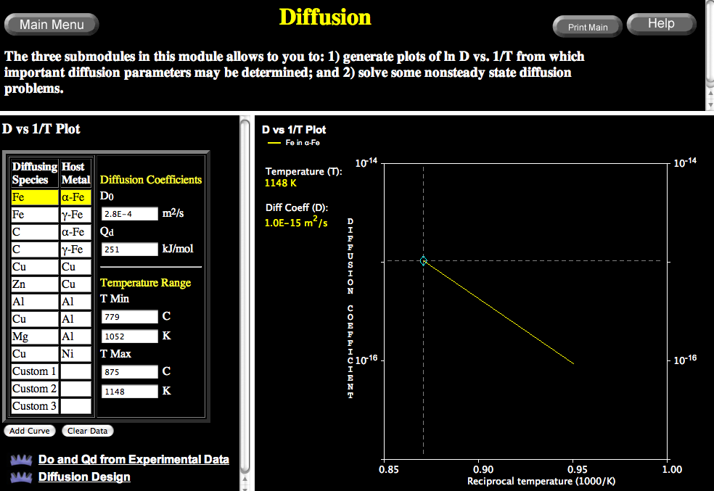
VMSE: Screenshot of Diffusion Computations & Data Plots

Slide 20
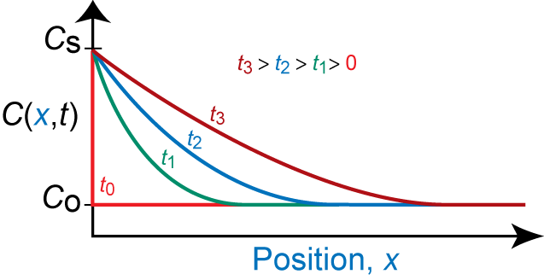
Non-steady State Diffusion
• Copper diffuses into a bar of aluminum.
Surface conc.,
C
of Cu atoms
bar
s
pre-existing conc., C_{o} of copper atoms
C
s
Fig. 5.5, Callister & Rethwisch 9e.
B.C. at t = 0, C = C_{o} for 0 ≤ x ≤ ∞
at t > 0, C = C_{S} for x = 0 (constant surface conc.)
C = C_{o} for x = ∞

Slide 21
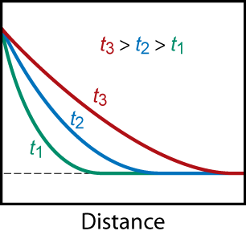
Solution:
C(x,t) = Conc. at point x at
time t
erf(z) = error function
erf(z) values are given in Table 5.1
C_{S}
C(x,t)
C_{o}
Fig. 5.5, Callister & Rethwisch 9e.

Slide 22
Non-steady State Diffusion
Sample Problem: An FCC iron-carbon alloy initially containing 0.20 wt% C is carburized at an elevated temperature and in an atmosphere that gives a surface carbon concentration constant at 1.0 wt%. If after 49.5 h the concentration of carbon is 0.35 wt% at a position 4.0 mm below the surface, determine the temperature at which the treatment was carried out.
Solution: use Eqn. 5.5

Slide 23
Solution (cont.):
  t = 49.5 h x = 4 x 10⁻³ m
  C_{x} = 0.35 wt% C_{s} = 1.0 wt%
  C_{o} = 0.20 wt%
∴ erf(z) = 0.8125

Slide 24
Solution (cont.):
We must now determine from Table 5.1 the value of z for which the error function is 0.8125. An interpolation is necessary as follows
z
erf(z)
0.90 0.7970
z 0.8125
0.95 0.8209
z = 0.93
Now solve for D

Slide 25
Solution (cont.):
To solve for the temperature at which D has the above value, we use a rearranged form of Equation (6.9a);
from Table 6.2, for diffusion of C in FCC Fe
D_{o} = 2.3 x 10⁻⁵ m²/s Q_{d} = 148,000 J/mol
∴
T = 1300 K = 1027°C

Slide 26
Example: Chemical Protective Clothing (CPC)
Methylene chloride is a common ingredient of paint removers. Besides being an irritant, it also may be absorbed through skin. When using this paint remover, protective gloves should be worn.
If butyl rubber gloves (0.04 cm thick) are used, what is the breakthrough time (t_{b}), i.e., how long could the gloves be used before methylene chloride reaches the hand?
Data
  diffusion coefficient in butyl rubber:
  D = 110 x 10⁻⁸ cm²/s

Slide 27
CPC Example (cont.)
Solution – assuming linear conc. gradient
glove
Breakthrough time = t_{b}
C₁
Equation from online CPC Case Study 5 at the Student Companion Site for Callister & Rethwisch 9e (www.wiley.com/
college/callister)
paint
remover
skin
C₂
x₁
x₂
D = 110 x 10⁻⁸ cm²/s
Time required for breakthrough ca. 4 min

Slide 28
Summary
Diffusion FASTER for...
• open crystal structures
• materials w/secondary
bonding
• smaller diffusing atoms
• lower density materials
Diffusion SLOWER for...
• close-packed structures
• materials w/covalent
bonding
• larger diffusing atoms
• higher density materials

