Slide 1
Properties of Substance & Steady State Energy Equation
Prof Akm Rahman
CC-BY-NC-SA Copyright by Prof. Dr. Akm Rahman

Slide 2
Energy Equation for a control Mass and Control volume
Energy Equation for a control mass , where mass is fixed, can be written as-
This is a Control Mass Approach, where the quantity is fixed.
How about fluid flowing across the control surface?
Or Leaves with an energy per unit mass?

Slide 3
Pure Substance
Homogeneous
Invariable chemical composition
Multiple phases may exist. For Example, water exists in both liquid and vapor
But chemical composition does not change.

Slide 4
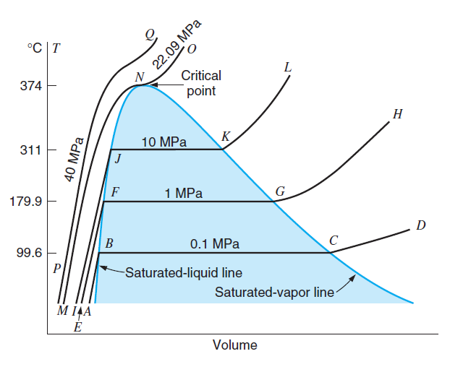
P,V,T surface for water
P-Lines
Change in one parameter can change other.
For example, Volume of water (Liquid/Vapor) can change with Temp or Pressure or both.
Pay Attention to critical point- Saturated liquid directly transforms into saturated vapor.
T-V diagram for water showing Liquid and Vapor Phase

Slide 5
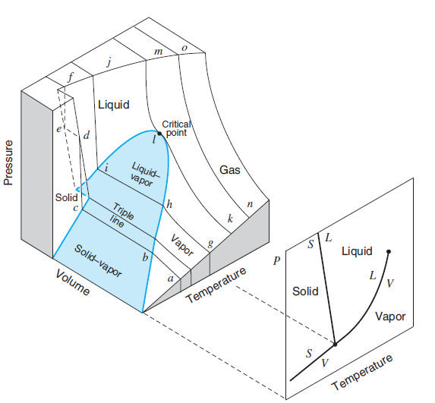
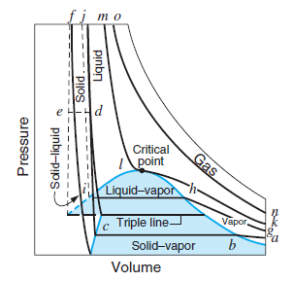
P-V-T in a 3D space
Important observation-
How P, V, T changes simultaneously
Triple Point- Where Solid, Liquid and Vapor co-exist
T-Lines
Triple Point
P-V Diagram at Various T

Slide 6
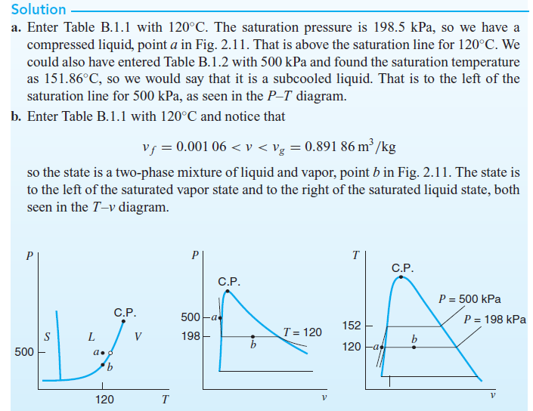
Example
Determine the phase for each of the following water states using the steam tables. a. 120 C, 500 kPa
b. 120 C, 0.5 m^3/kg .
Hint: Table B.1.1 is a
Saturated water table added
in the appendix of open lab.

Slide 7
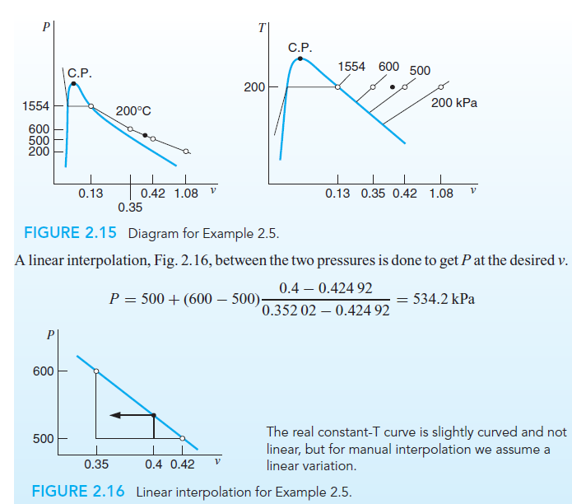
Example : Pressure Determination

Slide 8
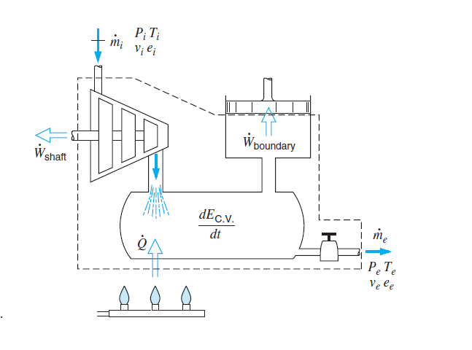
Steady State Energy Analysis
Steady state- Rate of change of incoming mass equals the rate of change in outgoing mass
How about fluid flowing across the control surface?
Or Leaves with an energy per unit mass?
Rate of in change in mass is constant- Steady state condition.
e= Total Energy per unit mass

Slide 9
Terminology of Energy Equation
h=Enthalpy=u+Pv= Internal energy + Work done
P = Pressure
V= Velocity
Z= Elevation
v=specific volume
Unit of h, J/kg

Slide 10
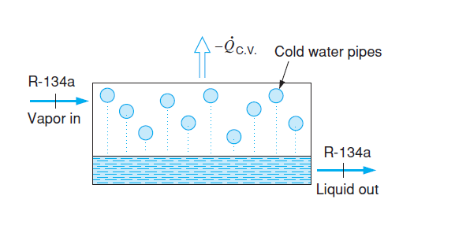
Steady State Process
It’s a Process where-
Example: Centrifugal air compressor

Slide 11
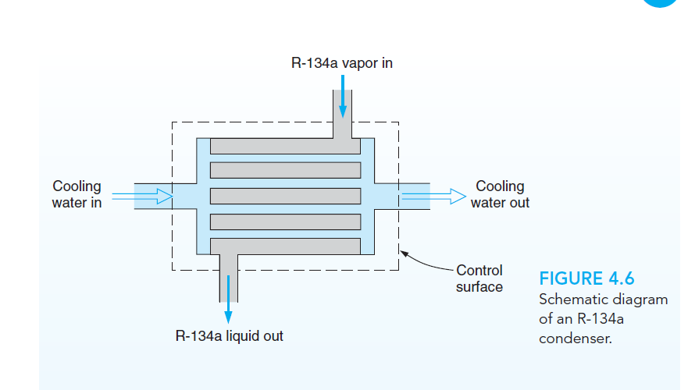
Example of Steady State
Refrigeration system condenser
Heat Exchanger--- For Heat transfer
R-134 is a Refrigerant
Cold water contains cold water

Slide 12
Analysis of Heat Exchanger
At a steady state condition-
Total energy in=Total energy out

Slide 13
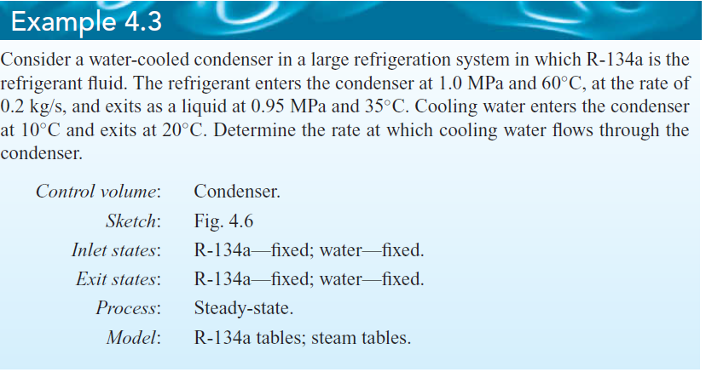
Example Problem
Given , Refrigerant (R-134 ) mi=0.2 kg/s
Find, mass flow rate of water..
How much water you need to maintain the cooling condition
(Cooling from 60 C to 35 C )?

Slide 14
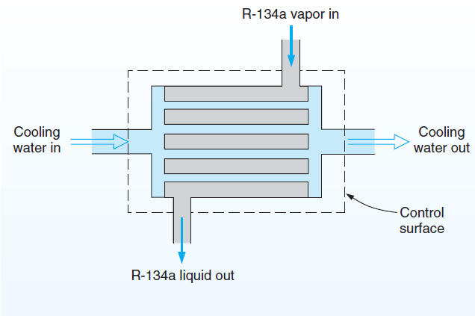
Solution

Slide 15
How much heat is Removed from Refrigerant?
Q=m*h=(kg/s)*(KJ/kg)
=kJ/s= kW
It can also be said-
Qr= Qw
Calculate m_{w}
M_{w} Is a design Parameter that indicates-
How many water tubes you need in the condenser
Diameter of the tube

Slide 16
Practice Problem
Use R-134A. Re-calculate the water mass flow rate,
using the following condition
m_{r}=0.3 kg/s, Refrigerant inlet condition, 70 C at 1 MPa
Refrigerant outlet condition, 40 C at .4 MPa.
Water inlet and outlet are 20 C and 30 C, (a) Find water mass flowrate, m_{w}
And (b) Heat removed from the refrigerant in kW.

