Slide 1
Introduction to Composite Materials
EGR 235 & MECH 2322
Dr. Akm Rahman

Slide 2
What is Composite Material?
The word composite signifies the combination of two or more materials
Combination in macroscopic level, identified by naked eye
In microscopic level, more homogeneous. Example metal alloys
The usage goes back to the ancient time, e.g., mud bricks strengthening by straw, Wood is a Natural Composite.
Composite materials are composed of:
Matrix (binder)
Fibers (reinforcements)
Matrix is the continuous phase of the composites
Fiber is to provide mechanical properties to the composites

Slide 3
Role of Fiber and Matrix
Matrix | Fiber
Gives shape to the composite | Gives strength, stiffness, etc
Protects the fiber from the environment | Dominates the properties such as coefficient of thermal expansion, conductivity, etc
Transfers loads to the fibers

Slide 4
Typical Fiber and Matrix Materials
Typical matrix material:
Polymers
Metals
Ceramics
Carbon
Rubbers (Example : Tire)
Thermoplastics ( Example: Wire Insulator)
Thermosets (Example: Epoxy, Poly-easter)

Slide 5
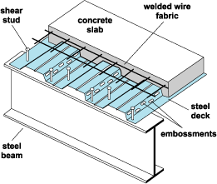
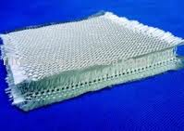
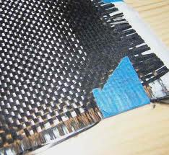
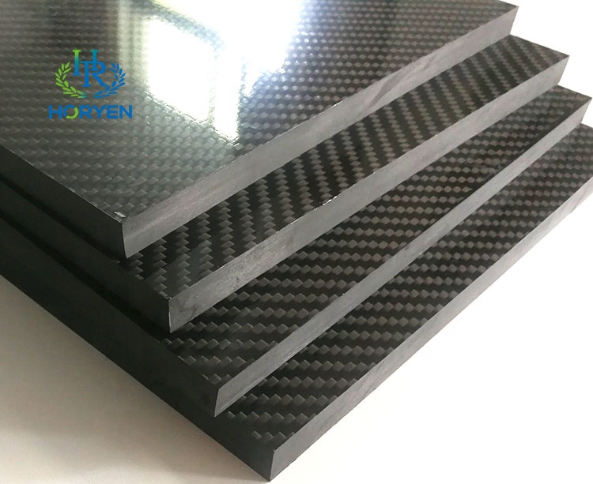
Typical Example of Composites
Glass fiber composite
Composite floor
Carbon fiber composite
Carbon fiber Stack

Slide 6
Typical Composite Properties
Composite materials usually exhibit the best qualities of their components
Some properties
Strength - Stiffness
Corrosion resistance - Wear resistance
Attractiveness - Weight
Fatigue life - Temp-dependent behavior
Thermal insulation - Thermal conductivity
Acoustical insulation - Thermal expansion
Note that not all can be improved, e.g., thermal conductivity and thermal resistance

Slide 9
Types of Composite Materials
Fibrous composite, fiber in a matrix (Ex. Fiber in the Matrix)
Laminated composite, layers of various materials
Particulate composite, particles in a matrix ( Ex: Sand, Gravel in Concrete)
Nanocomposites (Ex: Nanomaterials in the Matrix)
Combination of the above
Laminated Composite

Slide 10
Laminated fiber-reinforced composite materials
Laminae is the basic building block of laminate
Laminate (Singular) is a bonded stack of laminae (Plural)

Slide 11
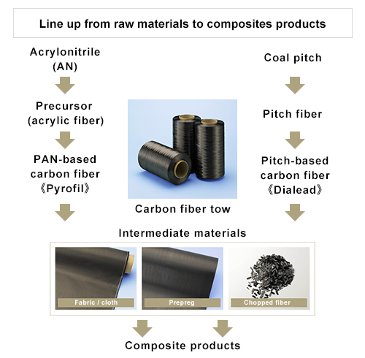
Carbon/Graphite Fibers
Higher strength and stiffness than fiberglass
Introduced in industrial scale on mid 1950’s
Three main types
PAN-based (Poly-
Acrylo Nitrile)
Pitch-based
Rayon-based

Slide 12
Carbon/graphite Fibers-Applications based on mechanical properties
Aviation industry (e.g., fuselage, helicopter rotor blades, etc)
Automotive industry (e.g., drive shaft, race car body, etc)
Spacecrafts, rockets and missiles
High precision tooling

