Slide 1
Matthew De Souza
05/5/2022

Slide 2
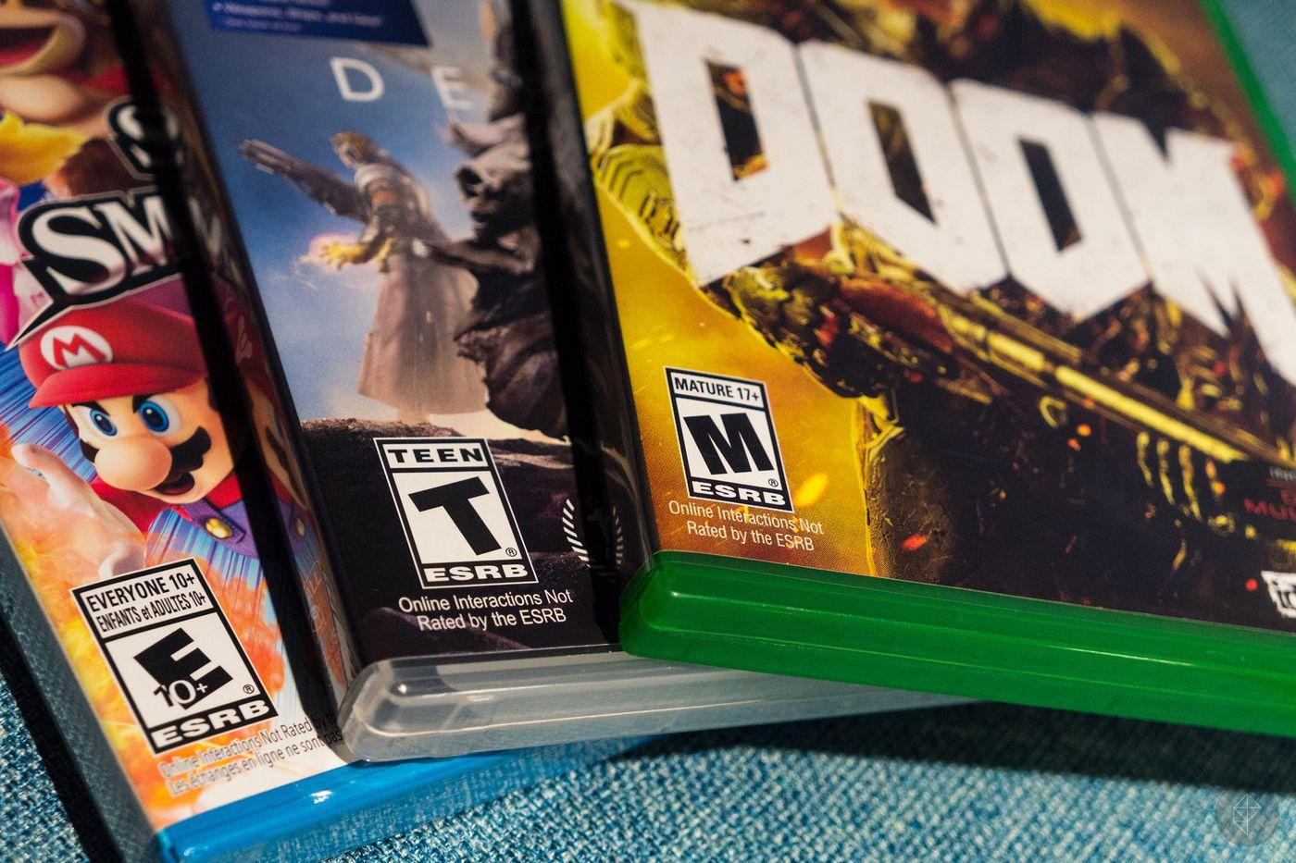
What is the ESRB Rating system?

Slide 3
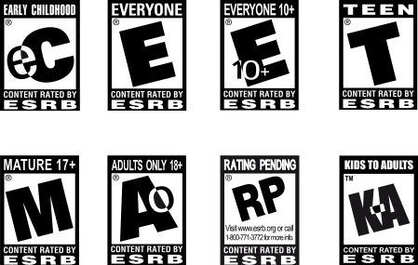
Classification / Ratings

Slide 4
Influences

Slide 5
Beneficial or Harmful

Slide 6
My Thoughts…

Slide 7
Guidelines
Fonts:
Arial
Bree Serif
Colors:

Slide 8
THANK YOU!

