Slide 1
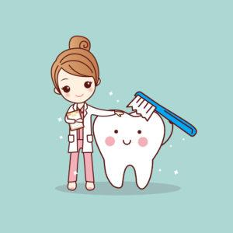
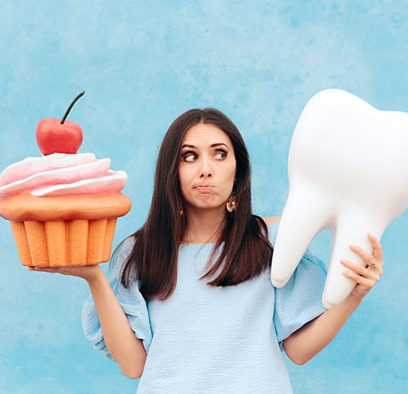
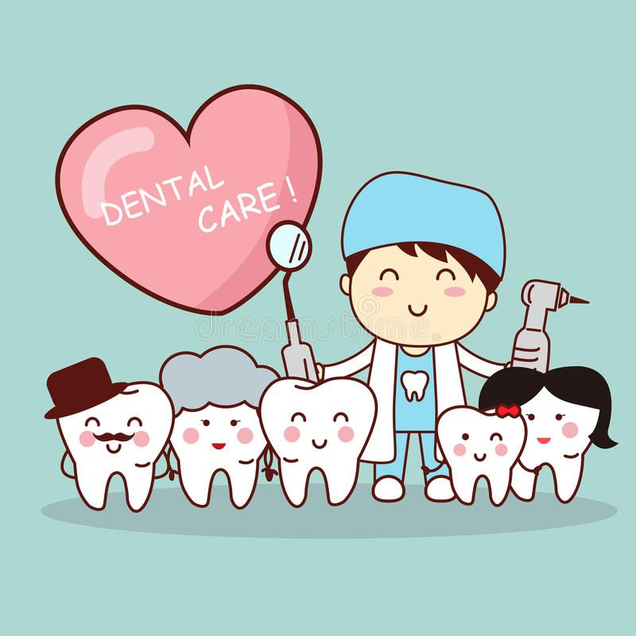
Impact Of Sugary Dietary Habits Of Adolescence On Dental Health
PRESENTED BY:
IRENA SHLOMOV
PAULINA PARZYCH
MICHAEL CHEUNG
VICTORIA PROTOPOPOVA

Slide 2
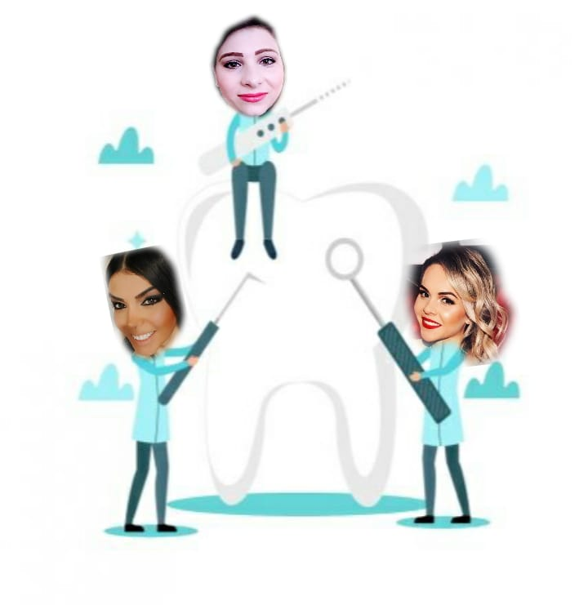
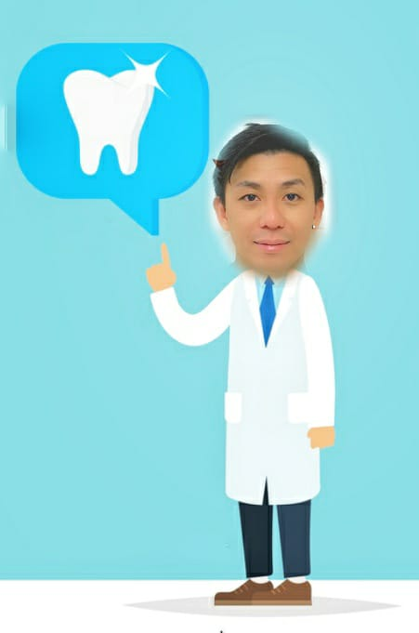
ICE BREAKER
OUR ROLE AS DENTAL HYGIENISTS
We are healthcare professionals that focus on prevention and treating oral diseases to protect the teeth, gums and patient overall health.
Teach proper oral hygiene techniques
Consult about good nutrition for maintaining good oral health
Notes:
Irena
Hello my name is Irena,my classmates Paulina, victoria and michael will be talking about how sugary food impact on dental health, Sugars in food and drinks play a major role in the development of dental caries. Bacteria within the plaque use the sugar as energy and release acid as a waste product, which gradually dissolves the enamel in the teeth.
But first i'll start with explaining our role as dental hygienists
Today we will learn about structure of the tooth, how unhealthy can lead to cavities and how we can prevent it, what are good vs bad food that affect our teeth also What must be done to keep our teeth healthy ?

Slide 3
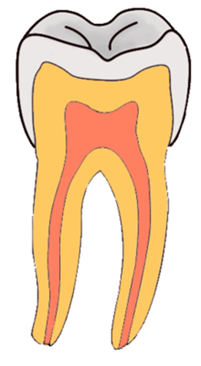
ORAL CAVITY
Enamel
The oral cavity, or mouth, is the first part of the digestive tract its bounded by the lips and cheeks and contains the teeth and tongue.
What a tooth looks like?
Crown
The part of the tooth above the gums.
Enamel
Is the hardest part in our body, even harder than bone!
Covers the crown and protects the tooth from everyday use.
Dentin
Is the softer layer which supports the enamel and help absorb pressure from eating.
Pulp
Fills the space inside the tooth. Contains blood vessels and nerves that keep the tooth alive!
Root
The part of the tooth below the gumline.
Just as the roots of a tree hold the tree in the ground, the roots of your teeth hold your teeth in your mouth.
Dentin
Crown
Pulp
Root
Surrounded by Gum Tissue and Bone
Notes:
Irena (Teeth structures and functions)
Now let's talk about the oral cavity. we will start from the basic. Have you ever wondered what makes up a tooth? The two main parts of the tooth are the crown and the root. The crown is the white part of the tooth you can see while the root is unseen below the gumline. Enamel:Is the hardest part in our body, even harder than bone! Covers the crown, and protects the tooth from everyday use.Dentin:Is the softer layer which supports the enamel and help absorb pressure from eating.Pulp:Fills the space inside the tooth.Contains blood vessels and nerves that keep the tooth alive!Root:The part of the tooth below the gumline.Just as the roots of a tree hold the tree in the ground, the roots of your teeth hold your teeth in your mouth.

Slide 4
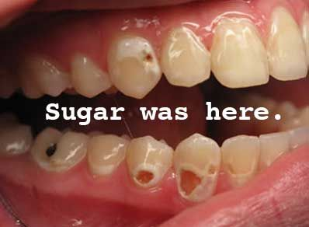
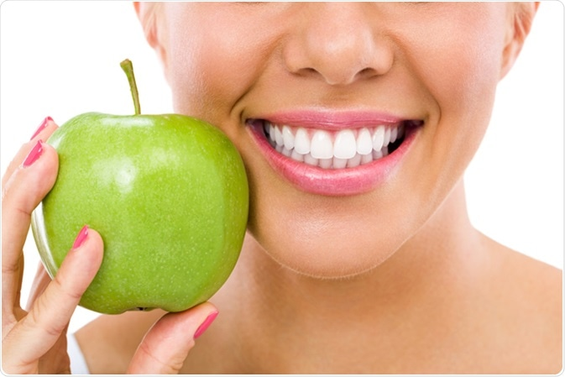
TEETH ARE AFFECTED BY OUR DAILY DIET
Sugar
+
Saliva and bacteria present in the mouth
=
Cavities
Fruits and vegetables
=
Help clean plaque and fresh breath.
Notes:
Michael
On this slide, I will briefly talk about how teeth are affected by our daily diet
The picture on the left shows the effect that sugar and bacteria can do in your mouth. As you can see when sugar and bacteria combines, cavities happen everywhere in the mouth
And from our daily diet, fruits and raw vegetables like apples carrots and celery help clean plaque from teeth and freshen your breath. Also vitamins such as vitamin C and other nutrients help protect teeth and gums from bacterial infection.
Now I will pass it on to Victoria

Slide 5
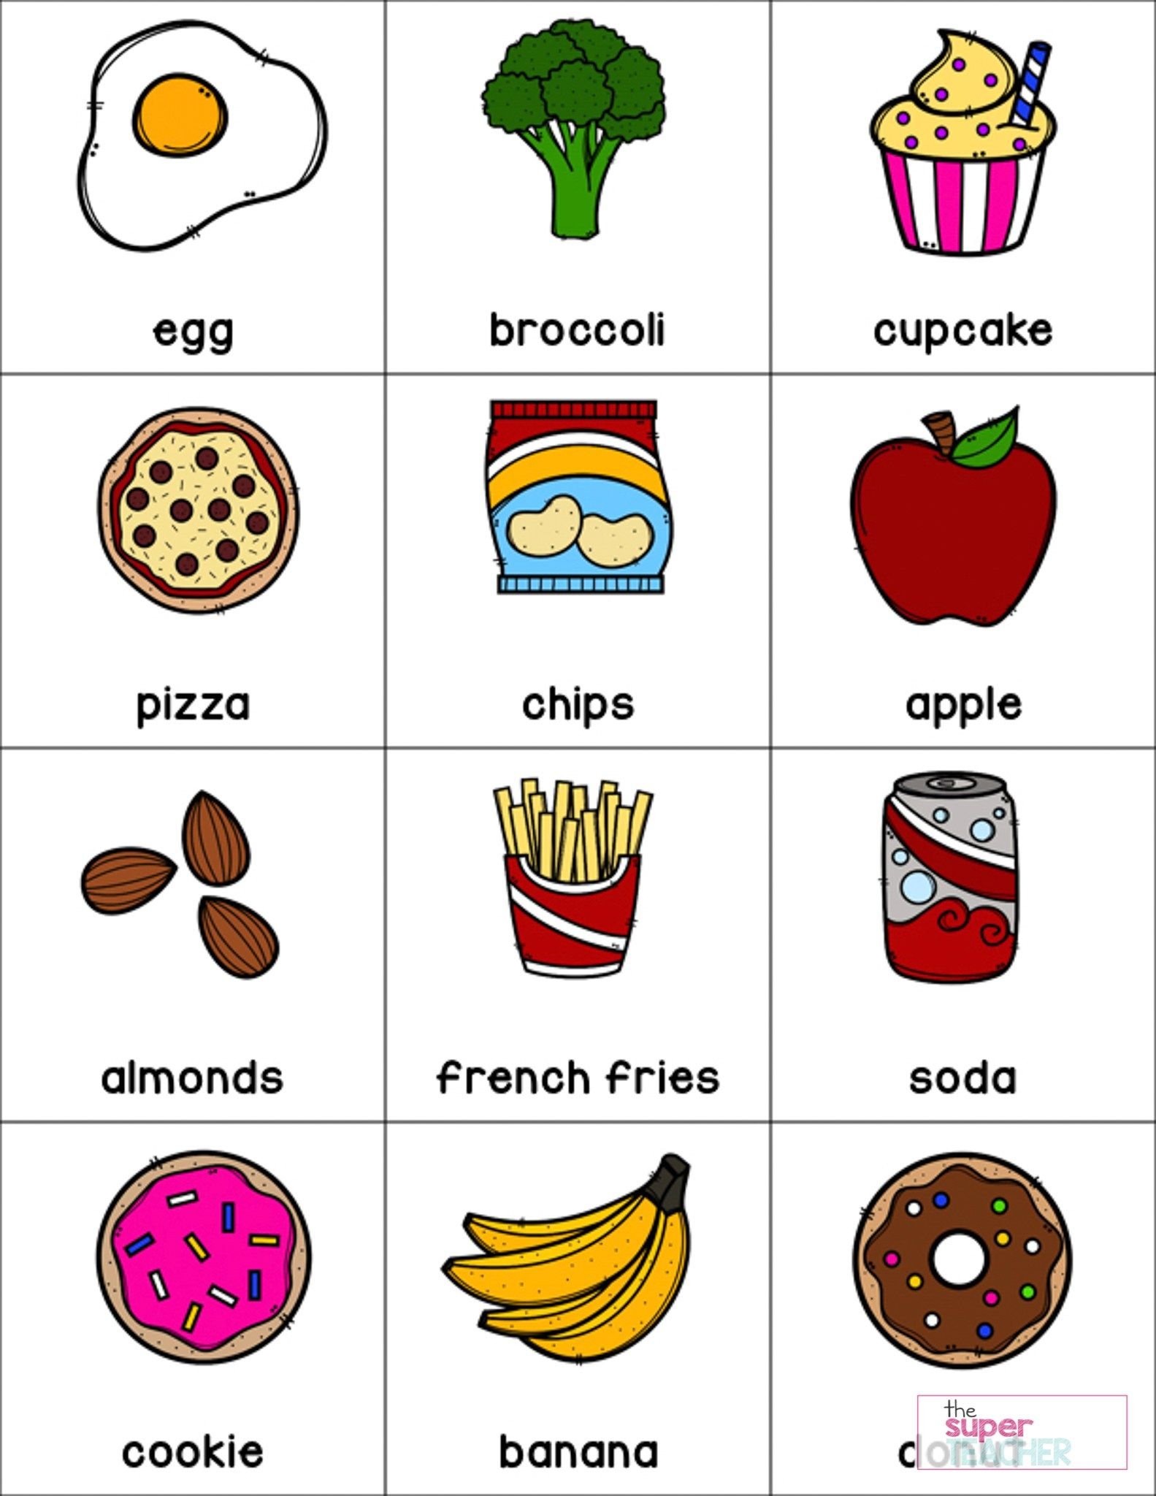
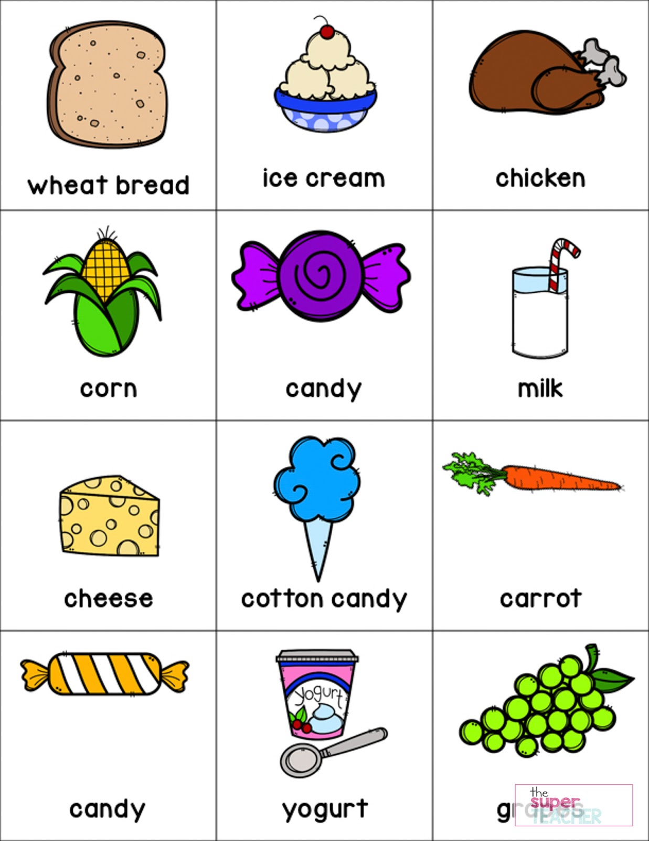
JUNK FOOD VS HEALTHY FOOD
Notes:
Victoria
Now let's play the game ! in a chat box write NOT healthy food from the pictures.
Ok great !
Now lets see what food you think it's healthy for our teeth. Write your answers in chat box
Great, thank you

Slide 6
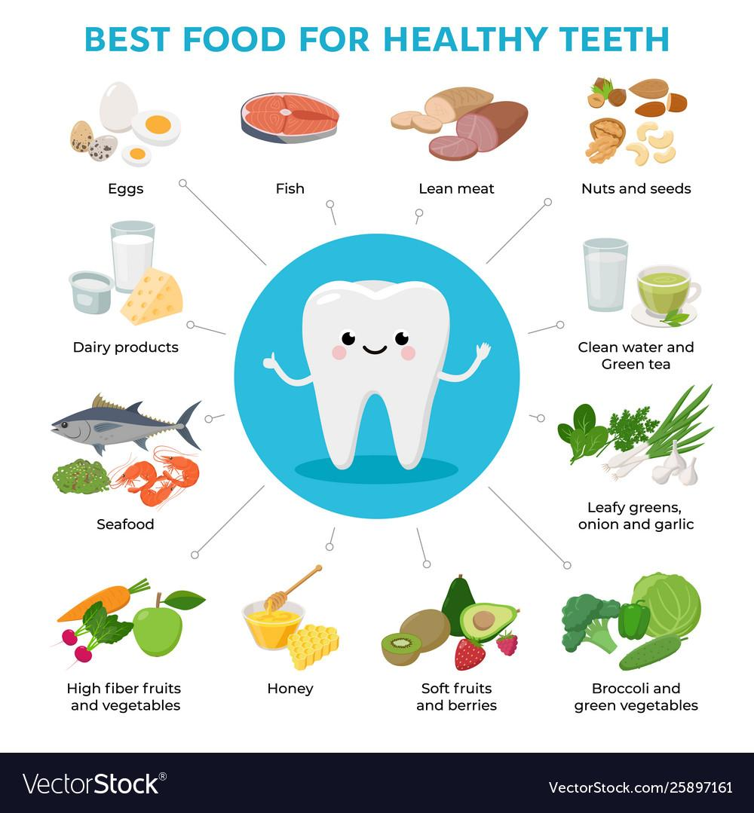
GOOD FOOD
Stimulate Saliva
Fight gum disease
Kill bad mouth bacteria
Prevent Cavities
Make Teeth Healthy and Stronger
Notes:
Victoria
Now let's talk about which good is good for our teeth and which one makes our teeth to have cavities.
Fruits and vegetables help to stimulate saliva that helps prevent cavities
Milk and dairy products has calcium that help put back minerals that you may lost due to other food. ( Like pepsi and other sugary drink )
Tea has minerals that interact with plaque bacteria. Help to kill or suppress the bacteria. Also it prevent them from growing or producing tooth attacking bacteria.
Seafood and meat will help to keep teeth healthy with powerful anti -inflammatory nutrients that helps to to keep your gum healthy also it make your bone stronger which prevent from bone.

Slide 7
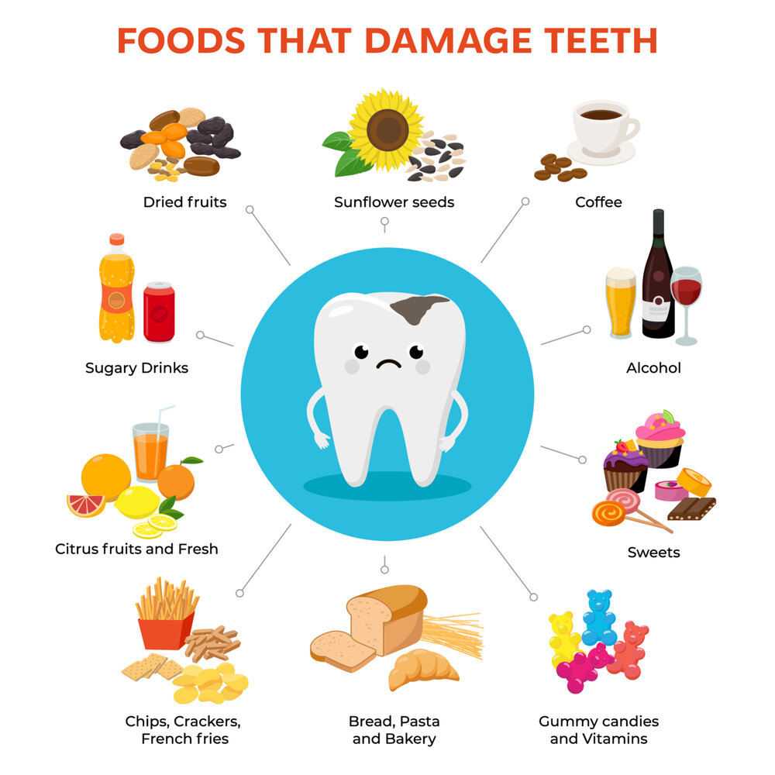
BAD FOOD
Cause Cavities
Reduce Saliva that wash away germs
Destroys Enamel
Gum Inflammation and Bleeding
Teeth Stains (teeth discoloration)
Bad Breath
Loss of bone
Notes:
Victoria
Candies like lollipops , caramels that contain so much sugar Also the hard candies dissolve slowly and they coat all sides of your teeth in sugar for long time. And sugar is the main cause of tooth decay.
Food like chips and popcorn can cause plaque buildup. Avoid anything that can get stuck in your teeth. That can be missed by bruising.
Carbonated drinks containing so much sugar that case cavities and destroys enamel. If enamel is damaged it cannot be brought back. Also soda can cause gum bleeding and gum inflammation.
Alcohol can cause tooth related problems, gums inflammation and risk to developing oral cancer.
Now we know how to make a good food chose that will help our teeth to be healthy and strong. But its not enough we also need to keep them clean!

Slide 8
SUGAR AND DRINKS
LET’S WATCH A VIDEO!!

Slide 9
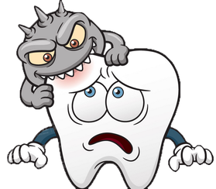
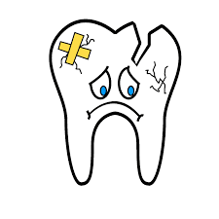
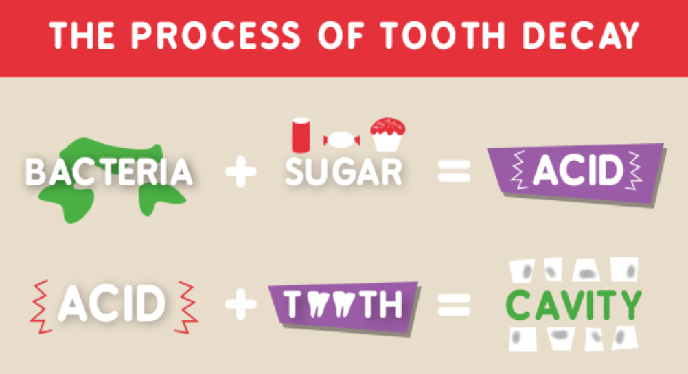
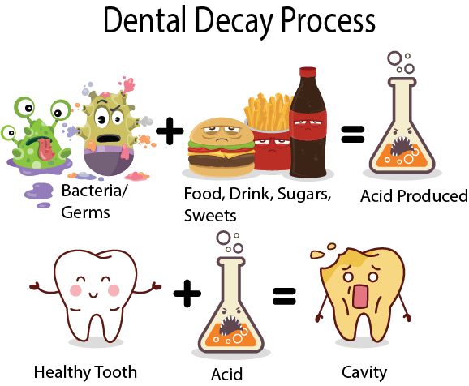
SUGAR-INDUCE CARIES
Sugar alone is not the factor that cause tooth cavity
During carbohydrate digestion in the mouth, the combination of oral natural bacteria and sugar will produce an acid environment that can promote tooth cavity
Notes:
Michael
Food that has high sugar content has a direct connection to tooth decay. After eating food that contains high in sugar these molecules combine with saliva and bacteria that always present in the mouth. All together lead to plaque (biofilm) on all of the teeth. This biofilm that we have it dissolve enamel which leads to a cavity
Now I will give it to Paulina

Slide 10
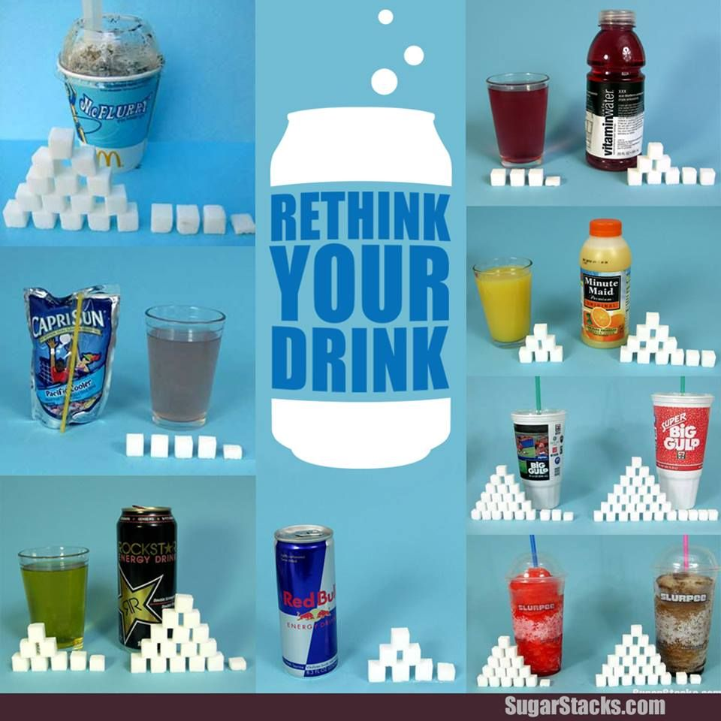
How much sugars is in your favorite drinks???
Notes:
Paulina

Slide 11
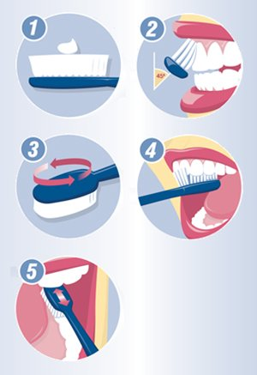
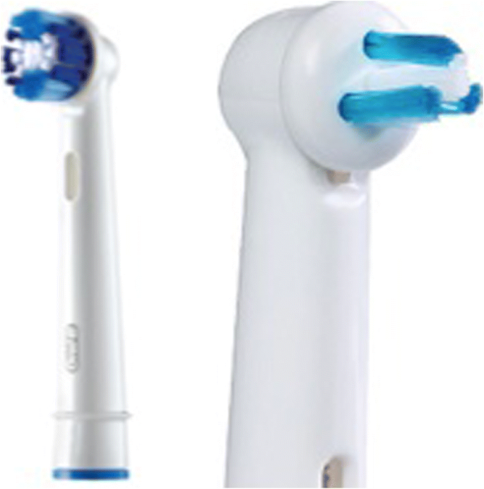
WHAT MUST BE DONE TO KEEP TEETH HEALTY?
Brushing teeth thoroughly twice a day with fluoride-containing toothpaste as well as flossing daily.
Reducing the amount and frequency of eating of sugars-containing sticky food and beverages
Rinsing the mouth with water if they are consumed.
Be familiar with the instructions given by company!!!
Notes:
Paulina

Slide 12
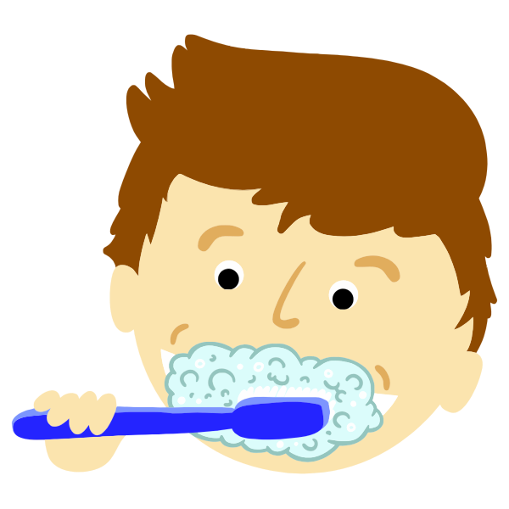
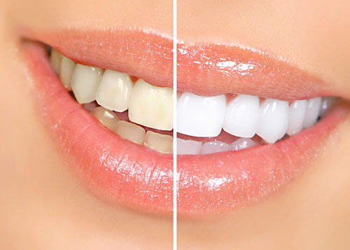
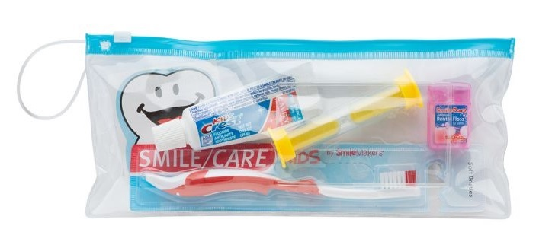
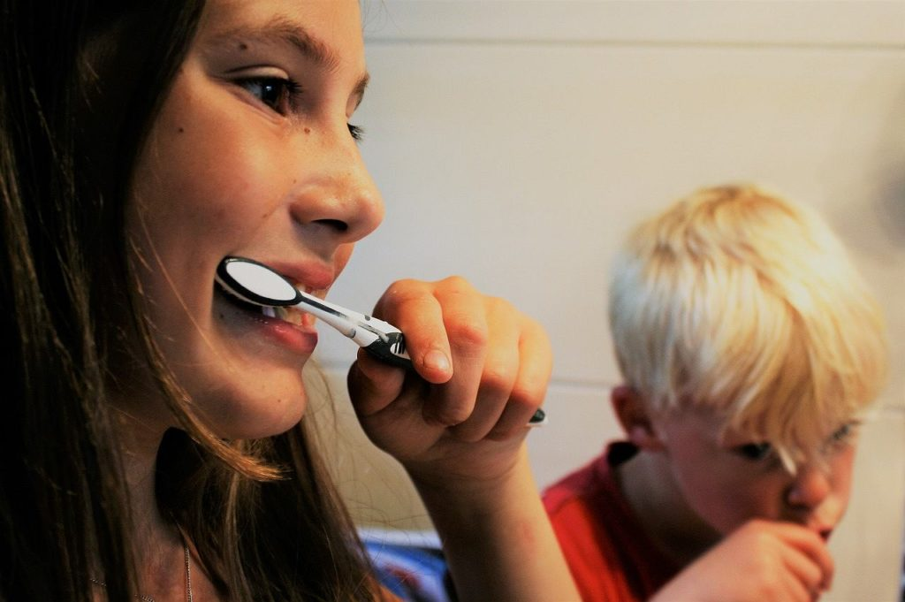
GOODIE BAG !!!!
TOOTHBRUSH
TOOTHPASTE
DENTAL FLOSS
ORAL RINSE
Notes:
Irena
I hope this presentation was informative and fun to learn and hopefully will lead you for better understanding about your mouth and a way to take care of them.
Thank you very much for listening hope you will use this tips and education we gave and keep your mouth clean and healthy.

Slide 13
