Slide 1
Syphilis
Michael Cheung

Slide 2
What is Syphilis?
A sexually transmitted disease
Known infective teratogen involved in congenital malformations
Earliest reference to dental manifestations of congenital syphilis was reported by Jonathan Hutchinson

Slide 3
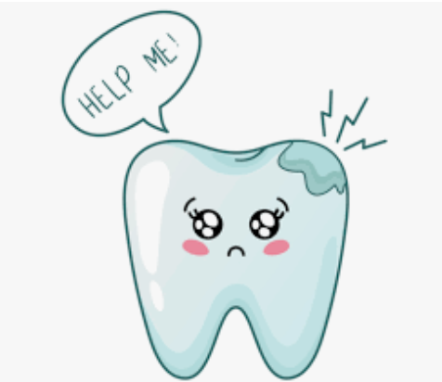
Developmental Disturbances
Dental abnormalities:
Hutchinson incisor
Mulberry molar
Other defects:
Blindness
Deafness
Possible paralysis

Slide 4
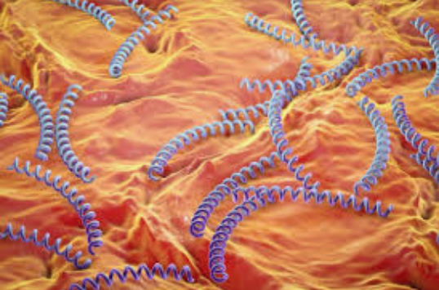
Etiology of Syphilis
Caused by bacterial spirochete
Treponema pallidum
Congenital Syphilis
Microorganism is transmitted from infected pregnant woman → fetus
Microorganism may cause localized enamel hypoplasia
Hutchinson incisors
Mulberry molars

Slide 5
When Does Developmental Disturbance Occur?
Tooth Development
Hutchinson incisors
Mulberry molars

Slide 6
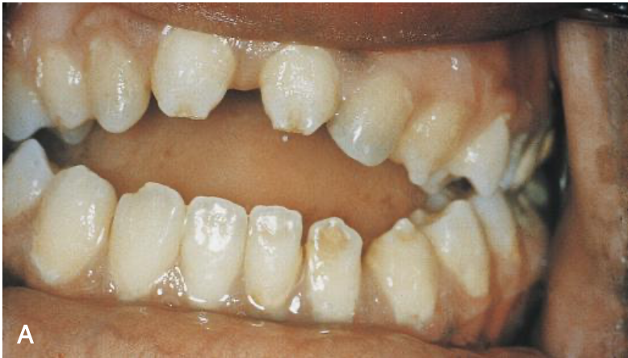
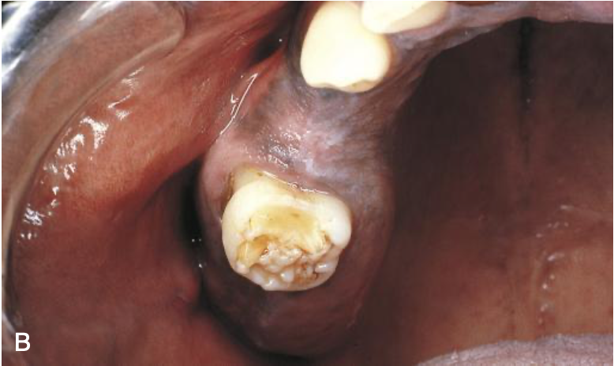
Illustration of Dental Abnormalities
Hutchinson Incisors
Mulberry molar

Slide 7
Conclusion
Impact of Hutchinson incisors and mulberry molars on patient
Poor oral appearance
Role of Dental Hygienist
Educate patient or parents of the patient on proper oral hygiene
Recognizing these developmental disturbances and collaborating with other members of the dental team

Slide 8
Tetracycline Stain
Michael Cheung

Slide 9
Tetracycline stain is…
An intrinsic yellow to yellow-brown discoloration of the teeth
Can occur in slight, moderate, or severe degrees

Slide 10
Etiology of Tetracycline Stain
Caused by systemic tetracycline antibiotic therapy
The antibiotic becomes chemically bound to the dentin for the life of the tooth
Pregnant women → affecting child’s primary teeth, developing during the fetal period
Children → affecting adult’s permanent teeth, developing during permanent dentition period

Slide 11
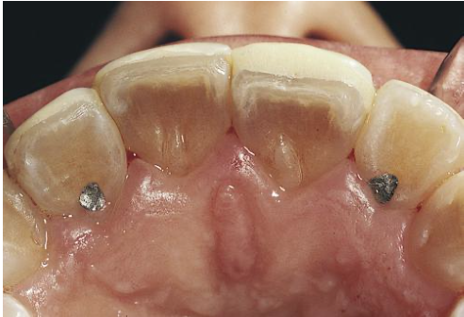
Illustration of Tetracycline Stain Teeth
Primary Teeth
Adult Permanent Teeth

Slide 12
Conclusion
Impact of Tetracycline Stain on Patient
Poor oral appearance
Role of Dental Hygienist
Provide patient with vital whitening of the teeth, also referred as bleaching at the clinic
Educate patient on proper use of whitening at home

