Slide 1
MANDIBULAR ANATOMY
NATALEE CARELA
&
MICHAEL CHEUNG
DEN1218-E612

Slide 2
ANATOMICAL LANDMARKS OF THE MANDIBLE
Central Incisors
Lateral Incisors

Slide 3
ANATOMICAL LANDMARKS OF THE MANDIBLE
Mental Ridges
Inferior border of mandible

Slide 4
ANATOMICAL LANDMARKS OF THE MANDIBLE
Mental Foramen
Mental Foramen

Slide 5
ANATOMICAL LANDMARKS OF THE MANDIBLE
Lingual Foramen
Genial Tubercles

Slide 6
ANATOMICAL LANDMARKS OF THE MANDIBLE
Walls of mandibular canal
Mandibular canal
Walls of mandibular canal

Slide 7
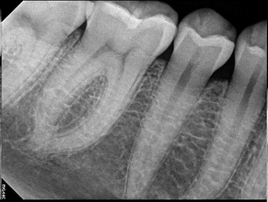
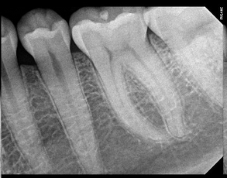
ANATOMICAL LANDMARKS OF THE MANDIBLE
Submandibular Gland Fossa

Slide 8
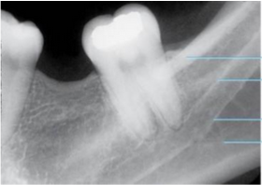
ANATOMICAL LANDMARKS OF THE MANDIBLE
External Oblique Ridge
Internal Oblique Ridge

Slide 9
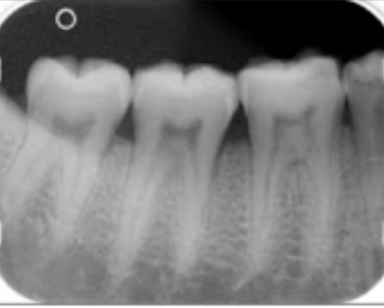
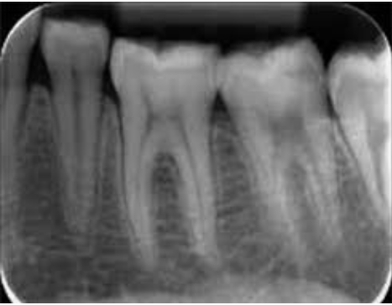
ANATOMICAL LANDMARKS OF THE MANDIBLE
2-rooted mandibular molars

Slide 10
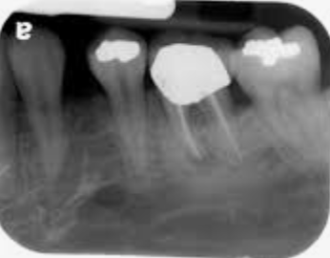
ANATOMICAL LANDMARKS OF THE MANDIBLE
Left premolar mental foramen

Slide 11
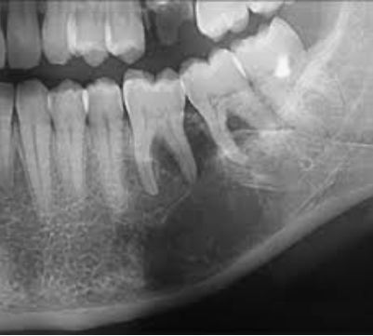
ANATOMICAL LANDMARKS OF THE MANDIBLE
External oblique ridge
Internal oblique ridge
Submandibular gland fossa
2-rooted mandibular molar

Slide 12
THE END
THANK YOU!
NATALEE CARELA
&
MICHAEL CHEUNG
DEN 1218 -E612

