Slide 1
NYCCT Faculty Publication Support Workshop Series 2023-24 leveraging the lit review
Prof. Monica Berger, Library Oct. 13, 2023

Slide 2
Learning Outcomes
Learn how to quickly get a bird’s eye view of your topic
Learn basics of using the library for the lit review
Understand how to effectively use Google Scholar, citation managers, link resolvers
Evaluating journal or book publishers →
Learn how to avoid predatory journals

Slide 3
Connect lit review to reading/scanning → targeting journals and book publishers, evaluating them → submit, revise, publish → keep up with new research / publications
The big learning outcome is iterative
We will also start to think about our individual needs re. selecting a publisher too!

Slide 4
Reading and Lit Review→Target journal or book publisher → Writing → Submit and Publish → Build more
2 Target journals and publishers + evaluate for scope, acceptance rates, other details
1 Lit review → who’s who on the topic + journals + publishers
=Scholarly conversations
1
4
2
4 Submit, revise, and publish … build on your work for the next publication!
3 Draft your mss. with target journal or publisher in mind; update your lit review
3
Notes:
Authors/professors, etc. make this a continual circle. Students tend to stop when the paper goes in …

Slide 5
Literature review w/o searching
Some disciplines/areas have review publications
Cochrane
Nature Reviews
Other disciplines may have articles that review the literature
Or use a recent, highly cited article w/good lit review (or monograph)

Slide 6
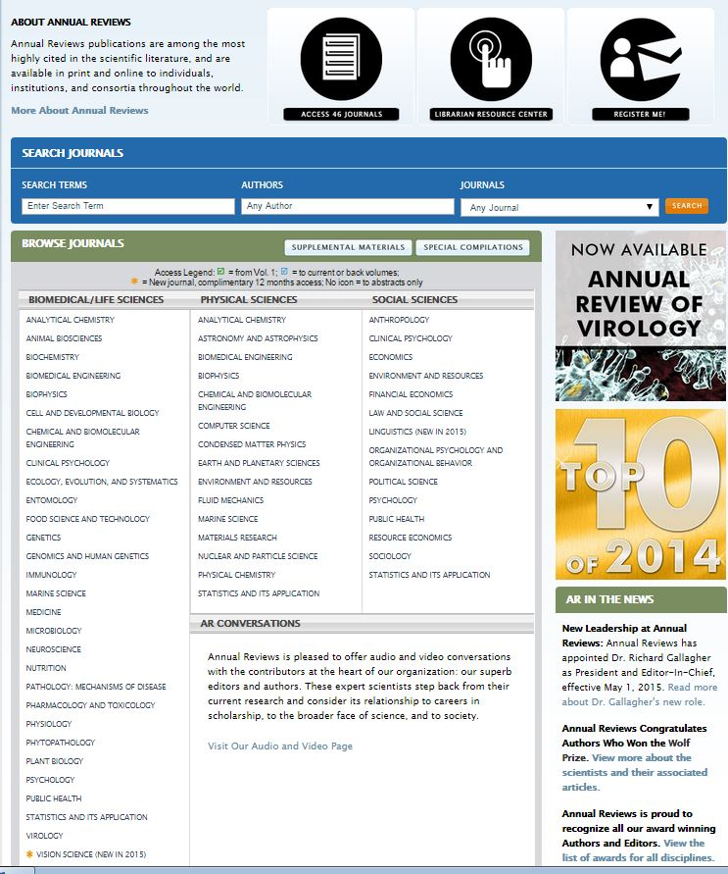
Annual Reviews for STEM and some Social Sciences (not at City Tech)

Slide 7
Literature review w/searching
Use the library database for your discipline
Google Scholar
I will cover how to use each!

Slide 8
1. Lit review: Need to read
Every individual’s “lit review” varies
Scholarship as a conversation
Where is there a gap or a need in the conversation?
Golden path to identifying and interconnecting your research topic with
methodologies
experts for support
journals and publishers

Slide 9
1. Lit review: Need to read
Scholarship as an ongoing conversation
Peer reviewing
Scanning/reading new research and publications
Your next publication!!!

Slide 10
2. Using the library
+guide(s) supporting this series

Slide 11
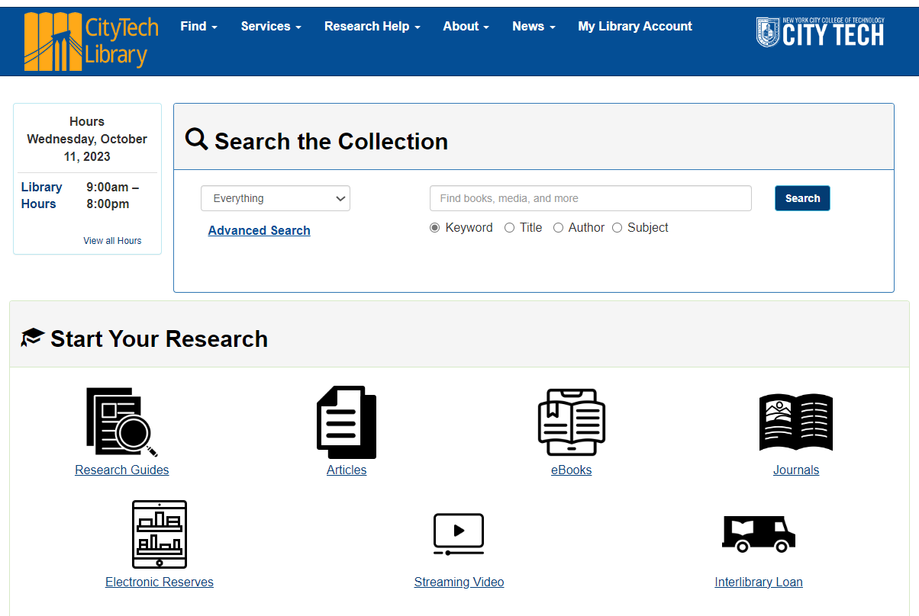
https://library.citytech.cuny.edu/

Slide 12
https://library.citytech.cuny.edu/

Slide 13
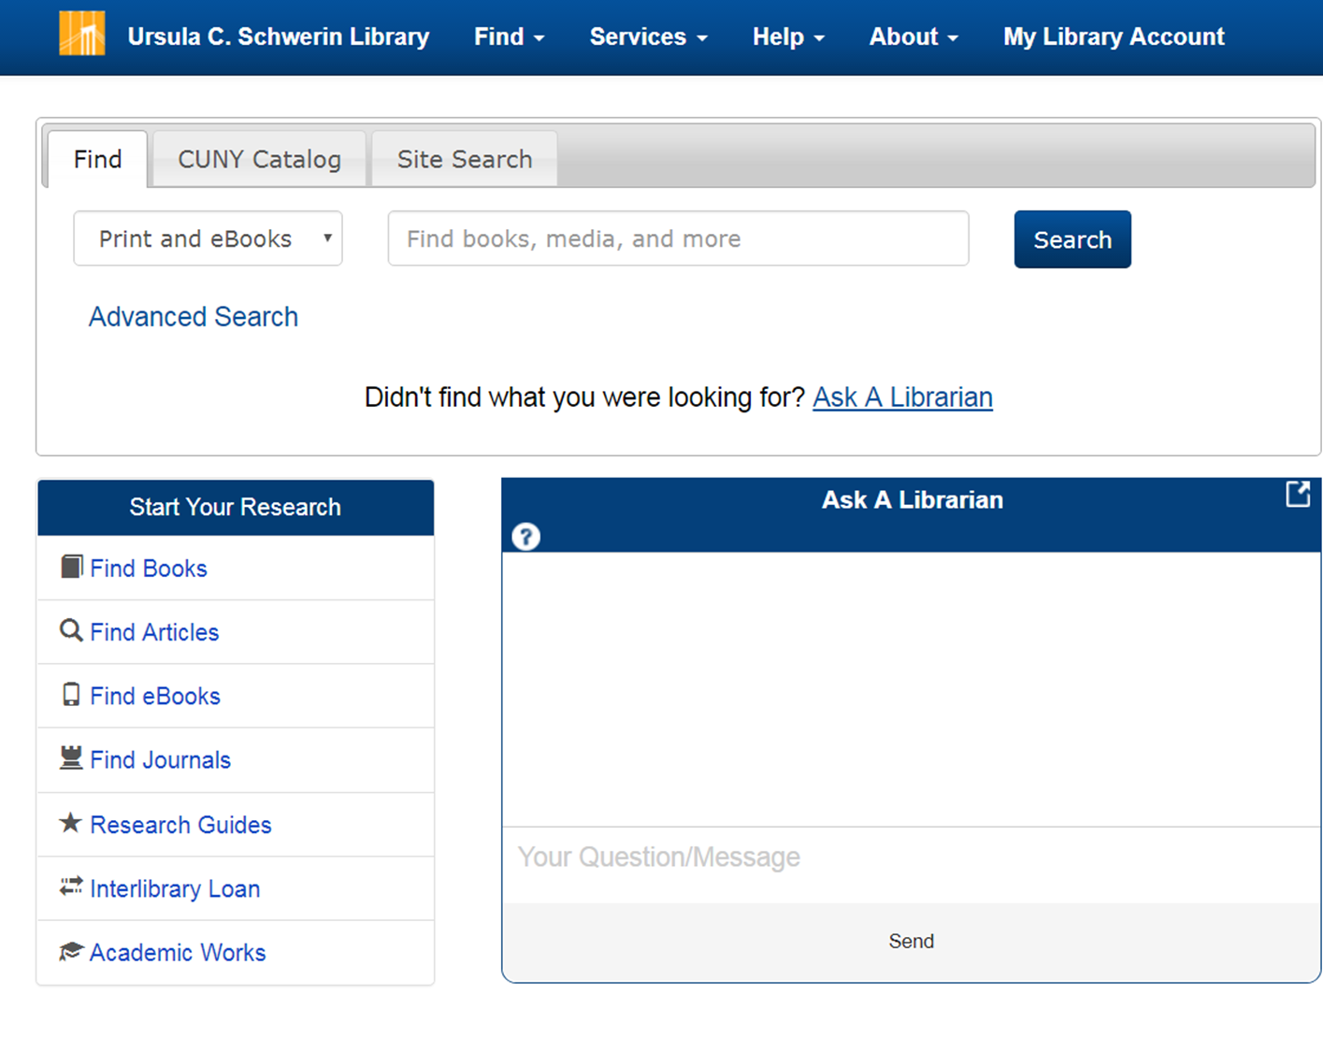
https://library.citytech.cuny.edu/

Slide 14
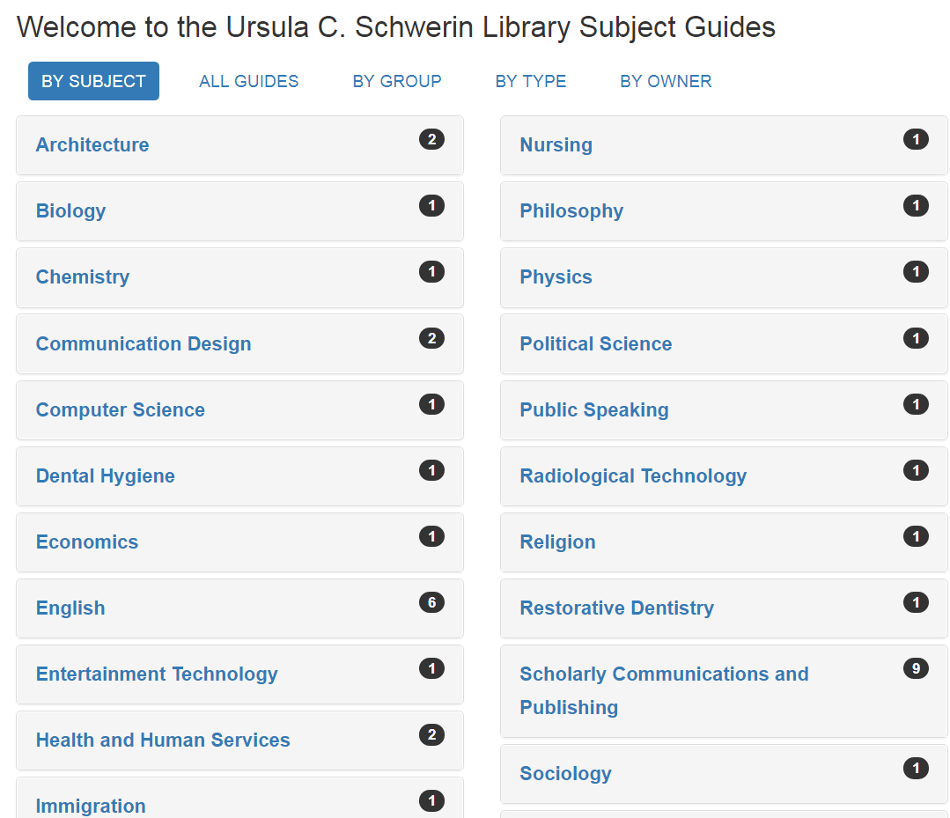

Slide 15
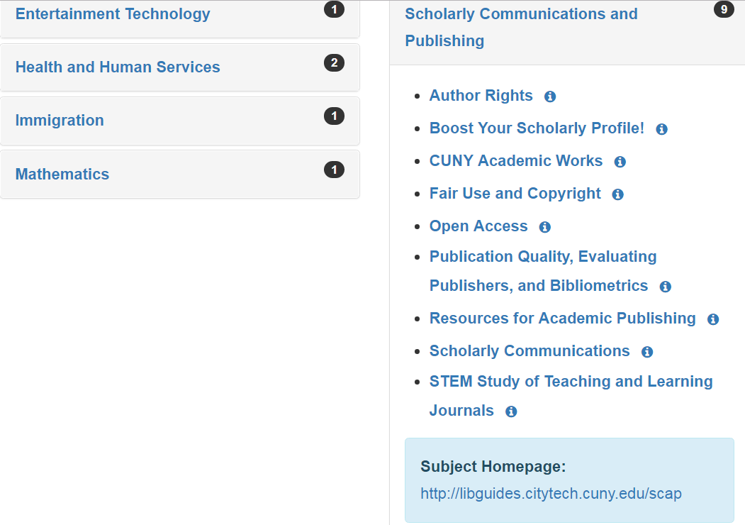

Slide 16
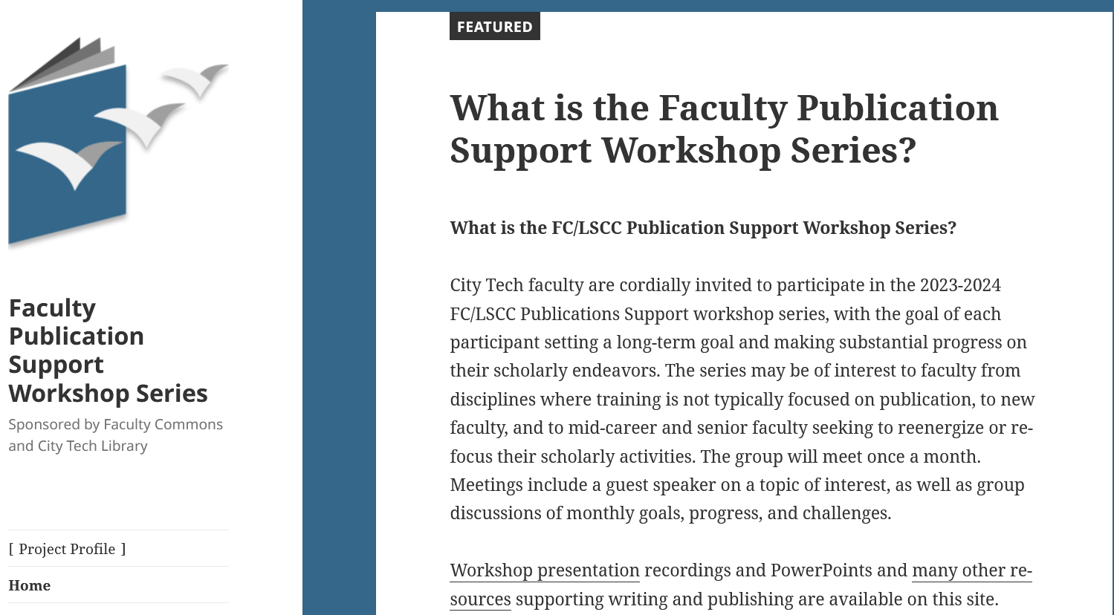
OL https://openlab.citytech.cuny.edu/mcfpp/

Slide 17
2. Using the library: Our library in context
City Tech library has a vast selection of content incl. data sets
Library also connects to Google Scholar if desired

Slide 18
2. Using the library: Our library in context
Other CUNY libraries
Can not access their local electronic content
Other specialized databases
Need to walk in to use except for requesting books

Slide 19
2. Using the library: Our library in context
Interlibrary loan for
books outside CUNY,
ebook chapters,
articles,
electronic delivery for … electronic content

Slide 20
Interlibrary loan https://library.citytech.cuny.edu/services/interlibraryLoan/index.php

Slide 21
3. Interlibrary Loan
If we don’t have it …
ILL it! (interlibrary loan)
Use your CUNY credentials to login (new)

Slide 22
Any questions, comments?

Slide 23
2. Databases: using the library for your lit review

Slide 24
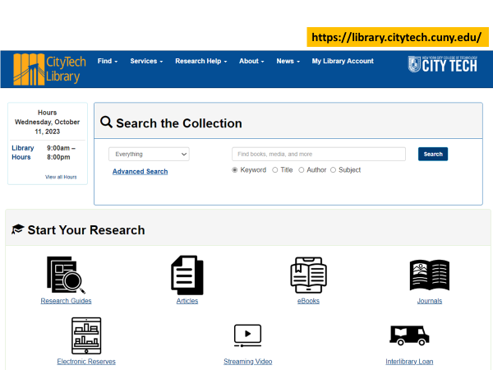
Databases of articles and other content

Slide 25
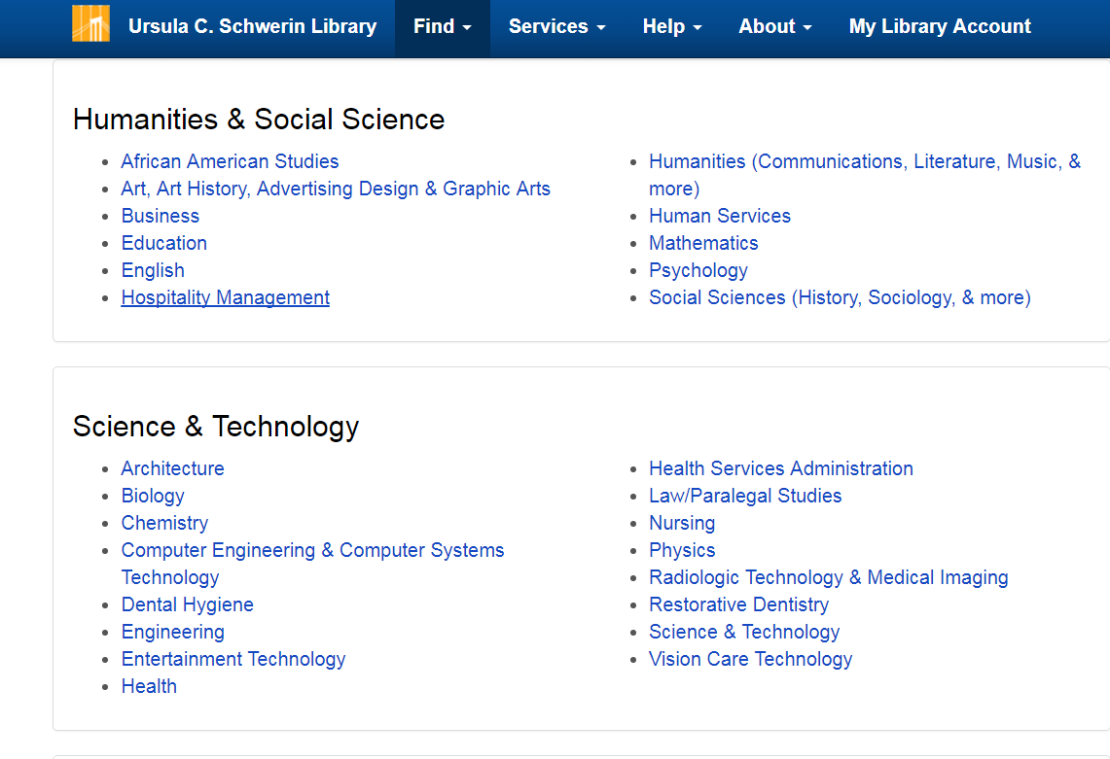

Slide 26
Log into library databases using your CUNY credentials

Slide 27
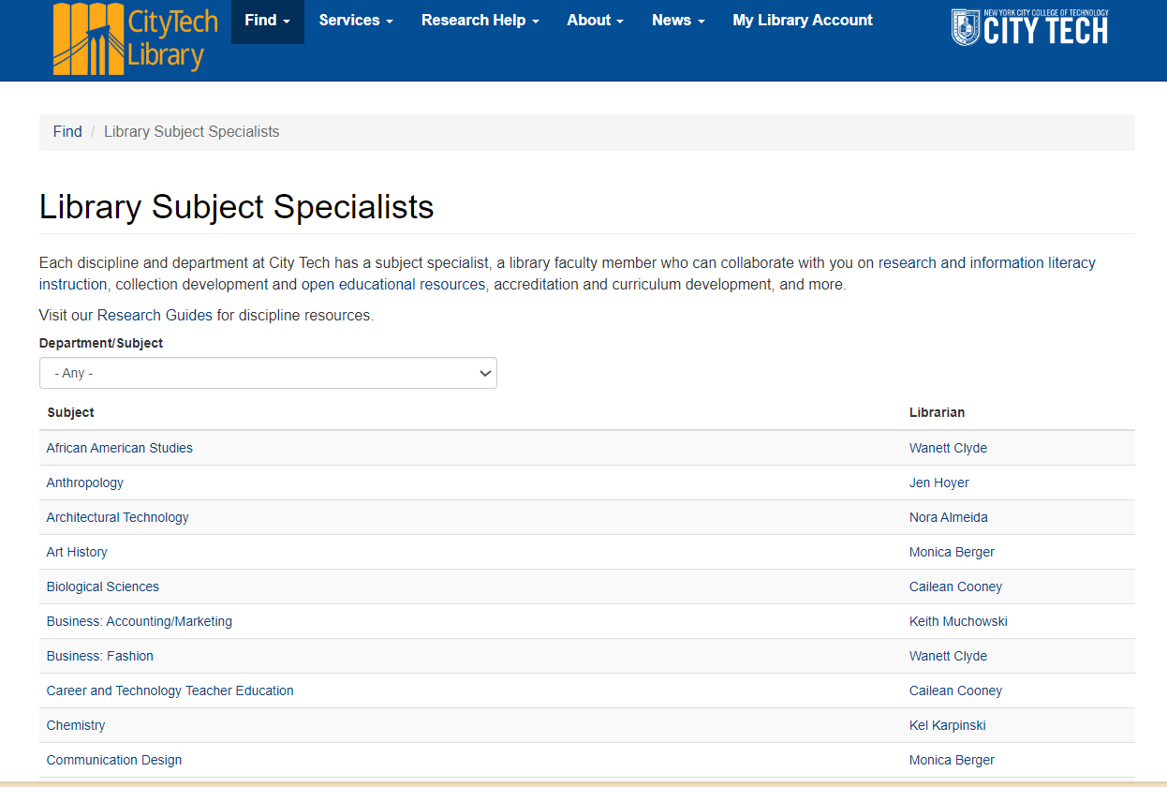

Slide 28
3. Google Scholar
+ citation managers

Slide 29
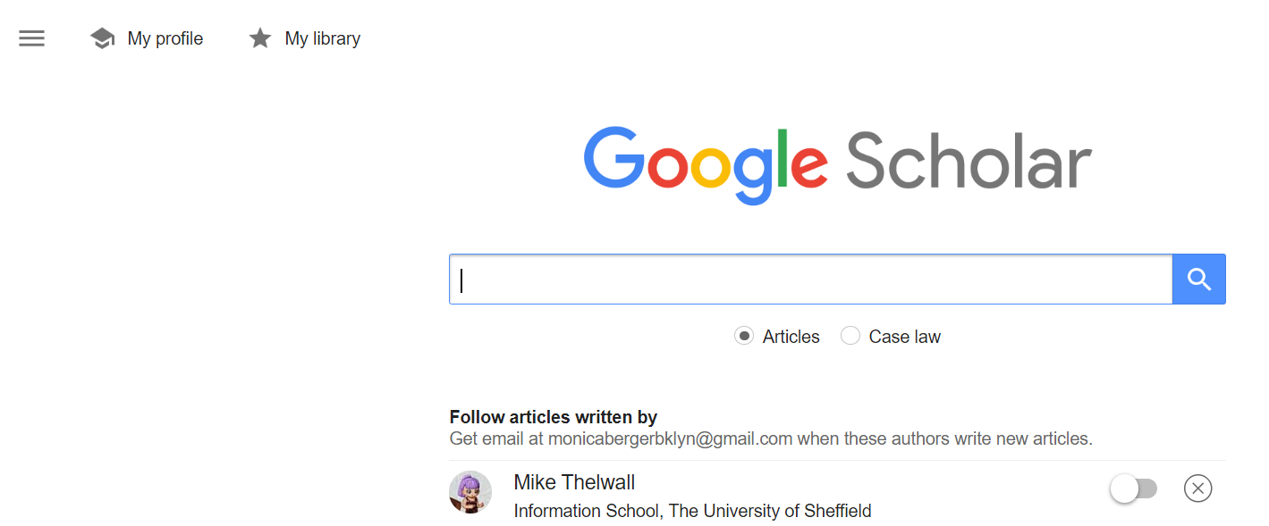
Google Scholar scholar.google.com what is in GS? Have you used it before?

Slide 30
4. Google Scholar vs. Library
Advantages of library over Google Scholar:
Library databases
subject or disciplinary focus
Rich metadata with hyperlinks
Filtering tools
Alerting options
Ability to save searches
Not EVERYTHING is indexed in Google Scholar

Slide 31
4. Google Scholar vs. Library
Advantages of Google Scholar over Library :
Google Scholar
Easier to search
Multidisciplinary
Great alerting system
Easy to see who has cited an article
Easy to see how many times an article has
been cited

Slide 32
4. Google Scholar
Don’t forget to link Google Scholar to library content! Otherwise, you’ll get only open access content, content in ResearchGate, citations

Slide 33
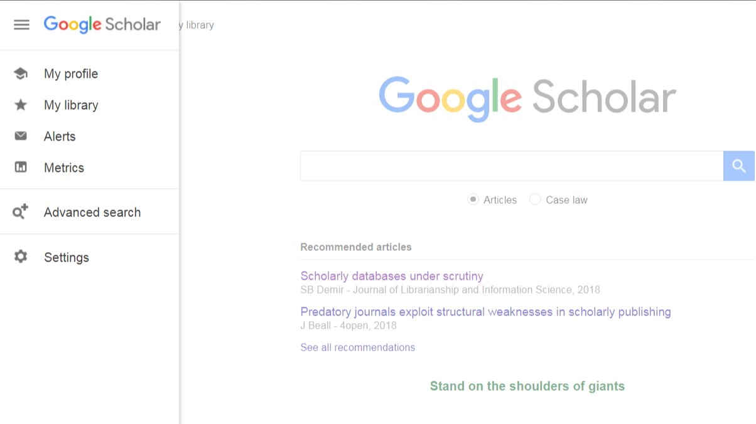
Click the three lines to open menu, select SETTINGS

Slide 34
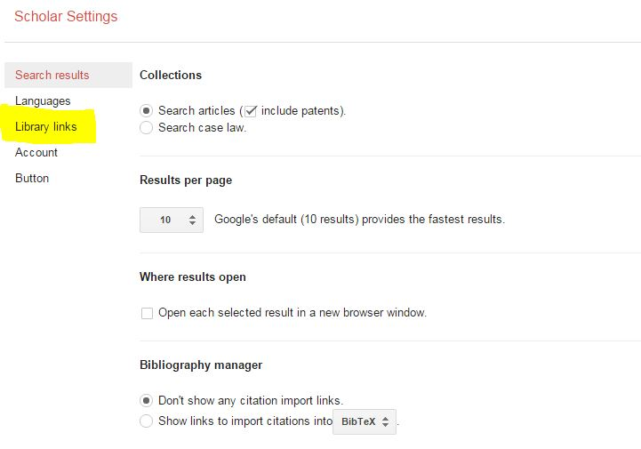
Select library links

Slide 35
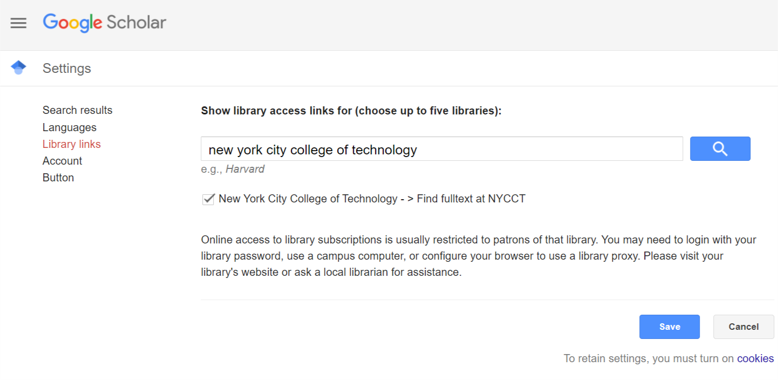
Save your search

Slide 36
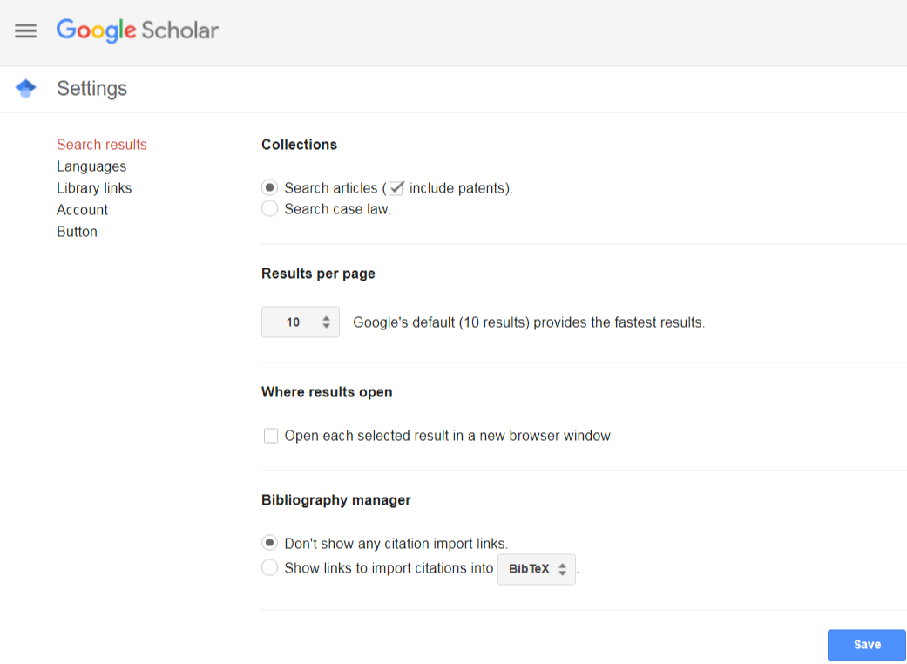
Hook up your bibliography manager

Slide 37
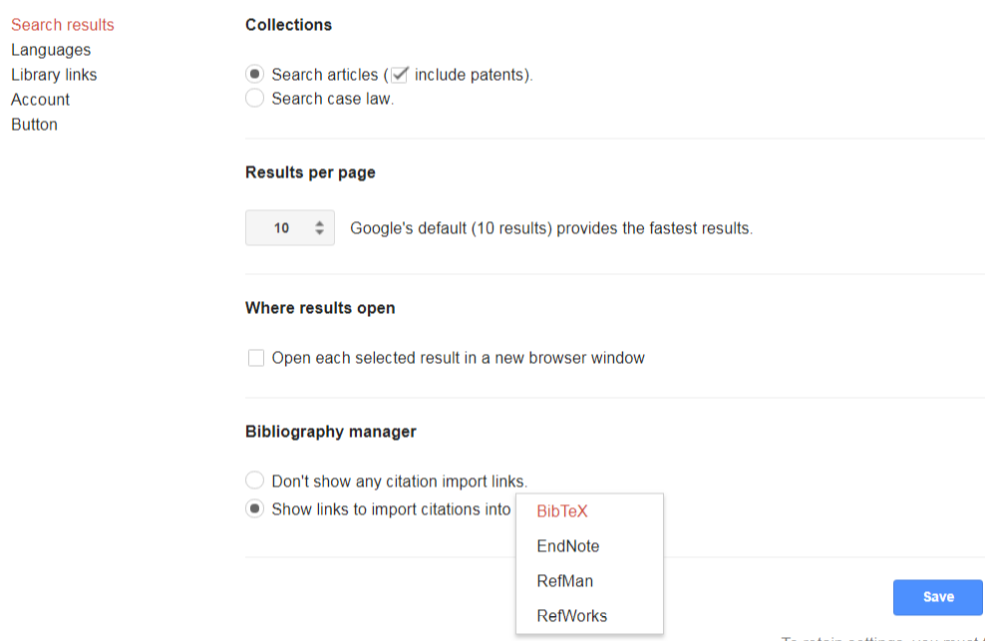
Find your citation manager’s format (EndNote for Zotero)

Slide 38
3. Citation Managers
Bibliography managers and citation tools
RefWorks (CUNY)
Zotero
Mendeley
EndNote
Many others

Slide 39
3. Citation Managers
Switch styles
Journal specific styles available
In-text citations plugins for MSWord, Google Docs
Manage your workflow
Note taking, tagging
Share citations and notes across projects
Import and export to other managers
Recommend Zotero

Slide 40
Zotero (and citation managers) help you stay organized

Slide 41
master comparison of bibliographic reference tools

Slide 42
Get full text: Link Resolvers

Slide 43
3. Get full text: Link Resolvers
Library databases AND Google Scholar
Some library databases are chiefly citations
Avery Index
MathSciNet
Notes:
The FindIt button pushes article citation data into the ILL form if there is no FT

Slide 44
The “FindIt@CUNY” button full text or interlibrary loan

Slide 45
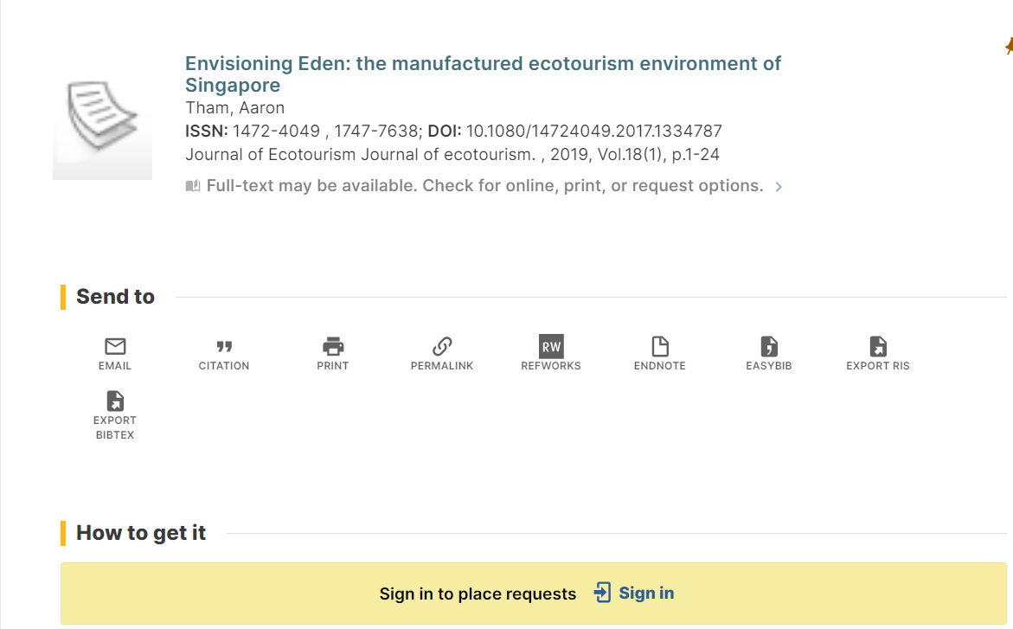
If no link, sign in for interlibrary loan

Slide 46
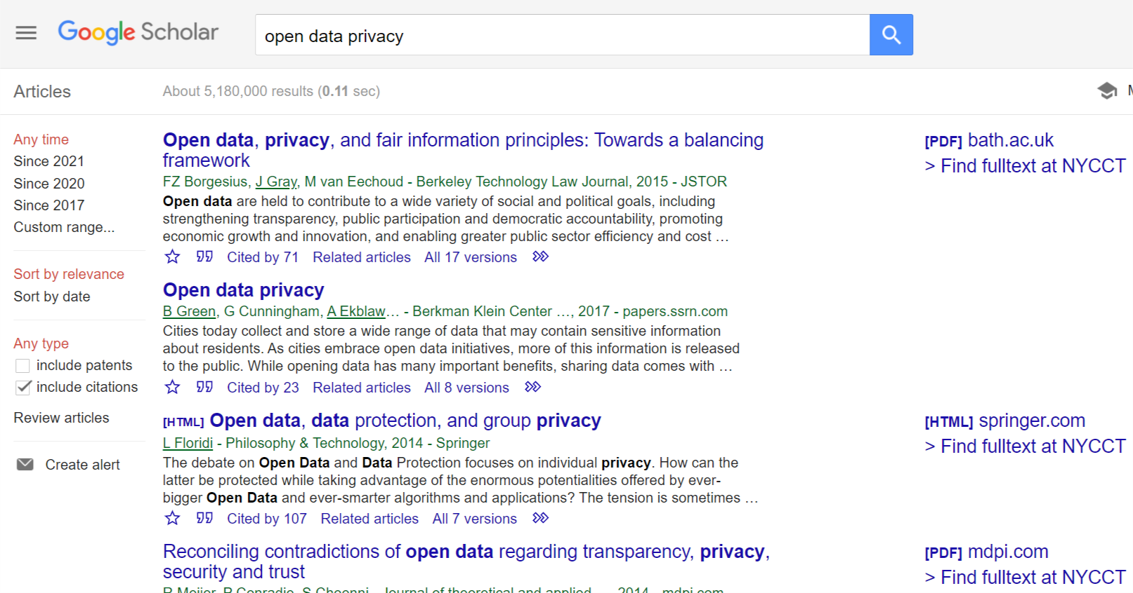
Use the Find Fulltext at NYCCT links to get to full text content

Slide 47
4. Journal and book publishers: what to look for

Slide 48
Find and browse by subject specific journals

Slide 49
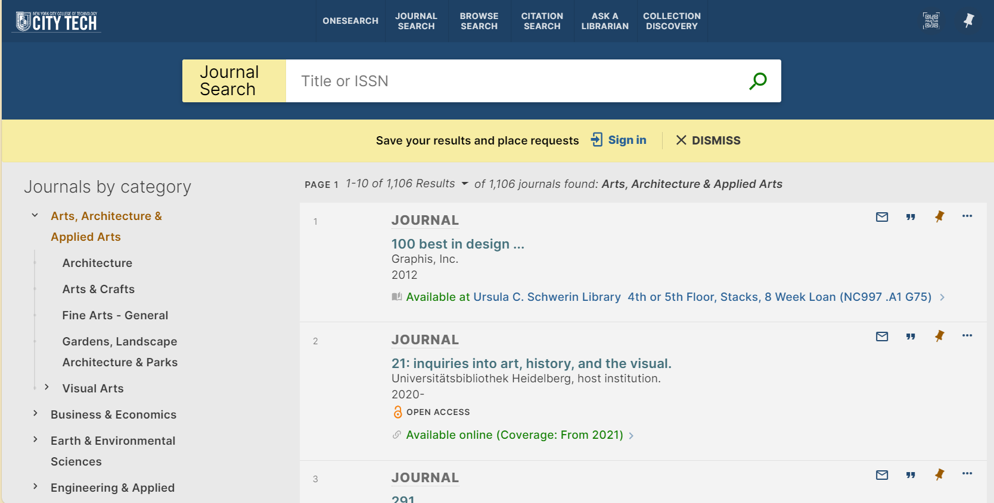
Browsing journals via library

Slide 50
Browsing journals
Ulrich’s @ NYPL 42nd St. only onsite
Care about JIF? Journal Citation Reports@ Grad Center
Scimago Journal & Country Rank
uses Scopus data, freely available
Google Scholar Metrics (must browse top 100 and then can select discipline, subdiscipline)
Professional organizations and societies

Slide 51
4. Journal details that may matter
Content scope + very much related
Methodologies? + very much related
Article formats (e.g. original research, opinion pieces)
Peer review format?
Acceptance rate?
Metrics?

Slide 52
4. Journal details that may matter
Editor-in-chief?
Editorial board?
Authors?
Quality of writing?
Professional-looking website?
Reputation

Slide 53
4. Journal details that may matter
Your values: do you care about a broad readership?
Your values: do you care about your citation rate?
Open access supports these
Talk to me more
Do you support scholar-led publishing, non-profit publishing, or do you prefer a well-known commercial house? → your audience and reach
Does the journal require author fees for open access? Build this into grants!

Slide 54
4. Journal details that may matter
Discoverability (your work is easily found when searching)
Is the journal indexed in key databases, e.g. Medline?
Does the journal provide DOIs for articles?
Does the journal preserve its content?
Solo and small publishers do not provide these → less discoverability

Slide 55
4. Journal details that may matter
Time to publication
Some journals are VERY slow …
Journal portal
Can ease communications with managing editor
Plagiarism detection

Slide 56
4. Book publisher details that matter
Are the publisher’s books
easily found in libraries
Available via ebook aggregators like JSTOR, Project Muse, or Ebook Central?
Are their books very expensive, limiting readership?
Is the publisher active in your subject area?
Scholarly publishers may be niche
University presses are especially niche

Slide 57
4. Book publisher details that matter
Do they do peer review of monographs?
How does the editor work with you? A little, a lot or not at all?
Do they provide indexing and copyediting?

Slide 58
CFPs, conferences, and other low hanging fruit = scaffolding
Notes:
"Low Hanging Fruit" by Christian Hammer Nielsen is licensed under CC BY-NC-SA 4.0
CFPs give you a deadline and are less scary than just sending an article to a journal or a proposal to a publisher
Conferences are also a scaffolding method for scholarship
Encyclopedia articles for novice authors

Slide 59
5. Avoid predatory publishers

Slide 60
5. Avoiding predatory publishers in 1 minute or so
Spam queries, flattering emails
Fast peer review promised
Lack of focus (sometimes)
Have you heard of the journal?
Are you sure? Copycat names
Ask a well-published colleague

Slide 61
5. Avoiding predatory publishers in 1 minute or so
Is it in a known database or citation index?
Is it in DOAJ, the Director of Open Access Journals?
Conferences are especially insidious
Avoid Google to identify journals
INVESTIGATE JOURNAL AND PUBLISHER BEFORE YOU SUBMIT and ASK YOUR LIBRARIAN TOO

Slide 63
Upcoming library workshops on Zoom
Demystifying Academic Works
Nov. 1, 4-5 PM
Get Organized! Zotero Basics
Dec. 5, 4-5 PM
Google Scholar Profile
Dec. 13, 11 AM -12 PM

Slide 64
Get more support
Scholarly Publishing Clinic http://bit.ly/NYCCTSPC
Office hour on 4 PM every first Tuesday of the month
Consultations a la carte http://bit.ly/NYCCTSPC

Slide 65
Questions?

Slide 66
Thank you Please reach out to me or your department liaison.
Find me at monica.berger11@citytech.cuny.edu

