Slide 1
Zotero basics
Prof. Monica Berger Associate Professor, Library NYCCT

Slide 2
Workshop overview
The capabilities of Zotero, client - cloud syncing, why Zotero?
Setting up preferences in the client
Various ways to import citations
Install and using Zotero Connector for Firefox or Chrome
Editing and organizing citations
Installing and using the Word plugin
Generating in-text citations and bibliographies

Slide 3
What is a bibliographic management tool? Have you ever used one? Why use one?
Notes:
Save time, reduce errors, keep you organized
Record references in a variety of formats including primary sources
Integration with word processors helps to generate in-text citations and bibliographies
Switch citation styles easily

Slide 4
master comparison of bibliographic reference tools
Notes:
Refer to this if you are considering other tools and want comparisons of functionalities

Slide 5
Demo
Share your research topic
Notes:
Search Google Scholar. Select CITATION, and then ENDNOTE. This will bring the citation into Zotero

Slide 6
Why Zotero is good
Notes:
Free
integrates with a variety of word processors
has many journal and specific styles
It is an open source, non-profit service with a big user community
Client plus cloud version
Fast citation creation by identifiers including DOI and ISBN
Can attach files (can pay nominal fee for extra storage)
Add notes
Add tags
Allows collaboration
Allows “public” collections

Slide 7
Look at my Zotero set up
+ Zotero terminology
Notes:
Library= your entire personal collection of citations, notes, and attached files
Collection=a folder. It can be for a topic or, probably more commonly, for a publication you are writing.
Subcollection=a subfolder.
Item=citation with attached notes, tags, and files
Important to separate deleting and moving an item to trash versus removing it from a collection
Easy to drag and drop an item from one collection to another, dynamic updating. Hold shift when you drag the item to move the citation rather than copying it

Slide 8
Any problems installing Zotero?

Slide 9
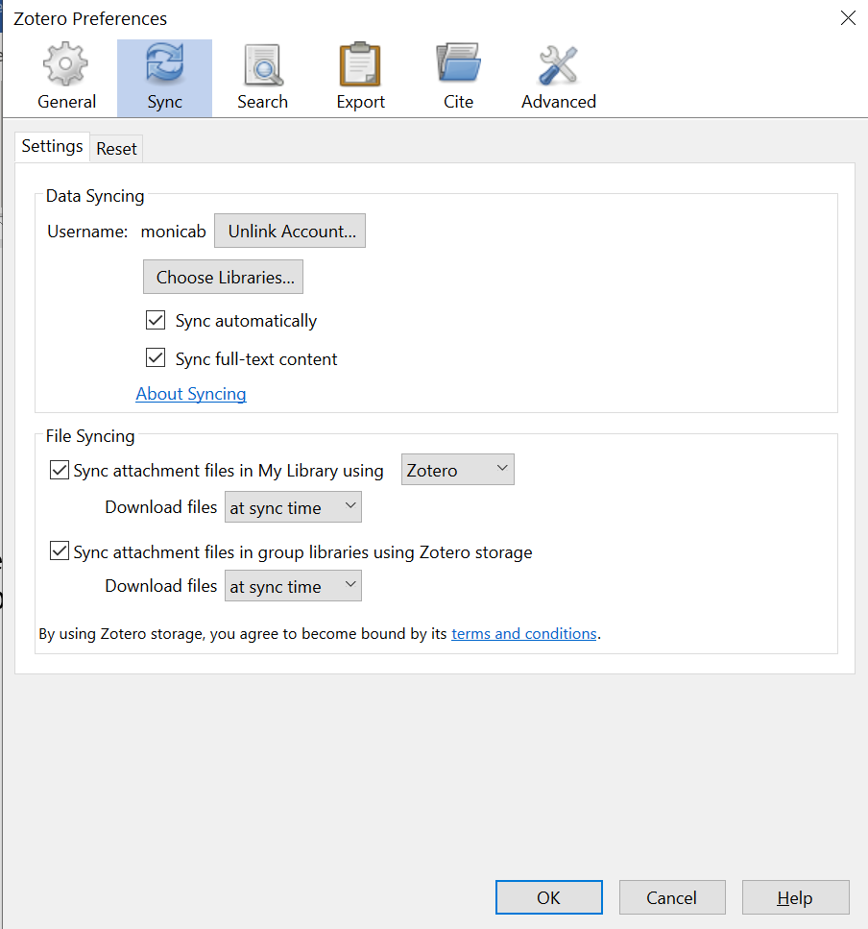
EDIT → PREFERENCES Create username/password, other preferences including citation style
Notes:
Create username/password

Slide 10
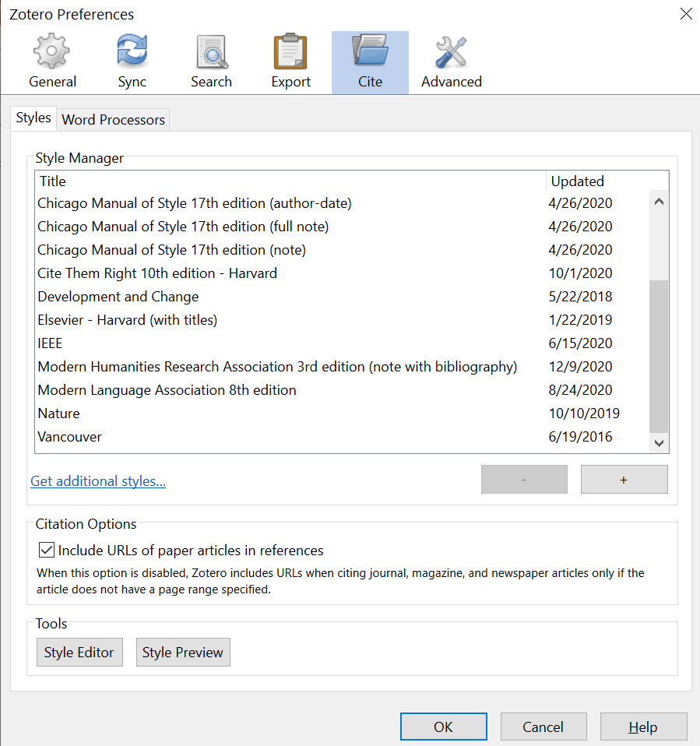
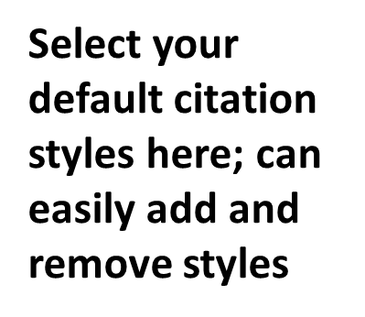

Slide 11
Creating your Zotero library

Slide 12
Ways to bring in citations
Via a browser plugin aka connectors
Within Zotero client either by DOI, ISBN, or manually
Google Scholar, save as Endnote format
Library databases
Notes:
Yes, you can bring in a citation by a pdf in your web browser but you may not get all the metadata needed for a complete citation. If no landing page, use google scholar search and import that way

Slide 13
Demo/practice bringing in citations
BROWSER PLUGIN, CLIENT, SCHOLAR

Slide 14
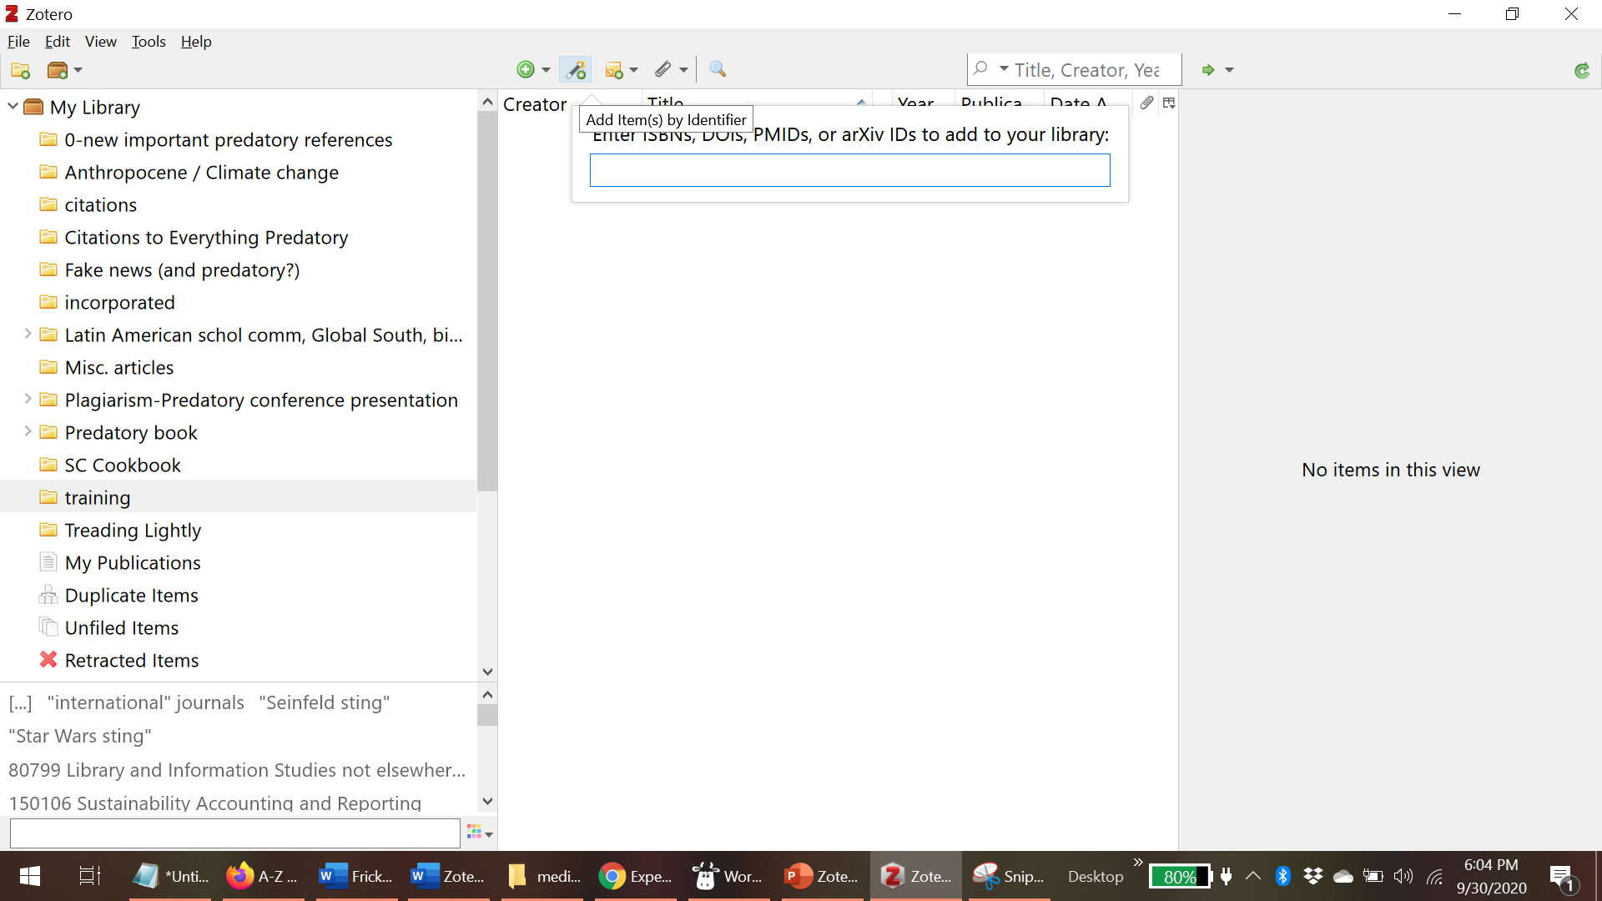
Bring in citation by identifier in Zotero client (look for wand icon)
Notes:
Please find a citation to a book or article in google scholar and import by doi or isbn

Slide 15
Editing and organizing your citations

Slide 16
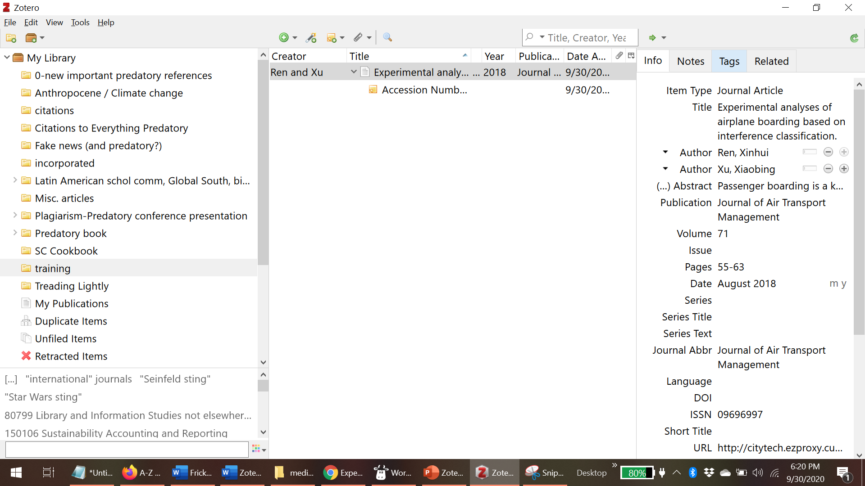
Triple pane view, right pane can be edited
Notes:
The item can easily be dragged and dropped to another folder. It will duplicate, not move!

Slide 17
Two ways to create a bibliography
Via right clicking on a collection within Zotero
By adding your citations into your MSWord doc (need Zotero plugin in MSWord)

Slide 18
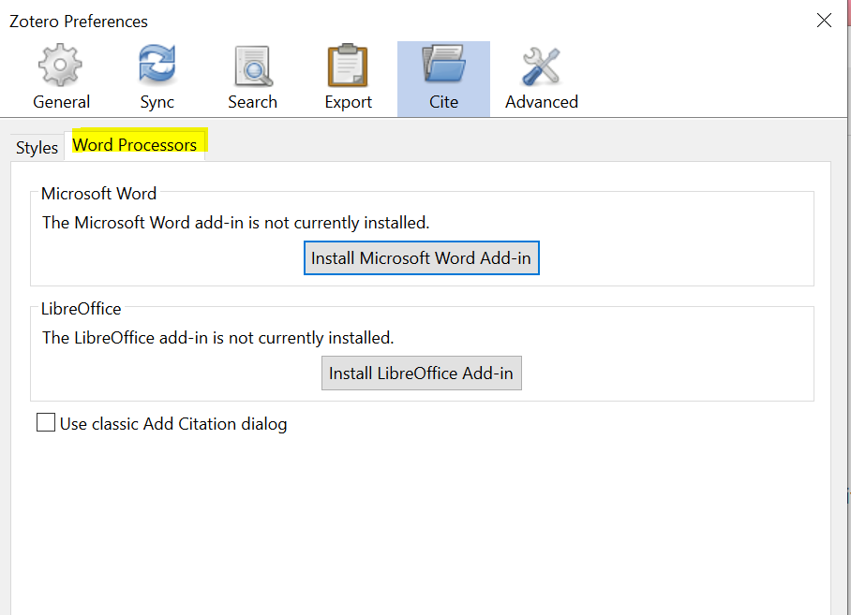
Notes:
Find the plugin either in the client or on the Zotero website. It usually automatically adds to MSWord when the Zotero software is initially installed

Slide 19
Demo/practice creating a bibliography in Zotero client

Slide 20
plugin for MSWord demo/practice adding a citation

Slide 21
Don’t forget to synch Green circle=synch

Slide 22
Miscellaneous tips +
Jason Puckett’s Zotero guide, handout
Notes:
https://research.library.gsu.edu/c.php?g=115275&p=750658

Slide 23
Questions?

Slide 24
Thank you
Monica Berger mberger@citytech.cuny.edu

