Slide 1
Funding and Other Opportunities within CUNY
FC/LSCC Publication Support Workshop Series
Emilie C. Boone
African American Studies

Slide 2
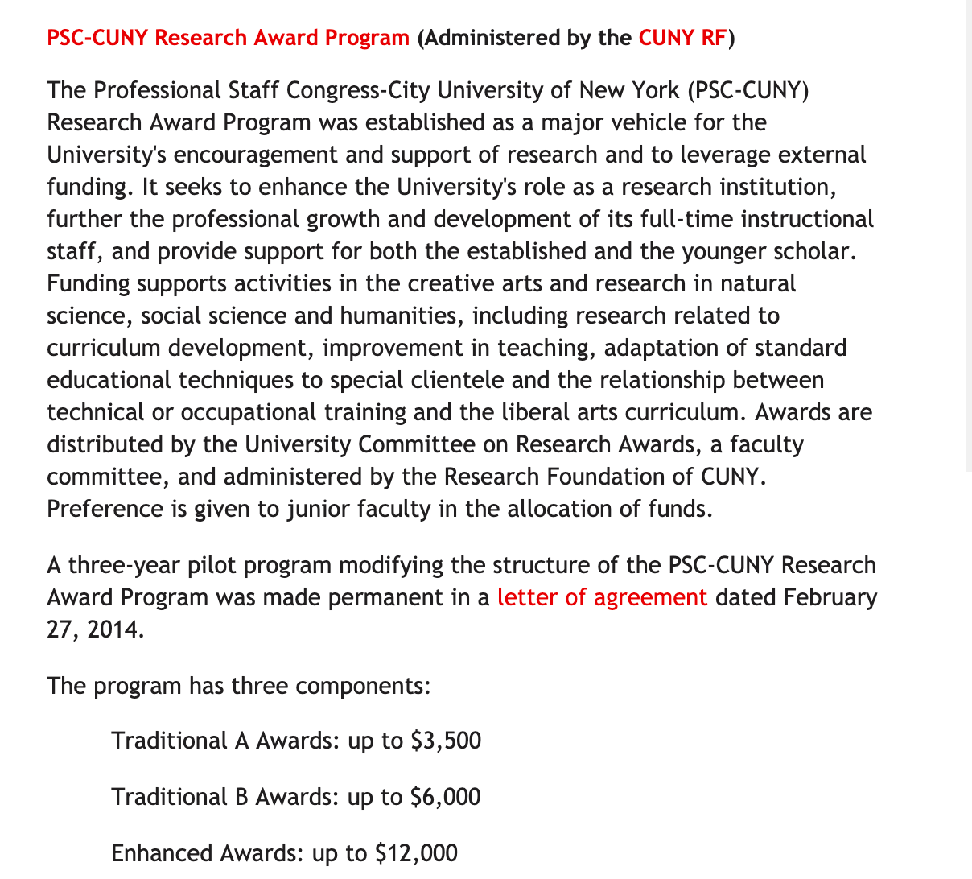
PSC-CUNY Research Award Program

Slide 3
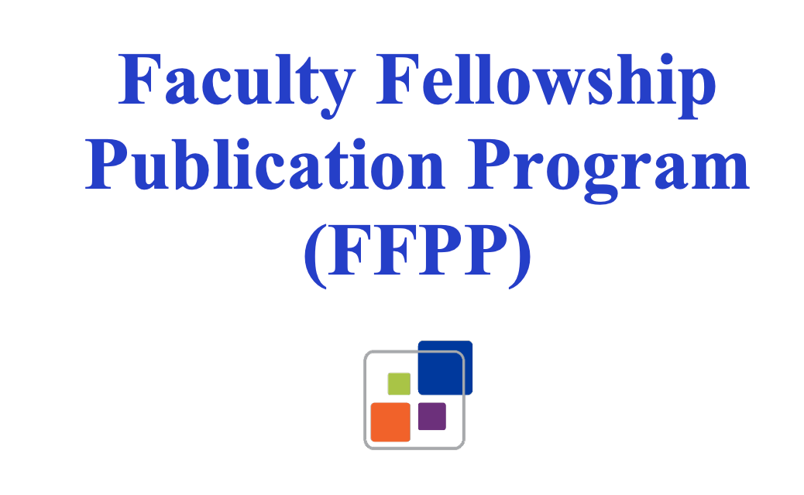
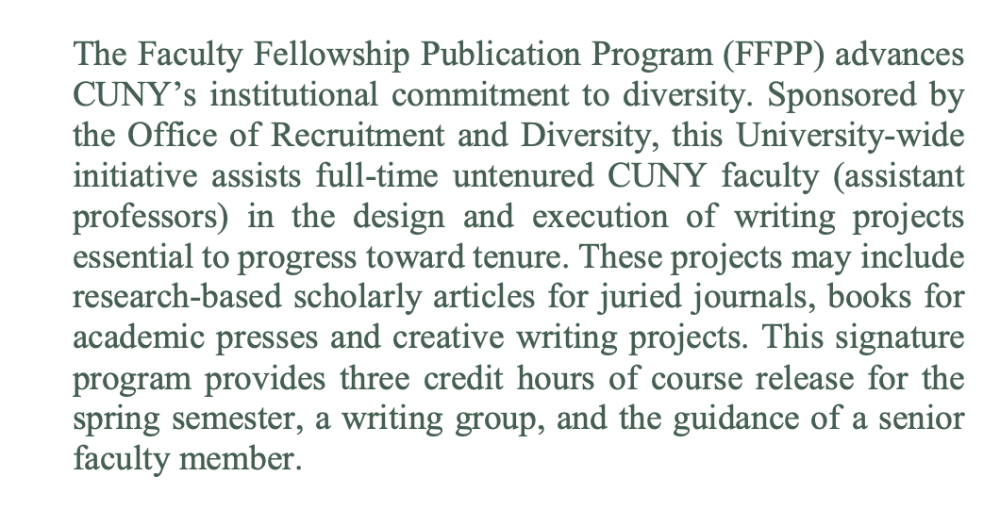

Slide 4
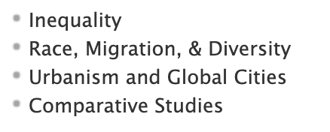

Slide 5
Book Completion Award

Slide 6
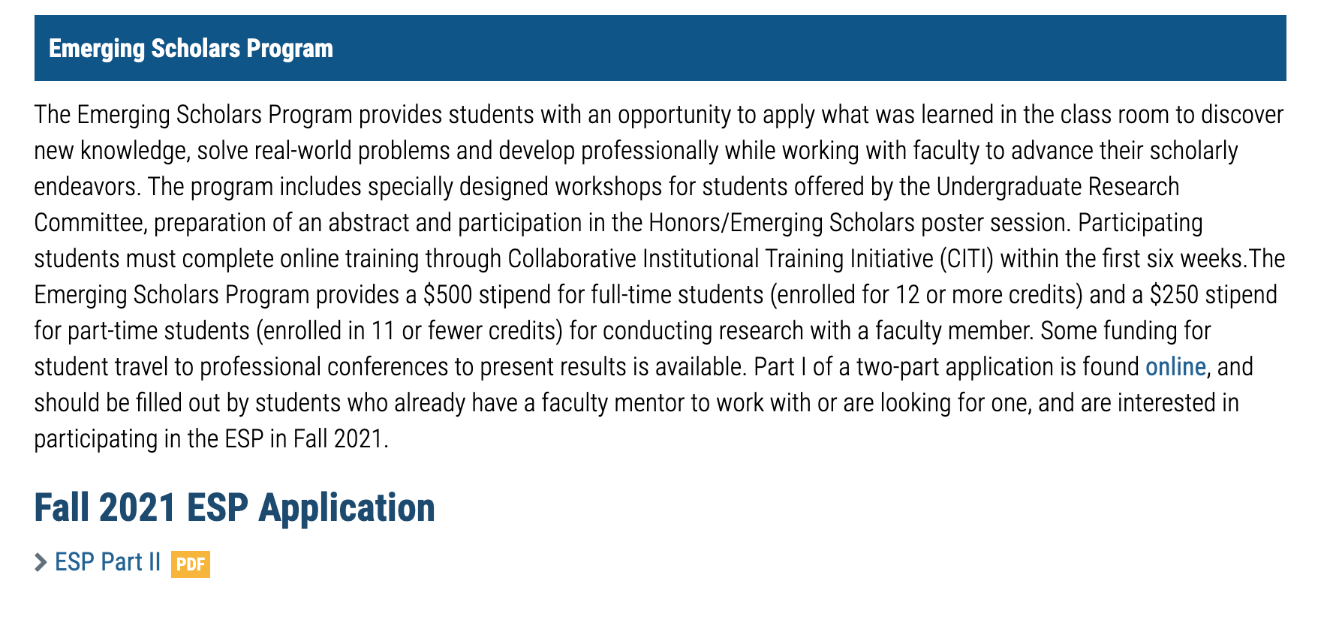
Emerging Scholars Program

Slide 7
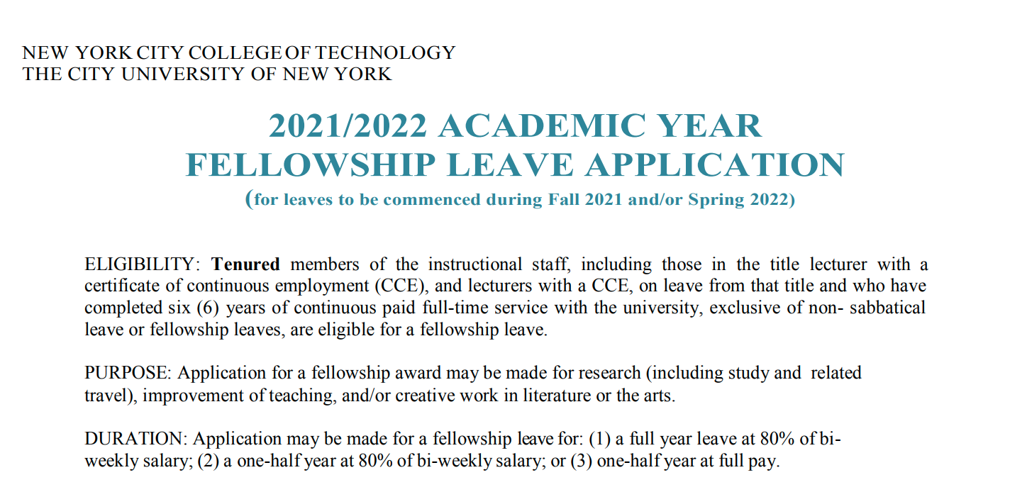

Slide 8
Dean’s Office
PDAC Funds
Office of Sponsored Programs
Patty Barba Gorkhover, CRA
Eleanor Bergonzo Faculty Outreach Coordinators, Professors Viviana Acquaviva and Patrick Corbett

