Slide 1
Google Scholar Profile
Prof. Monica Berger, Library
April 6, 2021

Slide 2
Workshop overview
What is in Google Scholar profile
Why it benefits you
How to create one
Caveats
Q & A

Slide 3
Categories of metrics
IN GOOGLE SCHOLAR PROFILE
Article level metrics (+book chapters, etc.)
Citations
Author metrics
H-Index
NOT IN GOOGLE SCHOLAR PROFILE
Journal level metrics
(can be found in Google Scholar Rankings )

Slide 4
H-Index
Author level metrics
H-Index of a scholar = overall citations over time relative to number of papers published
It quantifies: ‘x number of articles have been cited x number of times’
Notes:
H-factor is author-focused and tries to reflect both the productivity and influence of a scholar. It was created to assess article quality rather than journal quality. It quantifies: ‘x number of articles have been cited x number of times’
H-Index favors papers with large numbers of authors.
It can only increase over time: it doesn’t reflect the “half-life” of an article.

Slide 5
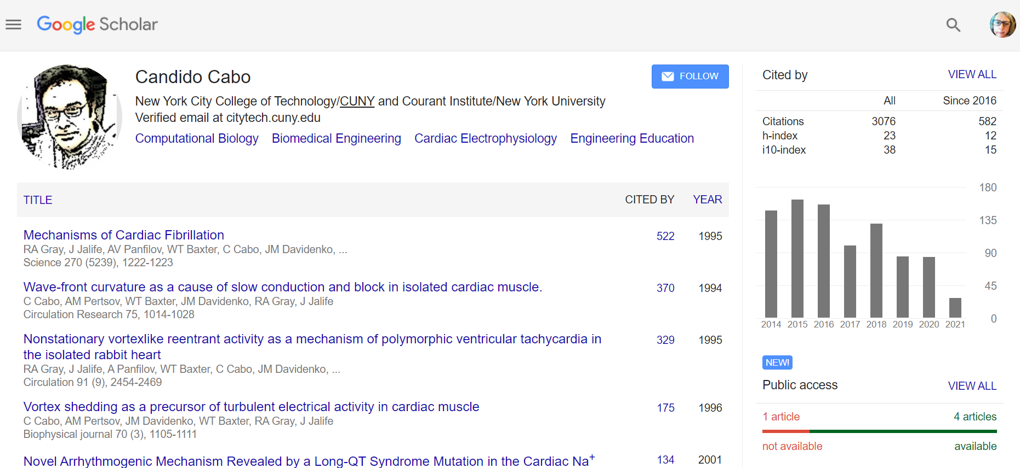
Example of computation biologist’s GS profile

Slide 6
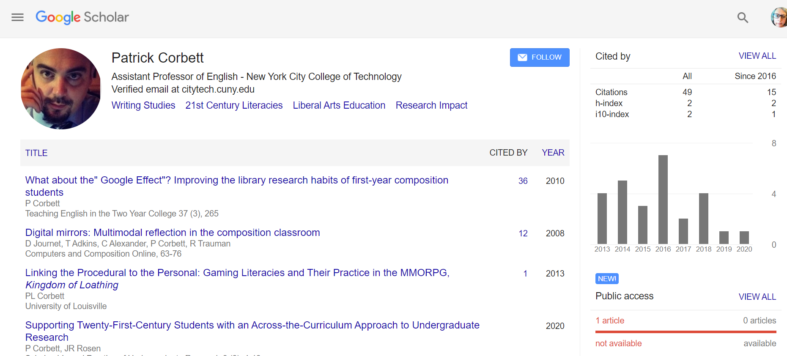
Example of English faculty GS profile

Slide 7
How Google Scholar benefits you

Slide 8
Google Scholar Profile Benefits
Data for PARSE
Data for funders, other evaluators, editors, publishers
Discovering other scholars that share your research topics
Knowing which of your works is being cited
Disambiguate (separate) yourself from other authors with your name (see also ORCID author identifies as solution)
Updates automatically
check for accuracy
Doesn’t index everything

Slide 9
How to create
Log into your Google account
Go to Google Scholar
Go to My Profile
Follow prompts

Slide 10
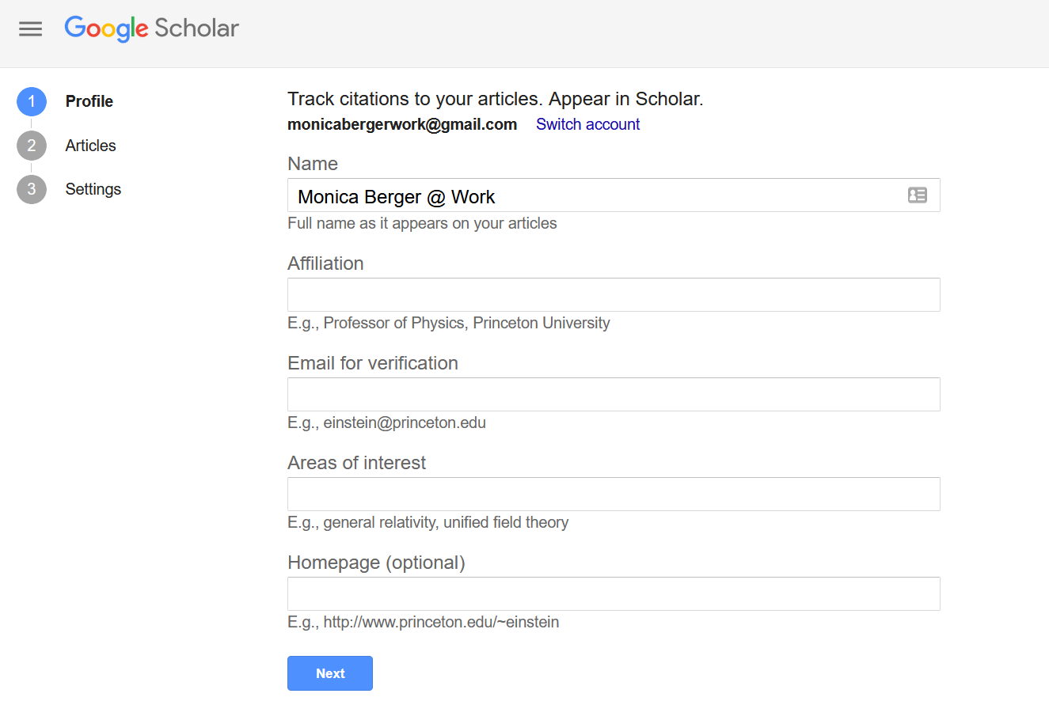

Slide 11
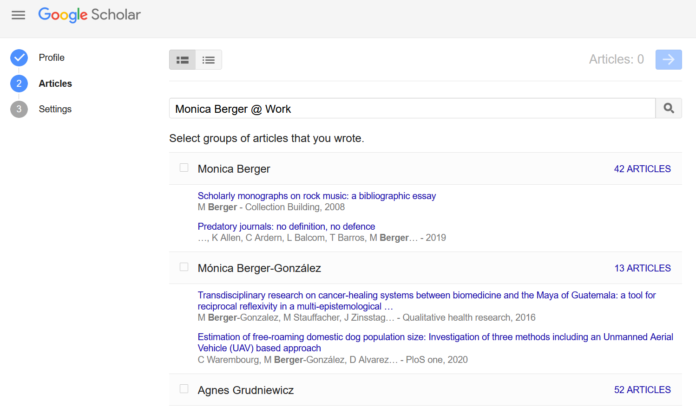

Slide 12
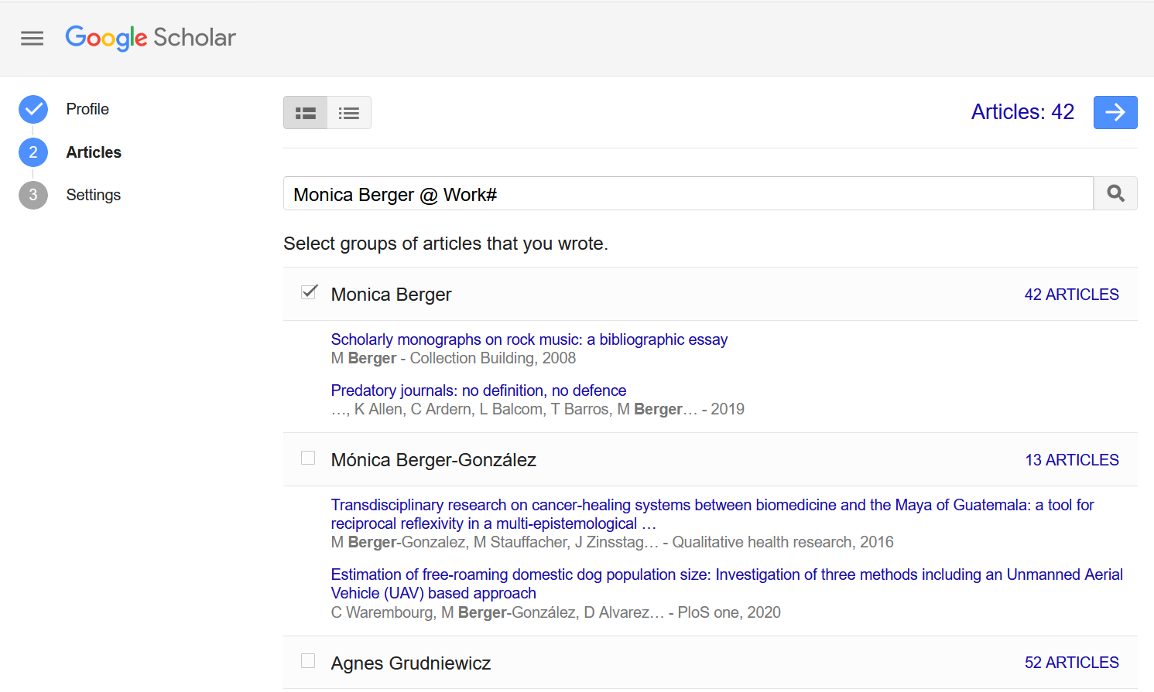
Add your
2—click forward arrow to proceed
1--check off your name where it appears correctly

Slide 13
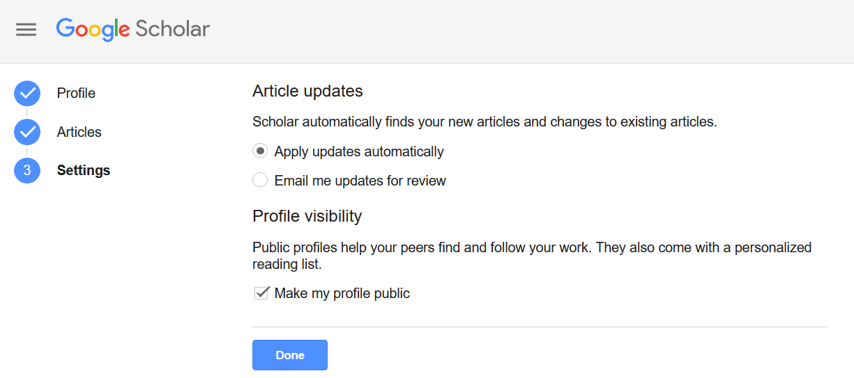
Choose your settings and click DONE

Slide 14
Add co-authors
Notes:
Adapted under a CC-BY 4.0 license from the The 30-Day Impact Challenge: The Ultimate Guide to Raising the Profile of Your Research eBook published by Impactstory.org and authored by Stacy Konkiel.

Slide 15
Deselect publications if needed
Notes:
Adapted under a CC-BY 4.0 license from the The 30-Day Impact Challenge: The Ultimate Guide to Raising the Profile of Your Research eBook published by Impactstory.org and authored by Stacy Konkiel.

Slide 16
Add missing works by search or manually

Slide 17
Create your profile

Slide 18
Caveats
Citation practices are discipline and subdiscipline dependent
Importance of bibliometrics are discipline and subdiscipline dependent + institutional values
Citations can be easily gamed by authors, editors, publishers
coercive citation
self-citation
Scholarship outside of corporate walls left out
DOI and library bibliographic databases → indexing by Google Scholar → likelihood of citation
Open access boosts likelihood of citation

Slide 19
Resources
Boost Your Scholarly Profile! +
Google Scholar Profile set up Reach out to your subject librarian or me

Slide 20
Questions?
Monica Berger
mberger@citytech.cuny.edu

