Slide 1
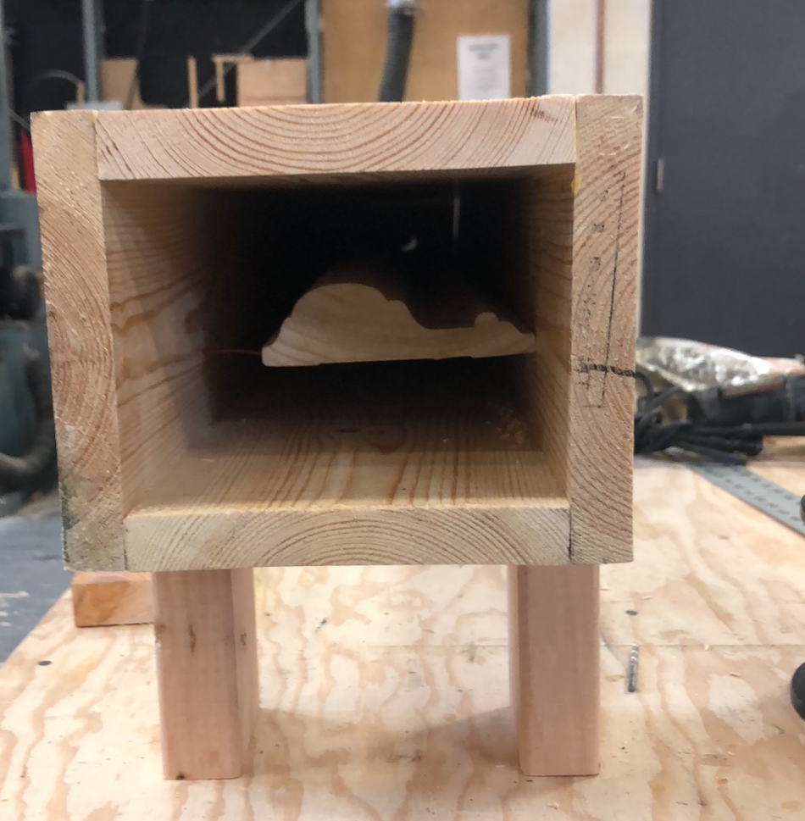
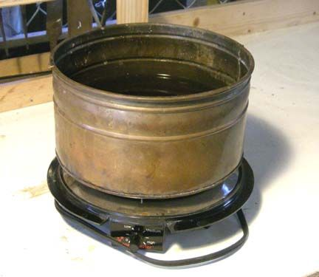
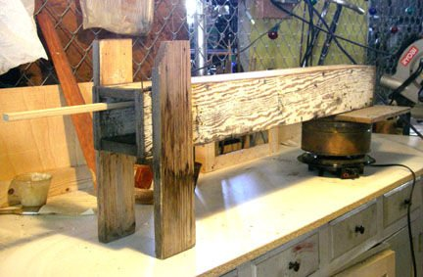
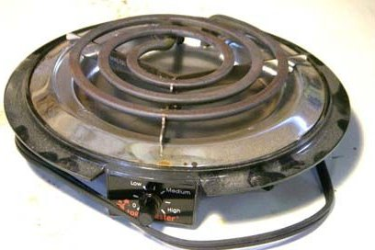
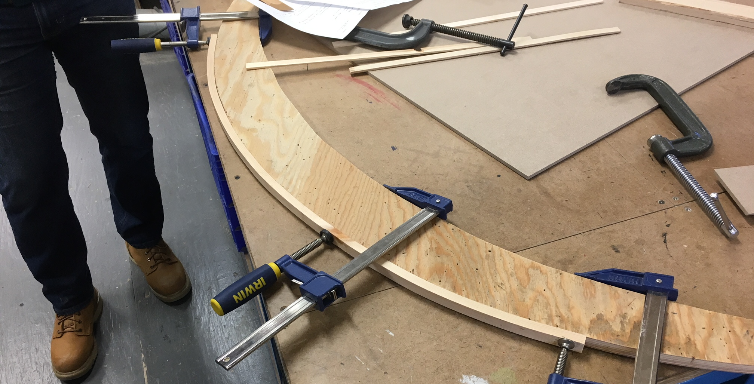
S
TEAM BOX
It is a handy way to heat wood so that it becomes more pliable than it is at room temperature.
Procedure and materials:
5/8 inch or 3/4 inch plywood.
Coat hanger or a few feet of heavy wire as supports inside the steam box.
Cooking pot.
Heat source.
It works much better than boiling water on a hotplate, mostly because it runs at a higher wattage and puts out more heat. If you can get a used one, go for it.
Result:
Tehnical Direction By John McCoullough
Prepared by: Massiel Gomez, Marcelo Fernandez, Bret Whelan
3/19/2019

