Slide 1
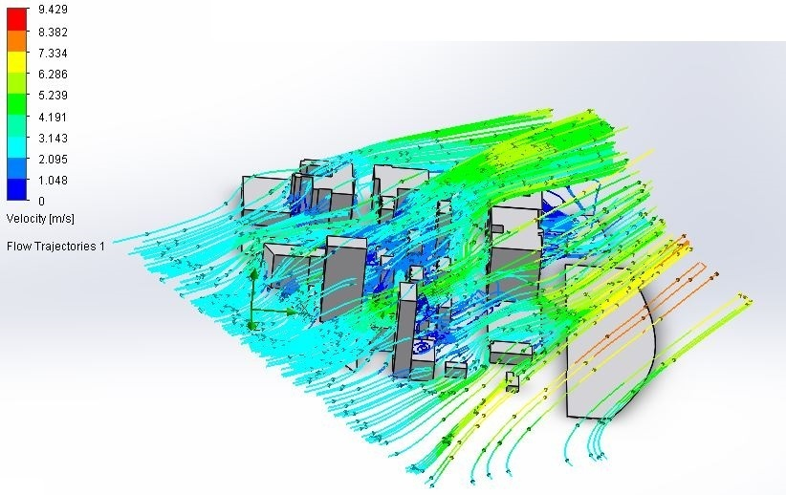
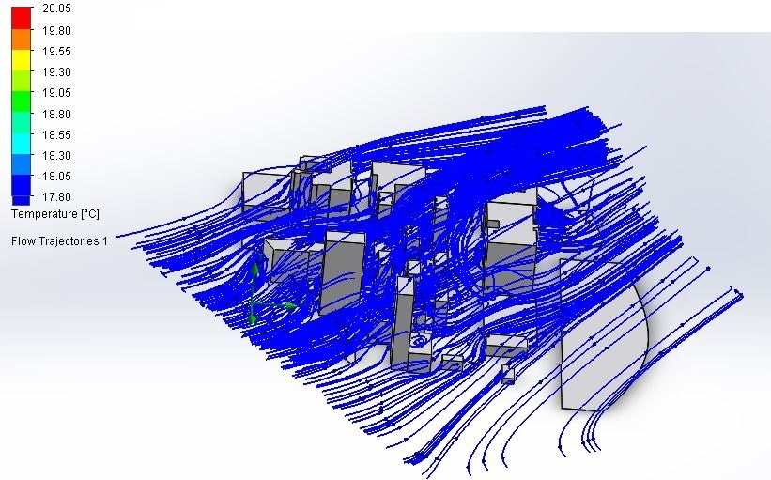
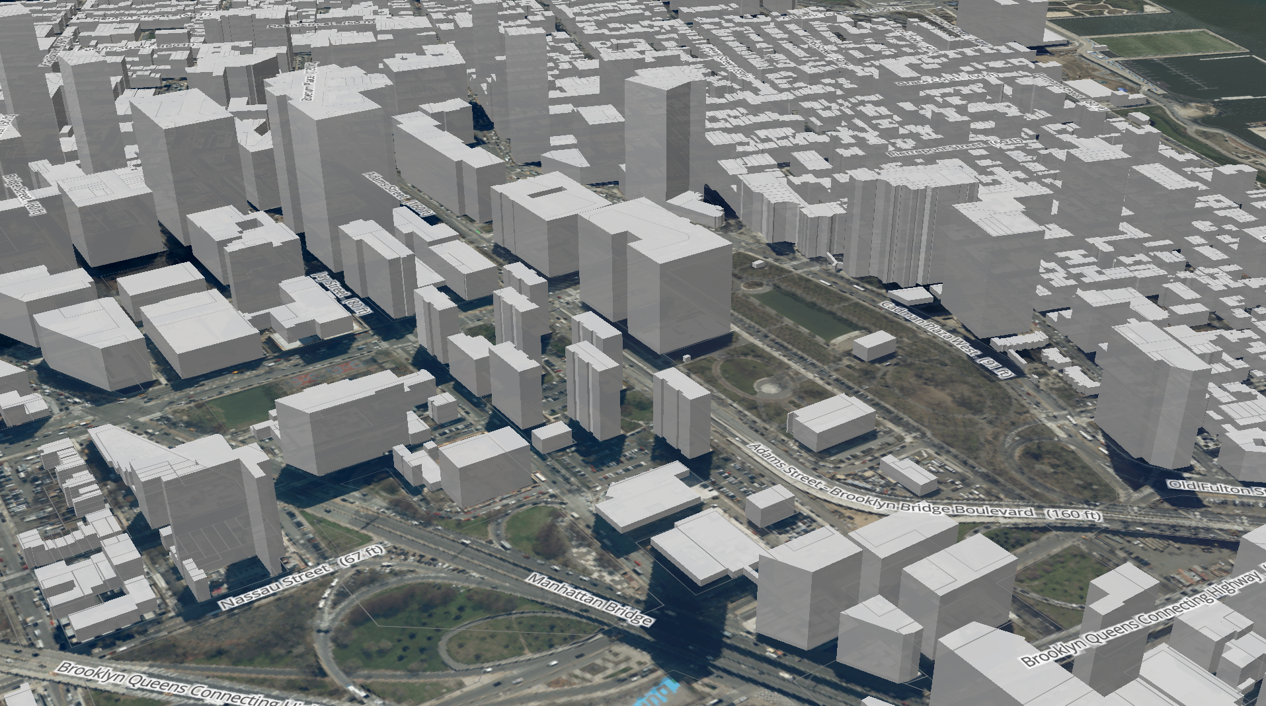
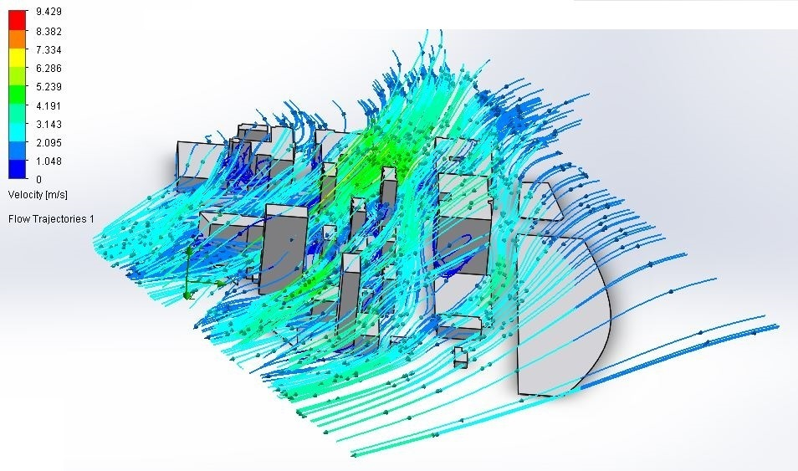
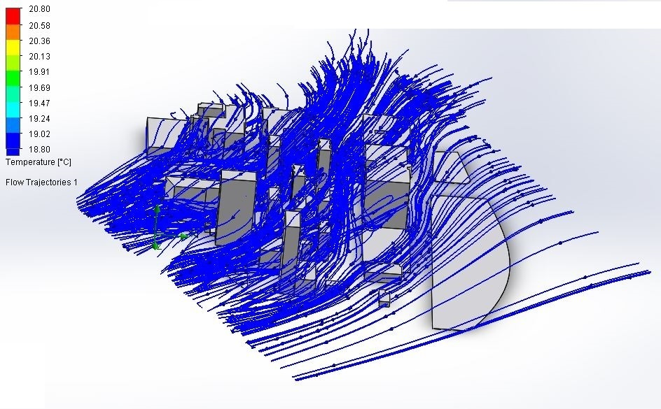
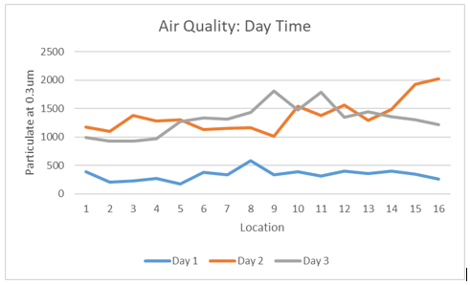
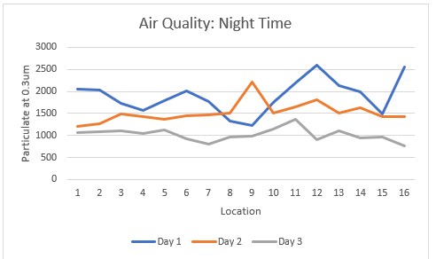
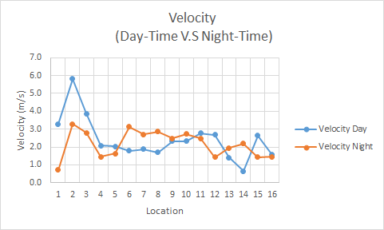
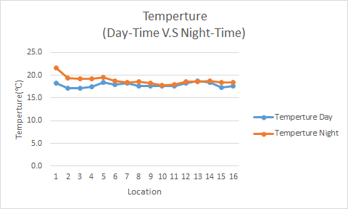
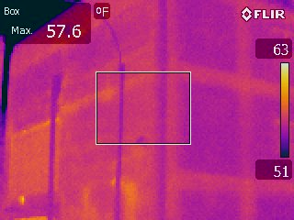
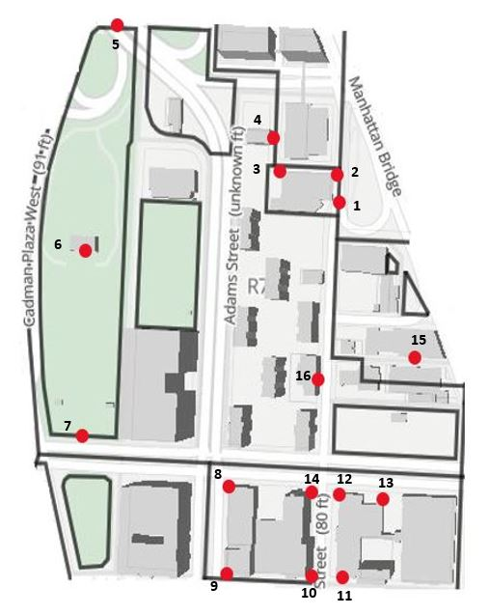
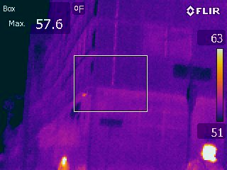
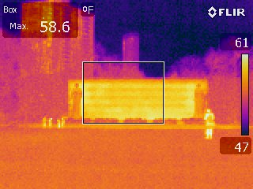
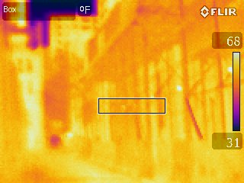
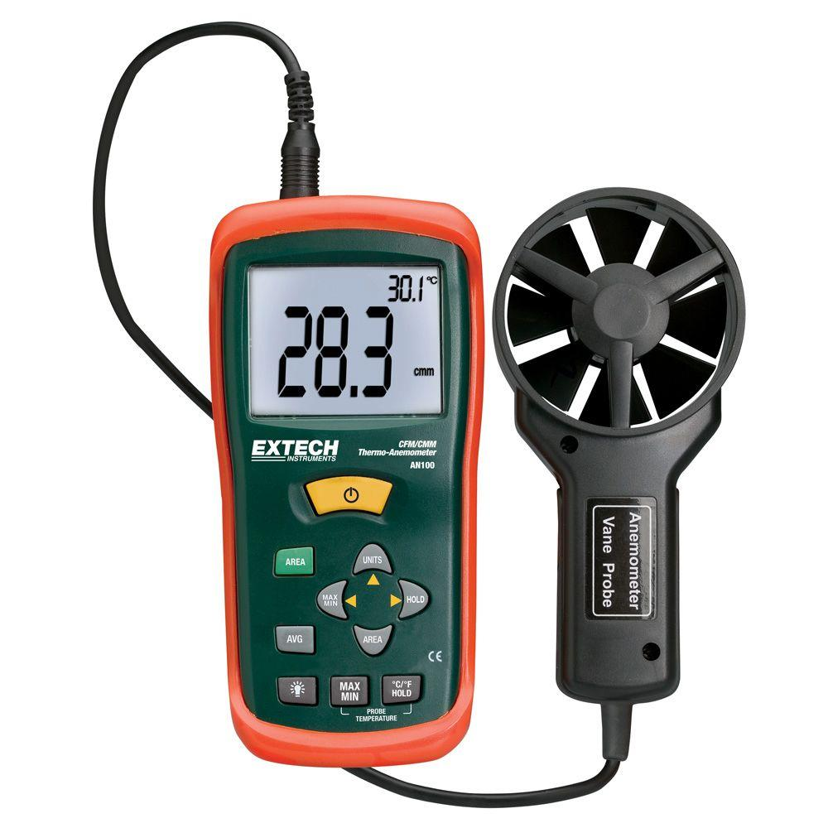
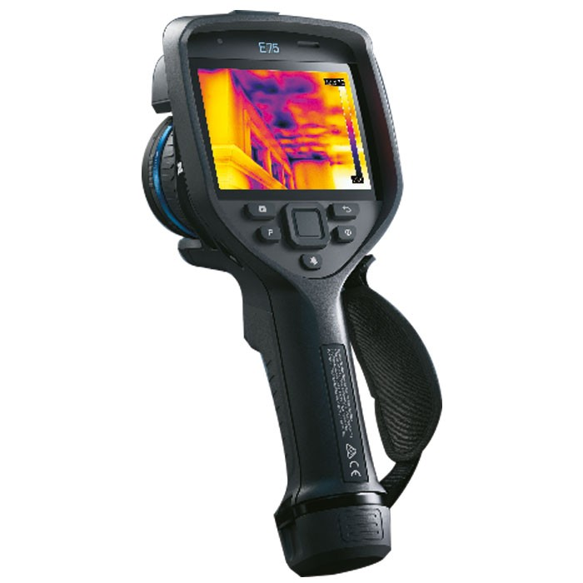
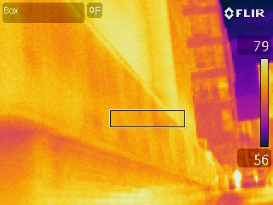
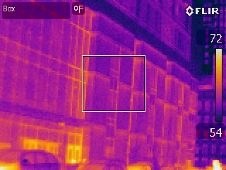
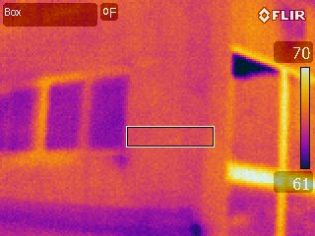
Analysis of Urban Heat Islands with Air Flow Simulations
Carlos Villalva, Xiao Lin, Timothy Medina
Mentor: Prof. Masato Nakamura
CUNY New York City College of Technology
ABSTRACT
RESULTS
Combinations of vehicles, buildings and industry within metropolitan areas produce higher thermal emittance defined as an urban heat island. Compared to surrounding rural areas, urban heat islands like New York City substantially have high-volume of building material (concrete and asphalt), low-volume of green spaces and unique building patterns. Within New York City gas emissions are released, but the resultant location is unknown due to high thermal emittance and outdoor air flow. Gas emissions precedently released into the atmosphere could remain 298+ years. Pollutants are capable of chemically combining with water, then becoming acid rain. As thermal emittance is released from land surfaces within urban heat islands, indirect dry heating occurs causing dry deposition. The goal of this project is to produce an air flow simulation model of downtown Brooklyn, capable of locating existing air flow patterns and thermal emittance. From collected InSitu data, a running simulation model using SolidWorks showcasing the New York City College of Technology campus unique building pattern and air flow. The analysis provided areas with higher heat emittance have lower air flow velocity compared to areas with lower heat emittance which had higher air flow velocity. By creating an air flow model which also indicates heat emittance in lower downtown Brooklyn, future energy conversions will indicate resultant location of dry deposition.
Fig.1. Air Flow simulation result of the Day-Time Velocity
Fig.2. Air Flow simulation result of the Day-Time Temperature
Fig.7. 3D Map of the building around NYCCT
Fig. 3. Air Flow simulation result of the Night-Time Velocity
Fig.4. Air Flow simulation result of the Night-Time Temperature
Fig.8 Air Quality of Day Time
Fig.9 Air Quality of Night Time
By looking at the Air Quality Data, we can see that on a regular sunny day the air quality particles tend to have a low value, which is a good sign. Compare to humid and rainy days, in which the particle tends to have a high value, which demonstrate that there is a high pollution on those specific day. A factor to this high pollution rate might be that rain being more acidic as the day pass.
Fig.5. Velocity: Day time V.S Night Time
Fig.6. Temperature: Day time V.S Night Time
The comparison of day-time and night-time data, it show that the average day-time velocity is 0.2 m/s(0.6ft/s) faster than average night-time velocity. The average night-time temperature is 1 ℃(33.8℉) higher than the average day-time temperature.
METHODOLOGY
DATA ANALYSIS
SUMMARY
During the experiment, we will use device such Arduino, Anemometer, and thermal camera to collect data for our airflow simulation. The AN306 Anemometer, can collect data, such as temperature, Air velocity, air flow and temperature. For the Arduino with the Air Pressure Sensor, can detect the air pressure and air quality of the environment. The thermal camera help determine the temperature of the exterior of the building and the surrounding area. The most important device will be a laptop, since the Arduino and Anemometer requires it to save the data that we gather. As well as, the Arduino requires a power source that a laptop can provide.
\
Base on the data we gained there are small difference between daytime and night time temperature. We know that it’s one of the characteristics of the urban heat island effect. For the building which has low-volume of green spaces surrounded has low the heat transfer rate it also locks air pollution particle in this area. The thermo photo show how the wind and rain affect the temperature of the building and its surrounding. In the wind simulation, it demonstrates where such pollution may travel as time passes every day and how wind affects building specifically. However, we can see from the air quality data that humid and rainy day adds largely to the pollution rate. This is because in today's world, rain tends to be more harmful than beneficial since outside factor throughout time made rain to be more acidic.
Fig.10 The map of the all location around NYCCT
Fig.11. Thermo Picture of the Environmental Building
Fig.12. Thermo Picture of the Voorhees Building
REFERENCES
Fig.14. Thermo Picture of City Tech Howard Building
Learn About Heat Islands
https://www.worldatlas.com/articles/urban-heat-island-causes-and-consequences.html
https://www.epa.gov/heat-islands/learn-about-heat-islands
What is Acid Rain?
https://www.epa.gov/acidrain/what-acid-rain
https://www.epa.gov/climate-indicators/greenhouse-gases
Heat Drying
https://www.epa.gov/biosolids/heat-drying
https://www.epa.gov/sites/production/files/2018-11/documents/heat-drying-factsheet.pdf
Use of Sewage Sludge in Cement Industry
https://www.bioenergyconsult.com/sewage-cement-industry/
Fig.13. Thermo Picture of the Cadman Plaza Park
CFM/CMM Thermo-Anemometer
PM2.5 Air Quality Sensor
ACKNOWLEDGEMENT
Fig.15. Thermo Picture of City Tech General Building
Fig.16. Thermo Picture of City Tech Klitgord center building
Fig.17. Thermo Picture of City Tech Midway Building
We would like to thank Dr. Masato. Nakamura’s help and mentor!
FLIR E53 240x180 Advanced Thermal Imaging Camera

