Slide 1
Polynomial and Rational Inequalities in Architecture
Victor Charles, Frederick De Leon, KC Rampersad, Diana Gil, Kenny Uruchima

Slide 2
Polynomial Inequality
A polynomial inequality is a mathematical statement that relates a polynomial expression as either less than or greater than another polynomial expression. A polynomial is a sum or difference of monomials, and a monomial is a number, variable, or a product of numbers and variables.
For Example: -3x + 7 > 19, -2x ≤ -6, 3 < -6x - 4 ≤ 13, x^2 - 3x + 4 ≥ 0
To solve you evaluate for the variable, which in this case is x:
2x +5 ≥ 4x - 11
2x + 5 - 4x ≥ -11
-2x ≥-16
x ≤ 8
So the solution to the polynomial inequality, 2x +5 ≥ 4x - 11 , is (-∞, 8].

Slide 3
Rational Inequality
A rational inequality is an inequality that contains a rational expression. A rational expression is a quotient of two polynomials, a fraction with a polynomial numerator and denominator.
For Example: x-3/x-1 ≥ 0, ((5x-2)/3 - (7x-3))/5 > x/4, (2x-3)/4 + 9 ≥ 3 + 4x/3
To solve you evaluate for the variable, which in this case is x:
Therefore, the solution to this rational inequality,
((5x-2)/3 - (7x-3))/5 > x/4, is (4, ∞).
$\frac{5x−2}{3}−\frac{7x−3}{5}>\frac{x}{4}$
$\frac{25x−10−21x+9}{15}>\frac{x}{4}$
$\frac{4x−1}{15}>\frac{x}{4}$
$4\left(\frac{4x−1}{15}\right)>\left(\frac{x}{4}\right)4$
$\left(\frac{4}{15}\right)\left(4x−1\right)>x$
$15\left(\frac{4}{15}\right)\left(4x−1\right)>\left(x\right)15$
$4\left(4x−1\right)>15x$
$16x−4>15x$
$x−4>0$
$x>4$

Slide 5
Architecture
A STEM field that utilizes both polynomial inequalities and rational inequalities is Architecture. Architecture is the process of planning, designing, and constructing buildings or other structures. These inequalities are used in the field of architecture to get ranges of values for making accurate CAD models and drafts of building plans. A rational inequality can for example be used to model the range of possible values of the trapezoidal base of a structure while still remaining under a certain maximum area.

Slide 6
Purpose of Choosing Architecture
We chose Architecture over the many other STEM applications because architecture was a field we were interested in and wanted to know more about and about the way in which polynomial and rational inequalities could be used in it. It’s also such an integral part of our society and human development throughout history, so we wanted to see the role polynomial and rational inequalities played in this vitally important field.

Slide 7
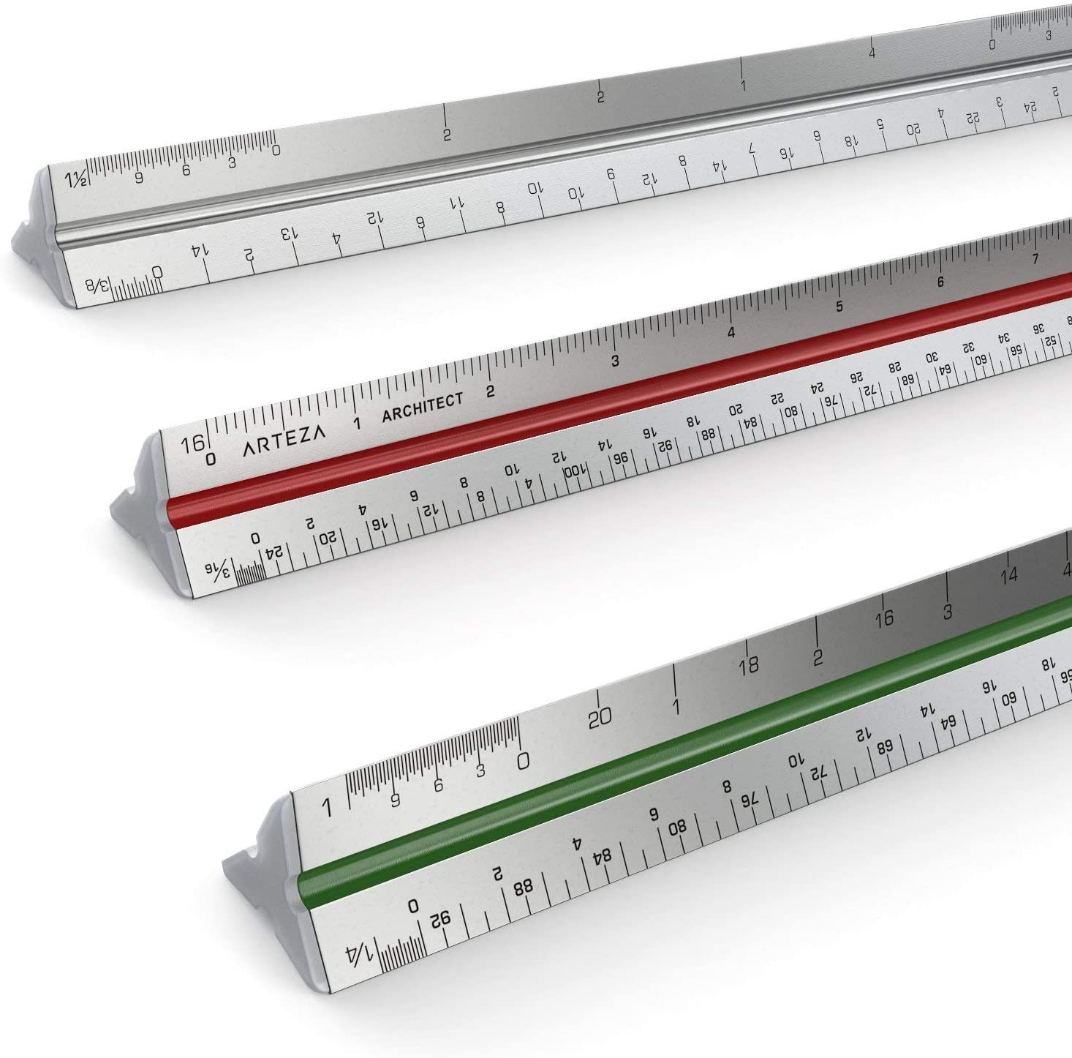
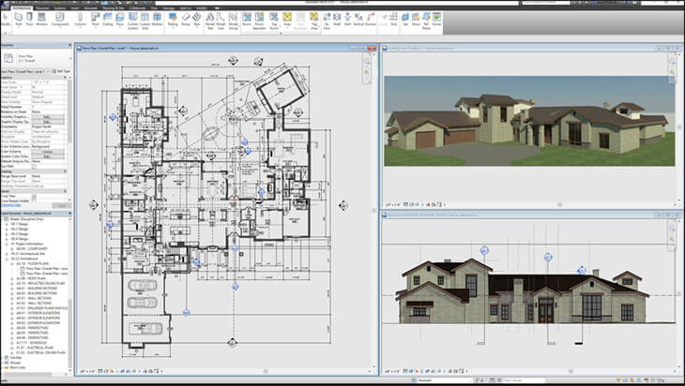
Architectural Tools
Measuring Tape: Used for measuring things longer than 12” and can be used to measure corners and irregularly shaped objects.
Architect Scale Ruler:
Has three color coded sides with six scales, 1-½”, 1-¾”, ⅜”, 3/32”, ½”, ¼”, and ⅛”.
CAD Software: Software used to model architecture digitally
Mechanical Drafting Pencil: Used for accurate drawing of models and plans

Slide 8
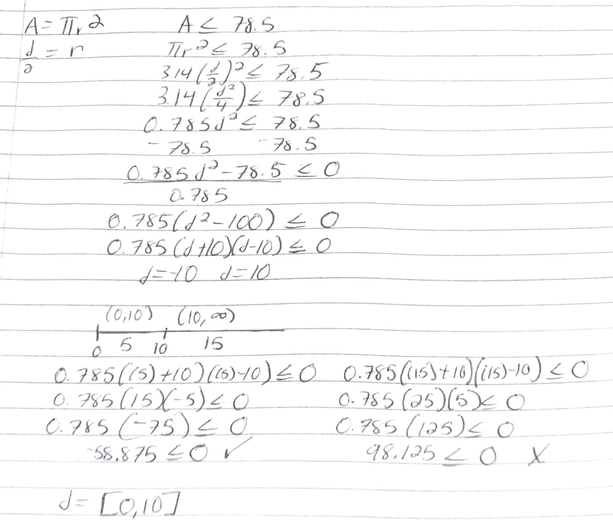
Problem: Polynomial Inequalities
You are constructing a circular koi pond in your backyard. What are possible values for the diameter of the pond if the area is to be no more than 78.5 ft^2? Use 3.14 to represent ℼ.
The possible values for the diameter of the pond if the area can not be more than 78.5 sq ft is any value greater than or equal to 0 and less than or equal to 10.
We can see here the usefulness of a polynomial inequality in architecture. It can allow an architect to determine a range of values for what they’re trying to construct.

Slide 9
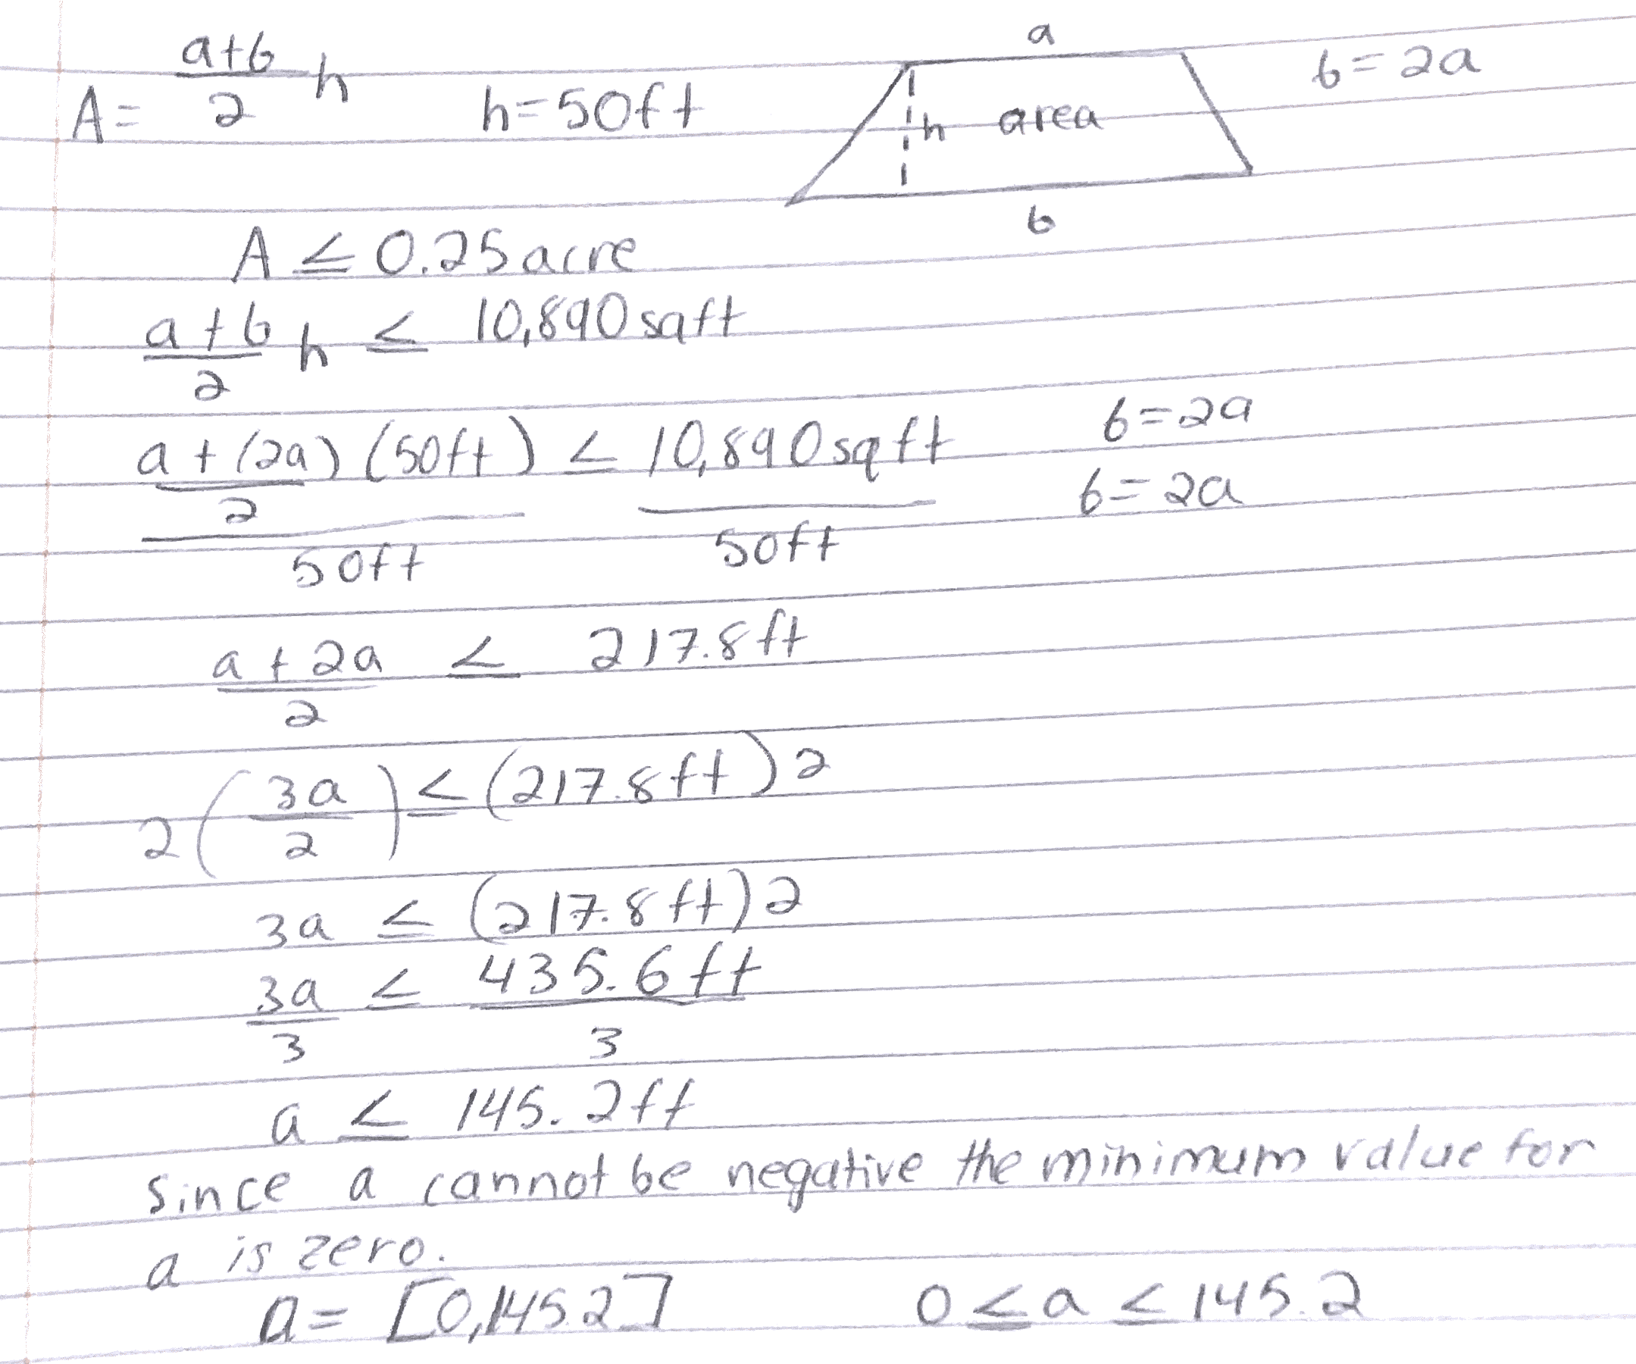
Problem: Rational Inequalities
You are drawing up plans for a new park/garden area with a trapezoidal shape that must have a height of 50 ft and an area of no more than 0.25 acre, or 10,890 sqft. The length of the bottom base of the park must also be 2 times the length of the top base of the park. What are the possible values for the length of the top base of the park, a?
The possible values for the length of the top base of the park if the area can not exceed 0.25 acre is any value greater or equal to 0 ft and less than or equal to 145.2 ft.
a = [0, 145.2] or 0 ≤ a ≤ 145.2

Slide 10
In Conclusion
In the STEM field, many manners of problems need to be solved. Understanding the dynamics of how the world works is key to solving these problems; The purpose of learning STEM is to understand and solve the problems that come with evolution and advancement.
Inequalities, polynomial, rational, or otherwise, are a constant in all manner of organic life; especially in human life. Understanding where they are featured in our lives and fields of study is only half the battle, the other half being the numbers and dynamics behind these inequalities.
In Architecture, a cornerstone of literally building any society, inequalities are ever-present. We hope this presentation gave a glimpse as to some situations where inequalities can be identified in the field, and how applied knowledge of them can be used to solve them.
Thank You

Slide 11
References
Precalculus Second Edition; Session 12: “Polynomial and rational inequalities” By Thomas Tradler and Holly Carley http://websupport1.citytech.cuny.edu/faculty/ttradler/Precalculus-Tradler-Carley.pdf
Video Lesson 12 Open Lab Polynomial and Rational Inequalities https://openlab.citytech.cuny.edu/mat1375coursehub/2020/03/19/lesson-12-polynomial-and-rational-inequalities/
Applications Involving Polynomial and Rational Inequalities video example problems https://www.youtube.com/watch?v=Kfs2cJjIldQ&t=1s
American Institute of Architects https://www.aia.org/

