Slide 1
Murad Pervez 5/17/13
Ruslan Yelizarov
Study time
Vs
Grade

Slide 2
Hypothesis:
WE ASSUME THAT THE GRADE A STUDENT EARNS AT THE END OF THE SEMESTER, IS DIRECTLY CORRELATED TO THE TIME THEY SPENT STUDYING. WE ALSO BELIEVE THAT A STUDENT MUST SPEND MORE TIME ON COURSES THAT THEY FIND MORE CHALLENGING. More studying=Better Grades

Slide 3
Research Question
Is there a relationship between students’ final grade and the number of hours of study per day?
And if students found a course difficult, would they obtained higher grade at the end of the semester if they study more or less hours per day?”

Slide 4
Sample
Group A Group B
English 1101 class Math 1475
Section 1 and 2 Section 1 and 2
22 NCCT students 18students
10 males ,10 females 8 males, 10 females

Slide 5
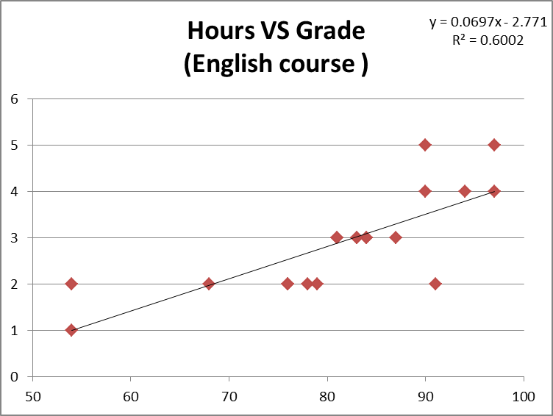
SCATTER PLOT

Slide 6
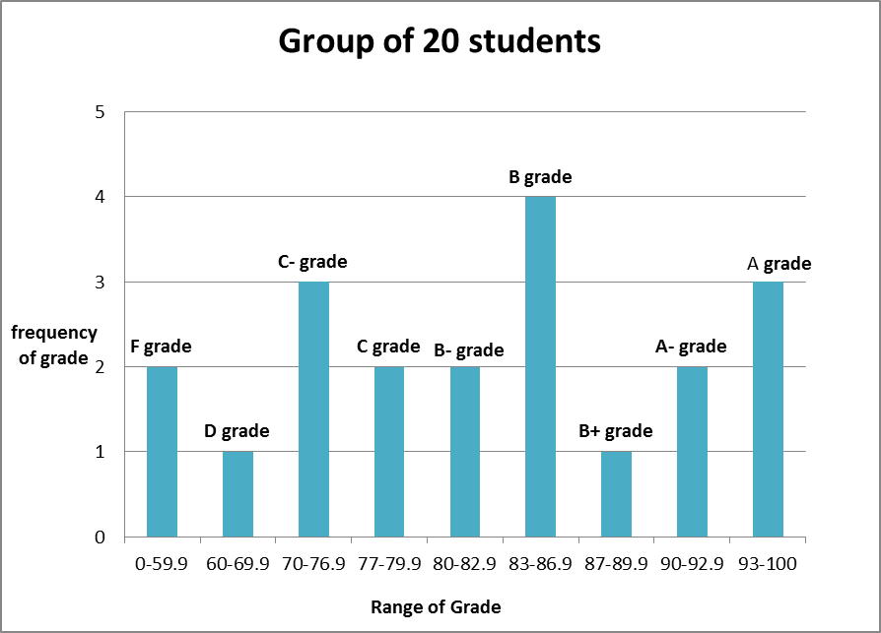
Histogram

Slide 7
Here Comes Math...

Slide 8
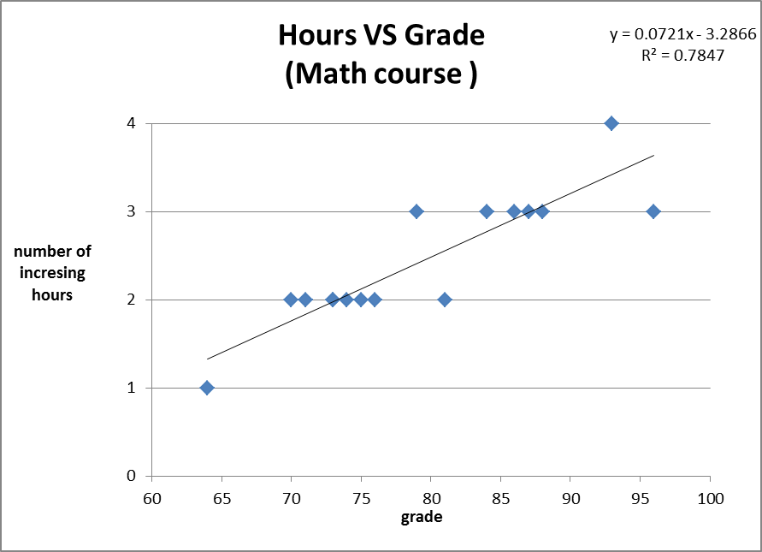
Scatter Plot

Slide 9
Stastical analysis
Sample size A: 20 Sample size B: 16
Mean grade: 81.35 Mean grade :79.37
Mean Hours :2.9 Mean Hour: 2.4375
Standard Deviation: ~12 Standard Deviation : 8.935 Correlation coefficient r = 0.77 Correlation coefficient r= 0. 88
y = 0.0697x - 2.771 y = 0.0721x - 3.2866
Y_{A}= 0.0697(95)-2.771 = 3.8505 Y_{B} = 0.0721(75) - 3.2866 = 2.12

Slide 10
Finding
a positive moderate correlation of 0.77 between 0.5 and .9 for the case of English course
positive moderate correlation of 0. between 0 and 1 for the Math course
The regression line also confirmed that as the grade increase by 1, the number of hour should also increases by 0.081% for the English students and by 0.09% for the Math students .

Slide 11
Discussion

Slide 12
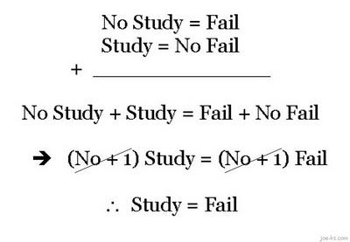
Thank You For Your Time!

