Slide 1
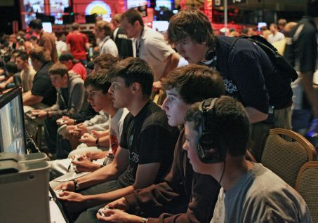
The effect of Gaming on GPA

Slide 2
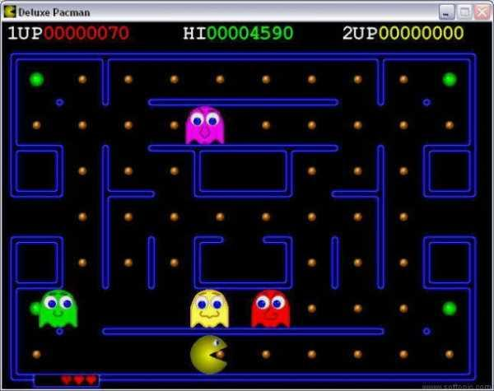
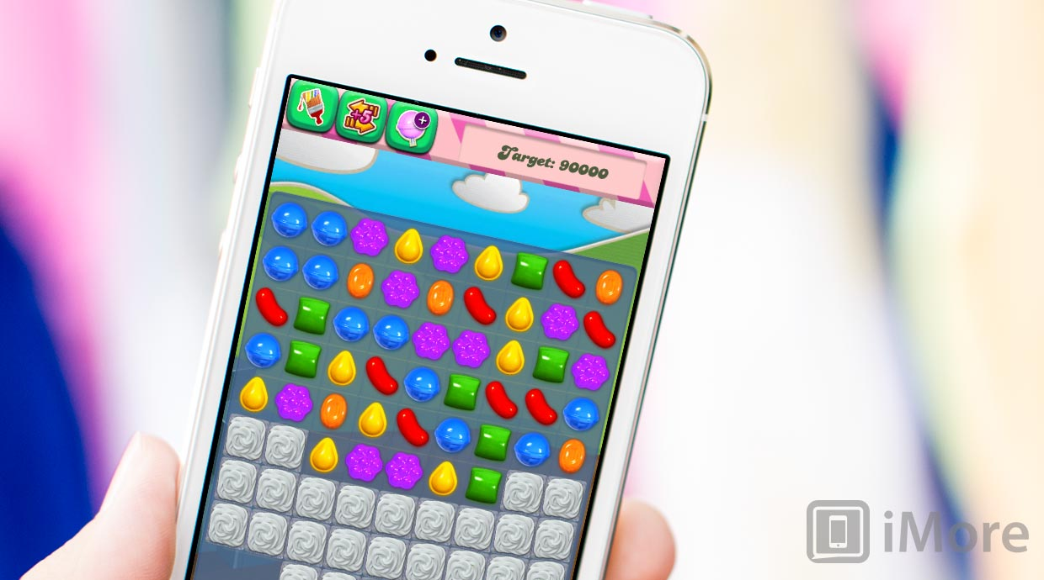
Video games have been around for 30+ years, and their popularity has never been greater.

Slide 3
Does the amount of time students dedicate to video games have an impact on GPA?

Slide 4
Hypothesis
We expect to see a negative correlation between the number of hours played per week and the GPA of the student who plays games.

Slide 5
Population
Survey of 93 video-game-playing students on the City Tech campus.

Slide 6
Variables
Hours per week played by the student gamers
GPA of the gamers. The range goes from 0 to 4

Slide 7
Our Experiment
Hours played per week
Sample: | 93
Mean: | 16.065
standard: | 19.033

Slide 8
GPA Students Gamers
sample: | 93
Mean: | 3.1
standard: | 0.5

Slide 9
Statistical Analysis
R2 value = 0.0000162
53.7% played 10 or more hours per week
8.6% played more than 40

Slide 10
Scatterplot with Regression Line

Slide 13
Results Obtained
The amount of time spent gaming does not seem to affect GPA.
Joshua Jansen
Maria Zherebtsova
Dekuwin Emmanuella Kogda

