Slide 1
Non-Alcoholic Consumption vs. Alcoholic Consumption
By Pablo Lara, Dennis Trotter Jr., & Ahou Eby

Slide 2
INTRODUCTION
A non-alcoholic drink, also called soft drink, it is a beverage that contains no alcohol.
An alcohol beverage contains ethyl alcohol.
People drink a lot of different things to quench their thirst today, our research is conducted to find what people drink the most.

Slide 3
HYPOTHESIS
Do people drink more alcoholic or non-alcoholic beverages?
What drinks do they mostly like?
Can we correlate this data to establish which liquids are drunk most and why?
What are the expectations?

Slide 4
Population
The object of this experiment is to attempt to determine if there is a relationship between weekly non-alcoholic and alcoholic beverages consumed by people; the data recorded is based on a survey of 75 NYC College of Technology students, and some friends.

Slide 5
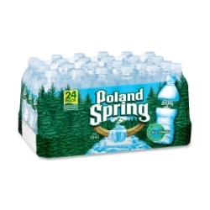
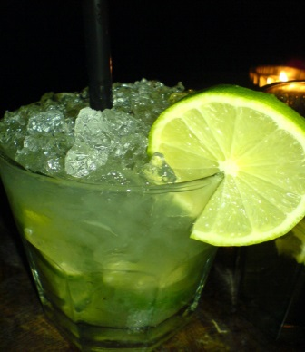
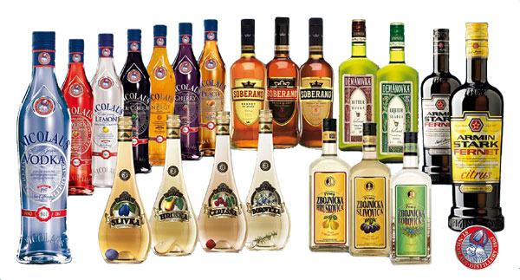
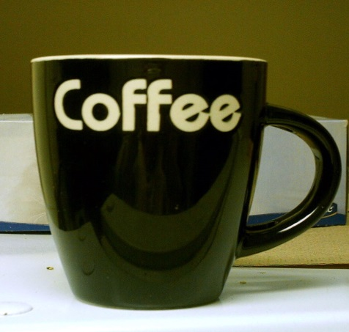
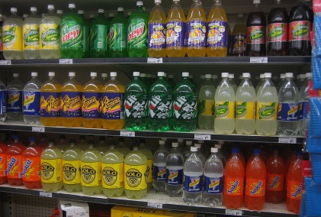
Variables
Hot and cold weather.
Females and males of different ages.
The different types of alcoholic and non-alcoholic beverages consumed.

Slide 6
DATA COLLECTING
The data collected was for drinks consumed in a week.
A pen and pencil survey was conducted among students at NYCCT and in neighborhood in New York City and ourselves.

Slide 7
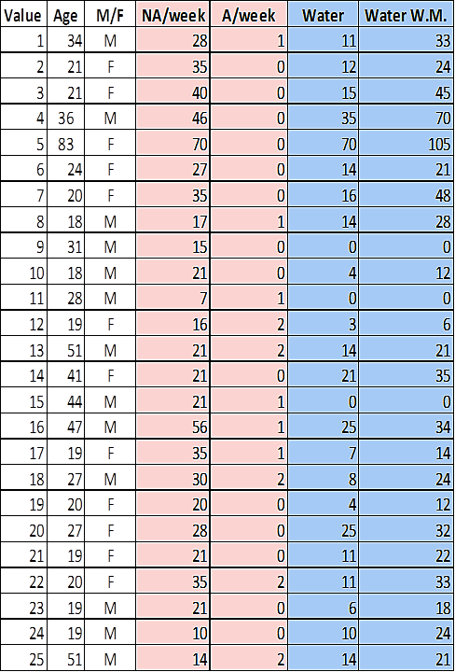
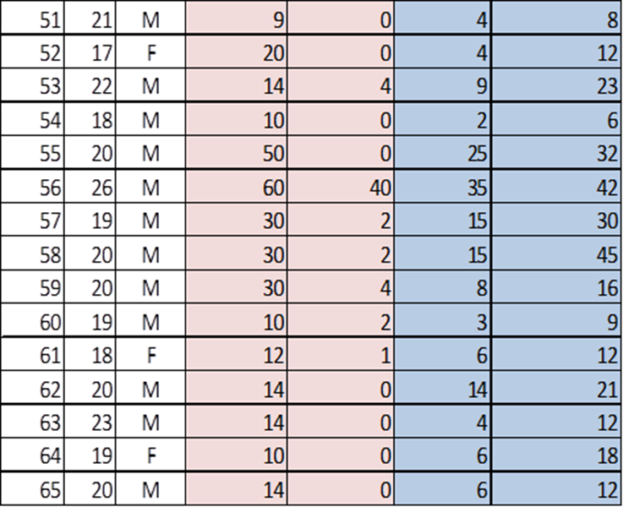
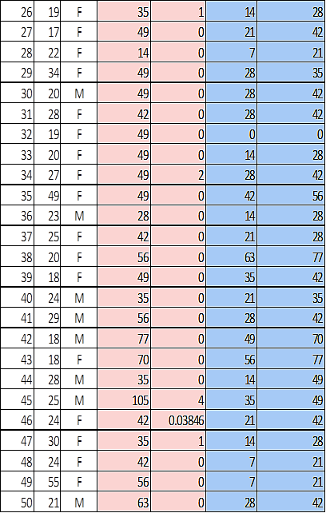
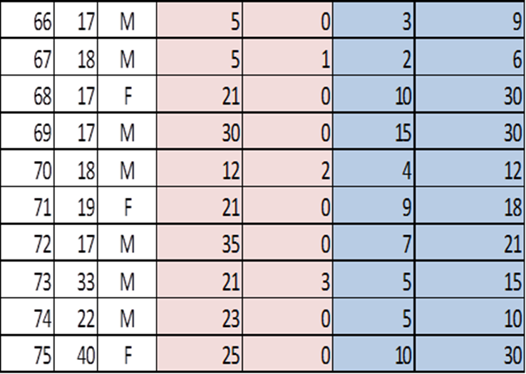
Data Set 1(1-75)

Slide 8
Data Set 2(1-75)

Slide 9
STUDY DESIGN
The correlation between alcoholic and non-alcoholic beverage is 0.15667037 and we have a positive & strong correlation, because the slope is 0.038 and the tend line increases.

Slide 10
Descriptive Statistics
Describing data | non-alcoholic beverage | alcoholic beverage
Mean | 32.53333333 | 1.133846133
Mode | 35 | 0
Median | 30 | 0
Total Frequency | 75 | 75
Standard deviation | 19.21031067 | 4.665255345
R^2 | 0.024545606
Correlation | 0.156670372
Expected Value | 2440.00000 | 85.03846

Slide 11
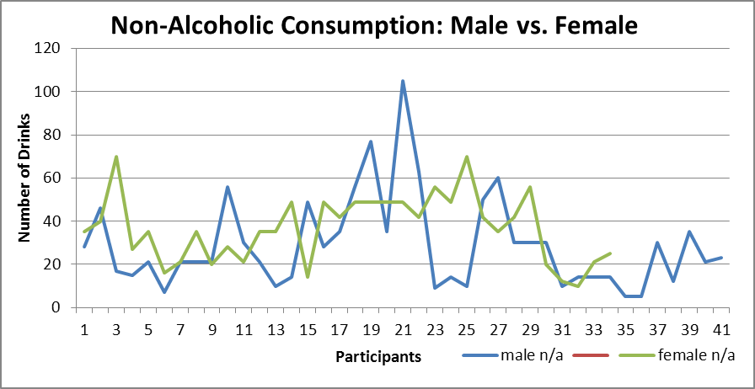
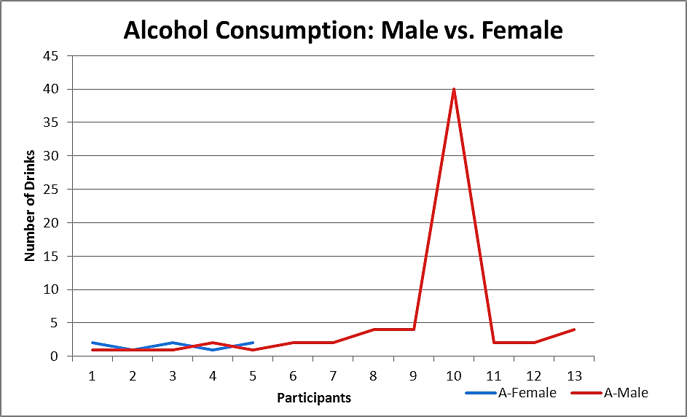
Non Alcohol Vs. Alcohol(Male vs. Female)

Slide 12
Conclusion
People consumed more non-alcoholic beverages, especially soda.
The correlation of our data for the given variables was positive and very close to what we expected.

Slide 13
THANK YOU AND GOODBYE

