Slide 1
MAT 1372
Statistics with probability
5.3 Expected value

Slide 2
Review (of 5.2)
A random variable X (or Y or W) is an experiment with a SINGLE numeric outcome
Exercise 5.2.8:
2 batteries are randomly chosen from bin containing 10 batteries: 7 good, 3 defective.
Let W denote # defective batteries chosen, then
w
P(w)

Slide 3
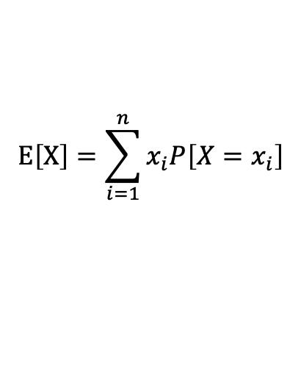
EXPECTED VALUE
The expected value of a random variable X (also known as the mean) is the sum of the outcomes weighted by their probabilities:
The Greek letter μ “m-you” is often used to represent the mean.
$$E\left[X\right]=\sum_{i=1}^{n}{x_{i}P\left[X=x_{i}\right]}$$

Slide 4

5.2.8 # bad batteries part 2
Let W denote # defective batteries chosen, then
w
P(w) and
$$E\left[W\right]=0∗P\left[0\right]+1∗P\left[1\right]+2∗P\left[2\right]=\frac{0∙7+1∙7+2∙1}{15}=\frac{9}{15}=\frac{3}{5}=0.6$$
In other words, just a little more than half a bad battery.

Slide 5
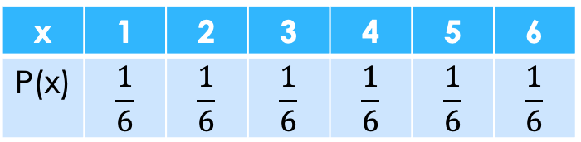
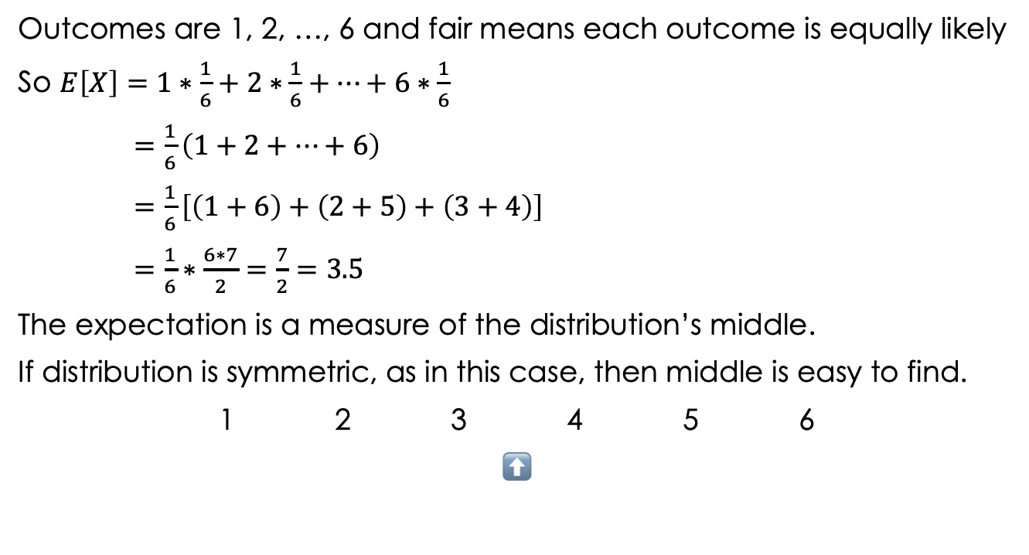
Rolling a single 6-sided, fair die
Outcomes are 1, 2, …, 6 and fair means each outcome is equally likely
So $E\left[X\right]=1∗\frac{1}{6}+2∗\frac{1}{6}+⋯+6∗\frac{1}{6}$
$=\frac{1}{6}\left(1+2+⋯+6\right)$
$=\frac{1}{6}\left[\left(1+6\right)+\left(2+5\right)+\left(3+4\right)\right]$
$=\frac{1}{6}∗\frac{6∗7}{2}=\frac{7}{2}=3.5$
The expectation is a measure of the distribution’s middle.
If distribution is symmetric, as in this case, then middle is easy to find.
1 2 3 4 5 6
⬆
x | 1 | 2 | 3 | 4 | 5 | 6
P(x) | $$\frac{1}{6}$$ | $$\frac{1}{6}$$ | $$\frac{1}{6}$$ | $$\frac{1}{6}$$ | $$\frac{1}{6}$$ | $$\frac{1}{6}$$

Slide 6
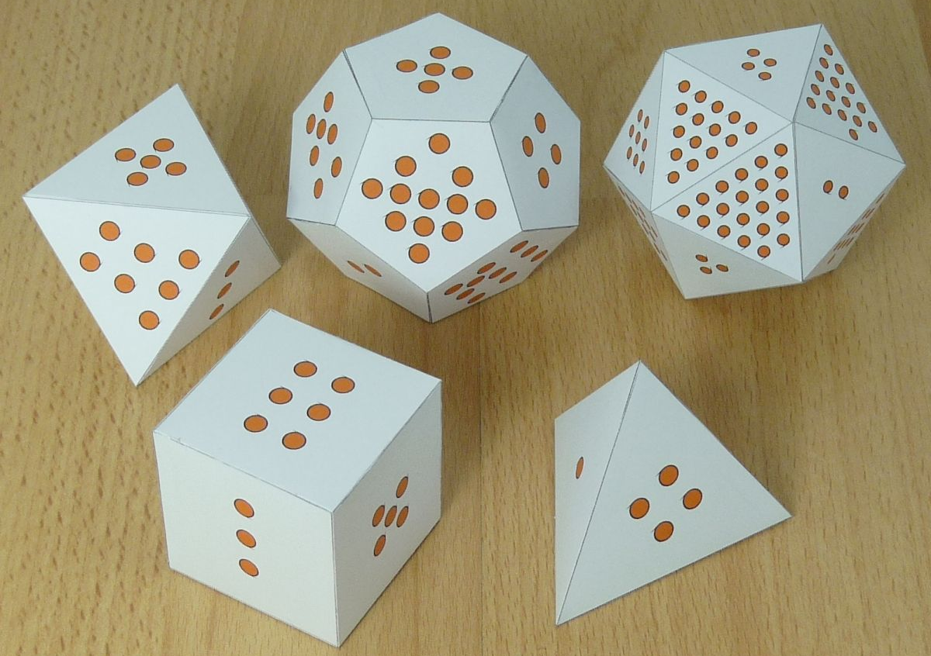

Uniform (generalization of a 6-sided die example)
5.3.6. Let X be a random variable that is equally likely to take on any of the values 1, 2, . . . , n, i.e.,
$$=\frac{1}{n}\sum_{i=1}^{n}{i}=\frac{1}{n}\frac{n\left(n+1\right)}{2}=\frac{n+1}{2}$$
We factored out 1/n and used identity: $\sum_{i=1}^{n}{i}=\frac{n\left(n+1\right)}{2}$
n | E[X]
4 | 2.5
6 | 3.5
8 | 4.5
12 | 6.5
20 | 10.5

Slide 7
5.3.7 Smaller or larger face of roll of 2 dice
If both dice show the same number, then take this to be the value of either face.
Here are the results calculated using Excel.

Slide 8
Baseball World Series length
5.3.12. If the two teams in a World Series have the same chance of winning each game, independent of the results of previously played games, then the probabilities that the series will end in 4, 5, 6, or 7 games are, respectively, 1/8, 1/4, 5/16, and 5/16. What is the expected number of games played in such a series?
So the series under the assumptions
will last on average about 5.8 games.
x | 4 | 5 | 6 | 7
p(x) | 1/8 | 1/4 | 5/16 | 5/16
Outcome |  |  |  | half of probability
6 | 5 nCr 2 | BBAAAA | 1 out of 64 | 10/64=5/32
 | ways to put | BABAAA
 | team B in | BAABAA
 | 2 different | :
 | locations | AAABBA
 | 10
7 | 6 nCr 3 | BBBAAAA | 1 out of 128 | 20/128=5/32
 | ways to put | BBABAAA
 | team B in | BBAABAA
 | 3 different | :
 | locations | AAABBBA
 | 20
Outcome |  |  |  | half of probability
4 |  | A A A A | 1 out of 16
5 | 4 places to | BAAAA | 1 out of 32 each | 4/32=1/8
 | put team B | ABAAA
 |  | AABAA
 |  | AAABA

Slide 9
5.3.1 Properties of Expected Values
Let X be a random variable with expected value E[X]. If c is a constant, then cX and X + c are also random variables and have expected values:
E[cX] = cE[X] (scaling)
E[X + c] = E[X] + c (translation)
Exercise: Put these properties into words.
Examples:
The government institutes an across the board 10% cut in salaries. How will the average salary be affected?
  Answer: The average salary will be cut by 10%: E[0.9X] = 0.9E[X]
The government institutes an across the board raise of $1000 in salaries. How will the average salary be affected?
  Answer: The average salary will be $1000 more: E[X + 1000] = E[X] + 1000

Slide 10
5.3.1 Another Property of Expected Values
Let X, Y be random variables, then X+Y is also an RV and:
E[X + Y] = E[X] + E[Y]
Example: in a mythical matriarchal country, there is one woman for every man and they are paired up to form household units.
On average, a man makes a $45k salary (due to domestic and childrearing responsibilities) and a woman makes a $63k salary.
What is the average household salary?
E[X + Y] = E[X] + E[Y] = $45k + $63k = $108k

Slide 11
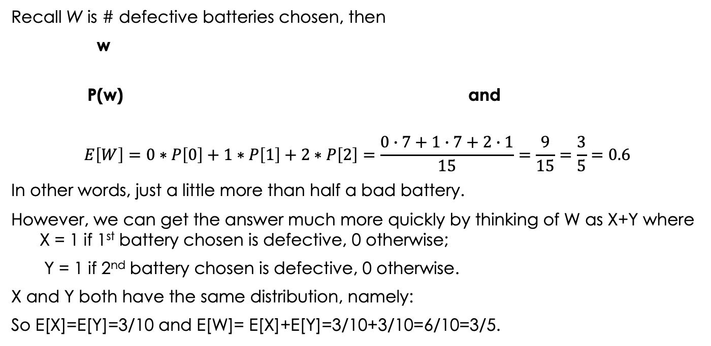
5.2.8 # bad batteries part 3
Recall W is # defective batteries chosen, then
w
P(w) and
$$E\left[W\right]=0∗P\left[0\right]+1∗P\left[1\right]+2∗P\left[2\right]=\frac{0∙7+1∙7+2∙1}{15}=\frac{9}{15}=\frac{3}{5}=0.6$$
In other words, just a little more than half a bad battery.
However, we can get the answer much more quickly by thinking of W as X+Y where X = 1 if 1st battery chosen is defective, 0 otherwise;
Y = 1 if 2nd battery chosen is defective, 0 otherwise.
X and Y both have the same distribution, namely:
So E[X]=E[Y]=3/10 and E[W]= E[X]+E[Y]=3/10+3/10=6/10=3/5.
X=Y | 0 | 1
P(x) or y | 7/10 | 3/10

Slide 12
More on properties of expectation
Properties of Expected Values
If c is a constant, then:
*E[cX] = cE[X] scale
E[X + c] = E[X] + c shift
For any random variables X and Y,
**E[X + Y] = E[X] + E[Y] sum
Example 1: single die expectation is 3.5, so sum of 2 dice expectation is 7.
Example 2: E[X − Y] = E[X] − E[Y] difference [combo of * (c = −1) and **]
Property ** extends to sum of more than 2 random variables
***3 X, Y, Z: E[X + Y + Z] = E[X] + E[Y] + E[Z]
****4 W, X, Y, Z: E[W + X + Y + Z] = E[W] + E[X] + E[Y] + E[Z]

Slide 13
Exercise:
Find the expectation for flipping a fair coin n times and counting the # of 1’s
Use n random variables with outcome 0 for tail and 1 for head.
Use properties **, ***, etc. to find expectation for 2, 3, 10 and n flips
flip a coin | expected number of heads
twice | E[X + Y] = E[X] + E[Y]
3 times | E[X + Y + Z] = E[X] + E[Y] + E[Z]=
10 times | E[X₁ + X₂ +…+ X₁₀] = E[X₁] + E[X₂ ] +…+ E[X₁₀]=
n times | E[X₁ + X₂ +…+ X_{n}] = E[X₁] + E[X₂ ] +…+ E[X_{n}]=

Slide 14
Exercise:
Find the expectation for flipping a fair coin n times and counting the # of 1’s
Use n random variables with outcome 0 for tail and 1 for head.
Use properties **, ***, etc. to find expectation for 2, 3, 10 and n flips
flip a coin | expected number of heads
twice | E[X + Y] = E[X] + E[Y] = ½ + ½
3 times | E[X + Y + Z] = E[X] + E[Y] + E[Z]
10 times | E[X₁ + X₂ +…+ X₁₀] = E[X₁] + E[X₂ ] +…+ E[X₁₀]
n times | E[X₁ + X₂ +…+ X_{n}] = E[X₁] + E[X₂ ] +…+ E[X_{n}]

Slide 15
Exercise:
Find the expectation for flipping a fair coin n times and counting the # of 1’s
Use n random variables with outcome 0 for tail and 1 for head.
Use properties **, ***, etc. to find expectation for 2, 3, 10 and n flips
flip a coin | expected number of heads
twice | E[X + Y] = E[X] + E[Y] = ½ + ½
3 times | E[X + Y + Z] = E[X] + E[Y] + E[Z] = ½ + ½ + ½ = 3/2
10 times | E[X₁ + X₂ +…+ X₁₀] = E[X₁] + E[X₂ ] +…+ E[X₁₀]
n times | E[X₁ + X₂ +…+ X_{n}] = E[X₁] + E[X₂ ] +…+ E[X_{n}]

Slide 16
Exercise:
Find the expectation for flipping a fair coin n times and counting the # of 1’s
Use n random variables with outcome 0 for tail and 1 for head.
Use properties **, ***, etc. to find expectation for 2, 3, 10 and n flips
flip a coin | expected number of heads
twice | E[X + Y] = E[X] + E[Y] = ½ + ½
3 times | E[X + Y + Z] = E[X] + E[Y] + E[Z] = ½ + ½ + ½ = 3/2
10 times | E[X₁ + X₂ +…+ X₁₀] = E[X₁] + E[X₂ ] +…+ E[X₁₀] = ½ + ½ + ½ + … + ½ = 10/2 = 5
n times | E[X₁ + X₂ +…+ X_{n}] = E[X₁] + E[X₂ ] +…+ E[X_{n}]

Slide 17
Exercise:
Find the expectation for flipping a fair coin n times and counting the # of 1’s
Use n random variables with outcome 0 for tail and 1 for head.
Use properties **, ***, etc. to find expectation for 2, 3, 10 and n flips
flip a coin | expected number of heads
twice | E[X + Y] = E[X] + E[Y] = ½ + ½
3 times | E[X + Y + Z] = E[X] + E[Y] + E[Z] = ½ + ½ + ½ = 3/2
10 times | E[X₁ + X₂ +…+ X₁₀] = E[X₁] + E[X₂ ] +…+ E[X₁₀] = ½ + ½ + ½ + … + ½ = 10/2 = 5
n times | E[X₁ + X₂ +…+ X_{n}] = E[X₁] + E[X₂ ] +…+ E[X_{n}] = ½ + ½ + ½ + … + ½ = n/2

Slide 18
5.4 VARIANCE OF RANDOM VARIABLES
We expect a random variable X to take on values around its mean E[X].
We might measure the spread of X by seeing how far (on average) X is from its mean, i.e.,
E[|X − μ|].
However, it turns out to be more useful to consider not the absolute value but the square of the difference from the mean:
Unfortunately, this expression has as units the square of the original ones, so we take the square root to get the standard deviation:

Slide 19
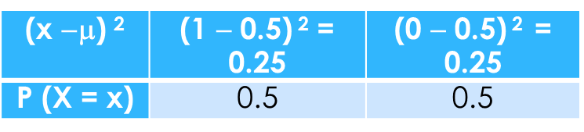
Var(X) for X, fair coin flip (h -> 1, t -> 0)
x | 1 | 0
P(X=x) | 0.5 | 0.5
First Solution (using definition of variance):
  Find the mean (expectation): μ = 1* 0.5 + 0* 0.5 = 0.5
  Find square of the deviation (difference) of each data value from mean:
  Multiply by the respective probabilities and sum to get variance.
  0.25*0.5 + 0.25*0.5 = 0.125 + 0.125 = 0.25
Take square root:
SD(X) = √Var(X) = √0.25 = 0.5
  Hence, on average (in fact always), outcomes are ½ unit from mean.
(x −$\text{}$) ² | (1 − 0.5) ² = 0.25 | (0 − 0.5) ² = 0.25
P (X = x) | 0.5 | 0.5

Slide 20
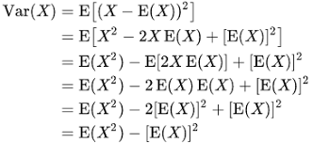

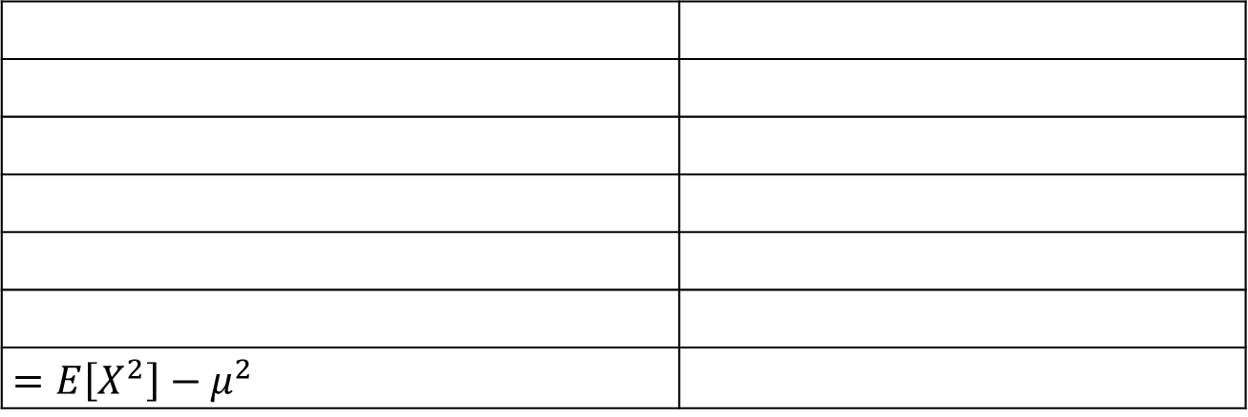
Theorem: $Var\left(X\right)=E\left[X^{2}\right]−μ^{2}$
What follows is a step by step proof of the Theorem.
Exercise: provide a justification for each step;
refer to properties of expectation (slide 3).
Definition of variance
Polynomial expansion
Expectation sum/difference
Expectation scale
Def of square
Polynomial simplify (-2+1=-1)
Substitution
$=E\left[X^{2}\right]−μ^{2}$

Slide 21
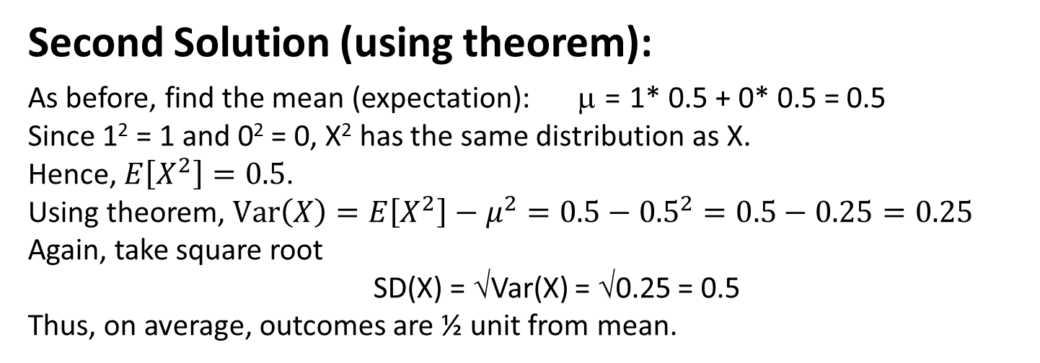
Var(X) for X, fair coin flip (h -> 1, t -> 0)
X = X² | 1 | 0
P(X) | 0.5 | 0.5
Second Solution (using theorem):
As before, find the mean (expectation): μ = 1* 0.5 + 0* 0.5 = 0.5
Since 1² = 1 and 0² = 0, X² has the same distribution as X.
Hence, $E\left[X^{2}\right]=0.5$.
Using theorem, $Var\left(X\right)=E\left[X^{2}\right]−μ^{2}=0.5−{0.5}^{2}=0.5−0.25=0.25$
Again, take square root
SD(X) = √Var(X) = √0.25 = 0.5
Thus, on average, outcomes are ½ unit from mean.

Slide 22
Example 5.12 (generalize to a bent or unfair coin)
Find Var(X) when X is defined by:
x | 1 | 0
P(X=x) | p | 1 − p
Solution: use definition. (Exercise: use theorem.)
Find the mean (expectation): μ = 1 * p + 0 (1 − p) = p
2. For each possible outcome, find square of the deviation (difference) from mean:
(x − μ)² | (1 − p)² | (0 − p)²
P(X = x) | p | 1 − p
3. Multiply by respective probabilities, sum to get variance, then simplify:
4. Take square root to get:
In the Excel file, these expressions are calculated for various values of p.

Slide 23
Problem 5.4.13v. A lawyer charges a fixed fee of $2000 or takes a contingency fee of $8000 if she wins the case (and $0 if she loses).
She estimates that her probability of winning is 0.3.
Determine the expectation and standard deviation of her fee if
(a) She takes the fixed fee.
(b) She takes the contingency fee.
(c) Do you think the lawyer’s fee structure is fair? Explain.
(a) (b)
See the Excel file for the formulas of the calculations for (b).
(c) Yes, people generally expect higher compensation if there is risk or uncertainty.
Fixed | X | 2000
 | P(X) | 1
 | E[X] | 2000
 | SD[X] | 0
Contigency fee | X | 8000 | 0
 | P(X) | 0.3 | 0.7
 |  | 2400 | 0
 | E[X] | 2400
 | (X-𝜇)^2 | 31360000 | 5760000
 | P(X) | 0.3 | 0.7
 |  | 9408000 | 4032000
 | V[X] | 13440000
 | SD[X] | 3666.061

Slide 24

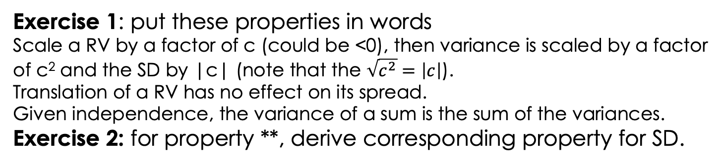
Properties of Variance and SD
For any RV X and scalar c:
*
If X and Y are independent:
**
$$SD\left(X+Y\right)= ___________?$$
Exercise 1: put these properties in words
Scale a RV by a factor of c (could be <0), then variance is scaled by a factor of c² and the SD by |c| (note that the $\sqrt{c^{2}}=\left|c\right|$).
Translation of a RV has no effect on its spread.
Given independence, the variance of a sum is the sum of the variances.
Exercise 2: for property **, derive corresponding property for SD.

Slide 25
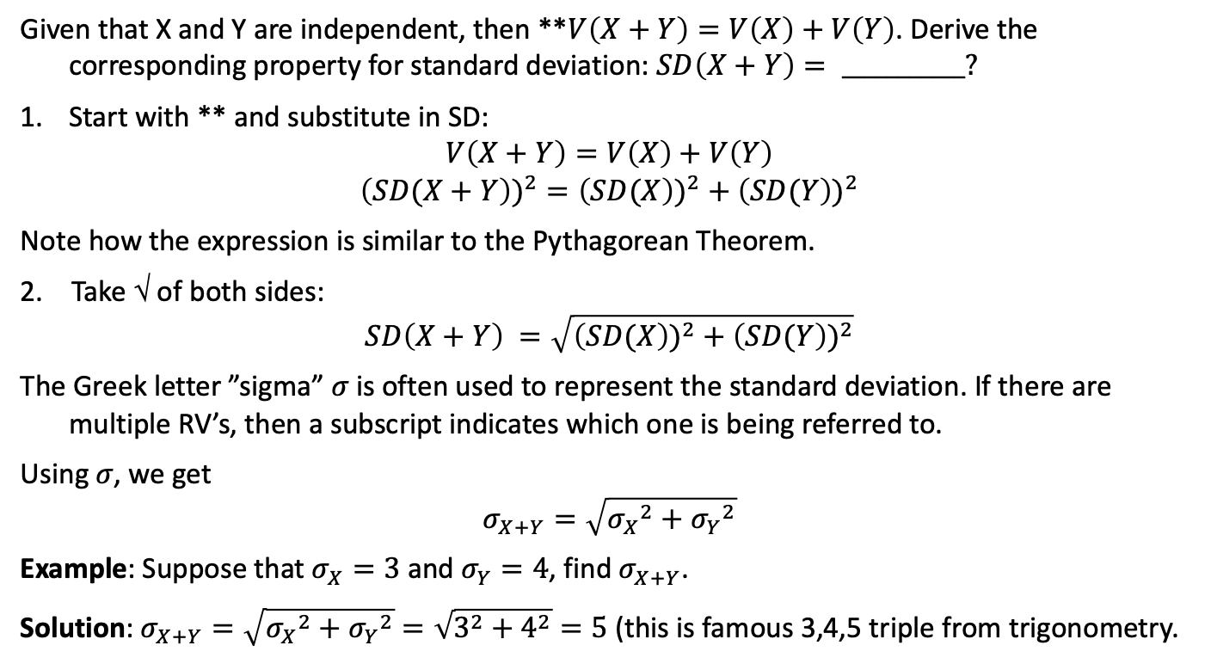
Solution to Exercise 2
Given that X and Y are independent, then **$V\left(X+Y\right)=V\left(X\right)+V\left(Y\right)$. Derive the corresponding property for standard deviation: $SD\left(X+Y\right)= ___________?$
Start with ** and substitute in SD:
$$V\left(X+Y\right)=V\left(X\right)+V\left(Y\right)$$
$${\left(SD(X+Y\right))}^{2}={\left(SD(X\right))}^{2}+{\left(SD(Y\right))}^{2}$$
Note how the expression is similar to the Pythagorean Theorem.
2. Take √ of both sides:
$$SD\left(X+Y\right) =\sqrt{{\left(SD(X\right))}^{2}+{\left(SD(Y\right))}^{2}}$$
The Greek letter ”sigma” 𝜎 is often used to represent the standard deviation. If there are multiple RV’s, then a subscript indicates which one is being referred to.
Using 𝜎, we get
$$σ_{X+Y}=\sqrt{{σ_{X}}^{2}+{σ_{Y}}^{2}}$$
Example: Suppose that $σ_{X}=3$ and $σ_{Y}=4$, find $σ_{X+Y}$.
Solution: $σ_{X+Y}=\sqrt{{σ_{X}}^{2}+{σ_{Y}}^{2}}=\sqrt{3^{2}+4^{2}}=5$ (this is famous 3,4,5 triple from trigonometry.

Slide 26
Two spread property problems
5.4.7v. If SD(X) = 4, what is Var(3X)?
Solution: Var(X) = 16, now use prop *: Var(3X)=3²Var(X)=9*16=144
5.4.18v. If SD(3X + 2) = 9, what is Var(X)?
Solution: translation has no effect on spread, so SD(3X) = 9
By prop *: SD(3X)=|3|SD(X) = 3*SD(X).
Substituting in and dividing both sides by 3: SD(X) = 3.
Finally, squaring both sides: Var(X)=(SD(X))² = 9

Slide 27
Another spread property problem
5.4.19. If X and Y are independent random variables,
both having variance 1, find
(a) Var(X + Y)
(b) Var(X − Y)
Solution:
Using prop **, Var(X + Y) = Var(X) + Var(Y) = 1 + 1 = 2
(note, SD(X + Y)=√2 (not 2))
(b) The answer is not 0! Var(X - Y) = Var(X) - Var(Y) = 1 - 1 = 0
We start with prop **:
Var(X − Y) = Var(X +(−1)*Y) = Var(X ) + Var((−1)*Y)
Now we use prop *:
= Var(X ) + (-1)²Var(Y) = 1 + 1*1 = 2

