Slide 1
MAT 1372 statistics with probability
Lesson 07, Part I: probability basics

Slide 2
Randomness and Probabilities
Say you’re listening to music on your phone and you hit ‘shuffle’. Your phone randomly selects one track to play from your library of songs.
What is the chance that your single most favorite song is played?
Pressing “shuffle” on your phone is an example of a random trial.
A ‘random trial’ is a process or experiment with two or more outcomes whose occurrence cannot be predicted with certainty.

Slide 3
Defining probability
First, we must determine all possible outcomes for a random trial.
- There are 2350 songs on my phone. Each song represents a possible outcome when I hit “shuffle”.
Then, we must define the event of interest.
An “event of interest” is the subset of possible outcomes in which we are interested.
There is just one “single most favorite song” on my phone.
Other possible events of interest might be “songs rated 5-stars”; “songs by MF DOOM”; or “songs longer than 8 minutes”

Slide 4
Probability
The probability of an event is the proportion of all random trials in which the specified event occurs, provided that the same random process is repeated over and over again independently and under the same conditions. (Probabilities range from 0 to 1.)
Notation: We use Pr[A] or P(A) to represent “probability of event A”
Example: suppose we flip a fair coin, then
Pr[heads]=Pr[tails]=1/2

Slide 5
Probability example
Example: suppose we have 112 songs by MF DOOM and 155 songs longer than 8 minutes, then
Pr[playing my single most favorite song] = 1/2350 ≈ 0.00043
Pr[playing a song by MF DOOM] = 112/2350 ≈4.8%
Pr[playing a song longer than 8 minutes] = 155/2350 ≈ 6.3%

Slide 6
Dice
Exercise: a six-sided die.
What are the possible outcomes of rolling the die?
(i.e., What is the sample space?)
Pr[rolling a four] = ______
Pr[rolling an even number] = ______
Pr[rolling a number greater than two] = _______

Slide 7
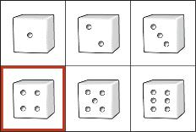
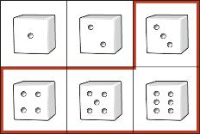
Using a venn diagram
What is Pr[rolling a four] = ?
What is Pr[rolling a number greater than two] = ?

Slide 8
Why do we study dice, coins & cards?
They are simple and familiar, and so it’s easier to think about the structure of probability in this context.
The same issues, structure and properties that we see with
rolling dice
flipping coins
drawing cards
are also present in important (non-gambling) applications:
Medical informatics: mutations and health issues
Astronomy: distance, age and collision prediction
Engineering: fatigue, deterioration and risks

Slide 9
Mutual exclusivity
Two events are mutually exclusive if they cannot both occur at the same time.
Events A and B are mutually exclusive if Pr[A and B] = 0
(the probability that both events occur at once is zero).
For example: A six-sided die cannot roll two different numbers simultaneously. Rolling a two and rolling a three are mutually exclusive events.
Non-example: A six-sided die can
roll an even number and a multiple of three at the same time.
These two events are NOT mutually exclusive.
Pr[even and multiple of 3]=Pr[6]=1/6 (if die is fair) ≠ 0

Slide 10
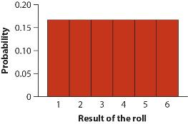
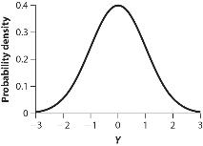
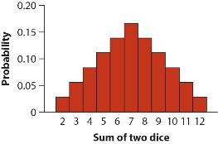
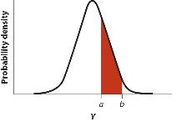
Discrete vs. continuous distributions intro
Discrete Probability Distribution
Continuous Probability Distribution
Probabilities of individual outcomes are zero. To get a positive probability, you must have an interval of outcomes.
Probabilities of individual outcomes are nonzero.

Slide 11
Discrete vs. continuous distributions details
Discrete Probability Distribution
In a discrete probability distribution, the variable is either discrete numeric or categorical.
Each rectangle has an area that is proportional to the probability of each discrete event occurring.
Continuous Probability Distribution
In a continuous distribution, the explanatory variable is continuous numeric.
The probability of any particular value occurring is zero. [Imagine the probability of hitting a specific point on a dartboard.]
Because of this, probabilities are measured for ranges of values. [regions on a dartboard)

Slide 12
MAT 1372 statistics with probability
Lesson 7, part ii: AND, OR, and NOT IN PROBABILITY

Slide 13
THE OR COMBINATION OF EVENTS
Given two events, “event A or event B” is itself a new event;
If the events A and B are mutually exclusive, the probability of A or B is the sum of the probabilities of each event A and B
Pr[A or B] = Pr[A] + Pr[B]

Slide 14
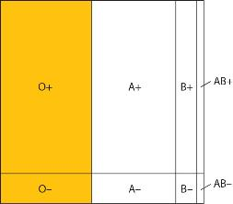
Mutually exclusive Blood types
A person cannot have two different types of blood – so the two events, “having Type O-” and “having Type O+” are mutually exclusive.
Type O is depicted in yellow in the diagram.
It is the union of two mutually exclusive types: O+ and O-.
So Pr[O] = Pr[Type O-] + Pr[Type O+]

Slide 15
Chance of type o for the Latinx population
Example: What is the probability of a random Latinx individual having “O” blood?
The 2 events O+ and O- are mutually exclusive, so for a Latinx individual:
Pr[O] = Pr[Type O+] + Pr[Type O-] = 0.53 + 0.04 = 0.57

Slide 16
Chance of type + for the Latinx population
Exmpl: What is probability of random Latinx individual having “+” blood?
The 4 events O+, A+, B+ and AB+ are mutually exclusive, so for a Latinx individual:
Pr[+] = Pr[O+] + Pr[A+] + Pr[B+] + Pr[AB+] = 0.53 + 0.29 + 0.09 + 0.02 =0.93

Slide 17
“NOT” – the opposite of an event
Probability of an event NOT occurring is whatever is left out of 100%.
Symbolically:
Pr[~A] = Pr[A^{c}] = Pr[not A] = 1 – Pr[A]
Probabilities may be written as proportions instead of percentages… e.g., 100% = 1.00

Slide 18
A not example for Blood types
What is the chance of someone not having Type O, in another words, the chance of having A, B or AB.
Type O is depicted in yellow in the diagram.
Not O are all the parts in white:
Pr[not O] = 1 - Pr[Type O]

Slide 19
Chance of not o for the Latinx population
Example: What is the probability of a random Latinx individual having “not O” blood?
Recall that Pr[type O] = Pr[Type O+] + Pr[O-] = 0.53 + 0.04 = 0.57
So Pr[not O] = 1 - Pr[Type O] = 1 – 0.57 = 0.43 or 43%

Slide 20
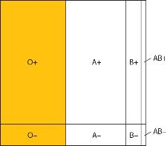
“OR” for non-mutually exclusive events
What happens if two events are NOT mutually exclusive, but we still want to know the probability of getting one event OR the other event?
We still add the probabilities of each event together…
But we might be counting some outcomes TWICE! (because some outcomes belong to BOTH events)
+: having positive blood type: light blue + overlap green
O: Having type O blood: yellow + overlap green
+ or O: having type + or O or both: any colored area
If we add Pr[+] + Pr[O], what is double-counted?
O+
So Pr[+ OR O] = Pr[+] + Pr[O] ⎼ PR[O+]

Slide 21
The general addition property
There are 2 formulas to calculate the probability of “event A” OR “event B”, depending on whether events have overlap (outcomes common to both events).
Mutually Exclusive:
Pr[A or B] = Pr[A] + Pr[B]
Not Mutually Exclusive:
Pr[A or B] = Pr[A] + Pr[B] – Pr[A and B]

Slide 22
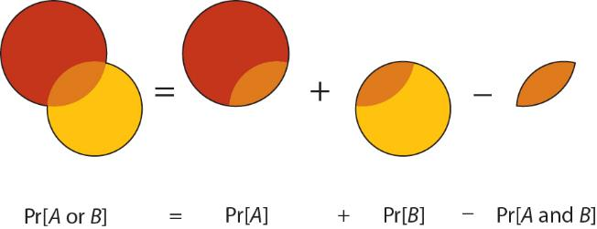
Depiction of or for overlapping events

Slide 23
Chance of type + or O for Latinx population
Example: What is the probability of a random Latinx individual having “+” or “O” blood?
Recall Pr[+] =0.92 and Pr[O] = 0.57, also note that
Pr[+ and O] = Pr[O+] = 0.53
Hence Pr[+ or O] = Pr [+] + Pr[O] – Pr[O+] = 0.92 +0.57 - 0.53 = 0.96
Note that due to roundoff error, the numbers may not match up.

Slide 24
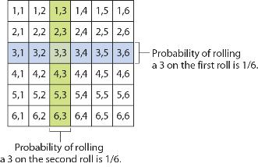
One approach to Independence
Two events are independent if the chance of one event occurring does not affect the chances of the other event occurring.
Example: Rolling a die twice. Do the odds of rolling a three on a six-sided die change if you roll the die more than once?

Slide 25
Multiplication test for independence
Two events A and B are independent
if and only
if Pr[A and B] = Pr[A] x Pr[B]

Slide 26
Using multiplication test for our die example
Recall that we roll a die twice and our events are:
1st roll is 3;
2nd roll is 3.
Are these events independent?
Using the multiplication test:
Pr[(1st roll is 3) and (2nd roll is 3)] =? Pr[1st roll is 3] x Pr[2nd roll is 3]
1/36 =? 1/6 * 1/6
Clearly true, so answer is yes, i.e.,
Rolling a die twice, the events
1st roll is 3
2nd roll is 3
are independent.

Slide 27
Non-example of independence (part 1)
Drawing a card with specific denomination twice from deck of playing cards without replacement.
What are the odds of drawing a 7 on the first attempt (call it event A)?
There are 52 cards and 13 denominations: (Ace, 2, 3, …., 10, J, Q, K)
Each denominations is on 4 cards, one for each suit
clubs (♣), spades (♠), hearts (♥) and diamonds (♦)
Hence Pr[A] = 4/52 = 1/13
It turns out that chance of getting 7 on 2nd card (call it event B) is same as chance of getting 7 on 1st card if we ignore what 1st card was, i.e., Pr[B] = 1/13

Slide 28
Non-example of independence (part 2)
Suppose that you get a 7 on the 1st draw, what is the chance of getting a 7 on the 2nd draw? (this is called a conditional probability)
For the 2nd draw, there are only 51 cards left to choose from. Of those only 3 have 7 as the denomination, so Pr[B given A] = 3/51 = 1/17
[Note how getting 7 on 1st draw lowers chance of getting 7 on 2nd draw.]
The chance that both cards are 7 is the product of the chance of getting a 7 on the first draw and this last probability: Pr[A and B] = 1/13 * 1/17
Is getting a 7 on the first draw independent of getting a 7 on the 2nd draw?
We use the multiplication test:
Pr[A and B] =? Pr[A] x Pr[B]
1/13*1/17 =? 1/13 x 1/13 clearly false so:
If we select 2 cards without replacement, the events
7 is 1st draw
7 is 2nd draw
are NOT independent.

