Slide 1
MAT 1372 Statistics with Probability
Sections 12.2-3 linear regression
aka trend line

Slide 2
Review of 2.5, 3.7: correlation
Given 2 numeric variables that are linked, draw a scatter plot.
Are the points scattered randomly?
If not, do the variables form a pattern or relate to one another?
  Does a simple linear regression model appear to be reasonable?
In the next few slides, we provide the scatter plots of a few 2-variable data sets and provide discussion.

Slide 3
12.2.2 # workers on duty and theft
A manager in a department store studies the relationship between # workers on duty & value of merchandise lost to shoplifters. The results are as follows:
Wk #workers Loss
1 9 420
2 11 350
3 12 360
4 13 300
5 15 225
6 18 200
7 16 230
8 14 280
9 12 315
10 10 410
There is a strong negative linear relation and the correlation coefficient r is -.97.

Slide 4
Revisit of 3.7.8 milk vs soda consumption
Clearly there is little linear relation between the variables.

Slide 5
Revisit of 3.7.8 milk vs soda consumption
Even if we remove the 2 outliers and focus on the main cluster, there is still no linear relation evident.

Slide 6
Revisit of 2.5.7 GPA vs study time
Clear positive relation between the variables.
Coefficient of determination is r²=69%, meaning up to 69% of a student’s gpa is due to study time.
In cw5, the slope was found to be 0.1/2.4 in other words, if a student studies an additional 2.4 hrs/wk, the gpa will ↑ by 0.1 on average

Slide 7
Chicken or the egg?
Another question that could be asked:
Which variable is the explanatory, and which is the response?
As we found with the cw4 IQ vs attention span, it might make more sense to use the IQ as the explanatory variable.
Sometimes there is a “which came first the chicken or the egg?” question, e.g., our last example 12.2.3 having to do with speed and traffic density.

Slide 8
12.2 SIMPLE LINEAR REGRESSION MODEL
Consider a pair of variables, one of which is called the input or explanatory variable and the other the output or response variable. For a specified input x, we express response as
Y = A + Bx + e.
A and B are parameters or constants that we would like to determine.
e is the error which varies for each data point and is the vertical signed distance between the data point and the line.
Regression is the process of finding the A and B which minimize the errors in some way.

Slide 9
12.3 ESTIMATING THE REGRESSION PARAMETERS
The most common way of collecting the errors is to sum their squares, called least-square estimation.
For given data pairs, we want to find values of A and B which minimize

Slide 10
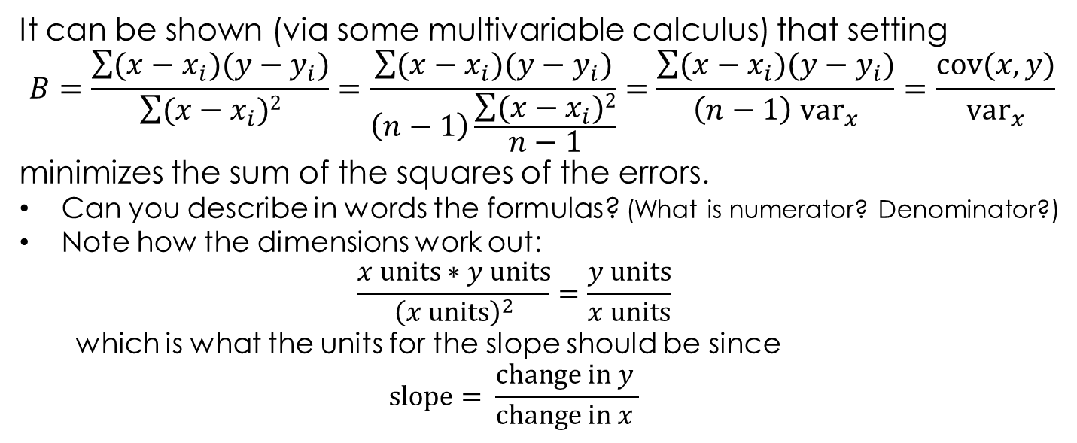
Regression slope B formula
It can be shown (via some multivariable calculus) that setting
$$B=\frac{\sum{(x−x_{i})(y−y_{i})}}{\sum{(x−x_{i})2}}=\frac{\sum{(x−x_{i})(y−y_{i})}}{\left(n−1\right)\frac{\sum{(x−x_{i})2}}{n−1}}=\frac{\sum{(x−x_{i})(y−y_{i})}}{\left(n−1\right){ \text{v}\text{ar}}_{x}}=\frac{\text{cov}(x,y)}{{\text{v}\text{ar}}_{x}}$$
minimizes the sum of the squares of the errors.
Can you describe in words the formulas? (What is numerator? Denominator?)
Note how the dimensions work out:
  $$\frac{x \text{units}∗y \text{units}}{{\left(x \text{units}\right)}^{2}}=\frac{y \text{units}}{x \text{units}}$$
  which is what the units for the slope should be since
  $$\text{slope}= \frac{\text{change} \text{in} y }{\text{change} \text{in} x }$$

Slide 11
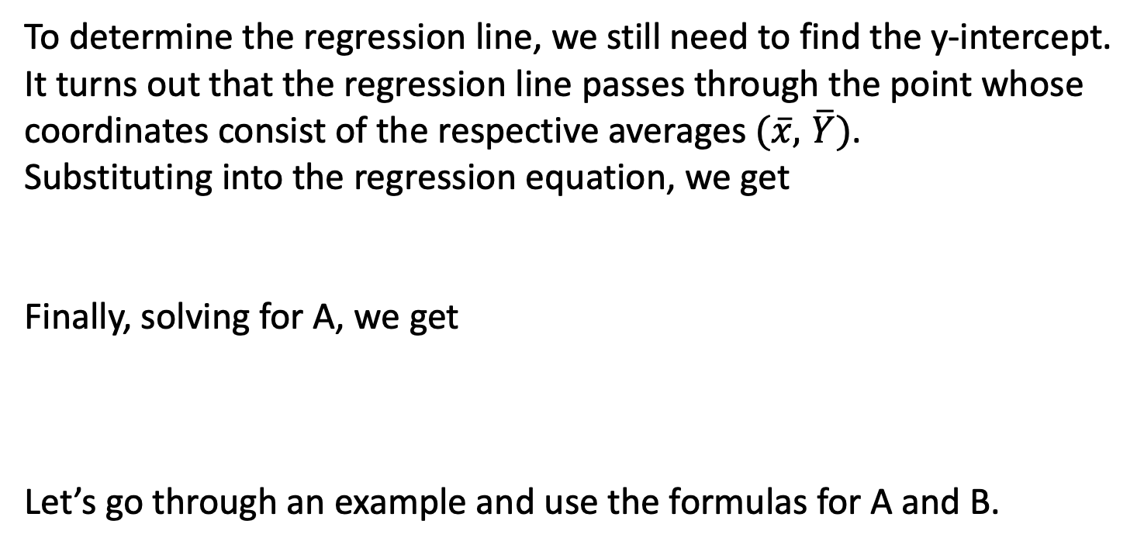
Regression Intercept A formula
To determine the regression line, we still need to find the y-intercept.
It turns out that the regression line passes through the point whose coordinates consist of the respective averages $(\overline{x},$ $\overline{Y})$.
Substituting into the regression equation, we get
Finally, solving for A, we get
Let’s go through an example and use the formulas for A and B.

Slide 12
12.2.3 speed vs traffic density
The following data relate the traffic density, described in # of automobiles per mile, to average speed of traffic in mph.
Data were collected at the same location at 10 different times within a span of 3 months.
Density Speed
69 25.4
56 32.5
62 28.6
119 11.3
84 21.3
74 22.1
73 22.3
90 18.5
38 37.2
22 44.6
As you can see from the plot, there is strong negative linear relation between the variables.

Slide 13
12.2.3 speed vs traffic density
The following data relate the traffic density, described in # of automobiles per mile, to average speed of traffic in mph.
Data were collected at the same location at 10 different times within a span of 3 months.
Density | Speed | xdev | ydev | xdev^2 | prod
69 | 25.4 | 0.3 | -0.98 | 0.09 | -0.294
56 | 32.5 | -12.7 | 6.12 | 161.3 | -77.724
62 | 28.6 | -6.7 | 2.22 | 44.89 | -14.874
119 | 11.3 | 50.3 | -15.08 | 2530 | -758.52
84 | 21.3 | 15.3 | -5.08 | 234.1 | -77.724
74 | 22.1 | 5.3 | -4.28 | 28.09 | -22.684
73 | 22.3 | 4.3 | -4.08 | 18.49 | -17.544
90 | 18.5 | 21.3 | -7.88 | 453.7 | -167.84
38 | 37.2 | -30.7 | 10.82 | 942.5 | -332.17
22 | 44.6 | -46.7 | 18.22 | 2181 | -850.87
 | density | speed
mean | 68.7 | 26.4
std dev | 27.1 | 9.7
count | 10
sum of xdevs^2 | 6594
sum of prods | -2320
r | -0.98
r^2 | 97%
B | -0.35
A | 50.6
If there are 3 additional cars per mile, then the average speed ↓ by 1 mph
If there are 15 additional cars per mile, then the average speed ↓ by 5 mph
As those of you who have experienced traffic can testify, there is a negative feedback in speed with corresponding positive feedback in density,
meaning more traffic leads to slower speeds which increases density which further decreases speeds.

Slide 14
12.2.4 √speed vs traffic density
The following data relate the traffic density, described in # of automobiles per mile, to average speed of traffic in mph.
Data were collected at the same location at 10 different times within a span of 3 months.
Note how the regression line is now an excellent fit to the data.
We can write the equation as √s=A+B*D, B=-.035 which is ~1/30
If there are 30 additional cars per mile, then the square root of the average speed↓ by 1 √(mph)
If you were traveling at say 49 mph=(7 √mph)^2 then your speed would now be 36 mph=(6 √mph)^2
Moral of story is that often it is transformations of the variables that are related.

Slide 15
Chapter 12 beyond section 12.3
Versions of course outline put linear regression after hypothesis testing.
Determining the statistics (r, B and A) does not end the story unless the data has been collected from the entire population (say in a census).
In real life, data is a sample taken from a population:
  The result are the statistics r, B and A.
  We want to say something about the corresponding parameters
  (the values of r, B and A for the entire population).
  Assuming no bias, the statistics are only estimates of the parameters.
Can we determine with say 95% certainty that there is linear correlation at all?
While we will not have time in the course to come back to systematically finish the chapter to answer these questions, I encourage you to do so on your own.

