Slide 1
Lesson #12
MAT 1372 Statistics with Probability

Slide 2
Binomial Experiments
The experiment is repeated for a fixed number of trials, where each trial is independent of other trials.
There are only two possible outcomes of interest for each trial. The outcomes can be classified as a success (S) or as a failure (F).
The probability of a success P(S) is the same for each trial.
The random variable x counts the number of successful trials.
© 2012 Pearson Education, Inc. All rights reserved.
2 of 63

Slide 3
Notation for Binomial Experiments
Symbol | Description
n | The number of times a trial is repeated
p = P(S) | The probability of success in a single trial
q = P(F) | The probability of failure in a single trial (q = 1 – p)
x | The random variable represents a count of the number of successes in n trials: x = 0, 1, 2, 3, … , n.
© 2012 Pearson Education, Inc. All rights reserved.
3 of 63

Slide 4
Example: Binomial Experiments
Decide whether the experiment is a binomial experiment. If it is, specify the values of n, p, and q, and list the possible values of the random variable x.
A certain surgical procedure has an 85% chance of success. A doctor performs the procedure on eight patients. The random variable represents the number of successful surgeries.
© 2012 Pearson Education, Inc. All rights reserved.
4 of 63

Slide 5
Solution: Binomial Experiments
Binomial Experiment
Each surgery represents a trial. There are eight surgeries, and each one is independent of the others.
There are only two possible outcomes of interest for each surgery: a success (S) or a failure (F).
The probability of a success, P(S), is 0.85 for each surgery.
The random variable x counts the number of successful surgeries.
© 2012 Pearson Education, Inc. All rights reserved.
5 of 63

Slide 6
Solution: Binomial Experiments
Binomial Experiment
n = 8 (number of trials)
p = 0.85 (probability of success)
q = 1 – p = 1 – 0.85 = 0.15 (probability of failure)
x = 0, 1, 2, 3, 4, 5, 6, 7, 8 (number of successful surgeries)
© 2012 Pearson Education, Inc. All rights reserved.
6 of 63

Slide 7
Example: Binomial Experiments
Decide whether the experiment is a binomial experiment. If it is, specify the values of n, p, and q, and list the possible values of the random variable x.
A jar contains five red marbles, nine blue marbles, and six green marbles. You randomly select three marbles from the jar, without replacement. The random variable represents the number of red marbles.
© 2012 Pearson Education, Inc. All rights reserved.
7 of 63

Slide 8
Solution: Binomial Experiments
Not a Binomial Experiment
The probability of selecting a red marble on the first trial is 5/20.
Because the marble is not replaced, the probability of success (red) for subsequent trials is no longer 5/20.
The trials are not independent and the probability of a success is not the same for each trial.
© 2012 Pearson Education, Inc. All rights reserved.
8 of 63

Slide 9
Binomial Probability Formula
Binomial Probability Formula
The probability of exactly x successes in n trials is
n = number of trials
p = probability of success
q = 1 – p probability of failure
x = number of successes in n trials
© 2012 Pearson Education, Inc. All rights reserved.
9 of 63

Slide 10
Example: Finding Binomial Probabilities
Microfracture knee surgery has a 75% chance of success on patients with degenerative knees. The surgery is performed on three patients. Find the probability of the surgery being successful on exactly two patients.
© 2012 Pearson Education, Inc. All rights reserved.
10 of 63

Slide 11
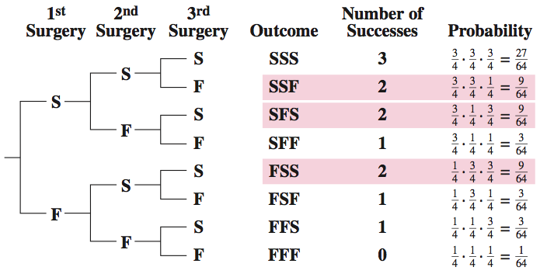
Solution: Finding Binomial Probabilities
Method 1: Draw a tree diagram and use the Multiplication Rule
© 2012 Pearson Education, Inc. All rights reserved.
11 of 63

Slide 12
Solution: Finding Binomial Probabilities
Method 2: Binomial Probability Formula
© 2012 Pearson Education, Inc. All rights reserved.
12 of 63

Slide 13
Binomial Probability Distribution
Binomial Probability Distribution
List the possible values of x with the corresponding probability of each.
Example: Binomial probability distribution for Microfracture knee surgery: n = 3, p =
  Use the binomial probability formula to find probabilities.
x | 0 | 1 | 2 | 3
P(x) | 0.016 | 0.141 | 0.422 | 0.422
© 2012 Pearson Education, Inc. All rights reserved.
13 of 63

Slide 14

Example: Constructing a Binomial Distribution
In a survey, U.S. adults were asked to give reasons why they liked texting on their cellular phones. Seven adults who participated in the survey are randomly selected and asked whether they like texting because it is quicker than
calling. Create a binomial probability distribution for the number of adults who respond yes.
© 2012 Pearson Education, Inc. All rights reserved.
14 of 63

Slide 15
Solution: Constructing a Binomial Distribution
56% of adults like texting because it is quicker than calling.
n = 7, p = 0.56, q = 0.44, x = 0, 1, 2, 3, 4, 5, 6, 7
P(0) = ₇C₀(0.56)⁰(0.44)⁷ = 1(0.56)⁰(0.44)⁷ ≈ 0.0032
P(1) = ₇C₁(0.56)¹(0.44)⁶ = 7(0.56)¹(0.44)⁶ ≈ 0.0284
P(2) = ₇C₂(0.56)²(0.44)⁵ = 21(0.56)²(0.44)⁵ ≈ 0.1086
P(3) = ₇C₃(0.56)³(0.44)⁴ = 35(0.56)³(0.44)⁴ ≈ 0.2304
P(4) = ₇C₄(0.56)⁴(0.44)³ = 35(0.56)⁴(0.44)³ ≈ 0.2932
P(5) = ₇C₅(0.56)⁵(0.44)² = 21(0.56)⁵(0.44)² ≈ 0.2239
P(6) = ₇C₆(0.56)⁶(0.44)¹ = 7(0.56)⁶(0.44)¹ ≈ 0.0950
P(7) = ₇C₇(0.56)⁷(0.44)⁰ = 1(0.56)⁷(0.44)⁰ ≈ 0.0173
© 2012 Pearson Education, Inc. All rights reserved.
15 of 63

Slide 16
Solution: Constructing a Binomial Distribution
x | P(x)
0 | 0.0032
1 | 0.0284
2 | 0.1086
3 | 0.2304
4 | 0.2932
5 | 0.2239
6 | 0.0950
7 | 0.0173
All of the probabilities are between 0 and 1 and the sum of the probabilities is 1.
© 2012 Pearson Education, Inc. All rights reserved.
16 of 63

Slide 17
Example: Finding Binomial Probabilities Using Technology
The results of a recent survey indicate that 67% of U.S. adults consider air conditioning a necessity. If you randomly select 100 adults, what is the probability that exactly 75 adults consider air conditioning a necessity? Use a technology tool to find the probability. (Source: Opinion Research Corporation)
Solution:
Binomial with n = 100, p = 0.67, x = 75
© 2012 Pearson Education, Inc. All rights reserved.
17 of 63

Slide 18
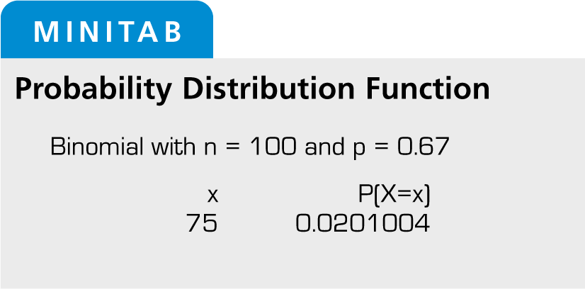
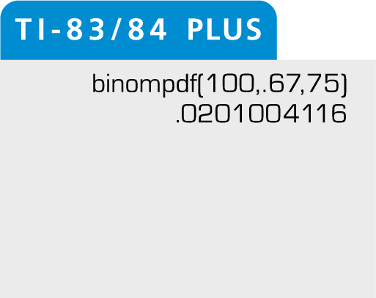
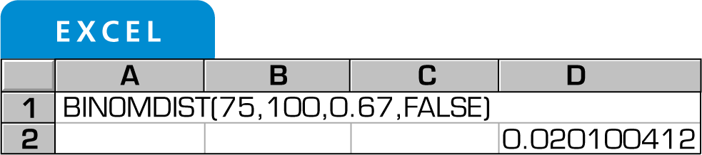
Solution: Finding Binomial Probabilities Using Technology
From the displays, you can see that the probability that exactly 75 adults consider air conditioning a necessity is about 0.02.
© 2012 Pearson Education, Inc. All rights reserved.
18 of 63

Slide 19
Example: Finding Binomial Probabilities
A survey indicates that 41% of women in the U.S. consider reading their favorite leisure-time activity. You randomly select four U.S. women and ask them if reading is their favorite leisure-time activity. Find the probability that at least two of them respond yes.
Solution:
n = 4, p = 0.41, q = 0.59
At least two means two or more.
Find the sum of P(2), P(3), and P(4).
© 2012 Pearson Education, Inc. All rights reserved.
19 of 63

Slide 20
Solution: Finding Binomial Probabilities
P(2) = ₄C₂(0.41)²(0.59)² = 6(0.41)²(0.59)² ≈ 0.351094
P(3) = ₄C₃(0.41)³(0.59)¹ = 4(0.41)³(0.59)¹ ≈ 0.162654
P(4) = ₄C₄(0.41)⁴(0.59)⁰ = 1(0.41)⁴(0.59)⁰ ≈ 0.028258
P(x ≥ 2) = P(2) + P(3) + P(4)
≈ 0.351094 + 0.162654 + 0.028258
≈ 0.542
© 2012 Pearson Education, Inc. All rights reserved.
20 of 63

Slide 21
Example: Finding Binomial Probabilities Using a Table
About ten percent of workers (16 years and over) in the United States commute to their jobs by carpooling. You randomly select eight workers. What is the probability that exactly four of them carpool to work? Use a table to find the probability. (Source: American Community Survey)
Solution:
Binomial with n = 8, p = 0.10, x = 4
© 2012 Pearson Education, Inc. All rights reserved.
21 of 63

Slide 22
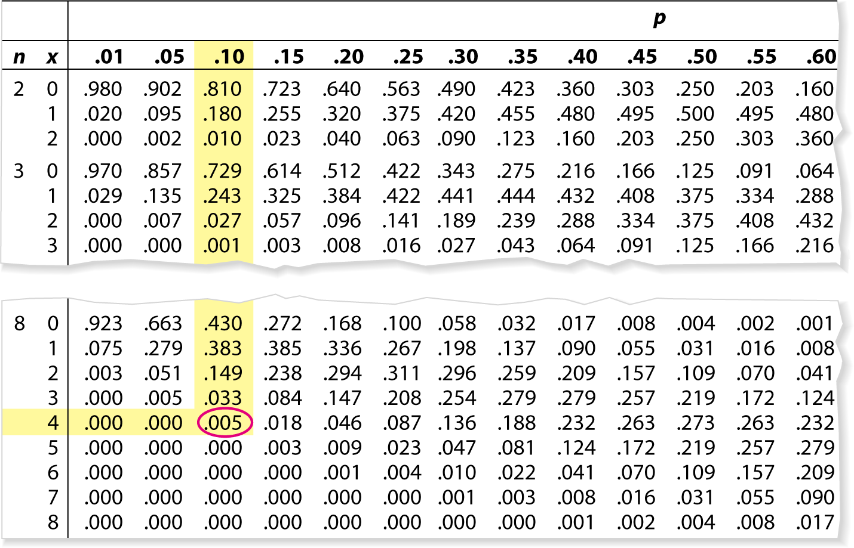
Solution: Finding Binomial Probabilities Using a Table
A portion of Table 2 is shown
The probability that exactly four of the eight workers carpool to work is 0.005.
© 2012 Pearson Education, Inc. All rights reserved.
22 of 63

Slide 23
Example: Graphing a Binomial Distribution
Sixty percent of households in the U.S. own a video game console. You randomly select six households and ask each if they own a video game console. Construct a probability distribution for the random variable x. Then graph the distribution. (Source: Deloitte, LLP)
Solution:
n = 6, p = 0.6, q = 0.4
Find the probability for each value of x
© 2012 Pearson Education, Inc. All rights reserved.
23 of 63

Slide 24
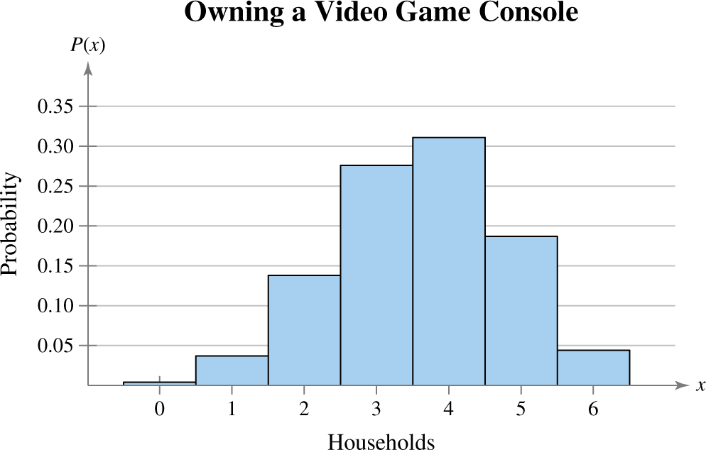
Solution: Graphing a Binomial Distribution
x | 0 | 1 | 2 | 3 | 4 | 5 | 6
P(x) | 0.004 | 0.037 | 0.138 | 0.276 | 0.311 | 0.187 | 0.047
Histogram:
© 2012 Pearson Education, Inc. All rights reserved.
24 of 63

Slide 25
Mean, Variance, and Standard Deviation
Mean: μ = np
Variance: σ² = npq
Standard Deviation:
© 2012 Pearson Education, Inc. All rights reserved.
25 of 63

Slide 26
Example: Finding the Mean, Variance, and Standard Deviation
In Pittsburgh, Pennsylvania, about 56% of the days in a year are cloudy. Find the mean, variance, and standard deviation for the number of cloudy days during the month of June. Interpret the results and determine any unusual values. (Source: National Climatic Data Center)
Solution: n = 30, p = 0.56, q = 0.44
Mean: μ = np = 30∙0.56 = 16.8
Variance: σ² = npq = 30∙0.56∙0.44 ≈ 7.4
Standard Deviation:
© 2012 Pearson Education, Inc. All rights reserved.
26 of 63

Slide 27
Solution: Finding the Mean, Variance, and Standard Deviation
μ = 16.8 σ² ≈ 7.4 σ ≈ 2.7
On average, there are 16.8 cloudy days during the month of June.
The standard deviation is about 2.7 days.
Values that are more than two standard deviations from the mean are considered unusual.
  16.8 – 2(2.7) =11.4, a June with 11 cloudy days or fewer would be unusual.
  16.8 + 2(2.7) = 22.2, a June with 23 cloudy days or more would also be unusual.
© 2012 Pearson Education, Inc. All rights reserved.
27 of 63

