Slide 1
CHAPTER 5
DISCRETE RANDOM VARIABLES AND THEIR PROBABILITY DISTRIBUTIONS
Prem Mann, Introductory Statistics, 9/E Copyright © 2015 John Wiley & Sons. All rights reserved.

Slide 2
Opening Example
Now that you know a little about probability, do you feel lucky enough to play the lottery? If you have $20 to spend on lunch today, are you willing to spend it all on four $5 lottery tickets to increase your chance of winning? Do you think you will profit, on average, if you continue buying lottery tickets over time? Can lottery players beat the state, on average? Not a chance! (See Case Study 5–1 for answers.)
Prem Mann, Introductory Statistics, 9/E Copyright © 2015 John Wiley & Sons. All rights reserved.

Slide 3
5.1 Random Variables
Discrete Random Variable
Continuous Random Variable
Prem Mann, Introductory Statistics, 9/E Copyright © 2015 John Wiley & Sons. All rights reserved.

Slide 4
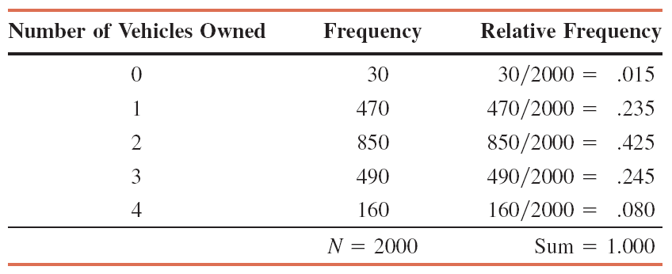
Table 5.1 Frequency and Relative Frequency Distributions of the Number of Vehicles Owned by Families
Prem Mann, Introductory Statistics, 9/E Copyright © 2015 John Wiley & Sons. All rights reserved.

Slide 5
Random Variables
Definition
A random variable is a variable whose value is determined by the outcome of a random experiment.
Prem Mann, Introductory Statistics, 9/E Copyright © 2015 John Wiley & Sons. All rights reserved.

Slide 6
Discrete Random Variable
Definition
A random variable that assumes countable values is called a discrete random variable.
Prem Mann, Introductory Statistics, 9/E Copyright © 2015 John Wiley & Sons. All rights reserved.

Slide 7
Examples of Discrete Random Variables
The number of cars sold at a dealership during a given month
The number of houses in a certain block
The number of fish caught on a fishing trip
The number of complaints received at the office of an airline on a given day
The number of customers who visit a bank during any given hour
The number of heads obtained in three tosses of a coin
Prem Mann, Introductory Statistics, 9/E Copyright © 2015 John Wiley & Sons. All rights reserved.

Slide 8
Continuous Random Variable
Definition
A random variable that can assume any value contained in one or more intervals is called a continuous random variable.
Prem Mann, Introductory Statistics, 9/E Copyright © 2015 John Wiley & Sons. All rights reserved.

Slide 9
Continuous Random Variable
Prem Mann, Introductory Statistics, 9/E Copyright © 2015 John Wiley & Sons. All rights reserved.

Slide 10
Examples of Continuous Random Variables
The length of a room
The time taken to commute from home to work
The amount of milk in a gallon (note that we do not expect “a gallon” to contain exactly one gallon of milk but either slightly more or slightly less than one gallon)
The weight of a letter
The price of a house
Note that money is often treated as a continuous random variable, specifically when there are a large number of unique values.
Prem Mann, Introductory Statistics, 9/E Copyright © 2015 John Wiley & Sons. All rights reserved.

Slide 11
5.2 Probability Distribution of a Discrete Random Variable
Definition
The probability distribution of a discrete random variable lists all the possible values that the random variable can assume and their corresponding probabilities.
Prem Mann, Introductory Statistics, 9/E Copyright © 2015 John Wiley & Sons. All rights reserved.

Slide 12
Example 5-1
Recall the frequency and relative frequency distributions of the number of vehicles owned by families given in Table 5.1. That table is reproduced below as Table 5.2. Let x be the number of vehicles owned by a randomly selected family. Write the probability distribution of x and make a histogram for this probability distribution.
Prem Mann, Introductory Statistics, 9/E Copyright © 2015 John Wiley & Sons. All rights reserved.

Slide 13
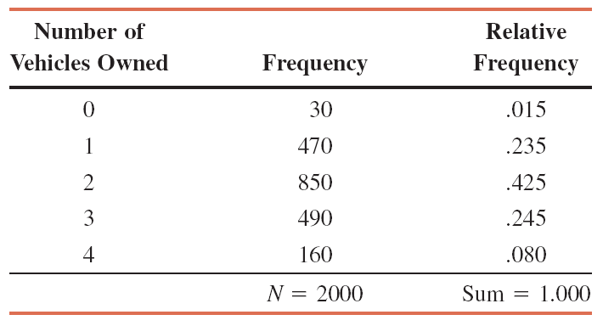
Table 5.2 Frequency and Relative Frequency Distributions of the Number of Vehicles Owned by Families
Prem Mann, Introductory Statistics, 9/E Copyright © 2015 John Wiley & Sons. All rights reserved.

Slide 14
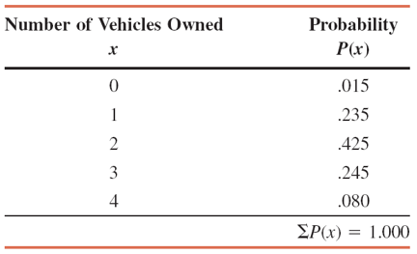
Example 5-1: Solution Table 5.3 Probability Distribution of the Number of Vehicles Owned by Families
Prem Mann, Introductory Statistics, 9/E Copyright © 2015 John Wiley & Sons. All rights reserved.

Slide 15
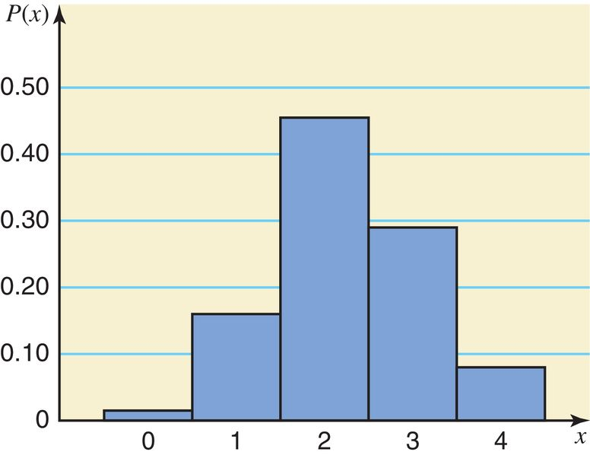
Example 5-1: Solution Figure 5.1 Histogram for the Probability Distribution of Table 5.3
Prem Mann, Introductory Statistics, 9/E Copyright © 2015 John Wiley & Sons. All rights reserved.

Slide 16
Two Characteristics of a Probability Distribution
The probability distribution of a discrete random variable possesses the following two characteristics.
1. 0 ≤ P(x) ≤ 1 for each value of x
2. Σ P(x) = 1
Prem Mann, Introductory Statistics, 9/E Copyright © 2015 John Wiley & Sons. All rights reserved.

Slide 17
Example 5-2
Using the probability distribution listed in Table 5.3 of Example 5–1, find the following probabilities:
(a) The probability that a randomly selected family owns two vehicles
(b) The probability that a randomly selected family owns at least two vehicles
(c) The probability that a randomly selected family owns at most one vehicle
(d) The probability that a randomly selected family owns three or more vehicles
Prem Mann, Introductory Statistics, 9/E Copyright © 2015 John Wiley & Sons. All rights reserved.

Slide 18
Example 5-2: Solution
Using the probabilities listed in Table 5.3,
(a) P(selected family owns two vehicles) = P(2) = .455
(b) P(selected family owns at least two vehicles)
= P(2 or 3 or 4) = P(2) + P(3) + P(4) = .455 + .290 + .080
= .825
(c) P(selected family owns at most one vehicle)
= P(0 or 1) = P(0) + P(1) = .015 + .160 = .175
(d) P(selected family owns three or more vehicles)
= P(3 or 4) = P(3) + P(4) = .290 + .080 = .370
Prem Mann, Introductory Statistics, 9/E Copyright © 2015 John Wiley & Sons. All rights reserved.

Slide 19
Example 5-3
Each of the following tables lists certain values of x and their probabilities. Determine whether or not each table represents a valid probability distribution.
Prem Mann, Introductory Statistics, 9/E Copyright © 2015 John Wiley & Sons. All rights reserved.

Slide 20
Example 5-3: Solution
(a) No, since the sum of all probabilities is not equal to 1.0.
(b) Yes.
(c) No, since one of the probabilities is negative.
Prem Mann, Introductory Statistics, 9/E Copyright © 2015 John Wiley & Sons. All rights reserved.

Slide 21
Example 5-4
The following table lists the probability distribution of the number of breakdowns per week for a machine based on past data.
Prem Mann, Introductory Statistics, 9/E Copyright © 2015 John Wiley & Sons. All rights reserved.

Slide 22
Example 5-4
Find the probability that the number of breakdowns for this machine during a given week is
(a) exactly 2
(b) 0 to 2
(c) more than 1
(d) at most 1
Prem Mann, Introductory Statistics, 9/E Copyright © 2015 John Wiley & Sons. All rights reserved.

Slide 23
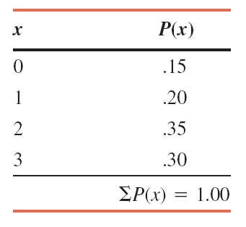
Example 5-4: Solution Table 5.4 Probability Distribution of the Number of Breakdowns
Let x denote the number of breakdowns for this machine during a given week. Table 5.4 lists the probability distribution of x.
Prem Mann, Introductory Statistics, 9/E Copyright © 2015 John Wiley & Sons. All rights reserved.

Slide 24
Example 5-4: Solution
Using Table 5.4,
(a) P(exactly 2 breakdowns) = P(2) = .35
(b) P(0 to 2 breakdowns) = P(0 ≤ x ≤ 2) = P(0 or 1 or 2) = P(0) + P(1) + P(2) = .15 + .20 + .35 = .70
(c) P(more than 1 breakdown) = P(x > 1) = P(2 or 3) = P(2) + P(3)
= .35 +.30 = .65
(d) P(at most 1 breakdown) = P(x ≤ 1) = P(0 or 1) = P(0) + P(1)
= .15 + .20 = .35
Prem Mann, Introductory Statistics, 9/E Copyright © 2015 John Wiley & Sons. All rights reserved.

Slide 25
Example 5-5
According to a survey, 60% of all students at a large university suffer from math anxiety. Two students are randomly selected from this university. Let x denote the number of students in this sample who suffer from math anxiety. Construct the probability distribution of x.
Prem Mann, Introductory Statistics, 9/E Copyright © 2015 John Wiley & Sons. All rights reserved.

Slide 26
Example 5-5: Solution
Let us define the following two events:
N = the student selected does not suffer from math
anxiety M = the student selected suffers from math anxiety P(0) = P(NN) = .16
P(1) = P(NM or MN) = P(NM) + P(MN)
= .24 + .24 = .48
P(2) = P(MM) = .36
Prem Mann, Introductory Statistics, 9/E Copyright © 2015 John Wiley & Sons. All rights reserved.

Slide 27
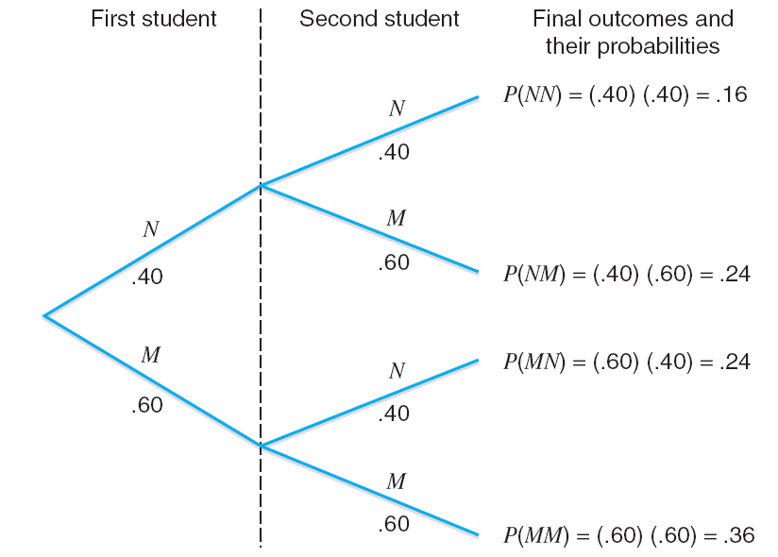
Example 5-5: Solution Figure 5.2 Tree Diagram
Prem Mann, Introductory Statistics, 9/E Copyright © 2015 John Wiley & Sons. All rights reserved.

Slide 28
Table 5.5 Probability Distribution of the Number of Students with Math Anxiety
Prem Mann, Introductory Statistics, 9/E Copyright © 2015 John Wiley & Sons. All rights reserved.

Slide 29
5.3 Mean and Standard Deviation of a Discrete Random Variable
The mean of a discrete variable x is the value that is expected to occur per repetition, on average, if an experiment is repeated a large number of times. It is denoted by µ and calculated as
µ = Σ x P(x)
The mean of a discrete random variable x is also called its expected value and is denoted by E(x); that is,
E(x) = Σ x P(x)
Prem Mann, Introductory Statistics, 9/E Copyright © 2015 John Wiley & Sons. All rights reserved.

Slide 30
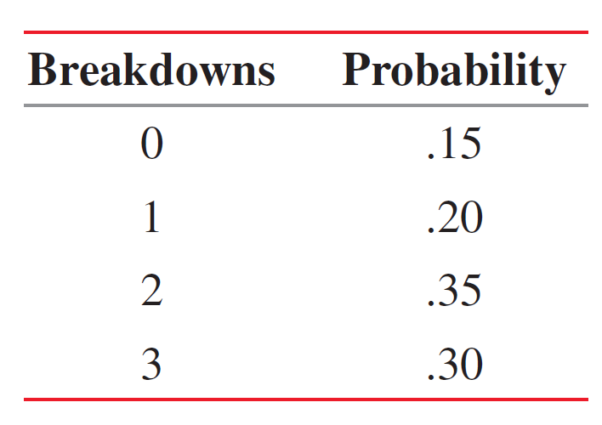
Example 5-6
The following table lists the number of breakdowns per week and their probabilities for a machine based on past data.
Find the mean number of breakdowns per week for this machine.
Prem Mann, Introductory Statistics, 9/E Copyright © 2015 John Wiley & Sons. All rights reserved.

Slide 31
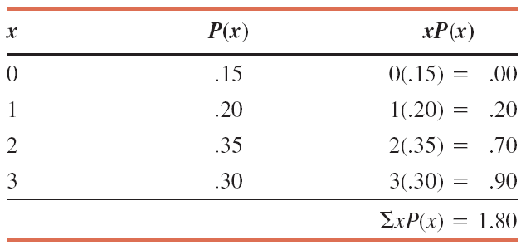
Example 5-6: Solution Table 5.6 Calculating the Mean for the Probability Distribution of Breakdowns
The mean is µ = Σx P(x) = 1.80
Prem Mann, Introductory Statistics, 9/E Copyright © 2015 John Wiley & Sons. All rights reserved.

Slide 32
Standard Deviation of a Discrete Random Variable
The standard deviation of a discrete random variable x measures the spread of its probability distribution and is computed as
Prem Mann, Introductory Statistics, 9/E Copyright © 2015 John Wiley & Sons. All rights reserved.

Slide 33
Case Study 5-1 All State Lottery
Prem Mann, Introductory Statistics, 9/E Copyright © 2015 John Wiley & Sons. All rights reserved.

Slide 34
Example 5-7
Baier’s Electronics manufactures computer parts that are supplied to many computer companies. Despite the fact that two quality control inspectors at Baier’s Electronics check every part for defects before it is shipped to another company, a few defective parts do pass through these inspections undetected. Let x denote the number of defective computer parts in a shipment of 400. The following table gives the probability distribution of x.
Prem Mann, Introductory Statistics, 9/E Copyright © 2015 John Wiley & Sons. All rights reserved.

Slide 35
Example 5-7
Compute the standard deviation of x.
Prem Mann, Introductory Statistics, 9/E Copyright © 2015 John Wiley & Sons. All rights reserved.

Slide 36
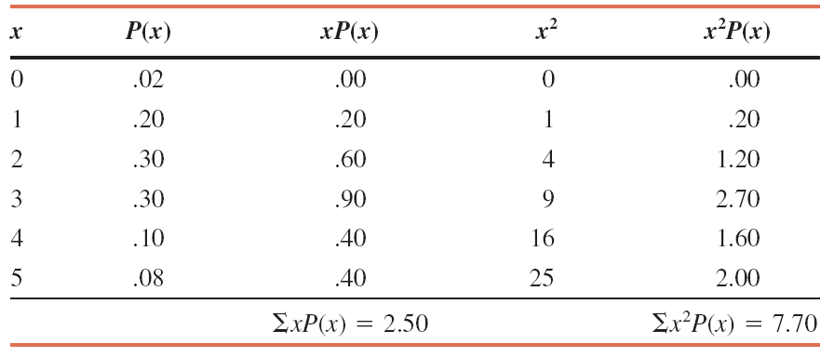
Example 5-7: Solution Table 5.7 Computations to Find the Standard Deviation
Prem Mann, Introductory Statistics, 9/E Copyright © 2015 John Wiley & Sons. All rights reserved.

Slide 37
Example 5-7: Solution
Prem Mann, Introductory Statistics, 9/E Copyright © 2015 John Wiley & Sons. All rights reserved.

Slide 38
Example 5-8
Loraine Corporation is planning to market a new makeup product. According to the analysis made by the financial department of the company, it will earn an annual profit of $4.5 million if this product has high sales and an annual profit of $ 1.2 million if the sales are mediocre, and it will lose $2.3 million a year if the sales are low. The probabilities of these three scenarios are .32, .51 and .17 respectively.
(a) Let x be the profits (in millions of dollars) earned per
annum from this product by the company. Write the
probability distribution of x.
(b) Calculate the mean and the standard deviation of x.
Prem Mann, Introductory Statistics, 9/E Copyright © 2015 John Wiley & Sons. All rights reserved.

Slide 39
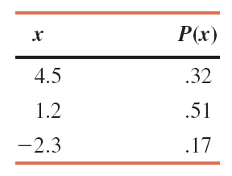
Example 5-8: Solution
(a) The table below lists the probability distribution of x. Note that because x denotes profits earned by the company, the loss is written as a negative profit in the table.
Prem Mann, Introductory Statistics, 9/E Copyright © 2015 John Wiley & Sons. All rights reserved.

Slide 40
Example 5-8: Solution
(b) Table 5.8 shows all the calculations needed for the computation of the mean and standard deviations of x.
Prem Mann, Introductory Statistics, 9/E Copyright © 2015 John Wiley & Sons. All rights reserved.

Slide 41
Table 5.8 Computations to Find the Mean and Standard Deviation
Prem Mann, Introductory Statistics, 9/E Copyright © 2015 John Wiley & Sons. All rights reserved.

Slide 42
Interpretation of the Standard Deviation
The standard deviation of a discrete random variable can
be interpreted or used the same way as the standard
deviation of a data set in Section 3.4 of Chapter 3.
The standard deviation is the most-used measure of dispersion.
The value of the standard deviation tells how closely the values of a data set are clustered around the mean.
Prem Mann, Introductory Statistics, 9/E Copyright © 2015 John Wiley & Sons. All rights reserved.

Slide 43
5.4 The Binomial Probability Distribution
The Binomial Experiment
The Binomial Probability Distribution and Binomial Formula
Using the Table of Binomial Probabilities
Probability of Success and the Shape of the Binomial Distribution
Mean and Standard Deviation of the Binomial Distribution
Prem Mann, Introductory Statistics, 9/E Copyright © 2015 John Wiley & Sons. All rights reserved.

Slide 44
The Binomial Experiment
Conditions of a Binomial Experiment
A binomial experiment must satisfy the following four
conditions.
1. There are n identical trials.
2. Each trail has only two possible outcomes (or events).
3. The probabilities of the two outcomes (or events)
remain constant for each trial.
4. The trials are independent.
Prem Mann, Introductory Statistics, 9/E Copyright © 2015 John Wiley & Sons. All rights reserved.

Slide 45
Example 5-9
Consider the experiment consisting of 10 tosses of a coin. Determine whether it is a binomial experiment.
Prem Mann, Introductory Statistics, 9/E Copyright © 2015 John Wiley & Sons. All rights reserved.

Slide 46
Example 5-9: Solution
1. There are a total of 10 trials (tosses), and they are all identical. Here, n=10.
2. Each trial (toss) has only two possible outcomes: a head and a tail.
3. The probability of obtaining a head (a success) is ½ and that of a tail (a failure) is ½ for any toss. That is,
p = P(H) = ½ and q = P(T) = ½
4. The trials (tosses) are independent.
Consequently, the experiment consisting of 10 tosses is a binomial experiment.
Prem Mann, Introductory Statistics, 9/E Copyright © 2015 John Wiley & Sons. All rights reserved.

Slide 47
Example 5-10
(a) Seventy five percent of students at a college with a large student population use Instagram. A sample of five students from this college is selected, and these students are asked whether or not they use Instagram. Is this experiment a binomial experiment?
(b) In a group of 12 students at a college, 9 use Instagram. Five students are selected from this group of 12 and are asked whether or not they use Instagram. Is this experiment a binomial experiment?
Prem Mann, Introductory Statistics, 9/E Copyright © 2015 John Wiley & Sons. All rights reserved.

Slide 48
Example 5-10: Solution
(a) We check whether all four conditions of the binomial probability distribution are satisfied.
1. This example consists of five identical trials.
2. Each trial has two outcomes: a student uses Instagram, or a student does not use Instagram.
3. The probability p that a student uses Instagram is .75. The probability q that a student does not use Instagram is .25.
4. Each trial (student) is independent.
Because all four conditions of a binomial experiment are satisfied, this is an example of a binomial experiment.
Prem Mann, Introductory Statistics, 9/E Copyright © 2015 John Wiley & Sons. All rights reserved.

Slide 49
Example 5-10: Solution
(b)
1. This example consists of five identical trials.
2. Each trial has two outcomes: a student uses Instagram or a student does not use Instagram.
3. The probability p is that a student uses Instagram. The probability q is that a student does not use Instagram. They do not remain constant for each selection. The probability of each outcome changes with each selection depending on what happened in the previous selections.
Prem Mann, Introductory Statistics, 9/E Copyright © 2015 John Wiley & Sons. All rights reserved.

Slide 50
Example 5-10: Solution
(b)
4. Because p and q do not remain constant for each selection, the trials are not independent.
Given that the third and fourth conditions of a binomial experiment are not satisfied, this is not an example of a binomial experiment.
Prem Mann, Introductory Statistics, 9/E Copyright © 2015 John Wiley & Sons. All rights reserved.

Slide 51
The Binomial Probability Distribution and Binomial Formula
For a binomial experiment, the probability of exactly x successes in n trials is given by the binomial formula
where
n = total number of trials
p = probability of success
q = 1 – p = probability of failure
x = number of successes in n trials
n - x = number of failures in n trials
Prem Mann, Introductory Statistics, 9/E Copyright © 2015 John Wiley & Sons. All rights reserved.

Slide 52
Example 5-11
Seventy five percent of students at a college with a large student population use the social media site Instagram. Three students are randomly selected from this college. What is the probability that exactly two of these three students use Instagram?
Prem Mann, Introductory Statistics, 9/E Copyright © 2015 John Wiley & Sons. All rights reserved.

Slide 53
Example 5-11: Solution
Here, we are given that:
n = 3, x = 2, and p = .75
The probability of two successes is denoted by P(x=2) or P(2).
Prem Mann, Introductory Statistics, 9/E Copyright © 2015 John Wiley & Sons. All rights reserved.

Slide 54
Example 5-12
At the Express House Delivery Service, providing high-quality service to customers is the top priority of the management. The company guarantees a refund of all charges if a package it is delivering does not arrive at its destination by the specified time. It is known from past data that despite all efforts, 2% of the packages mailed through this company do not arrive at their destinations within the specified time. Suppose a corporation mails 10 packages through Express House Delivery Service on a certain day.
Prem Mann, Introductory Statistics, 9/E Copyright © 2015 John Wiley & Sons. All rights reserved.

Slide 55
Example 5-12
(a) Find the probability that exactly one of these 10 packages will not arrive at its destination within the specified time.
(b) Find the probability that at most one of these 10 packages will not arrive at its destination within the specified time.
Prem Mann, Introductory Statistics, 9/E Copyright © 2015 John Wiley & Sons. All rights reserved.

Slide 56
Example 5-12: Solution
n = total number of packages mailed = 10 p = P(success) = .02 q = P(failure) = 1 – .02 = .98
Prem Mann, Introductory Statistics, 9/E Copyright © 2015 John Wiley & Sons. All rights reserved.

Slide 57
Example 5-12: Solution
x = number of successes = 1 n – x = number of failures = 10 – 1 = 9
Thus, there is a .1667 probability that exactly one of the 10 packages mailed will not arrive at its destination within the specified time.
(a)
Prem Mann, Introductory Statistics, 9/E Copyright © 2015 John Wiley & Sons. All rights reserved.

Slide 58
Example 5-12: Solution
(b) At most one of the ten packages is given by the sum of the probabilities of x = 0 and x = 1
Thus, the probability that at most one of the 10 packages mailed will not arrive at its destination within the specified time is .9838.
Prem Mann, Introductory Statistics, 9/E Copyright © 2015 John Wiley & Sons. All rights reserved.

Slide 59
Example 5-13
According to a survey, 33% of American employees do not plan to change their jobs in the near future. Let x denote the number of employees in a random sample of three American employees who do not plan to change their jobs in the near future. Write the probability distribution of x and draw a histogram for this probability distribution.
Prem Mann, Introductory Statistics, 9/E Copyright © 2015 John Wiley & Sons. All rights reserved.

Slide 60
Example 5-13: Solution
n = total employees in the sample = 3
p = P(an employee does not plan to change his/her job in the near future) = .33
q = P(an employee does plan to change his/her job in the near future)
= 1 - .33 = .67
Prem Mann, Introductory Statistics, 9/E Copyright © 2015 John Wiley & Sons. All rights reserved.

Slide 61
Example 5-13: Solution
Prem Mann, Introductory Statistics, 9/E Copyright © 2015 John Wiley & Sons. All rights reserved.

Slide 62
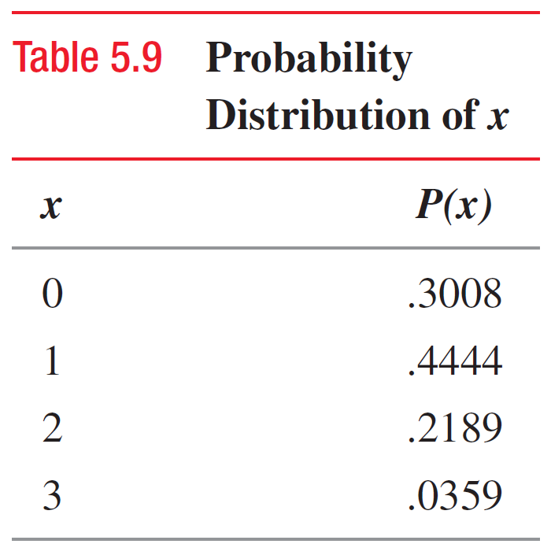
Example 5-13: Solution Table 5.9 Probability Distribution of x
Prem Mann, Introductory Statistics, 9/E Copyright © 2015 John Wiley & Sons. All rights reserved.

Slide 63
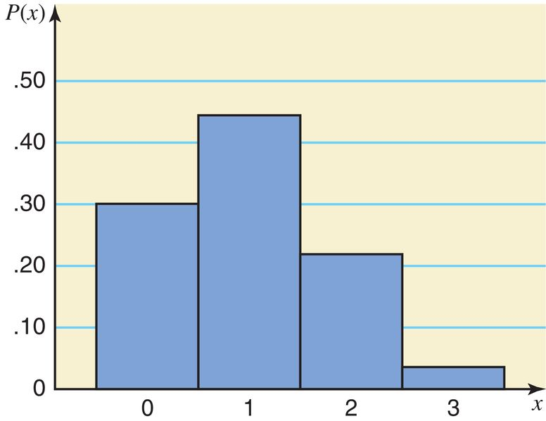
Figure 5.3 Histogram for the Probability Distribution of Table 5.9
Prem Mann, Introductory Statistics, 9/E Copyright © 2015 John Wiley & Sons. All rights reserved.

Slide 64
Using the Table of Binomial Probabilities
The probabilities for a binomial experiment can also be read from Table I in Appendix B, the table of binomial probabilities.
This lists the probabilities of x for n = 1 to n = 25.
This lists the probabilities of x for selected values of p.
Prem Mann, Introductory Statistics, 9/E Copyright © 2015 John Wiley & Sons. All rights reserved.

Slide 65
Example 5-14
According to a survey, 30% of college students said that they spend too much time on Facebook. (The remaining 70% said that they do not spend too much time on Facebook or had no opinion.) Suppose this result holds true for the current population of all college students. A random sample of six college students is selected. Using Table I of Appendix B, answer the following.
Prem Mann, Introductory Statistics, 9/E Copyright © 2015 John Wiley & Sons. All rights reserved.

Slide 66
Example 5-14
(a) Find the probability that exactly three of these six college students will say that they spend too much time on Facebook.
(b) Find the probability that at most two of these six college students will say that they spend too much time on Facebook.
(c) Find the probability that at least three of these six college students will say that they spend too much time on Facebook.
Prem Mann, Introductory Statistics, 9/E Copyright © 2015 John Wiley & Sons. All rights reserved.

Slide 67
Example 5-14
(d) Find the probability that one to three of these six college students will say that they spend too much time on Facebook.
(e) Let x be the number in a random sample of six college students who will say that they spend too much time on Facebook. Write the probability distribution of x and draw a histogram for this probability distribution.
Prem Mann, Introductory Statistics, 9/E Copyright © 2015 John Wiley & Sons. All rights reserved.

Slide 68
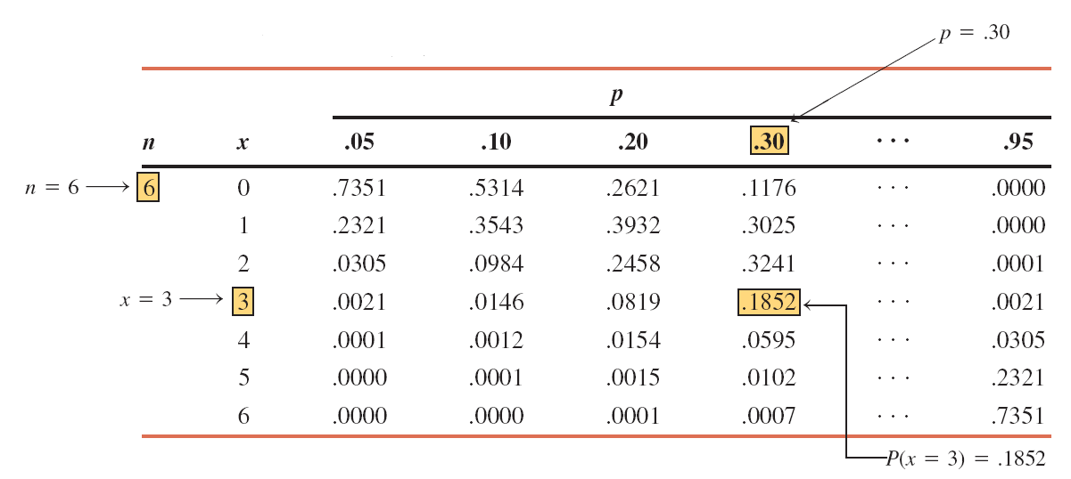
Table 5.10 Determining P(x = 3) for n = 6 and p = .30
Prem Mann, Introductory Statistics, 9/E Copyright © 2015 John Wiley & Sons. All rights reserved.

Slide 69
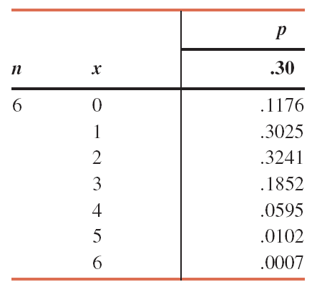
Table 5.11 Portion of Table I for n = 6 and p= .30
Prem Mann, Introductory Statistics, 9/E Copyright © 2015 John Wiley & Sons. All rights reserved.

Slide 70
Example 5-14: Solution
(a) P(3) = .1852
(b) P(at most 2) = P(0 or 1 or 2)
= P(0) + P(1) + P(2)
= .1176 + .3025 + .3241 = .7442
(c) P(at least 3) = P(3 or 4 or 5 or 6)
= P(3) + P(4) + P(5) + P(6) = .1852 + .0595 + .0102 + .0007
= .2556
(d) P(1 to 3) = P(1) + P(2) + P(3)
= .3025 + .3241 + .1852 = .8118
Prem Mann, Introductory Statistics, 9/E Copyright © 2015 John Wiley & Sons. All rights reserved.

Slide 71
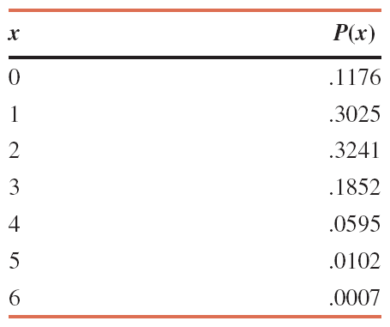
Example 5-14: Solution Table 5.12 Probability Distribution of x for n = 6 and p= .30
(e)
Prem Mann, Introductory Statistics, 9/E Copyright © 2015 John Wiley & Sons. All rights reserved.

Slide 72
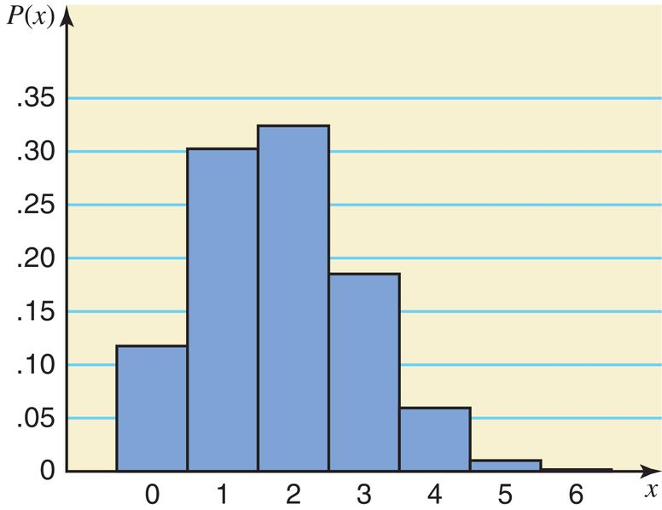
Example 5-14: Solution Figure 5.4 Histogram for the Probability Distribution of x
(e)
Prem Mann, Introductory Statistics, 9/E Copyright © 2015 John Wiley & Sons. All rights reserved.

Slide 73
Probability of Success and the Shape of the Binomial Distribution
For any number of trials n:
1. The binomial probability distribution is symmetric if p =.50.
2. The binomial probability distribution is skewed to the right if p is less than .50.
3. The binomial probability distribution is skewed to the left if p is greater than .50.
Prem Mann, Introductory Statistics, 9/E Copyright © 2015 John Wiley & Sons. All rights reserved.

Slide 74
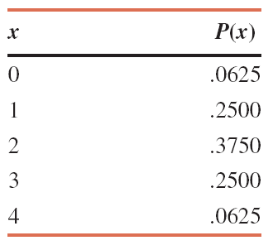
Table 5.13 Probability Distribution of x for n = 4 and p= .50
Prem Mann, Introductory Statistics, 9/E Copyright © 2015 John Wiley & Sons. All rights reserved.

Slide 75
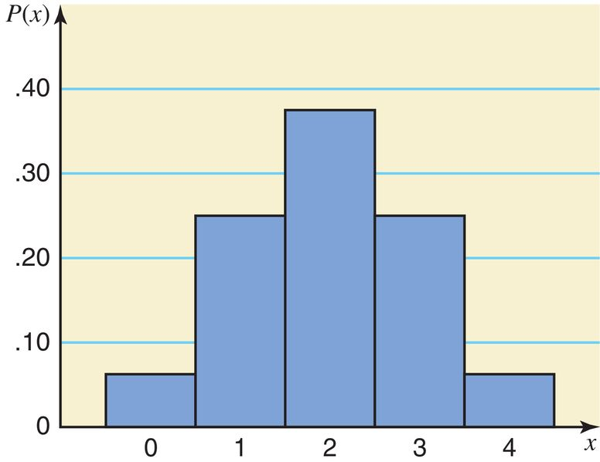
Figure 5.5 Histogram for the Probability Distribution of Table 5.13
Prem Mann, Introductory Statistics, 9/E Copyright © 2015 John Wiley & Sons. All rights reserved.

Slide 76
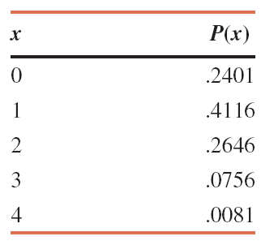
Table 5.14 Probability Distribution of x for n = 4 and p= .30
Prem Mann, Introductory Statistics, 9/E Copyright © 2015 John Wiley & Sons. All rights reserved.

Slide 77
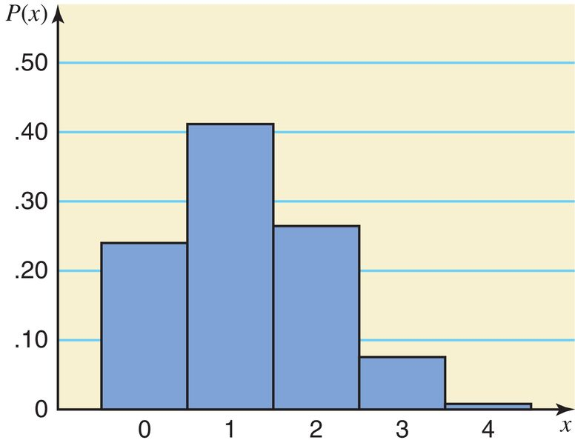
Figure 5.6 Histogram for the Probability Distribution of Table 5.14
Prem Mann, Introductory Statistics, 9/E Copyright © 2015 John Wiley & Sons. All rights reserved.

Slide 78
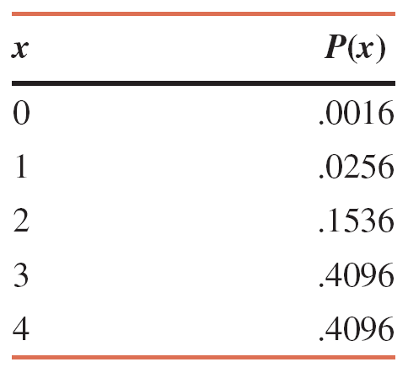
Table 5.15 Probability Distribution of x for n = 4 and p= .80
Prem Mann, Introductory Statistics, 9/E Copyright © 2015 John Wiley & Sons. All rights reserved.

Slide 79
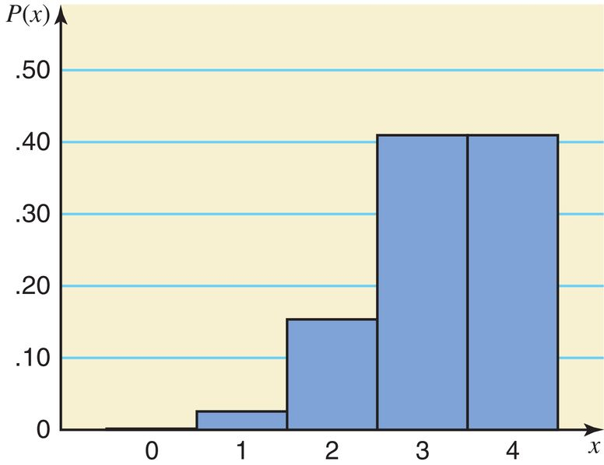
Figure 5.7 Histogram for the Probability Distribution of Table 5.15
Prem Mann, Introductory Statistics, 9/E Copyright © 2015 John Wiley & Sons. All rights reserved.

Slide 80
Mean and Standard Deviation of the Binomial Distribution
The mean and standard deviation of a binomial distribution are, respectively,
where n is the total number of trials, p is the probability of success, and q is the probability of failure.
Prem Mann, Introductory Statistics, 9/E Copyright © 2015 John Wiley & Sons. All rights reserved.

Slide 81
Example 5-15
According to a Pew Research Center survey released on May 12, 2015, 22.8% of U.S. adults do not have a religious affiliation (Time, May 25, 2015). Assume that this result is true for the current population of U.S. adults. A sample of 50 U.S. adults is randomly selected. Let x be the number of adults in this sample who do not have a religious affiliation. Find the mean and standard deviation of the probability distribution of x.
Prem Mann, Introductory Statistics, 9/E Copyright © 2015 John Wiley & Sons. All rights reserved.

Slide 82
Example 5-15: Solution
n = 50, p = .228, and q = .772
Using the formulas for the mean and standard deviation of
the binomial distribution,
Prem Mann, Introductory Statistics, 9/E Copyright © 2015 John Wiley & Sons. All rights reserved.

Slide 83
5.5. The Hypergeometric Probability Distribution
Let
N = total number of elements in the population
r = number of successes in the population
N – r = number of failures in the population
n = number of trials (sample size)
x = number of successes in n trials
n – x = number of failures in n trials
Prem Mann, Introductory Statistics, 9/E Copyright © 2015 John Wiley & Sons. All rights reserved.

Slide 84
The Hypergeometric Probability Distribution
The probability of x successes in n trials is given by
Prem Mann, Introductory Statistics, 9/E Copyright © 2015 John Wiley & Sons. All rights reserved.

Slide 85
Example 5-16
Brown Manufacturing makes auto parts that are sold to auto dealers. Last week the company shipped 25 auto parts to a dealer. Later, it found out that 5 of those parts were defective. By the time the company manager contacted the dealer, 4 auto parts from that shipment had already been sold. What is the probability that 3 of those 4 parts were good parts and 1 was defective?
Prem Mann, Introductory Statistics, 9/E Copyright © 2015 John Wiley & Sons. All rights reserved.

Slide 86
Example 5-16: Solution
N = 25, r = 20, N – r = 5, n = 4, x = 3, n – x = 1
Thus, the probability that three of the four parts sold are good and one is defective is .4506.
Prem Mann, Introductory Statistics, 9/E Copyright © 2015 John Wiley & Sons. All rights reserved.

Slide 87
Example 5-17
Dawn Corporation has 12 employees who hold managerial positions. Of them, 7 are female and 5 are male. The company is planning to send 3 of these 12 managers to a conference. If 3 managers are randomly selected out of 12,
(a) Find the probability that all 3 of them are female
(b) Find the probability that at most 1 of them is a female
Prem Mann, Introductory Statistics, 9/E Copyright © 2015 John Wiley & Sons. All rights reserved.

Slide 88
Example 5-17: Solution
(a)
N = 12, r = 7, N – r = 5, n = 3, x = 3, n – x = 0
Thus, the probability that all 3 of managers selected are female is .1591.
Prem Mann, Introductory Statistics, 9/E Copyright © 2015 John Wiley & Sons. All rights reserved.

Slide 89
Example 5-17: Solution
(b)
N = 12, r = 7, N – r = 5, n = 3, x = 0 and 1, n – x = 3
Thus, the probability that at most 1 of 3 managers selected is female is .3637.
Prem Mann, Introductory Statistics, 9/E Copyright © 2015 John Wiley & Sons. All rights reserved.

Slide 90
5.6 The Poisson Probability Distribution
Using the Table of Poisson probabilities
Mean and Standard Deviation of the Poisson Probability Distribution
Prem Mann, Introductory Statistics, 9/E Copyright © 2015 John Wiley & Sons. All rights reserved.

Slide 91
The Poisson Probability Distribution
Conditions to Apply the Poisson Probability Distribution
The following three conditions must be satisfied to apply the Poisson probability distribution.
1. x is a discrete random variable.
2. The occurrences are random.
3. The occurrences are independent.
Prem Mann, Introductory Statistics, 9/E Copyright © 2015 John Wiley & Sons. All rights reserved.

Slide 92
Examples of Poisson Probability Distribution
1. The number of accidents that occur on a given highway during a 1-week period.
2. The number of customers entering a grocery store during a 1–hour interval.
3. The number of television sets sold at a department store during a given week.
Prem Mann, Introductory Statistics, 9/E Copyright © 2015 John Wiley & Sons. All rights reserved.

Slide 93
The Poisson Probability Distribution
Poisson Probability Distribution Formula
According to the Poisson probability distribution, the probability of x occurrences in an interval is
where λ (pronounced lambda) is the mean number of occurrences in that interval and the value of e is approximately 2.71828.
Prem Mann, Introductory Statistics, 9/E Copyright © 2015 John Wiley & Sons. All rights reserved.

Slide 94
Example 5-18
On average, a household receives 9.5 telemarketing phone calls per week. Using the Poisson distribution formula, find the probability that a randomly selected household receives exactly 6 telemarketing phone calls during a given week.
Prem Mann, Introductory Statistics, 9/E Copyright © 2015 John Wiley & Sons. All rights reserved.

Slide 95
Example 5-18: Solution
Prem Mann, Introductory Statistics, 9/E Copyright © 2015 John Wiley & Sons. All rights reserved.

Slide 96
Example 5-19
A washing machine in a laundromat breaks down an average of three times per month. Using the Poisson probability distribution formula, find the probability that during the next month this machine will have (a) exactly two breakdowns (b) at most one breakdown
Prem Mann, Introductory Statistics, 9/E Copyright © 2015 John Wiley & Sons. All rights reserved.

Slide 97
Example 5-19: Solution
Prem Mann, Introductory Statistics, 9/E Copyright © 2015 John Wiley & Sons. All rights reserved.

Slide 98
Example 5-20
Cynthia’s Mail Order Company provides free examination of its products for 7 days. If not completely satisfied, a customer can return the product within that period and get a full refund. According to past records of the company, an average of 2 of every 10 products sold by this company are returned for a refund. Using the Poisson probability distribution formula, find the probability that exactly 6 of the 40 products sold by this company on a given day will be returned for a refund.
Prem Mann, Introductory Statistics, 9/E Copyright © 2015 John Wiley & Sons. All rights reserved.

Slide 99
Example 5-20: Solution
λ = 8, x = 6
Thus, the probability is .1221 that exactly 6 products out
of 40 sold on a given day will be returned.
Prem Mann, Introductory Statistics, 9/E Copyright © 2015 John Wiley & Sons. All rights reserved.

Slide 100
Using the Table of Poisson Probabilities
The probabilities for a Poisson distribution can also be read from Table III in appendix B, the table of Poisson probabilities.
Prem Mann, Introductory Statistics, 9/E Copyright © 2015 John Wiley & Sons. All rights reserved.

Slide 101
Example 5-21
On average, two new accounts are opened per day at an Imperial Saving Bank branch. Using Table III of Appendix B, find the probability that on a given day the number of new accounts opened at this bank will be (a) exactly 6 (b) at most 3 (c) at least 7
Prem Mann, Introductory Statistics, 9/E Copyright © 2015 John Wiley & Sons. All rights reserved.

Slide 102
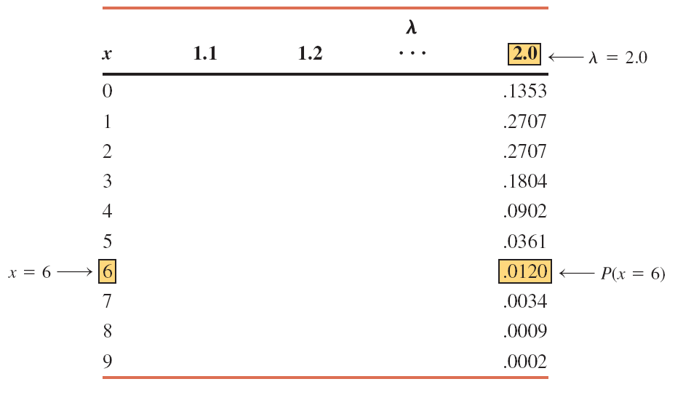
Table 5.16 Portion of Table III for λ = 2.0
Prem Mann, Introductory Statistics, 9/E Copyright © 2015 John Wiley & Sons. All rights reserved.

Slide 103
Example 5-21: Solution
(a) P(6) = .0120
(b) P(at most 3) = P(0) + P(1) + P(2) + P(3)
=.1353 +.2707 + .2707 + .1804 = .8571
(c) P(at least 7) = P(7) + P(8) + P(9)
= .0034 + .0009 + .0002 = .0045
Prem Mann, Introductory Statistics, 9/E Copyright © 2015 John Wiley & Sons. All rights reserved.

Slide 104
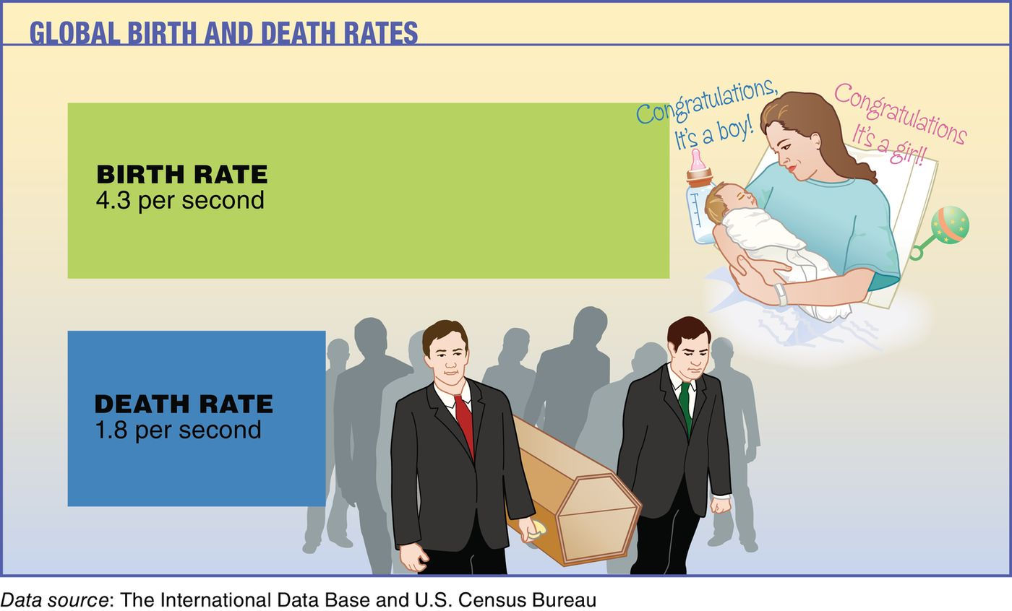
Case Study 5-2 Global Birth and Death Rates
Prem Mann, Introductory Statistics, 9/E Copyright © 2015 John Wiley & Sons. All rights reserved.

Slide 105
Example 5-22
An auto salesperson sells an average of .9 car per day. Let x be the number of cars sold by this salesperson on any given day. Using the Poisson probability distribution table, write the probability distribution of x. Draw a graph of the probability distribution.
Prem Mann, Introductory Statistics, 9/E Copyright © 2015 John Wiley & Sons. All rights reserved.

Slide 106
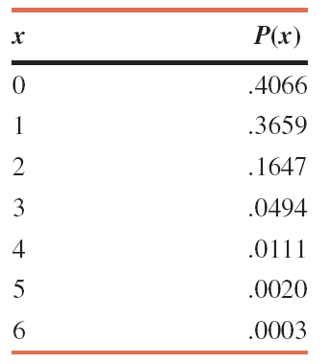
Example 5-22: Solution Table 5.17 Probability Distribution of x for λ = .9
Prem Mann, Introductory Statistics, 9/E Copyright © 2015 John Wiley & Sons. All rights reserved.

Slide 107
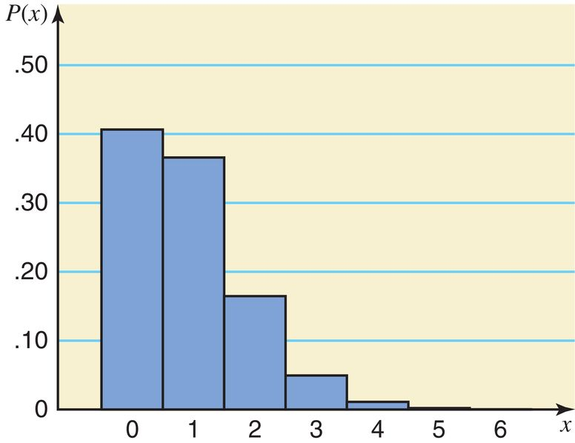
Example 5-22: Solution Figure 5.8 Histogram for the Probability Distribution of Table 5.17
Prem Mann, Introductory Statistics, 9/E Copyright © 2015 John Wiley & Sons. All rights reserved.

Slide 108
Mean and Standard Deviation of the Poisson Probability Distribution
Prem Mann, Introductory Statistics, 9/E Copyright © 2015 John Wiley & Sons. All rights reserved.

Slide 109
Example 5-22 (continued)
An auto salesperson sells an average of .9 car per day. Let x be the number of cars sold by this salesperson on any given day. Find the mean, variance, and standard deviation.
Prem Mann, Introductory Statistics, 9/E Copyright © 2015 John Wiley & Sons. All rights reserved.

Slide 110
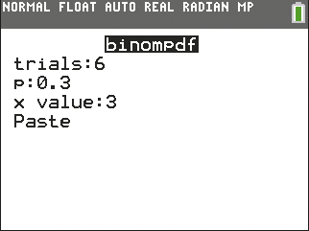
TI-84
Prem Mann, Introductory Statistics, 9/E Copyright © 2015 John Wiley & Sons. All rights reserved.

Slide 111
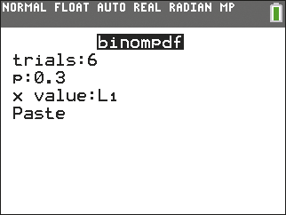
TI-84
Prem Mann, Introductory Statistics, 9/E Copyright © 2015 John Wiley & Sons. All rights reserved.

Slide 112
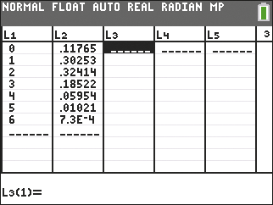
TI-84
Prem Mann, Introductory Statistics, 9/E Copyright © 2015 John Wiley & Sons. All rights reserved.

Slide 113
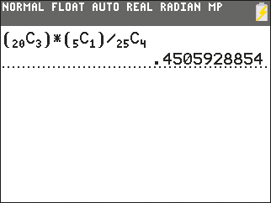
TI-84
Prem Mann, Introductory Statistics, 9/E Copyright © 2015 John Wiley & Sons. All rights reserved.

Slide 114
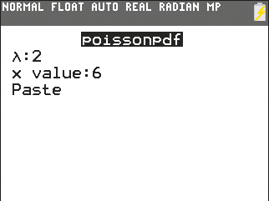
TI-84
Prem Mann, Introductory Statistics, 9/E Copyright © 2015 John Wiley & Sons. All rights reserved.

Slide 115
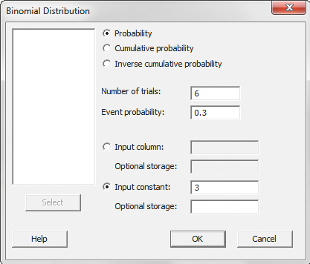
TI-84
Prem Mann, Introductory Statistics, 9/E Copyright © 2015 John Wiley & Sons. All rights reserved.

Slide 116
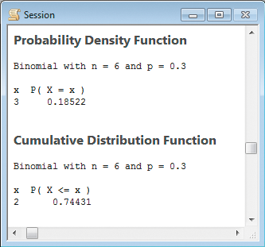
TI-84
Prem Mann, Introductory Statistics, 9/E Copyright © 2015 John Wiley & Sons. All rights reserved.

Slide 117
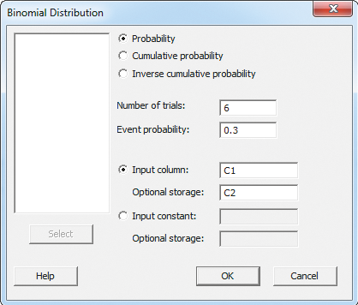
TI-84
Prem Mann, Introductory Statistics, 9/E Copyright © 2015 John Wiley & Sons. All rights reserved.

Slide 118
TI-84
Prem Mann, Introductory Statistics, 9/E Copyright © 2015 John Wiley & Sons. All rights reserved.

Slide 119
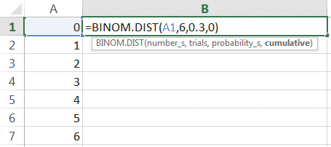
TI-84
Prem Mann, Introductory Statistics, 9/E Copyright © 2015 John Wiley & Sons. All rights reserved.

