Slide 1
Success is a Treasure
Raecine
Keven
Nirvi
Jonathan

Slide 2
Introduction
Success means to achieve our planned goals in life. Each person has their own aims which they think of as Success. Some might think good grades, to be wealthy, to have a healthy family, to earn good income and such other purposes in life. Our group thinks success means to acquire good education, to learn new things and being happy with your accomplishments in life. There is one key towards success which is to work hard and be educated.

Slide 3
What does Success mean to us
Keven - Success to me means being responsible in life despite the challenges in life and being able to create a sustainable life such as earring a lot of money owning a nice house and having a degree from college.
Jonathan - To me, being successful means to be happy and content with your accomplishments in life.
Raecine- Success is defined by happiness and creating wealth for yourself and generations to come.
Nirvi - For me, success means to achieve your goals, acquire good education, learning new things and to be happy in life.

Slide 4
Hypothesis
Considering all of these different variables we needed a hypothesis that will be able to answer all of our questions. Thus, we came up with the following:
If a person attends college and maintains a high GPA, they will be happy with their current level of Success.
If a person attends college then they will have a high chance of being currently employed.

Slide 5
Measures
Markers -
A qualitative marker of success can be the person's overall happiness.
A quantitative marker of success can be the number of achievements or goals that they completed.
Predictors-
Qualitative predictor of success, we can say that if a person attended a college after high school that person would achieve higher opportunities of success based on the type of degree they obtained or the GPA they obtained in school.

Slide 6
Data Collection
A four question survey was created:
What is your highest level of education?
What was your college GPA?(NA if you never went to college)?
Are you currently employed and if so, do enjoy what you do?
How happy are you with your current level of success?
https://docs.google.com/forms/d/e/1FAIpQLSeIucE46YgM1onulru2oLmZx_KhyRWgzpi5lE-9kWbzi88JLw/viewform

Slide 7
Sample Description
Our Final Data consisted of 45 respondents from different backgrounds like people with different degrees,different work status,different success levels and different GPAs. We did not ask for any personal information like which college, address etc because it was not relevant for our survey. We think that data coming from people of different backgrounds would give good assumption of where people stand in success based on their degrees,GPA and work status.

Slide 8
Statistical Analysis
The results from the google form came in the from of a pie chart and we decided to use pie charts to display the data because it is easy to see the data visually.
We also graphed the data points on a scatter plot for college GPA and Current level of happiness so we could compare the correlation between the two which made it easy to prove or disprove our hypotheses.

Slide 9
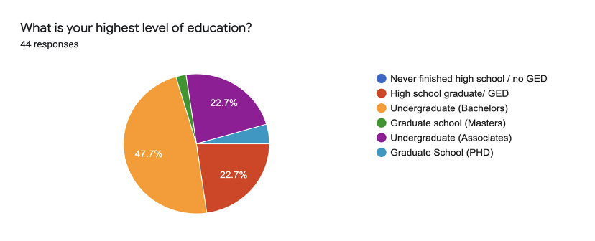
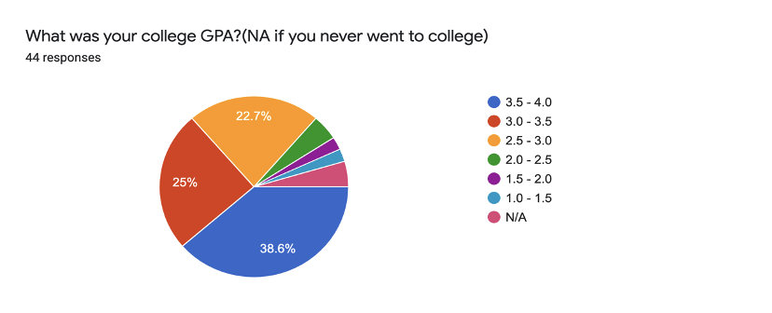
Results

Slide 10
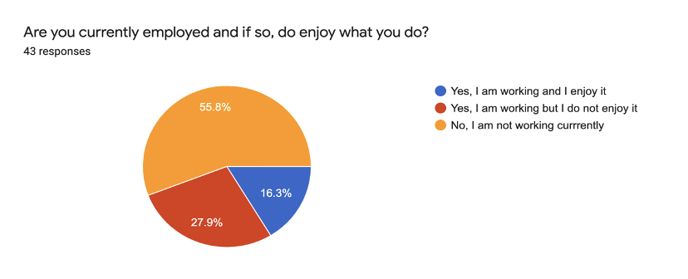
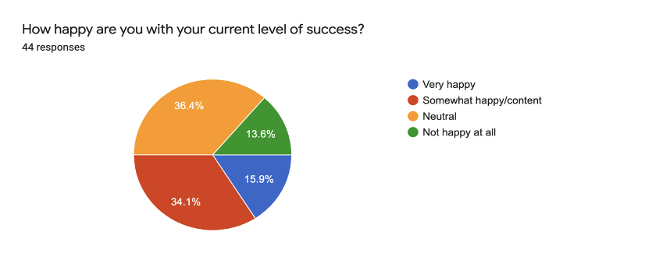
Results Cont.

Slide 11
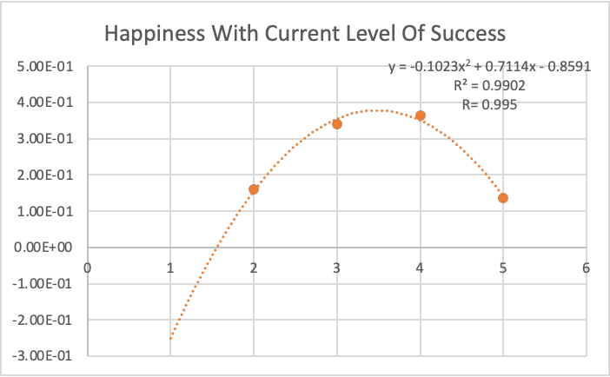
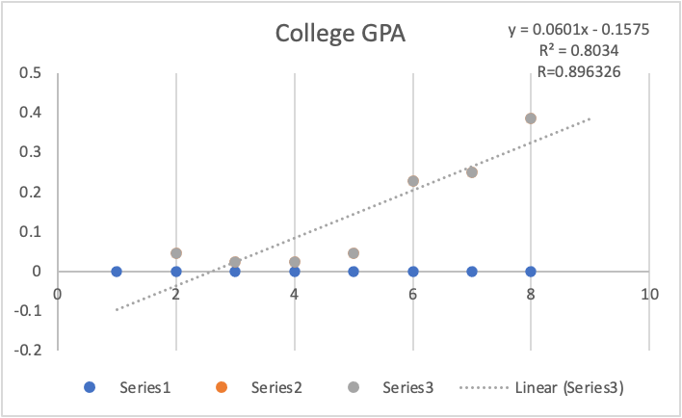
Results Cont.
Neutral
Content
Not happy
Not happy at all
Very Happy

Slide 12
Conclusion
72.5% of people have a college degree, 63.6% of people have at least a 3.0 GPA or higher, 54.2% of people are working, 50% of people are either somewhat happy, content, or very happy with their current level of success.
There is a strong correlation between attending college, having a GPA of 3.0 or higher, obtaining a job, and being content with your current level of success.
Based on the data we collected from our survey, we concluded that all of our hypotheses were proven true.
Our data was definitely skewed because we sent our survey to people in this class and our peers so the sample size was limited to people around the same age. Another factor is whether the people answered each question honestly.
Ur

Slide 13
Implications
From our experiment, we were able to see that education, GPA and having a job have an impact on success.
An improvement for less bias data would be to spread out the sample size and the age range of the participants.

Slide 14
Thank You

