Slide 2
Name : Mohamad Kechaiche
Module : Graphic design
Internship : NYC Department of Housing Preservation and Development (HPD)

Slide 3
How did I find my internship?
Work study program.
Applied to jobs outside the college.
Started 4 months before the internship class and had to extend
the period because of the class.

Slide 4
What is the NYC Department of Housing Preservation and Development HPD?
HPD is like the police of housing.
Located at 100 Gold St in Manhattan.
A brief explanation on how HPD work.

Slide 5
HPD work environment and culture:
A very friendly work environment with few strict rules.
If you have something to do, you do it.
Usually supervisor have much more work and responsibility
than regular employees.

Slide 6
A typical day at HPD:
Boring as HELL! Unless there are some design work for me.
I arrive at 9, login to my HPD user on the computer.
Wait until the supervisor come and tell me what I have for the day.
Sometimes I don’t have design work so I help with other jobs like data entry or working in the department printer.
At 5 I take my stuff and go home.

Slide 7
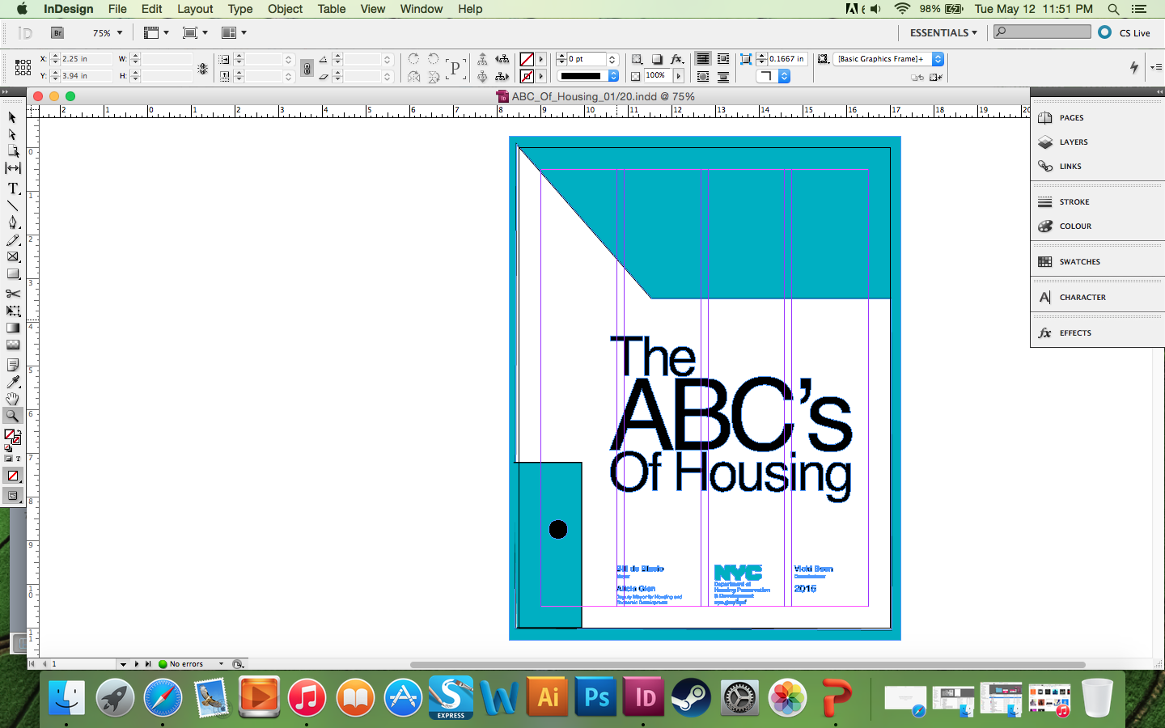
A collaborative project that I worked on:
I designed the ABC’s of Housing.
ABC of Housing is the book of rules for owners of tenants.

Slide 8
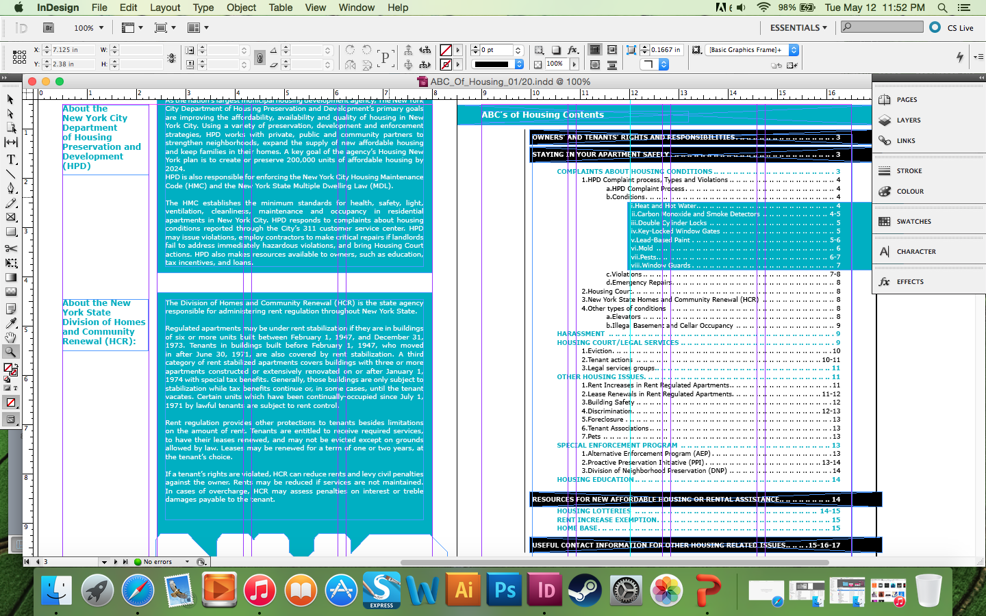
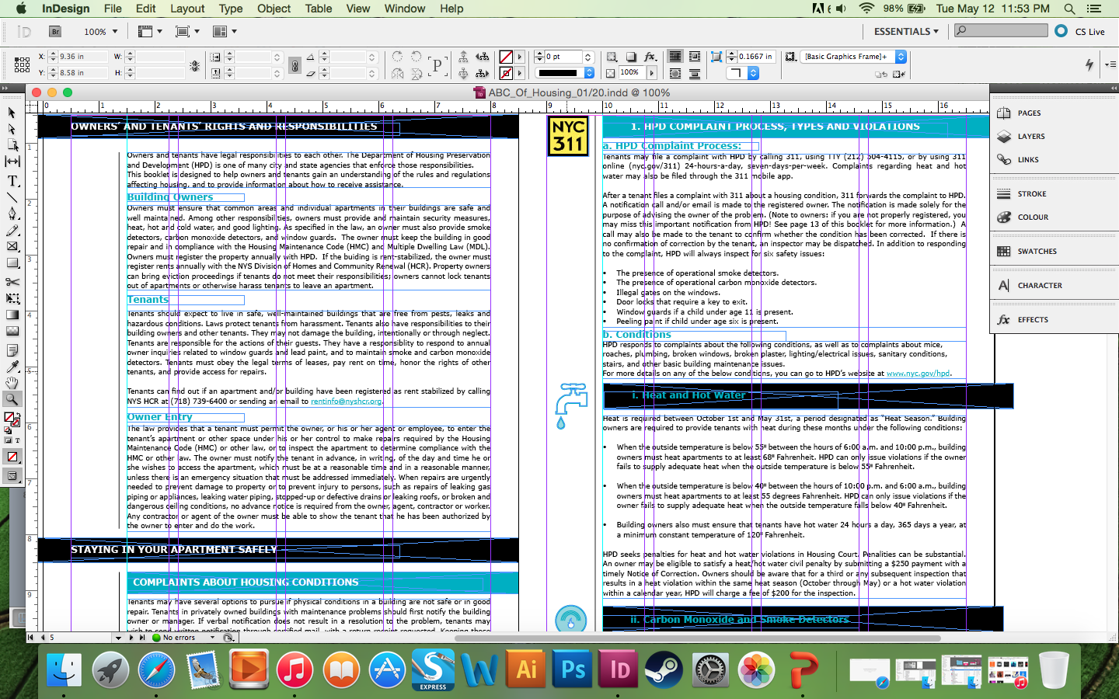

Slide 9
What did I learn from the internship?
I expected to learn more at the internship, but there were no graphic design department so I was the only designer there.
I did learn a lot about HPD and the way they work which I didn’t know about before.
I had extra practice on designing with a huge amount of text in small spaces.
I am happy that I have a couple published work already.

Slide 10
How my classwork at City Tech applied to my internship?
Writing journals every week helped me develop my writing skills a little.
The discussions that we make every two weeks are very important to learn about each others internship.
The reading that we did are important to improve our reading and writing skills.

Slide 11
THANK YOU.

