Slide 1
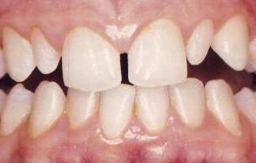
Macro & Microdontia
By: Angela Mancuso
Section D219
Tuesday 2:00 pm

Slide 2
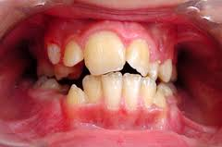
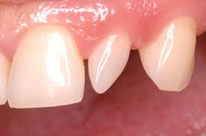
What Is Macro & Microdontia?
Macrodontia
abnormally large teeth
Microdontia
abnormally small teeth
Example: Maxillary third molar, and maxillary lateral incisors
A peg lateral
Macrodontia

Slide 3
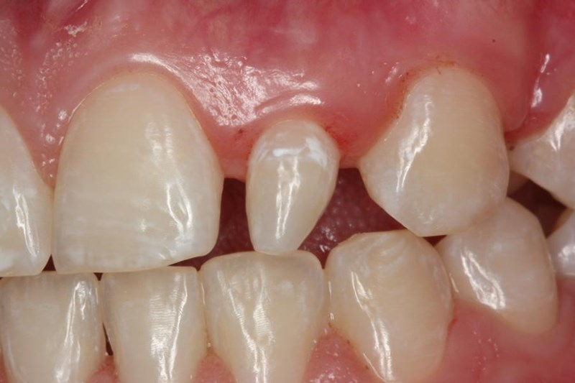
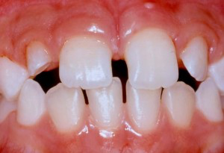
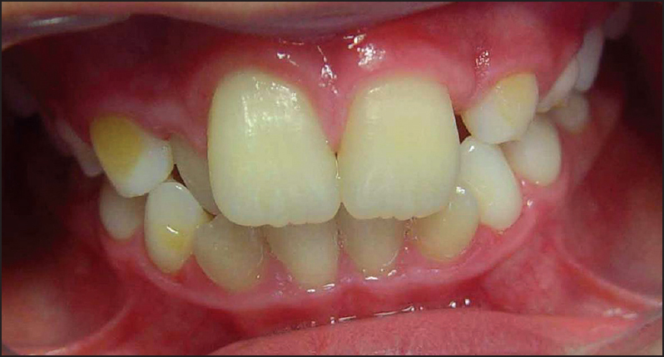

Slide 4
How Does This Occur?
Microdontia is associated with hypopituitarism or Down syndrome
Hypopituitarism is diminished hormone secretion by the pituitary gland, causing dwarfism in children and premature aging in adults
Macrodontia is associated with childhood hyperpituitarism
Hyperpituitarism is excessive production of growth hormones by the pituitary gland

Slide 5
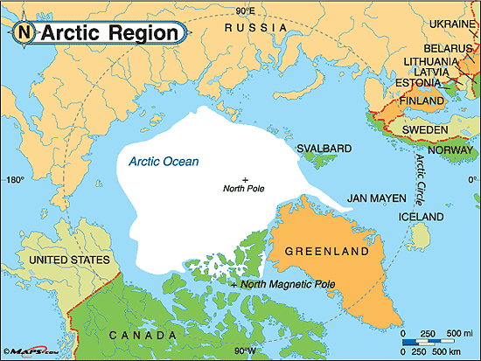
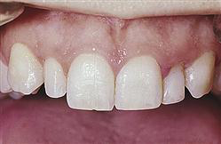
Other Reasons
Some population groups have larger teeth overall than other groups
One of these groups are the Inuit people of arctic regions of North America
Heredity can be a factor in microdontia.
A child may inherit large jaw from one parent and normal size teeth from another resulting in the illsuion of small teeth.

Slide 6
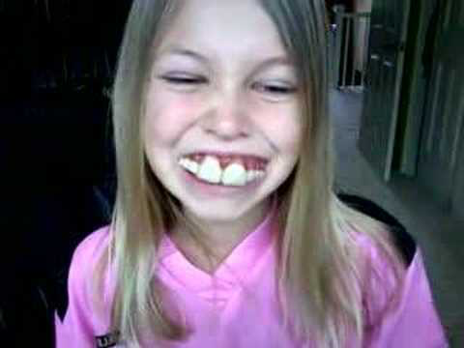
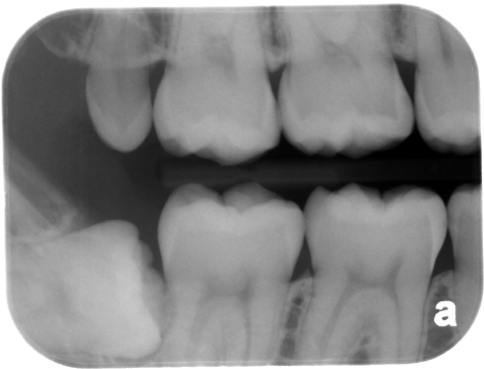
Role of the Dental Hygienist
Macrodontia and microdontia can be seen when doing an intraoral examination
Sometimes extractions are necessary, orthodontics, and enamelplasty for macrodontia which is shaving off portions of the tooth.
Suggest a proper toothbrush technique

Slide 7
Resources
Dental embryology, histology and anatomy -Fehrenbachand Popowics 4th edition
http://www.merriam-webster.com/dictionary/hyperpituitarism
http://www.intelligentdental.com/2011/12/09/abnormalities-in-size-of-tooth-teeth/

