Slide 1
Saint Laurent
By Makenna Prince

Slide 2
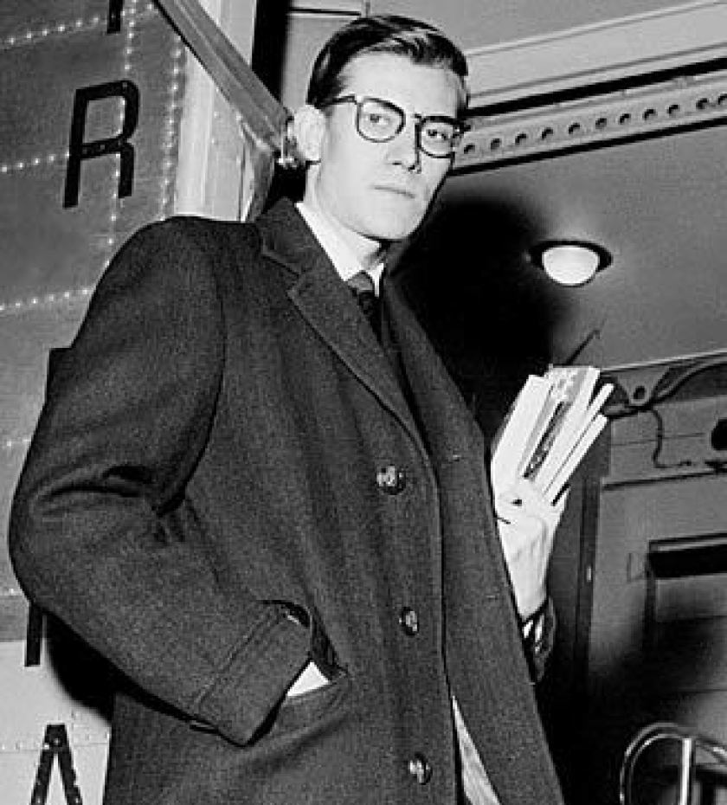
Yves Saint Laurent
Born: August 1st, 1936, Oran, Algeria
Designed clothing for his mom and sisters
At 17 he met Michael de Brunhoff
Moved to Paris
Enrolled in Chambre Syndicale de la Couture

Slide 3
Career Path
1955
Worked for Christian Dior
1957
First collection with Ligne Trapeze
1962
Set up fashion house with Pierre Berge
1966
Introduced le smoking
1998
Last ready-to-wear collection
1999
Tom Ford took over the house
2002
Last haute couture show

Slide 4
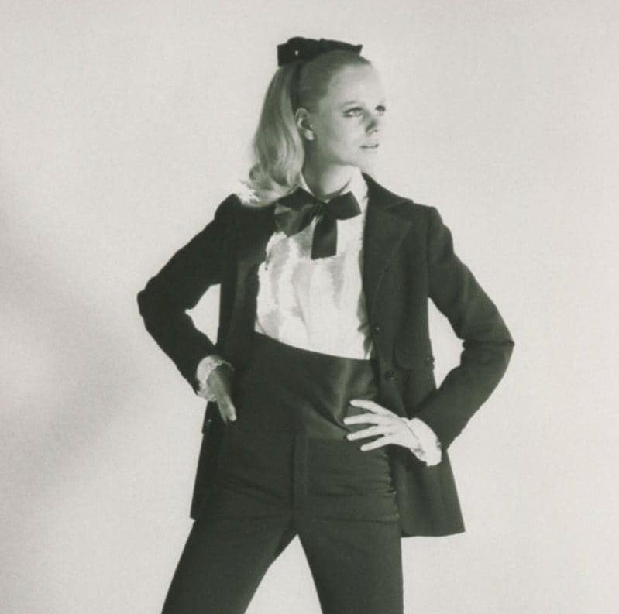
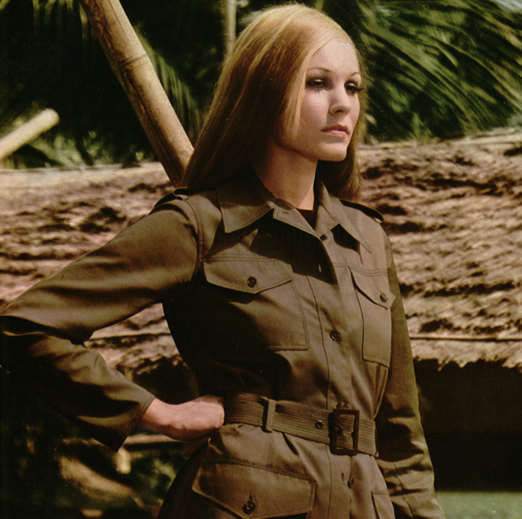
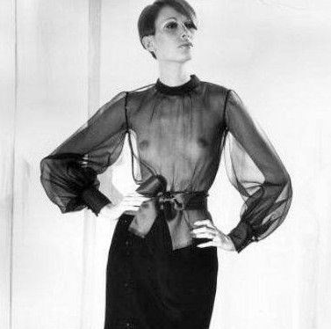
best-known contribution to the fashion industry
The smoking suit (Le Smoking)
The Safari Jacket
The sheer blouse

Slide 5
Interesting Facts
Saint Laurent was able to launch his fashion career at a young age
Dior made Saint Laurent the hire of his Fashion house

Slide 6
Conclusion
Saint Laurent was influential in bring forth self expression with his clothing.
He broke gender stereotypes by dressing women in suits such as the smoking suit making him a leader in breaking social norms in fashion.
Saint Laurent had an overall successful fashion career and brand.

Slide 7
References
B. (2020, August 18). Yves Saint Laurent. Retrieved from https://www.biography.com/fashion-designer/yves-saint-laurent
Craven, J. (2019, August 15). Yves Saint Laurent. Retrieved from https://www.vogue.co.uk/article/yves-saint-laurent-biography
McDowell, C. (2018, September 28). Yves Saint Laurent (1936-2008). Retrieved from https://www.businessoffashion.com/articles/news-analysis/yves-saint-laurent-1936-2008-2

