Slide 1
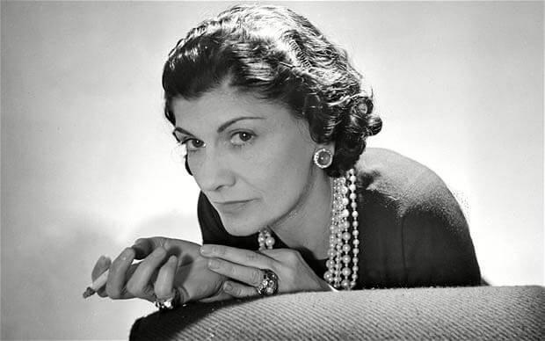
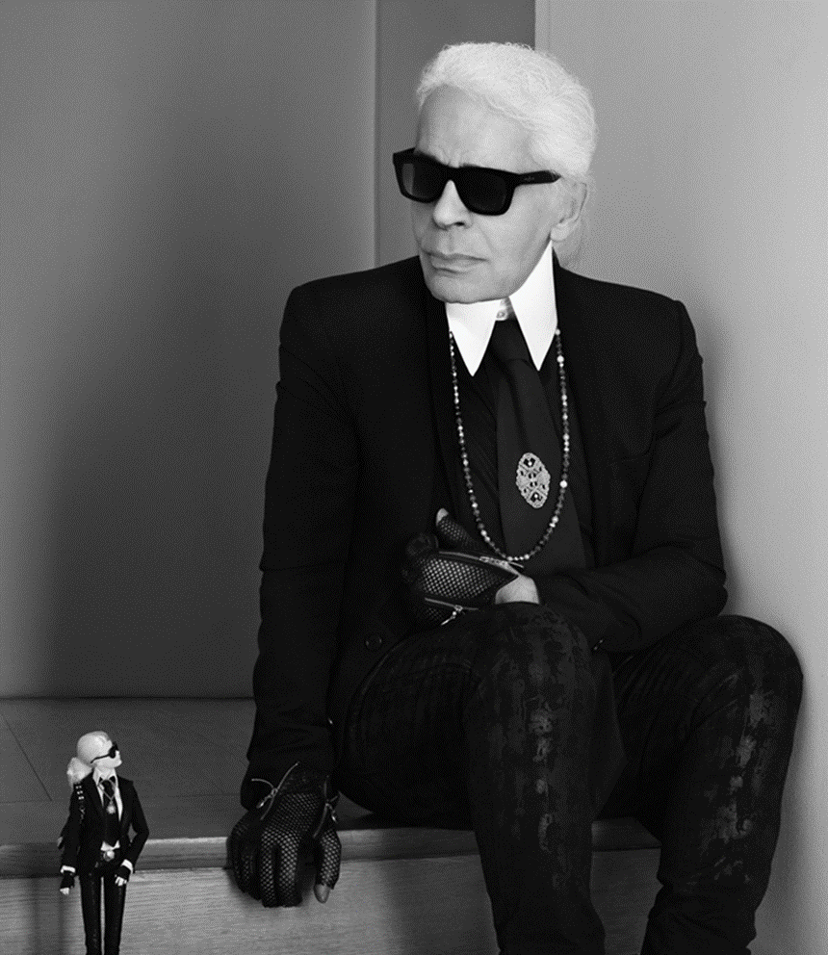

Chanel
The Brand
Presentation by Makenna

Slide 2
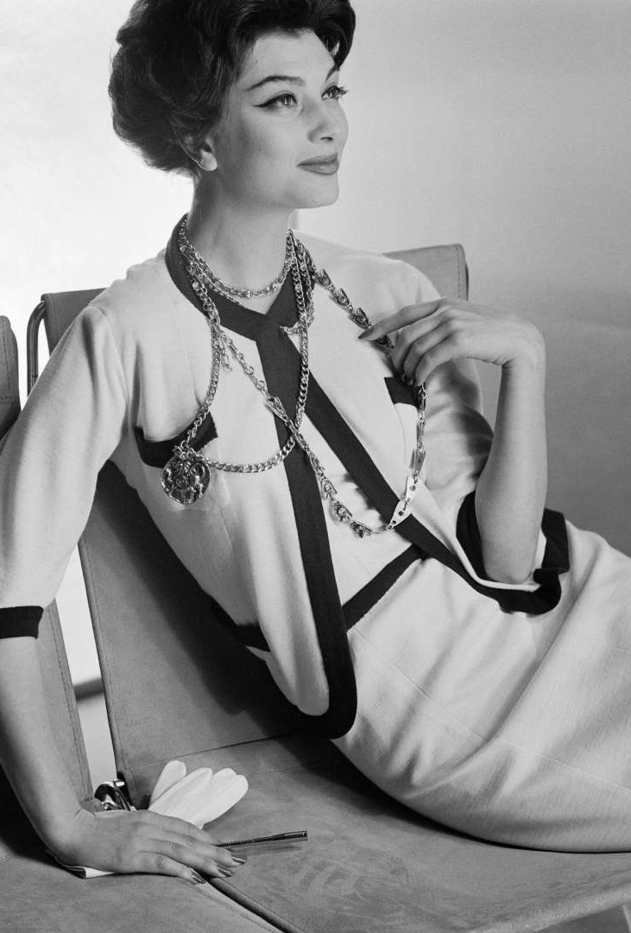
Introduction
Born: August 19th, 1886 in Saumur France
Learned to sew from the orphanage she was put into and from her aunt
She was a mistress and used it to her benefit
She was a milliner
Opened her famous Chanel house
Passed away at the age of 84 in the year 1971

Slide 3
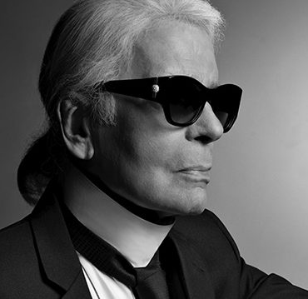
Introductions
Karl Otto Lagerfeld was born on September 10th , 1933 in Hamburg, Germany
Won a fashion design competition at 17
Revived the Chanel brand
Died Paris, France 2019

Slide 4







Career Path
Milliner – hat maker
Started to sell perfume
Created the Chanel Suit and Little Black Dress
Left fashion during WWII
Returned to fashion in her 70’s
Karl Otto Lagerfeld released a collection for Chanel
1910
1925
1950s
1984
1920s
1930’s
1983
Karl Lagerfeld
Opened his own brand

Slide 5
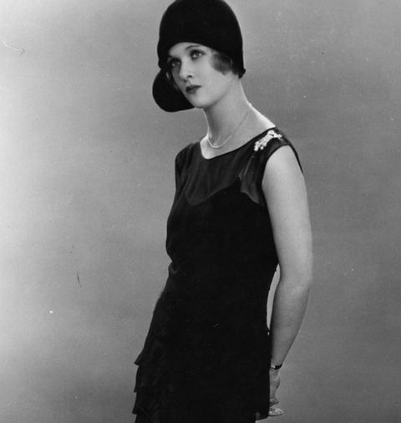

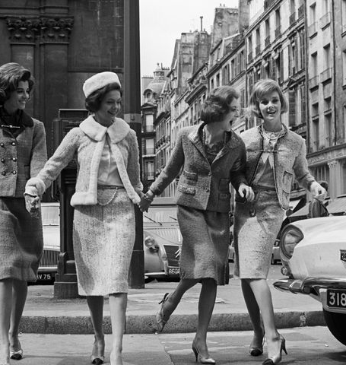
best-known contribution to the fashion industry
Little black dress
Luxury perfume
Chanel Suit

Slide 6
Interesting Fact
Chanel took a break from fashion after it was outed that she was in a relationship with a German diplomat.
She used the men to whom she was a mistress to help fund and start her fashion empire.
Karl won a design competition that propelled his career forward
He created the “cc” chanel logo

Slide 7
Conclusion
Coco Chanel created a simple, luxurious and comfortable for women in a time women clothing was uncomfortable
Karl Lagerfeld was able to recapture what made Chanel, Chanel and save the fashion brand

Slide 8
References
B. (2021, January 21). Coco Chanel. Retrieved from https://www.biography.com/fashion-designer/coco-chanel
Mackelden, A. (2019, February 22). Karl Lagerfeld’s Career Was Unlike Anyone Else’s. Retrieved from https://www.harpersbazaar.com/fashion/designers/g26415353/karl-lagerfeld-career-timeline/
The Editors of Encyclopaedia Britannica. (2021, January 25). Coco Chanel | Biography, Fashion, Designs, Perfume, & Facts. Retrieved from https://www.britannica.com/biography/Coco-Chanel
Why Chanel would cease to exist without Karl Lagerfeld. (n.d.). Retrieved February 04, 2021, from https://vinvoy.com/blog/chanel-without-karl-lagerfeld/

