Slide 1
City Tech 101
Winter 204
Professor Kim K. Mahase
Kim.mahase58@login.cuny.edu
City Tech 101 by Karen Goodlad and Sarah Paruolo is licensed under a Creative Commons Attribution-NonCommercial-ShareAlike 4.0 International License.

Slide 2
You Paid for It, Use It:
Resources + Services at City Tech
Session 4
January 11st 2024
Professor Kim K. Mahase
City Tech 101 by Karen Goodlad and Sarah Paruolo is licensed under a Creative Commons Attribution-NonCommercial-ShareAlike 4.0 International License.

Slide 3
Today’s Topics
Where College Happens, Pt. 3
Taking Notes
Overview of Resources + Services
Accessing Resources + Services
Asking for Help

Slide 4
Where does
college happen?
Notes:
We want students to understand that college isn’t just going to class and leaving. Getting a full college experience means that learning and growth happen in many different spaces and in different ways. Variations on these slides will appear in each presentation from Session 2 to Session 6.

Slide 5
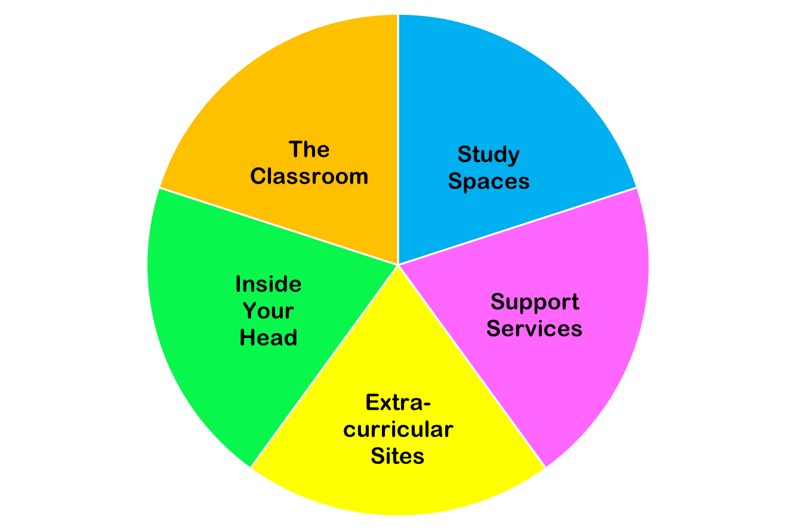
College happens in lots of places
These
are all necessary parts of college!
Notes:
You do NOT need to discuss each piece of this pie in detail. Just discuss the “pie wedge” for the current session and let students know that we will go over each of these pieces in subsequent sessions.

Slide 6
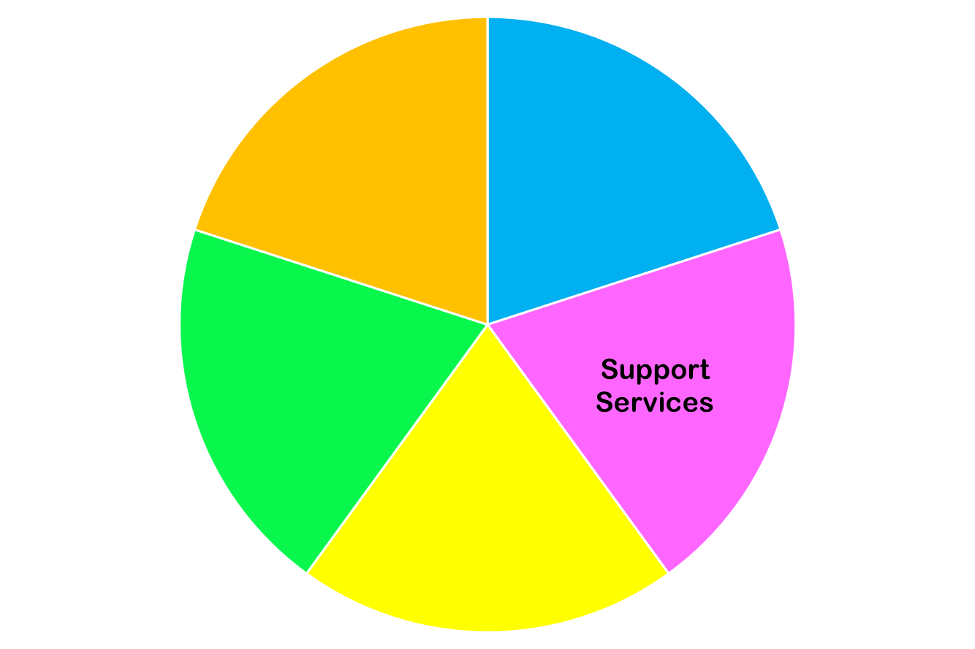
Today we are focused on…

Slide 7
College
Success

Slide 8
Three Keys to Success
Work Hard!
Get Involved!
Ask for Help!

Slide 9
Taking Notes

Slide 10
Effective Note-Taking Strategies
Studies have shown taking notes by hand is most effective!
Note-taking is not just a way to record material for later review–it is also a first step in learning the material
Don’t try to write down everything the professor says. Instead, identify main ideas and crucial information
Add your own questions, ideas, and connections to other course materials. For example, if an idea discussed in lecture relates to a reading you’ve done, mention that in your notes.
Consider using the Cornell Notes method.
Notes:
I added this section on note-taking because several students had asked specifically for note-taking tips. I really like the Cornell Notes method and recommend showing the linked short video. It connects well to the “You Can Grow Your Brain” article because the Cornell Notes technique specifically engages the brain in multiple ways.

Slide 11
Let’s test out our note- taking skills today!
Today you will be given a lot of information today about resources available at City Tech. There is more information here than you can remember all at once.
As you listen, try taking notes using the Cornell Method or another preferred technique. What do you need to write down to get to the information you need later?
We’ll check in at the end to see how we did.

Slide 12
Resources
+ Services
@City Tech

Slide 13
Academic
Resources + Services

Slide 14
Tutoring
Atrium Learning Center
Writing Center
Tutor.com [log in through Bb; access varies]
Department-Specific Tutoring (See Dept. Sites)
Self-Paced Department Resources

Slide 15
Student Success Center
Student Hub for questions, issues, confusion, guidance– any kind of help you need!
Connections to Emergency Resources + Funds
Coaching and Workshops
May contact you during the semester if you are struggling in your classes– but you can always contact them first!
Room: Library G-18R [ground floor of the Library Building, across from the elevators] Just walk in!
StudentSuccessCenter@citytech.cuny.edu or their website

Slide 16
Professor Office Hours
Questions from class
Questions about careers
Questions about majors or tracks
Questions about advisement
Questions about college or City Tech

Slide 17
Peer Leaders
First Year Programs Peer Mentors
Math Peer Leaders
Perkins Peer Advisement
Student Success Coaches
SLD Peer Navigators

Slide 18
City Tech Library
Reference Desk
Ask A Librarian
Research Guides
Technology Loans
Reserve Materials
Scanning + Photocopies
LGBTQ+ Resource
Website

Slide 19
Center For
Student Accessibility
If you had an IEP in high school
If you have any type of disability
If you are sick or unable to attend classes for more than a day or two
Website
City Tech is committed to supporting the educational goals of enrolled students with disabilities in the areas of enrollment, academic advisement, tutoring, assistive technologies, and testing accommodations. If you have or think you may have a disability, you may be eligible for reasonable accommodations or academic adjustments as provided under applicable federal, state and city laws. You may also request services for temporary conditions or medical issues under certain circumstances. If you have questions about your eligibility or would like to seek accommodation services or academic adjustments, you can leave a voicemail at 718-260-5143, send an email to: Accessibility@citytech.cuny.edu, or visit the Center’s website at http://www.citytech.cuny.edu/accessibility/ for more information.

Slide 20
Comprehensive Programs

Slide 21
Full Service
ASAP
ACE
SEEK
CUNY EDGE

Slide 22
Administrative
Resources + Services

Slide 23
College Administration
Registrar
Bursar
Financial Aid
Scholarship & Residency Services
International Student Services

Slide 24
Student-Centered
Resources + Services

Slide 25
First Year Students
First Year Programs
FYP Peer Mentors

Slide 26
Student Leaders
Student Government Association (SGA)
NYPIRG

Slide 27
Student Clubs + Events
Student Life + Development (SLD)
Yellow Jacket Journey (Presence)

Slide 28
Professional
Development Center
Exploring majors, interests, and values
Resume and Cover letter critiques
Interview preparation & Mock interviews
Graduate School Exploration
Virtual Workshops & Seminars
Virtual Informational Sessions with Employers
Virtual Networking Events
Website
The PDC encourages students to make an appointment in their first year of coursework to plot a successful course of study!

Slide 29
Workshops and Speakers
Targeted topics
Experts in different areas
Department specific

Slide 30
Technology
Resources + Services

Slide 31
Computer Labs
Atrium Learning Center, Library Building, ground floor
Library, 4th floor
General Building, 6th floor
Vorhees, 2nd floor
Virtual Computer Lab

Slide 32
Student Help Desk
CUNYFirst
CT email + Email Lookup
One Drive + Microsoft Office
Blackboard
OpenLab
Zoom
Specialized Programs + Tools
Student Help Desk StudentHelpDesk@citytech.cuny.edu
Room L114 718-260-4900

Slide 33
Targeted Resources + Services

Slide 34
Student Health + Well-Being
Counseling Services
Community Standards
Wellness Center
Public Safety
Petrie Fund (via Student Success Center)
Recreation and Intramural Sports
Fitness Center

Slide 35
Student Health + Well-Being
Nutrition for Education & Student Achievement (N.E.S.T.)
The N.E.S.T. is City Tech’s Food Pantry
Don’t miss the chance to grab free groceries! Perishable and non-perishable items, such as fruits, vegetables, canned foods, and dry goods are available.
Located in the General Building, Room 414
Open to all current students
Need to schedule an appointment to pick up food: https://citytech-cuny.presence.io/event/food-pantry

Slide 36
Affinity Support
Black Male Initiative (BMI)
Veteran Support Services
Childcare Center
CREAR Futuros
Identity-Based Clubs

Slide 37
LGBTQIA+ Support
Pride Club
Contact: lwestengard@citytech.cuny.edu
Pride Lounge (AG29B)
Spring Hours TBD
Supervisor Daniel Ryan: DRyan@citytech.cuny.edu
Minor in Gender and Sexuality Studies
Counseling Contact
Jennifer Cruz
JCruz@citytech.cuny.edu
CUNY LGBTQ Hub
Instagram account: @citytechpride
Notes:
Pride Club meets during club hour, Thursdays 12:45-2:15

Slide 38
How did your note taking go?
Look back at your notes. How do you think you did?
Take a minute to go back and fill in where anything seems to be missing.
What seems most important? If you were going to study your notes for an exam, what strategies would you use?

Slide 39
Accessing Resources
+ Services

Slide 40
Navigating the
City Tech Website
www.citytech.cuny.edu

Slide 41
Small Group Scavenger Hunt
Directions:
Using the information from class today and the City Tech website, find the answers to the following questions.
The group with the most correct answers at the end of 15 minutes wins!
Accessing
Resources
+ Services

Slide 42
SCAVENGER HUNT

Slide 43
Asking for Help!

Slide 44
What are some factors that might make a student less likely to ask for help?
Brainstorm ideas and let’s make a list together…

Slide 45
Asking for help is...
Responsible
Healthy
Proactive
Normal

Slide 46
Asking for help is NOT...
A sign of weakness
A sign of failure
A sign that you don’t belong in college

Slide 47
“Be strong enough to stand alone;
Smart enough to know when you need help;
And brave enough to ask for it.”

Slide 48
Recap
Where College Happens, Pt. 3
Taking Notes
Overview of Resources + Services
Accessing Resources + Services
Asking for Help

Slide 49
Before Session 5…
Complete Reflection on OpenLab by replying to Reflection #4 Post.
Reflection #4
Now that you are halfway through the workshop, what questions do you still have about becoming a college student? Ask four questions you would like to have answers to by the end of CT101.

Slide 50
You Paid For It, Use It:
Resources + Services at City Tech
Session 4
January 11th 2024
Professor Kim K. Mahase
City Tech 101 by Karen Goodlad and Sarah Paruolo is licensed under a Creative Commons Attribution-NonCommercial-ShareAlike 4.0 International License.

Slide 51
FOR OPTIONAL ACTIVITY: insert immediately after slide 9
Think of two activities, resources, or support services you would like to access during your time at City Tech.
Take a minute to write them down.
As we go through the presentation, look for information on those items!

Slide 52
FOR OPTIONAL ACTIVITY: insert immediately after slide 37
Look through your notes.
Did you hear about any resource or service at City Tech that matches up with what you wrote before the presentation?
Which service did you hear about? How do you think it might help you?

