Slide 1
Ethical Concerns for Conducting Health Psychology Survey Research on Racial Minorities in the United States
Presented by
Amanda Almond, Ph.D.
Associate professor
Social sciences department (Psychology)

Slide 3
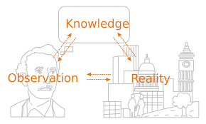
These observations inform the research done by health psychologists!
Methods of Science
Observations of the world inform the research done by health psychologists
These observations inform the research done by health psychologists!

Slide 4
People of color share a disproportionate burden of disease and death by disease

Slide 5
What do Health Psychologists See?
Disease and Disparity
Mortality: number of deaths caused by specific illness per population
Morbidity: number of specific illnesses per population
Incidence: number of new cases of specific illness per population (for a specific time)
Prevalence: number of all current cases of specific illness per population (for a specific time)
Relative risk: number of cases of specific illness in one population relative to another population
When I see differences in these rates, I take a closer look by conducting research on humans (I put my hand on the elephant)

Slide 6
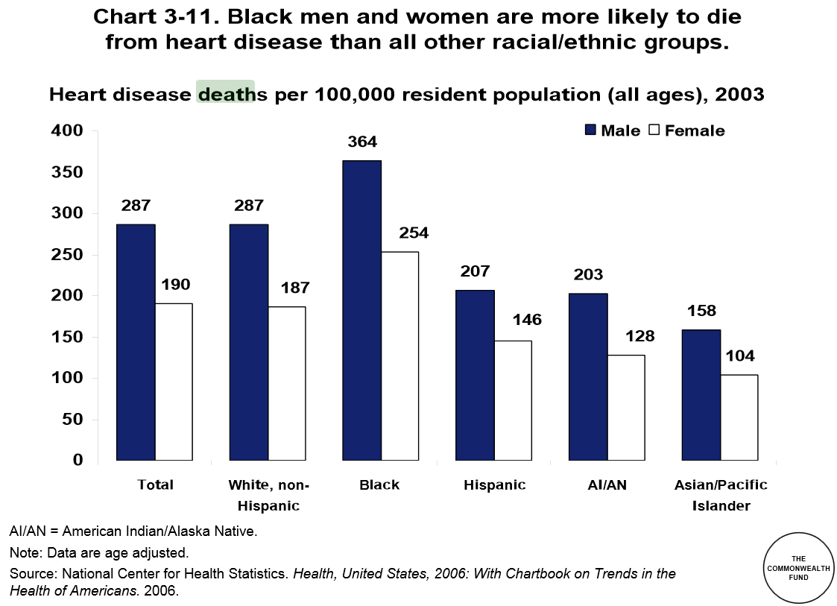
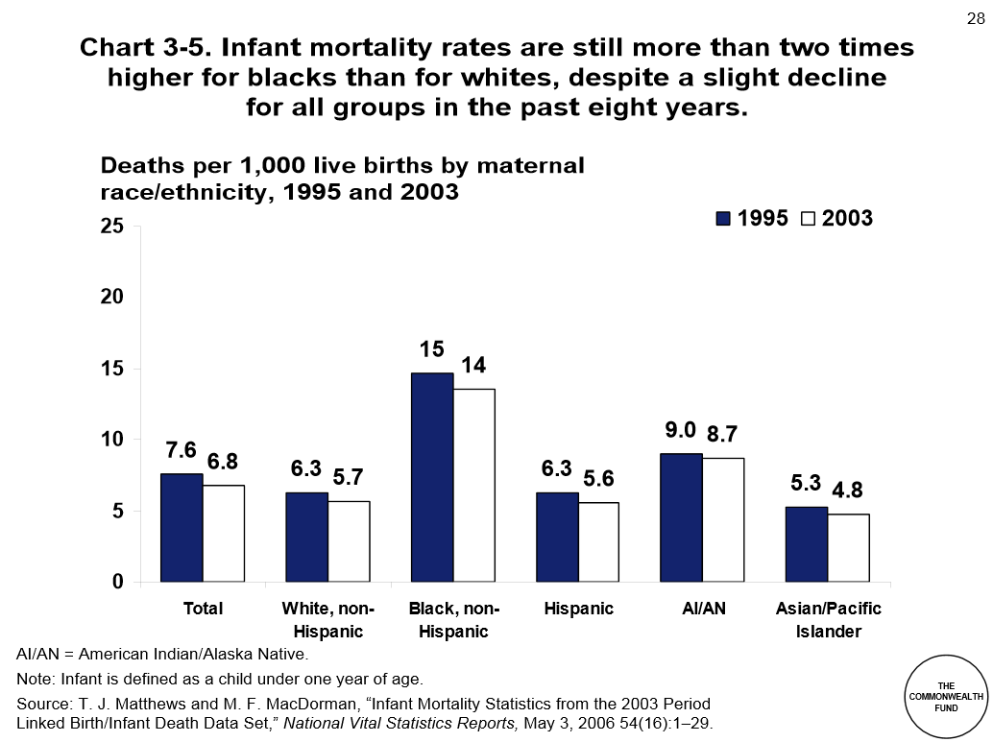
Racial disparities in mortality

Slide 7
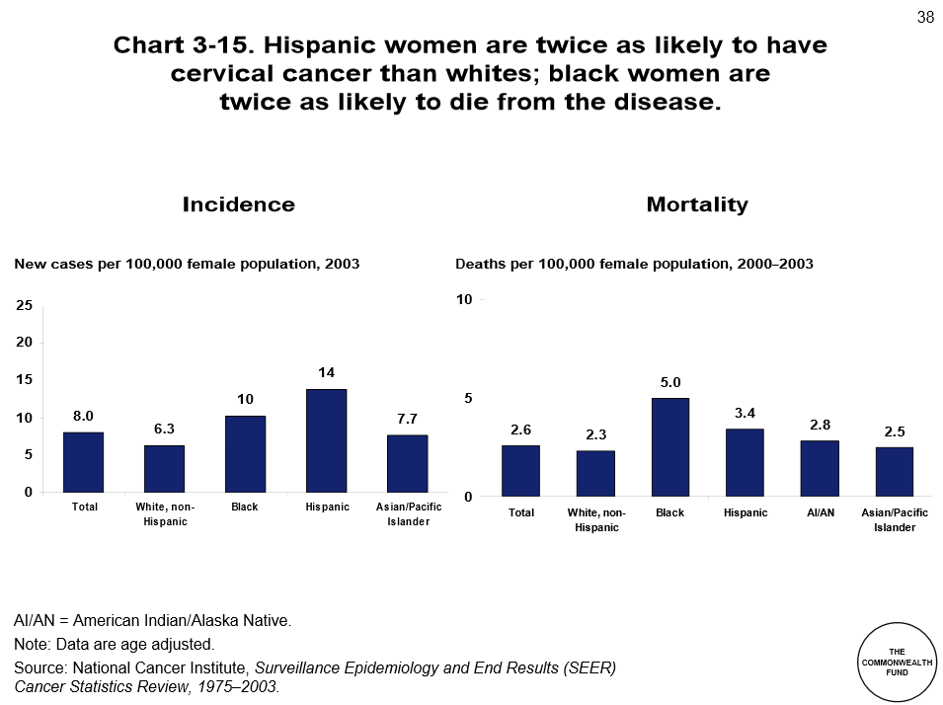
…And in Incidence and Mortality rates

Slide 8
Racial differences in Morbidity

Slide 9
… and disease Prevalence

Slide 10
Relative Risk of dying from asthma

Slide 11
How do we get information about people?
Surveys!
Pros & Cons
The survey method of data collection is likely the most common of the research methods.
The benefits of this method include low cost, large sample size, and efficiency.
Practical issues
The major problem with this method is accuracy: since surveys depend on subjects' motivation, honesty, memory, and ability to respond, they are very susceptible to bias.
A researcher must have a strong understanding of how to properly frame survey questions in order to gather reliable and relevant information.
Psychological measurement is its own discipline--- reliable measures are certain
Current research example: a widely-used survey simply ‘doesn’t work’ on representative samples

Slide 12
Connecting Health and Race
Disease and Vulnerability: What we Know
Populations disenfranchised via public policy/historical practices
Groups of people with historically limited rights
Marshall Islanders; TB outbreak after nuclear testing
Pima Indian tribe; rates of diabetes and fatalities; water rights revoked
Factory towns; closures and rates of unemployment and premature death (not found in other countries)
Variable explanations as to why groups of people are sick– but often disconnected from ethics and politics
Example of ethics, science and politics being inextricably linked: Nuclear Weapons

Slide 13
Understanding Health Disparities
Starting Point:
Inequalities
in Health
Designing Multiple
Interventions
Explanations & Causal Theory
⬅
⬇
Biological
Processes
& Overall
Model
Sociological
Explanations
Biological
Societal
Processes
Life
Events
Social
Support
Coping,
Vulnerability
& Resistance
Individual

Work
Stress
Theories
⬇
Behavioral
Theories
Personality

Slide 14
Research Concerns: Representation
Population: an entire group of people (e.g., Black American, college students)
Sample: a representative group of people from the population

Slide 15
Research Concerns: Power
Type I and Type II Error
Type I (α)
Something is happening, but you are unable to capture it
“The absence of evidence is not evidence of absence”
Type II (β)
You found something, but it was actually nothing
How I remember these differences: Type I error is not finding the murderer and s/he is still on the streets, while Type II error is putting an innocent person in jail for the crime

Slide 16
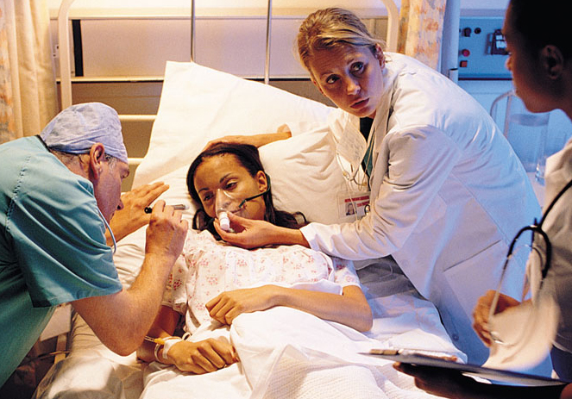
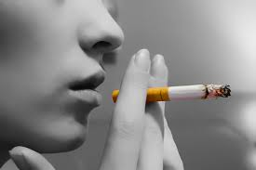
Research Concern: Effect and Sample Size
Effect size
Effect size is considered either small, medium, or large
Small effect size -> need large sample; Large effect size -> smaller sample required
Psychologists must balance which phenomena they research with the sample they can obtain
It essential to be upfront and honest about the ability of your research design when making claims about benefits to participants.

Slide 17
Recap
Power Analyses: Two types
Calculating sample size for effect size (strength of relationships)
Calculating sample size for parameter estimates (statistics such as means)
Strong theoretical underpinning
Relationships that have been long established are best suited for scientific research
This is essential to understanding effect size!
Sampling: Time and money
Large sample sizes require time (so do longitudinal data)
Participants need to be recruited widely and compensated

Slide 18
Example of My Own Research
GOAL: To improve upon the role played by behavioral scientists as Black health advocates
HYPOTHESIS: Communicating “race as risk” might predict health behavior-antecedents of Black Americans
AND, subtle forms of discrimination (microaggression) from physician influence people’s perceptions of health
Power analyses were conducted for both sample size and parameter estimates: the suggested sample size was 112 per group (n=336) for parameter estimate; 92 per group for effect sixe (n=276)
Total sample: n=388

Slide 19
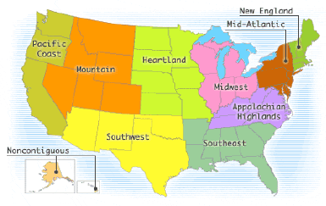
Sampling: Representativeness
Gender, N=388
Education, N=388
Body Mass Index, N=385, Missing=3
Male/Mostly male | 39.1%
Intersex | <1%
Female/Mostly female | 60.7%
< than 8th grade | <1%
Some high school | 2.8%
High school/GED | 20.4%
Some college | 45.2%
College, B.A./B.S. | 24.3%
Graduate School/College | 7.0%
Underweight <18.5 | 1.8%
Normal Weight 18.5-24.9 | 31.4%
Overweight 25.0-29.9 | 27.6%
Obese >30.0 | 38.4%
Geographical Region, N=388
 | Data Set | Cumulative | National Average/Black Population by Region
New England | <1% | 21% | Northeast: 18.3%
Mid-Atlantic | 20.9%
Appalachian | 8.3% | 15.9% | Midwest: 18.2%
Heartland/Midwest | 7.5%
Southeast | 31.2% | 42.8% | South: 54.3%
Southwest | 11.6%
Mountain | 6.2% | 14.4% | West: 9.1%
Pacific Coast | 8.2%
Non-contingent U.S. | 5.4% | n/a | n/a
Cost: $1600 per trial
Time: Over time I’ve reached approximately over 1500 participants

Slide 20
What predicts someone’s preparedness to change?
Various aspects of Black identity related to how we process risk information about disease:
Influencing Experience of Microaggression (from Providers):
Skin Color
Desired Skin Color
Skin Color Satisfaction
Racial Centrality
Racial Regard (Private and Public)
Racial Ideologies (Assimilationist, Nationalist, Humanist, or Oppressed Minority)
Influencing Decision to Change Behavior
Microaggression
Race as biological vs social
Racial Attributions of disease

Slide 21
Conclusions and Questions
Let’s revisit the Indian Tale of the Blind Men and the Elephant
Which character from the story was most memorable?

Slide 22
Thank you! Time for Questions

Slide 23
Views on Race
Various explanations of racial health disparities:
Are differences between “races” biological?
NO! Do not to reduce people to genetics, but rather look closely at their lived experiences
Are groups of people similar enough to one another to be put in the same group?
NO! Then, conceptually, how does “race” work in the U.S.?
Two views of race: biological and social
All views of race do the same thing: explains difference between groups and similarities with groups… the difference is in the explanations.
Social race is the only view with scientific evidence. Notions that genetics differences are what make “the races” is not accurate or true.

Slide 24
Creating a Reliable Measure of Experience with Medical Professionals
Defining microaggression: unintentional, automatic slights that reinforce inferiority
Measure adapted from Constantine (2007)
Term “therapist” replaced with “physician”
Open ended questions assessed validity (trustworthiness)
Research was piloted and I asked people what matters to them.
Excellent psychometric properties; predictive of frequency of doctor’s visits (pilot conducted prior to study)

