Slide 1
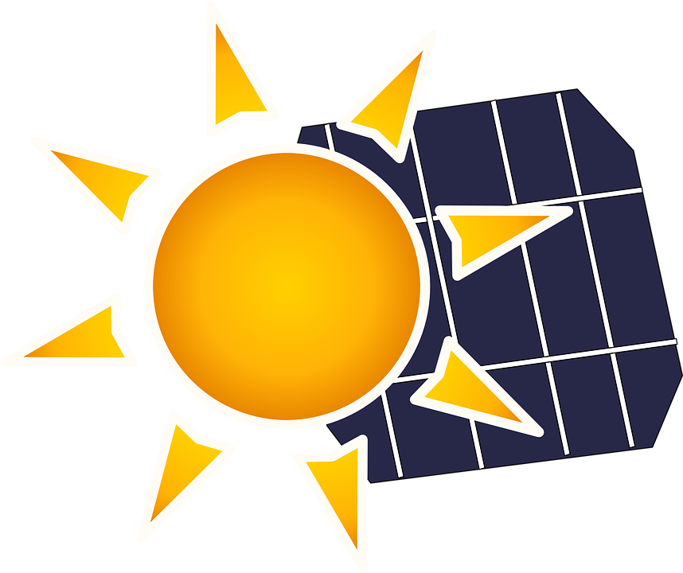
How can the efficiency of solar energy be improved and what are some of the issues involving sustainable solar energy?
Professor MacDonald
Environmental Economics D728
By: Kwang & Or

Slide 2
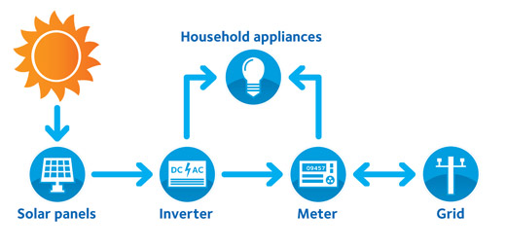
What is Solar Energy?
Solar energy is, simply, energy provided by the sun. This energy is in the form of solar radiation, which makes the production of solar electricity possible. Solar energy is the cleanest and most abundant renewable energy source available.
http://www.seia.org/about/solar-energy

Slide 3
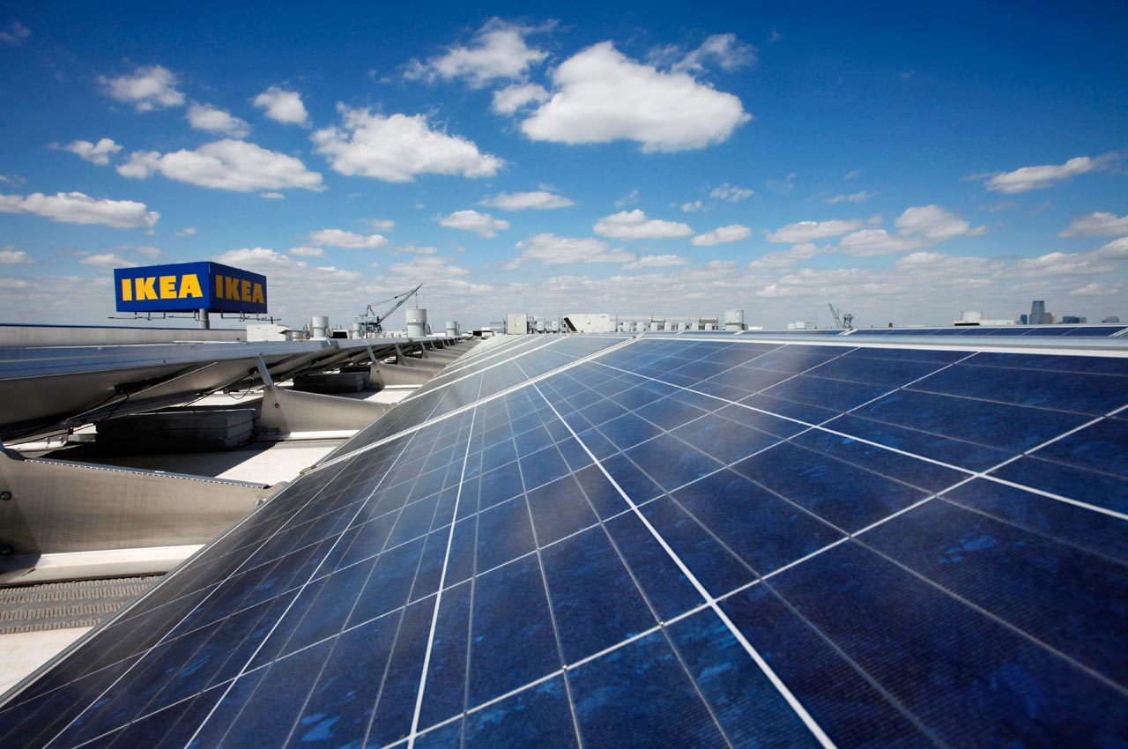
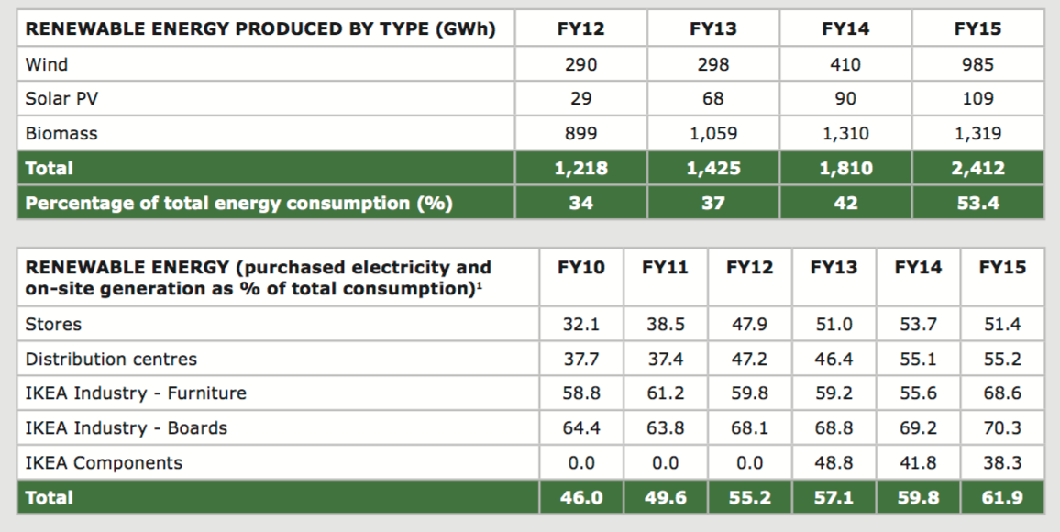
Field Based Research
In 2013, IKEA installed around 550,000 PV panels on more than 100 stores and other buildings in nine countries.
http://www.ikea.com/ms/en_US/img/ad_content/2015_IKEA_sustainability_report.pdf
Notes:
http://www.ikea.com/ms/en_US/pdf/reports-downloads/sustainability-strategy-people-and-planet-positive.pdf

Slide 4
Solar Energy History
7th Century B.C. Magnifying glass used to concentrate sun’s rays to make fire and to burn ants.
1954 - Photovoltaic technology (4% efficiency)
1958 - Vanguard I the first solar-powered satellite, 50 Years
1981 - The Solar Challenger, first solar-powered aircraft.
1982 - The Quiet Achiever, first solar-powered car
As of 2014, 46% Maximum solar cell efficiency from Soitec & Fraunhofer Institute. (Zachary Shahan, 2014)
https://www1.eere.energy.gov/solar/pdfs/solar_timeline.pdf

Slide 5
What are the advantages of solar energy?
There are more than 30 advantages for solar energy.
It's a renewable energy source
No Pollution
Save/Make Money
http://www.solar-facts-and-advice.com/advantages-of-solar-energy.html

Slide 6
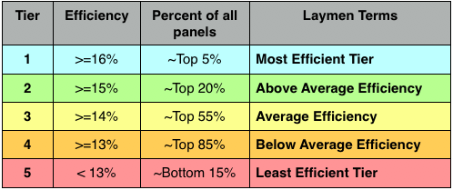
Is Solar Energy Sustainable ?
No, solar energy is not sustainable. Currently we can only convert around 23.8% of sunlight into energy.
Solar panel efficiency
http://panasonic.hol.es/panasonic-beats-sunpowers-new-solar-module-efficiency-record#.VzvQ2vkrKCo

Slide 7
What are some of the obstacles stopping us from achieving sustainable solar energy?
Solar cells only produce energy when the sun is shining on them.
Solar energy storage, cheap battery packs have reliability issues and good quality battery packs are more expensive.
Solar cell efficiency isn’t good enough, we need to produce more electricity than we need.
Solar energy infrastructure, everything that currently runs on fossil fuels would need to be converted into being solar-compatible.
http://www.makeuseof.com/tag/solar-energy-sustainable-4-problems-stop-solar-revolution-tracks/

Slide 8
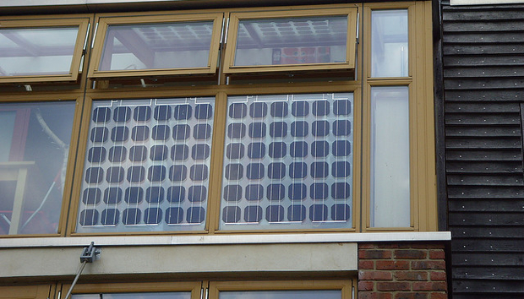
Solar Cell Efficiency
Currently chemistry researchers are studying energy loss of plastic material for development of highly efficient, low-cost and flexible solar energy cells.
This category of plastic material is called organic semiconductors.
This research can lead to applications such as entire buildings being covered in semitransparent, flexible windows that act as a giant solar cell.
http://phys.org/news/2015-06-efficiency-solar-energy-cells.html

Slide 9
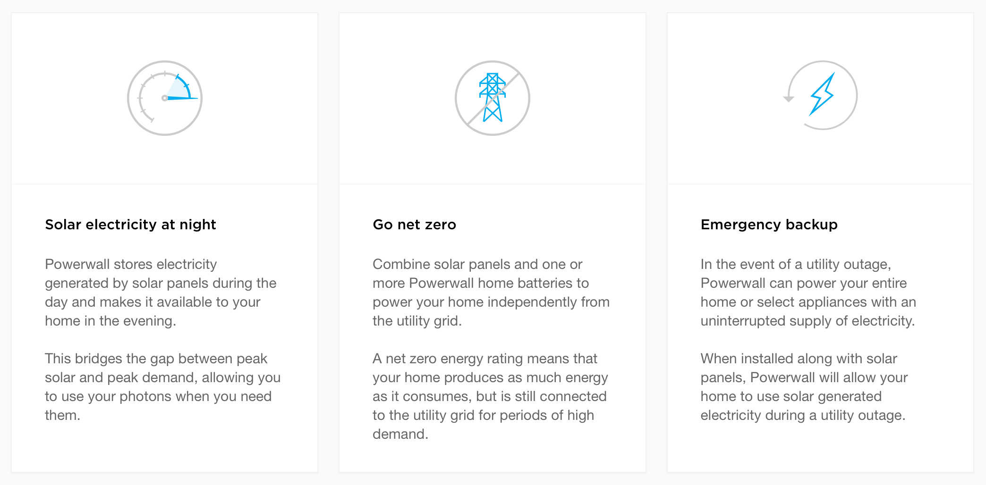
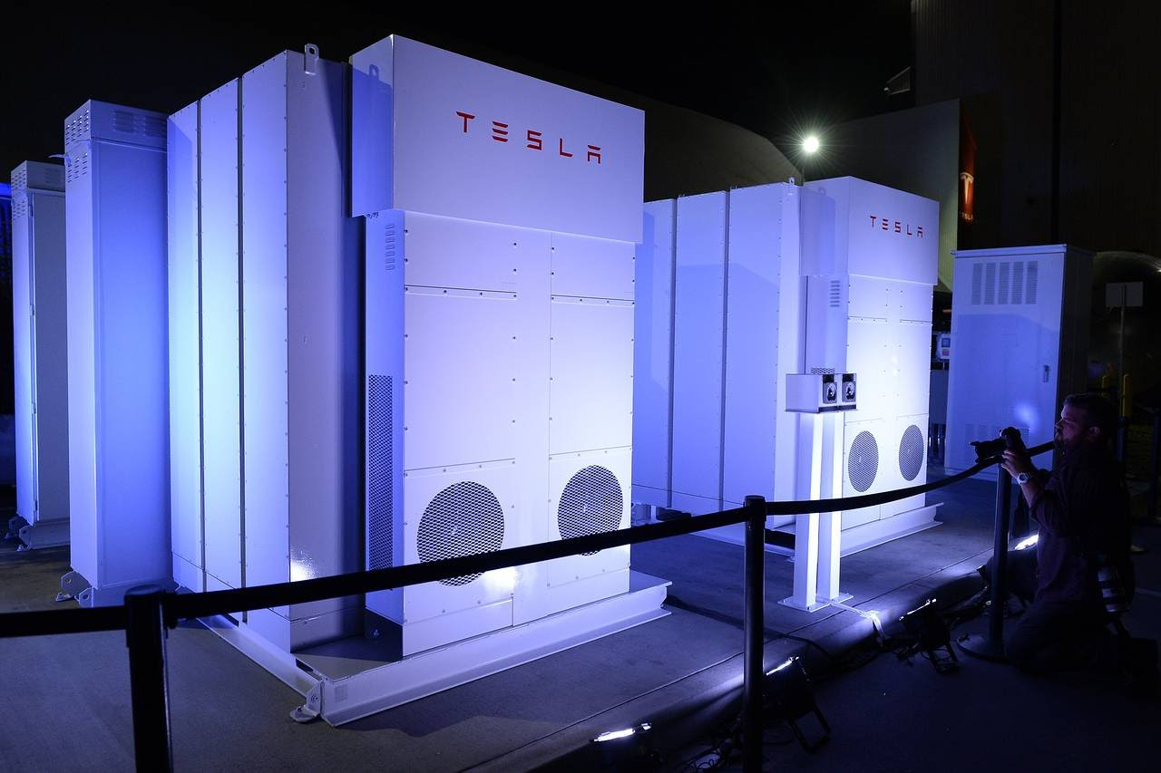
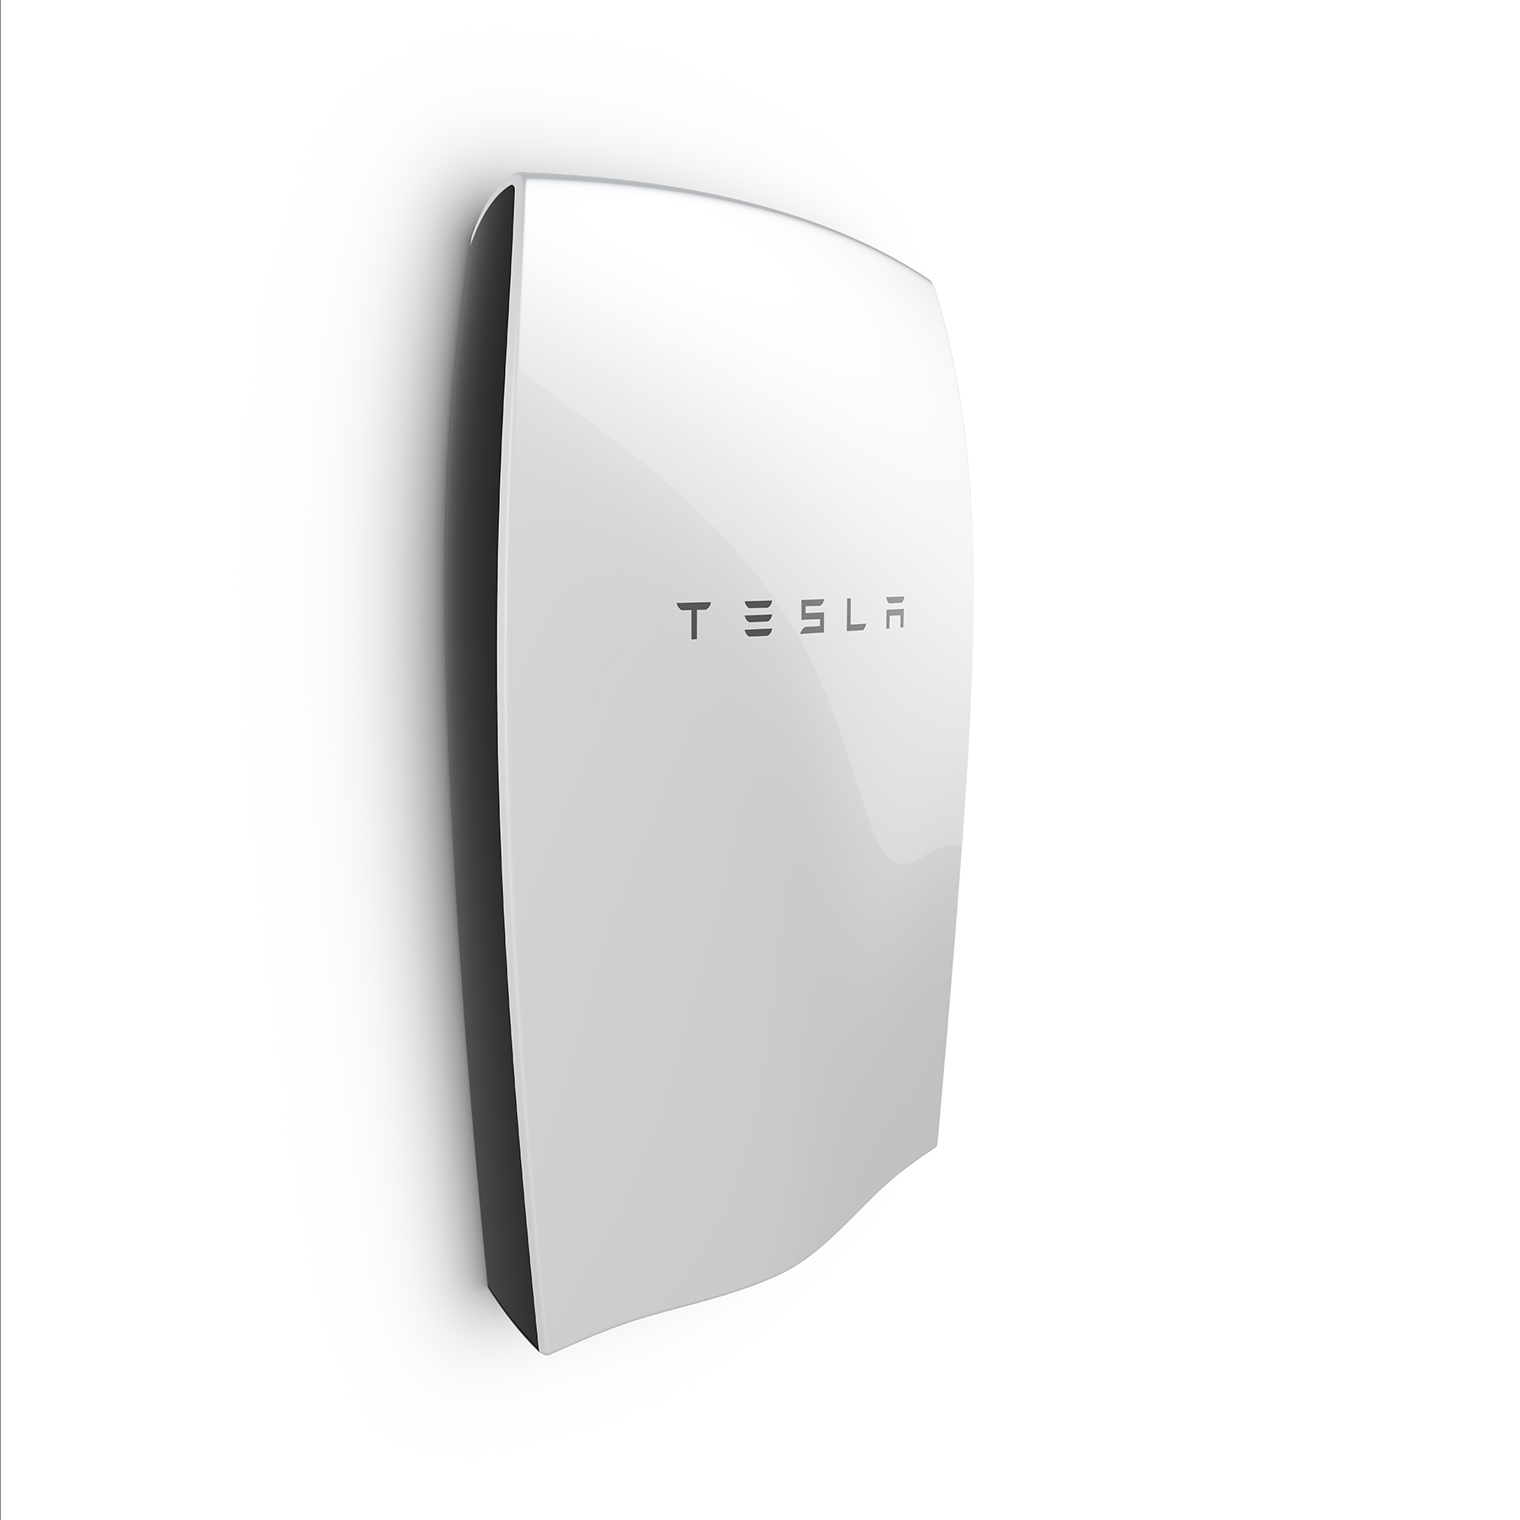
Storage Solution
Tesla Power Wall & Powerpack
https://www.teslamotors.com/powerwall

Slide 10
Resources
http://www.seia.org/sites/default/files/resources/EA_ShiningCities2015_scrn.pdf
https://www3.epa.gov/
https://www.epa.gov/re-powering
http://energy.gov/eere/solarpoweringamerica/solar-powering-america-home
https://www.washingtonpost.com/news/energy-environment/wp/2015/08/04/how-the-clean-energy-boom-let-epa-toughen-up-its-carbon-rules/
https://www3.epa.gov/climatechange/kids/solutions/technologies/solar.html
https://www.epa.gov/greenpower
http://www.npr.org/sections/alltechconsidered/2016/04/05/470810118/solar-and-wind-energy-may-be-nice-but-how-can-we-store-it
https://www.teslamotors.com/powerwall
https://www1.eere.energy.gov/solar/pdfs/solar_timeline.pdf
http://phys.org/news/2015-06-efficiency-solar-energy-cells.html
http://www.makeuseof.com/tag/solar-energy-sustainable-4-problems-stop-solar-revolution-tracks/
http://pureenergies.com/us/how-solar-works/solar-panel-efficiency/
http://www.npr.org/sections/alltechconsidered/2016/04/05/470810118/solar-and-wind-energy-may-be-nice-but-how-can-we-store-it
http://cleantechnica.com/2014/02/02/which-solar-panels-most-efficient/
http://www.ikea.com/gb/en/campaigns/solar-panels.html

