Slide 1
How to Create Sustainable Living for Non-homeowners?
Environmental Economics ECON 2505-D727
Tiffany Hodgson
Prof. S. MacDonald

Slide 2
The Hydrogen House Project by Mike Striki in Hopwell, NJ
Mike is a engineer and inventor that created the first solar hydrogen house in North America.
Total cost of $500,000 of which $100,000 was funded by Mike Striki
He pays no energy bills and sells excess electricity to the utility company
No pollution, emission is only water and oxygen!!

Slide 3
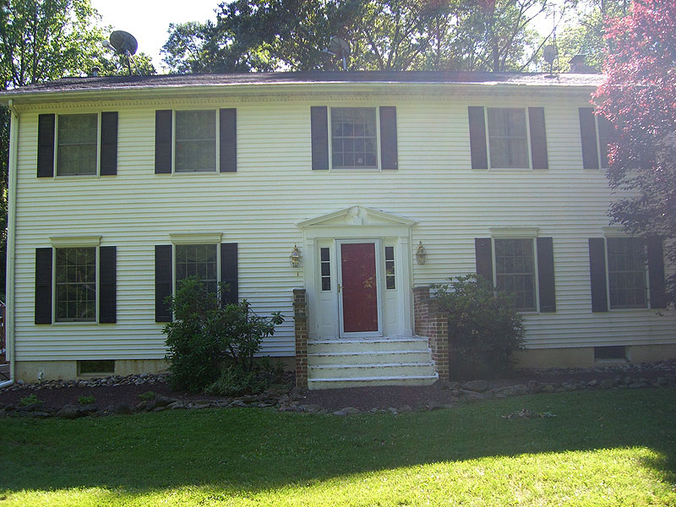
Front of the Hydrogen House
(HHP, 2016)

Slide 4
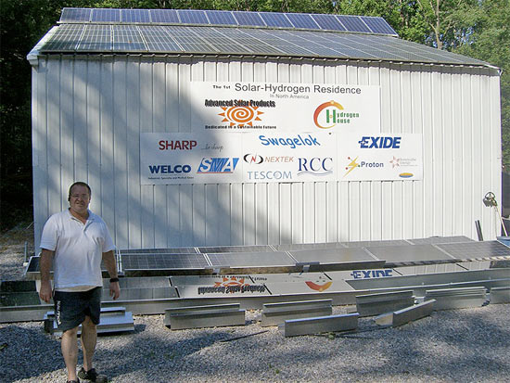
Workshop with 21 kilowatt array of solar panels
(HHP, 2016)

Slide 5
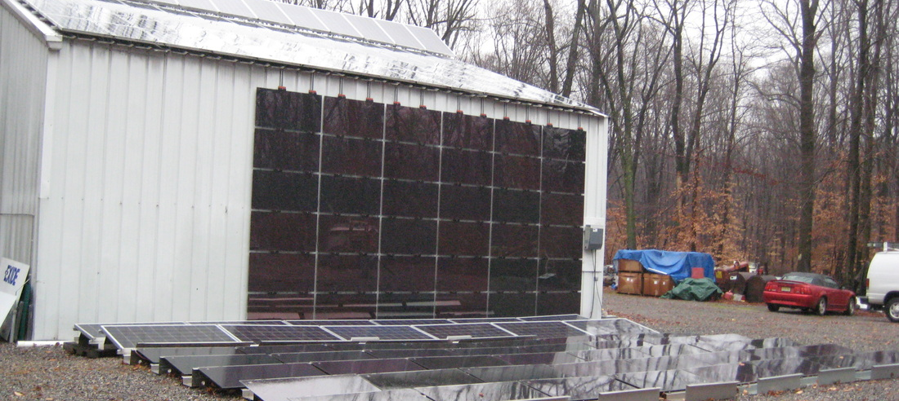
Workshop with 21 kilowatt array of solar panels
Side View
(HHP, 2016)

Slide 6
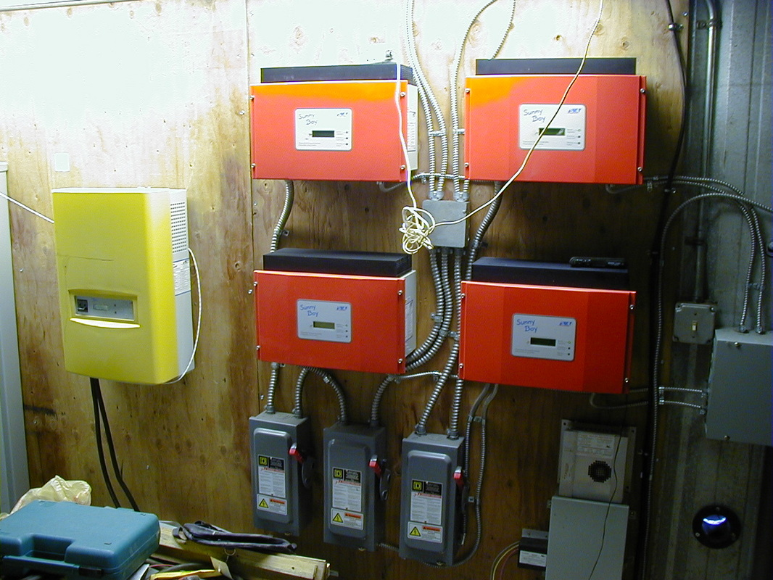
Inverters
Transforms solar panel power from DC to AC
(HHP, 2016)

Slide 7
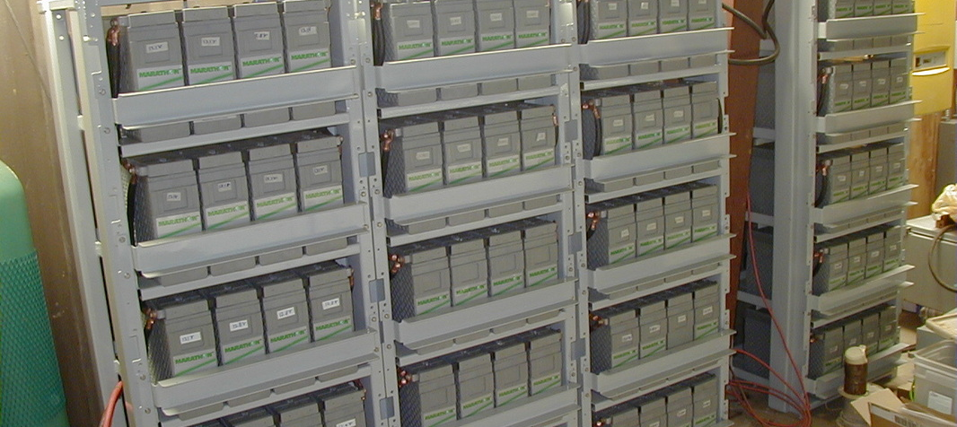
Battery Bank
(HHP, 2016)

Slide 8
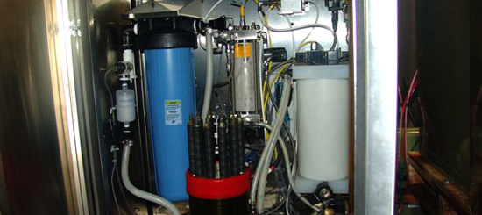
Inside the electrolyzer
Uses electric current to split water into hydrogen and oxygen
(HHP, 2016)

Slide 9
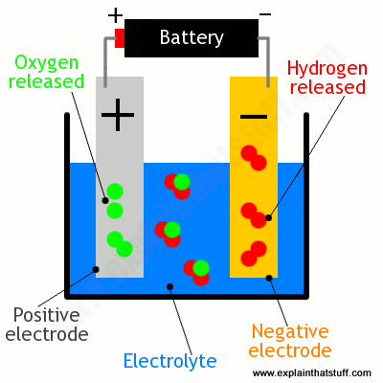
How a Electrolyzer Works

Slide 10
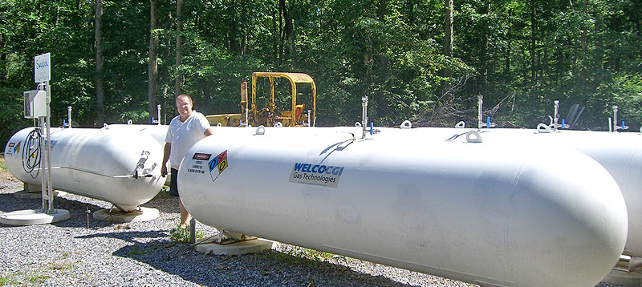
Hydrogen storage tanks
(HHP, 2016)

Slide 11
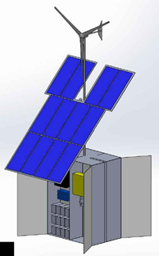
The Joule Box
Portable unit that provides solar, wind, battery and hydrogen power
Dimensions is 6’ x 6’ 16’
Able to back feed into the electrical utility grid
Prices start at $30,000

Slide 12
Example of Electricity Charges

Slide 13
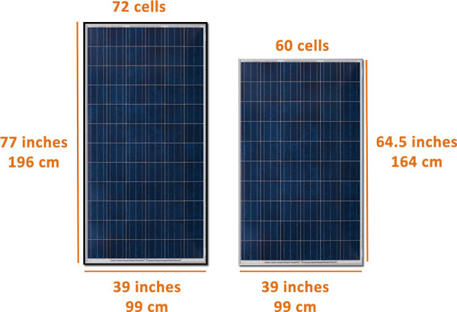
Proposal
Create solar panels the size of commons dish satellites for individual households.
Eliminate need for storage and send excess power to the grid
Federal offers tax credit of 30% of total cost
Reduces and has potential to eliminate monthly electricity cost
State requirement for communities to have solar panels based on electricity use of the area

Slide 14
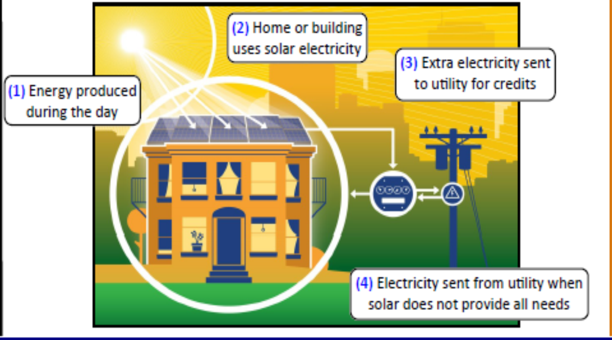
Net Metering

Slide 15
Net Metering
Renewable energy policy that allow users to reduce their electricity bill by generating their own electricity through solar panels.
Single owner: One meter on a single property
Tenant Aggregation: Savings spread through tenants
Virtual/Community Solar: solar is offsite but services multiple owners, savings based on ownership

Slide 16
References
"Hydrogen House Project: Home." Web. May 2016.
"NYS Net Metering FAQ-Residential." Web. May 2016.
How do electrolyzers work? (n.d.). Retrieved May, 2016, from http://www.explainthatstuff.com/electrolyzers.html

Slide 17
Questions?

