Slide 1
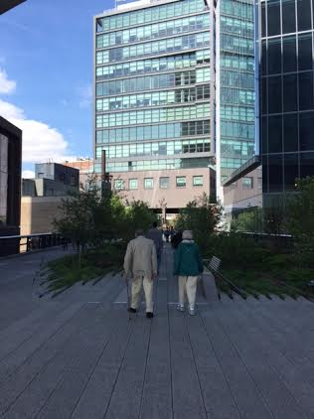
The Highline: A Public Green Space
Presented By:
Ron Copper
Econ 2505
Prof. MacDonald

Slide 2
What is The Highline?
A linear park is a park in an urban setting that is longer than it is wide. Usually, they ore converted from unused parts of a city.
Maintenance is provided by Friends of the Highline
The park is located on West Manhattan and extends from Gansevoort Street to 34th Street.

Slide 3
Highline History
The Highline was previously a set of train tracks used to transport goods.
The elevated tracks were created to prevent accidents. Originally, trains ran on the streets. 10th Ave gained the nickname “Death Ave”
Prior to elevated tracks, men rode on horseback ahead of the train to prevent fatalities.

Slide 4
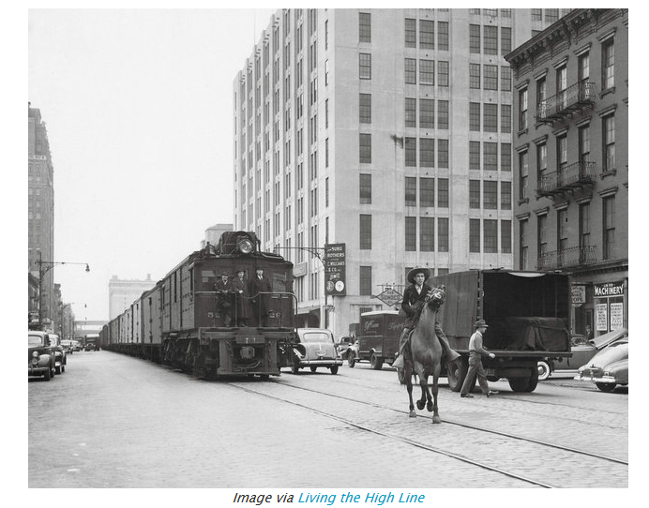
Pic of horses

Slide 5
History of The Highline
The construction of the elevated tracks was part of a massive urban redevelopment program lead by Robert Moses.
What made this particular project interesting is that the tracks go through buildings rather than running directly over traffic

Slide 6
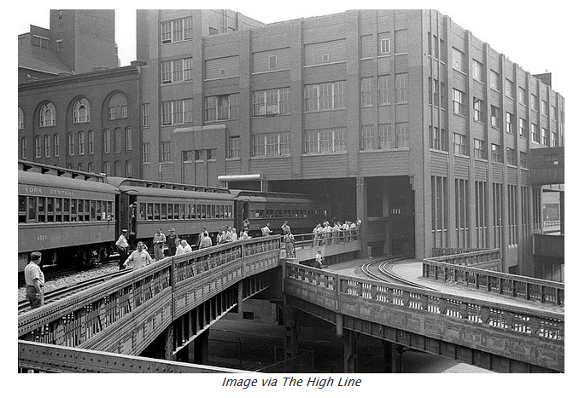
Old

Slide 7
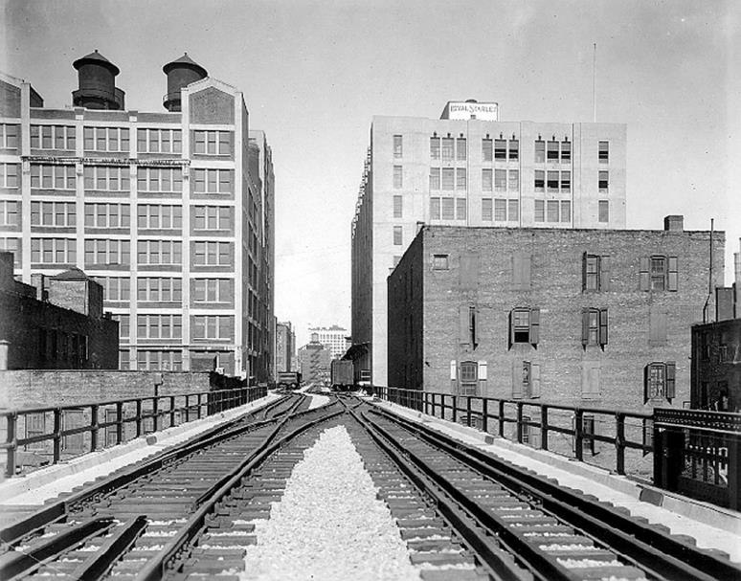

Slide 8
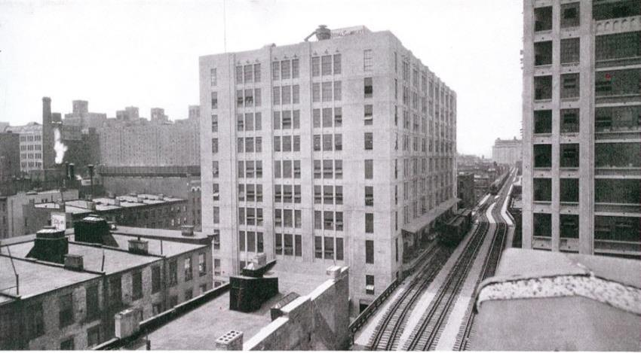

Slide 10
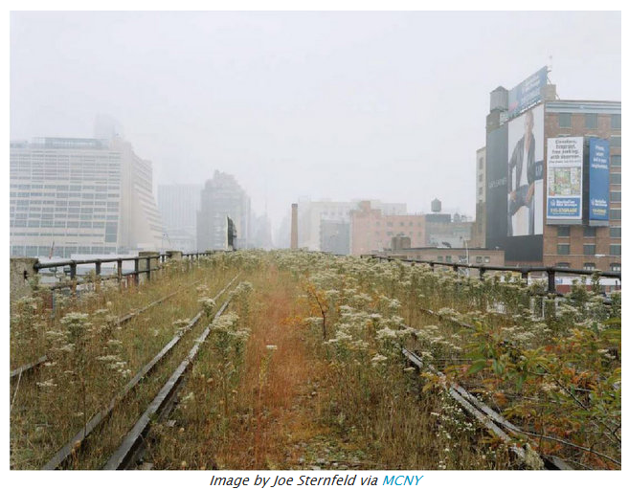

Slide 11
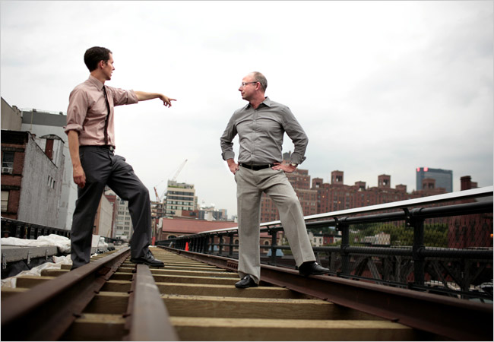
Friends of the Highline
The site was on the path to demolition, but the community had other plans. Friends of the Highline was formed
This organization was founded by Joshua David and Robert Hammond (whom lived in the area) in 1999 as a small community base group to advocate preservation of the neighborhood.

Slide 12
Friends of the Highline
The site was on the path to demolition, but the community had other plans. Friends of the Highline was formed
This organization was founded by Joshua David and Robert Hammond (whom lived in the area) in 1999 as a small community base group to advocate preservation of the neighborhood.

Slide 13
Friends of the Highline
Funding for the Highline came from contributions from the State and Federal Government as well as money raised by Friends of the Highline.
The Highline was built in sections. Section 1 & 2 alone cost $152.3 million according to the New York City Economic Development Corporation.

Slide 14
Designers
The park was designed by James Corner Field Operations, Diller Scofidio + Renfro and Piet Oudolf.
Each portion of the park took about 2 years to reconstruct.
The park is maintained by Friends of the Highline, all staff members are credited on the official website.

Slide 15
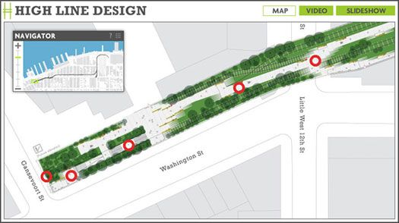
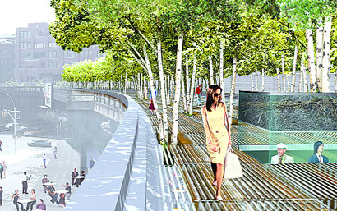

Slide 16
A section of the Highline, below 34th Street, in 2010

Slide 17
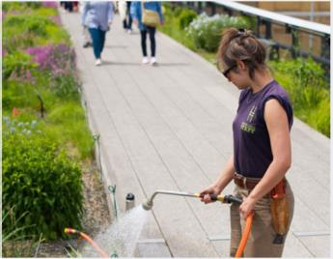
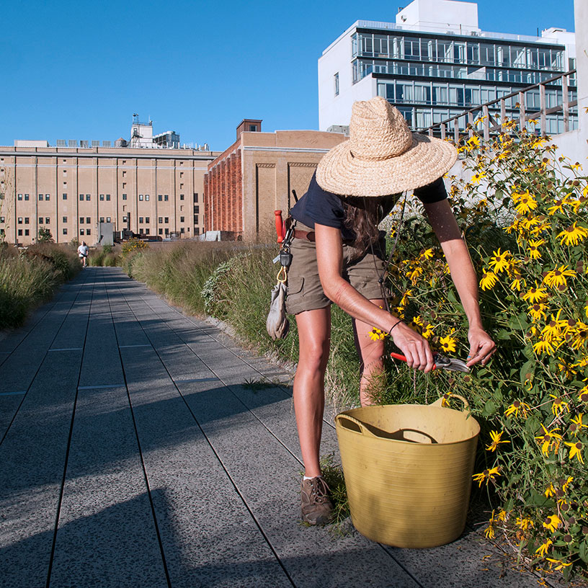
Sustainable Practices
The park uses many sustainable practices. Some of these include Drop Irrigation, Composting and the addition of Native Plants.

Slide 18
Sustainable Practices (cont.)
The unused nature of the Pre-Highline Park led to variations in the soil and access to light, or “micro climates”. Instead of making the entire park one uniform climate, the park works around the naturally occurring micro climates.
Local Sourcing- Whenever possible, the park used supplies from within a 100 mile radius. This includes plant life.
Plant Life- The plants used in the park are all native to New York, and naturally thive in the conditions of the area.

Slide 19
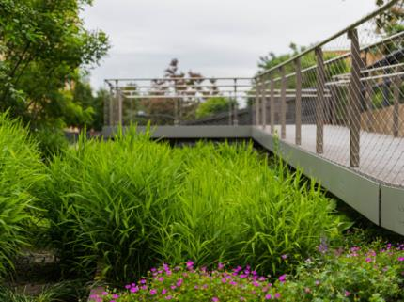
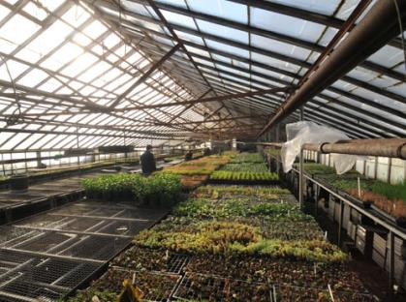
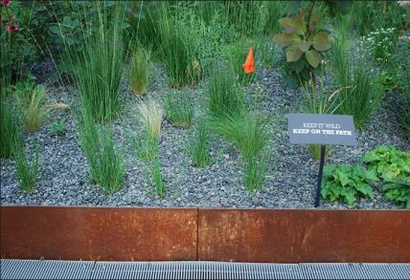
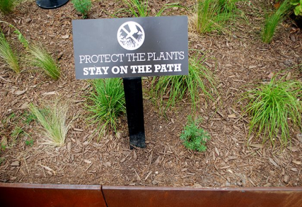

Slide 20
Sustainable Practices (cont.)
Irrigation- The highline does use manual watering when necessary, but relies heavily on a “Drop Irrigation” system.
In this system, water leaves a reservoir, travels through a series of pipes, and due to pressure differences and gravity the water exits through holes either directly on top of or within the soil.

Slide 21
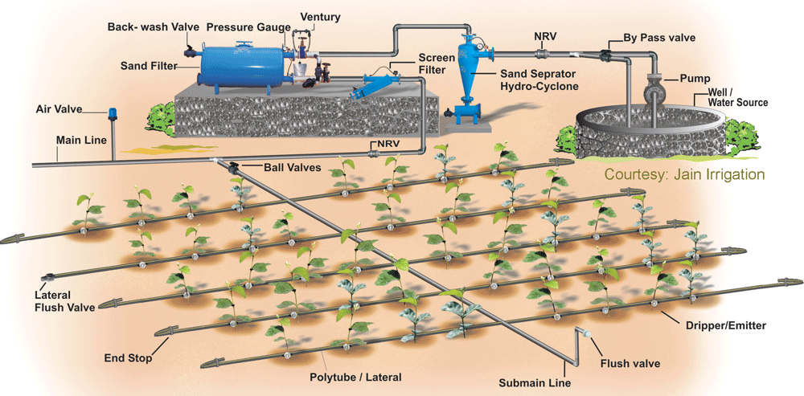

Slide 22
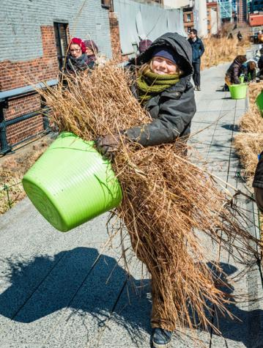
Sustainable Practices (cont.)
Composting- The Highline prides itself in it’s use of compost as a means of fertilizer.
The use of on site composting decreases the amount of waste that actually leaves the Highline, reducing the impact on the community.

Slide 23
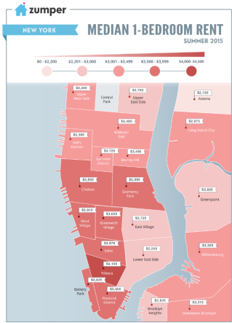
Economic Impact (cont.)
Median rent for a 1BR apartment in Chelsea is approx $3,800!!!
New York Real Estate News reported this area as one of the fastest increasing rental areas in a 2007 article.

Slide 24
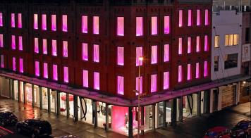
Economic Impact (cont.)
Local shopping- The area has elevated it’s clientele by opening new high end stores in the area.
Stores include: Diane Von Furstenberg, Rag and Bone, Giorgio Armani, etc…

Slide 25
Economic Impact (cont.)
Development along The Highline includes:
Gansevoort Market- This market is getting revamped, historically it was an open air produce market in 1884. It uses architecture that mixes it’s historical appearance and modern technology
The Chelsea Market- site of numerous vendors and stores, including Anthropologie, L’Arte gel Gelato wine bars and the city’s last independent bookstore “Posman Books”. Historically it is also the location of the Nabisco plant where the first Oreos were baked in 1912.
The McKittrick Hotel- offers a rooftop bar, as well as the site for the production “Sleep No More”.

Slide 26
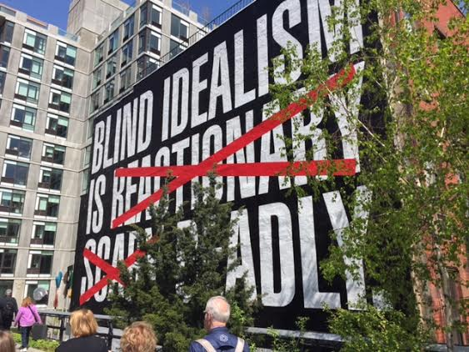
Economic Impact (cont.)
Local artists get a chance to put their work on display throughout the park. Here is “Untitled (Blind Idealism Is…) by Barbara Kruger

Slide 27
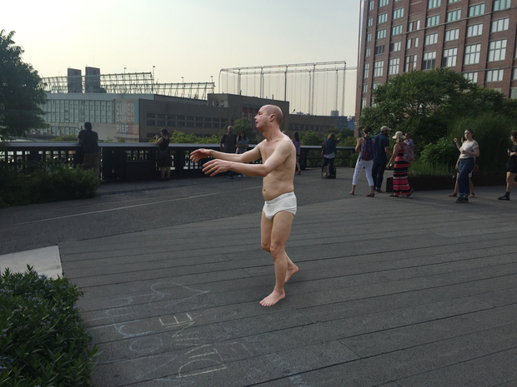
Wanderlust by Various Artists

Slide 28
Economic Impact
The exposure from having this art on display indirectly affects local artists.
Map of Highline Art

Slide 29
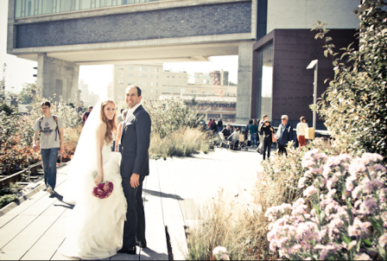
Economic Impact
The Highline acts as a venue for events. This keeps, and brings, money to that area as well as local vendors.

Slide 30
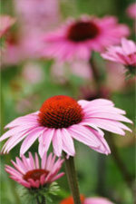
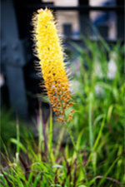
How to Support the Highline
One way to contribute is by Adopting a Plant. You make a donation and choose a plant that will be placed in the park.

Slide 31
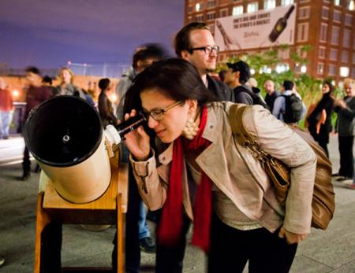
How to Support the Highline
Every Tuesday 30 minutes before dusk The Highline the use of telescopes to look at the stars, provided by The Amateur Astronomers Association of New York

Slide 32
Visit the Highline
The park is open from 7AM-10PM
Entrances are located on Gansevoort Street, 14th, 16th, 18th, 20th, 23rd, 26th, 28th, 30th, and 34th streets.
Free public tours are offered of the park, the art and the plant life.
Take a Look!

Slide 33
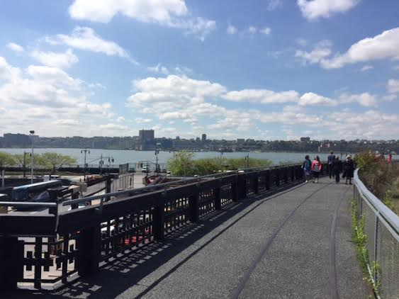
THANK YOU!!

