Slide 1
The Benefits of Biofuels From Food Waste
By Jade Jackson
Environmental Economics 2505ID

Slide 2
Intro
The production of biofuels from food waste could stimulate the United States economy and help mitigate the environmental impact of this food waste in US landfills and it’s cost on the US economy.
The types of biofuels and how they add value to food waste.

Slide 3
How much food is wasted in the US? How much does it cost?
In 2010, the United States Department of Agriculture’s (USDA) Economic Research Service of 31 % of food loss was at the retail and consumer levels, which amounted to approximately 60 million metric tons and $161 billion worth of food.
In 2013, The National Resource Defense Council Project Scientist, Dana Gunders said that the disposal of food waste was costing Americans around $165 billion a year.
In 2014, an analysis in the International Journal on Food System Dynamics ,that showed that the avoidable food waste in the US exceeded 55 million metric tons per year, nearly 29% of annual food production, at a cost of $198 billion.

Slide 4
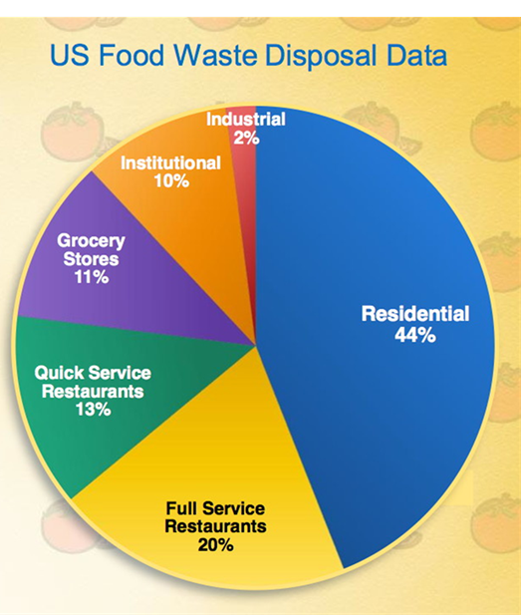
Who’s wasting food?
Residences (single and multi-family)
Food-service entities (restaurants, cafeterias, etc.)
Grocery and retail stores
Institutions(schools)
Food processing industry

Slide 5
How food waste in landfills impacts the environment
Once this food gets to the landfill, it then generates methane, a greenhouse gas 23 times more potent than carbon dioxide, and traps more heat in our atmosphere.
According to the U.S. Environmental Protection Agency (EPA), in 2009 landfills accounted for 34% of all methane emissions in the U.S.
A study done in 2014, stated that food waste produced life-cycle greenhouse gas emissions of at least 113 million metric tons of CO2 annually, that was equivalent to 2% of national emissions.

Slide 6
Why is turning food waste into biofuels better for the economy and environment?
There would a reduction in the amount of food waste in landfills.
The creation of a sustainable fuel source within our borders.
There would be value added to food waste instead of a cost for its disposal.

Slide 7
Types of biofuels, their processes and their uses.
Anaerobic digestion is a series of biological processes in which microorganisms break down biodegradable material (food waste) in the absence of oxygen.
This process creates biogas, which is combusted to generate electricity and heat, or can be processed into renewable natural gas and transportation fuels.
Transesterification is a simple process of combining a chemical compound called an "ester"(vegetable oil or animal fats) and an alcohol to make another ester and another alcohol. This is how biodiesel is made, and this an alternative fuel to gasoline.
Fermentation process mainly uses sugar, although it can also be manufactured by the chemical process of reacting ethylene with steam. This makes bioethanol an alternative petrol for road vehicles.

Slide 8
How can the government can help fast track these alternative fuels?
Incentives for farmers and supermarkets such as subsidies to offset the cost of packaging and shipping their food waste to labs to be processed instead of throwing it away.
Tax incentives could be offered to residents to sort their food waste for treatment.
This could branch into a new waste food industry to collect domestic waste and transport this waste to the labs

Slide 9
Conclusion
There are some major benefits to forming biofuels from food waste. There would be a reduction in the amount of food waste, plus the creation of a sustainable fuel source within our borders. There would be value added to food waste instead of a cost for its disposal and new markets for the sale of food waste on a large scale. So our sustainable fuel resources lies in biofuels.

Slide 10
Citations
Basic Information about Landfill Gas.”EPA, Environmental Protection Agency, 30 Nov. 2017, www.epa.gov/lmop/basic-information-about-landfill-gas
Karmee, Sanjib Kumar. "Liquid Biofuels from Food Waste: Current Trends, Prospect and Limitation." Renewable & Sustainable Energy Reviews, vol. 53, Jan. 2016, pp. 945-953. EBSCOhost, doi:10.1016/j.rser.2015.09.041
Kiran, Esra Uçkun , et al. “Bioconversion of food waste to energy: A review.” Fuel, Elsevier, 6 June 2014, www.sciencedirect.com/science/article/pii/S0016236114005365.
Ravindran, Rajeev and Amit K. Jaiswal. "Exploitation of Food Industry Waste for High-Value Products." Trends in Biotechnology, vol. 34, no. 1, Jan. 2016, pp. 58-69. EBSCOhost, doi:10.1016/j.tibtech.2015.10.008.
SDA | OCE | U.S. Food Waste Challenge | FAQ's, www.usda.gov/oce/foodwaste/faqs.htm. Es
Wilkes-Edrington, Lindsay. “Food Waste Costs Americans Around $165 Billion Annually (VIDEO).” The Huffington Post, TheHuffingtonPost.com, 3 Jan. 2013, www.huffingtonpost.com/2013/01/03/food-waste-america_n_2404451.html
Zhang, Cunsheng, et al. “Reviewing the anaerobic digestion of food waste for biogas production.” Renewable and Sustainable Energy Reviews, Pergamon, 25 June 2014, www.sciencedirect.com/science/article/pii/S1364032114003633
Zhang, Zhanying, et al. "Biofuels from Food Processing Wastes." Current Opinion in Biotechnology, vol. 38, Apr. 2016, pp. 97-105. EBSCOhost, doi:10.1016/j.copbio.2016.01.010.

