Slide 1
Sound or Noise Pollution
(Environmental & social effect)

Slide 2
Sound or Noise Pollution
• What is sound pollution
• Cause of sounds pollution
• Environmental affect
• Complaints
• Solution
• Conclusion

Slide 3
What is sound pollution
Sound pollution takes place when there is either excessive amount of noise or an unpleasant sound that causes temporary disruption in the natural balance.
Noise pollution is the disturbing noise with harmful impact on the activity of human and animal life.

Slide 4
Reasons of sounds pollution
Traffic noise
Traffic noise is the main supply of sound pollution caused in urban areas. With the ever-increasing range of on-road vehicles, the noise caused by the exhaust of the autos, the cars, the trucks, the motorcycles and the buses are that the chief reasons for sound pollution.
Aircrafts
Because of the low flying military aircrafts which are nowadays seen over the national parks, wilderness and alternative vacant areas noise has increased. The extent of sound pollution has drastically multiplied in these antecedently areas.
Railways
Individuals living beside railway stations are exposed with lots of noise from locomotive engines, horns and whistles and change and shunting operation in rail yards. This is often one among the main sources of sound pollution.
Construction
To fulfill the strain of the essential necessity of living, the development of buildings, highways and town streets causes lots of noise. Air compressors, gas hammers, bulldozers, dump trucks, loaders and pavement breakers are the main sources of sound pollution in construction sites.

Slide 5
Reasons of sounds pollution
Industrial noise
Although not a major reason, industrial noise adds to the sound pollution. Machinery, motors and compressors utilized in the industries produce lots of noise that adds to the already damaging state of sound pollution.
5. House items
Things used at home like air conditioners, boilers, generators, and fans also generate a lot sound than we imagine. But then in such cases one can easily control these genre of pollutions by reducing the sound making exertions and thus making the home ambience quite claim and betting for living.
4. Cleaning equipment
Social unit equipment’s, like vacuum cleaners, mixers and a few room appliances are noisemakers of the house. Although they are doing not cause an excessive amount of drawback, their impact can’t be neglected.
Music
Another such reason is that the internal noise supply of music. Significant volumes and beats produce the sound pollution.
1. Room noise
Room noise is additionally one of causes of the sound pollution. Besides this there are various reasons of room noise such as fighting between the roommates or some other relevant chaos.

Slide 6
Social & Environmental effects
Hearing
The immediate and acute effect of noise pollution to a person, over a period of time, is impairment of hearing. Prolonged exposure to impulsive noise to a person will damage their eardrum, which may
result in a permanent hearing impairment.
Effects on general health
Increase in the rate of heart-beat, increased cholesterol and blood pressure.
Constriction of blood vessels
Digestive spasms and stomach disorders
Dilation of the pupil of the eye
It interferes with proper communication, peace of mind and behavior
It causes headache, irritability and nervousness, feeling of fatigue and decreases work efficiency.
Noise also affects the developing embryo in mothers uterus.

Slide 7
Social & Environmental effects
Sleeping Disorders: Loud noise can certainly hamper your sleeping pattern and may lead to irritation and uncomfortable situations. Without a good night sleep, it may lead to problems related to fatigue and your performance may go down in office as well as at home. It is therefore recommended to take a sound sleep to give your body proper rest.
Effect on Wildlife: Wildlife faces far more problems than humans because noise pollution since they are more dependent on sound. Animals develop a better sense of hearing than us since their survival depends on it. The ill effects of excessive noise begin at home. Pets react more aggressively in households where there is constant noise.

Slide 8
Complaints (research project about Noise Pollution)
There are many types of noise complaints over the year which includes:
Construction Noise
Barking Dog
Highway/Bridge noise
Car honk
Different Alarms Noises
Music and party
Loud talk
Construction
Others

Slide 9
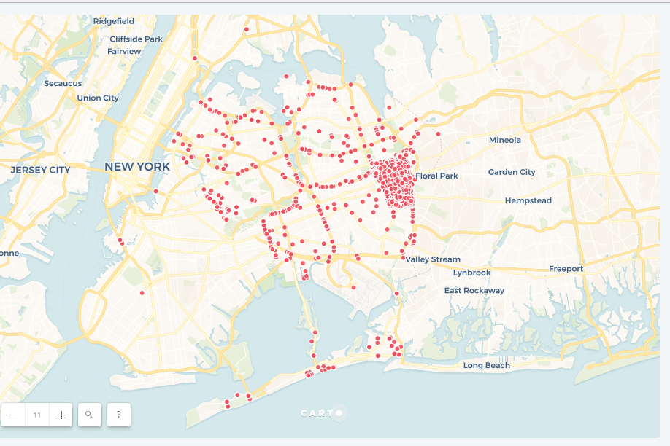
research project about Noise Pollution mapping
Different types of noise complaints shown on the Queens Borough

Slide 10
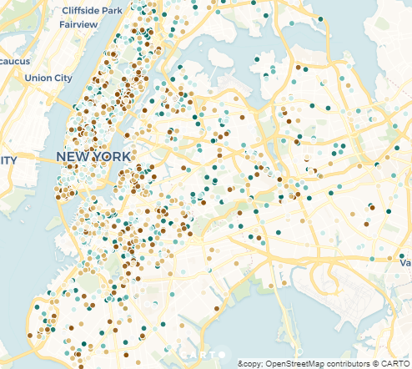
research project about Noise Pollution mapping
Another map showing noise complaint near schools

Slide 11
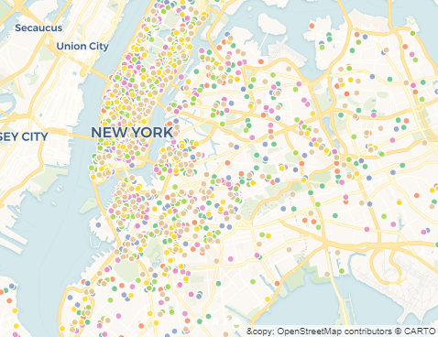
research project about Noise Pollution mapping
A map of noise complaint near highway or bridges

Slide 12
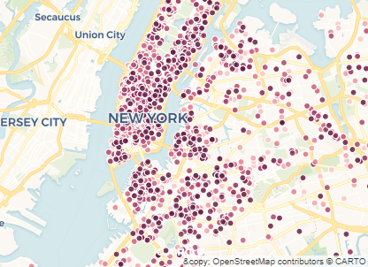
research project about Noise Pollution mapping
Noise from cars locations are mostly around the city

Slide 13
Solution: Control of Noise Pollution
Construction of sound proof rooms for noisy machines in industries.
Use of horns with jarring sounds to be banned.
Noise producing industries, aerodromes, and railway stations to be shifted away from the inhabited areas.
Proper law should be enforced to check the misuse of loudspeakers and public announcements systems.
To enforce silence zones near schools / colleges, hospitals etc.
Growing green plants/trees along roadside to reduce noise pollution as they absorb sound.
Loud speakers are banned from 10pm to 6am. India enacted Air (Prevention and Control of Pollution) Act, 1981 and noise pollution has been declared an offence.
Improve your insulation in House
Creating awareness and education

Slide 14
Conclusion
The threat of noise pollution needs to be taken seriously. For this, the first step is to make people aware with various diseases caused by noise pollution. We should focus on using low noise emitting machines and equipment.

