Slide 1
Fusion Energy
putting the sun in a box
Alfaj Sourav
ECON 2505
13 December 2017

Slide 2
Index
Why we need a better clean energy option.
What is fusion?
How we can bring fusion to earth.
ITER .
Advantages of fusion.
The complexity and challenges of fusion.
What it will mean to have fusion and limitless clean energy.

Slide 3
Not enough clean energy
Only 3% of the worlds total energy consumption
Is form renewables.
Most of today’s energy use around the world are from oil, natural gas and coal which is the major cause of climate change.

Slide 4
Disadvantages of modern renewables
Today when we think about clean energy, we think of wind and solar
It is difficult to generate the quantities of electricity using wind and solar power that are as large as those produced by traditional fossil fuel generators.
Renewable energy often relies on the weather for its source of power. Hydro generators need rain to fill dams to supply flowing water. Wind turbines need wind to turn the blades, and solar collectors need clear skies and sunshine to collect heat and make electricity. When these resources are unavailable so is the capacity to make energy from them
We also don’t have the technology to store large amount of energy to take advantage of good weather.
We need to look at more option of clean energy source. One of them is can be fusion.

Slide 5
What is fusion?
Difference between Nuclear fission and fusion
In Nuclear fission the atom is split (usually a heavy one like Uranium) to start a chain reaction, which also releases energy.
In Nuclear fusion two atoms (usually very light ones like Hydrogen) are fused to create another atom of different element (in the case of Hydrogen fusing it’s Helium)
Fusion has been around sine 1960s, but the lack of technology delayed the process to fusion energy.

Slide 6
Conditions needed for fusion
In the Sun's core, where temperatures reach 15,000,000 °C and enormous gravitational pressure, hydrogen atoms are in a constant state of agitation. The fusion of light hydrogen atoms produces a heavier element, helium.
Every second, our Sun turns 600 million tones of hydrogen into helium, releasing an enormous amount of energy. But without the benefit of gravitational forces at work in our Universe, achieving fusion on Earth has required a different approach
Since we can’t recreate pressure at the core of the sun, we must make the temperature 10 times hotter, which would be 150 million degree Celsius.
There are many types of fusion reactors that are trying to achieve this.

Slide 7
types of fusion reactors
Magnetic confinement- the “tokamak” and the “stellerator” are two types of magnetically confined fusion reactors with the tokamak being the most popular one.
Inertial confinement – that uses lasers to reach the temperature needed for fusion.
Magnetized Target Fusion(MTF)- pulsed approach to fusion that combines the compressional heating of inertial confinement fusion with the magnetically reduced thermal transport and magnetically enhanced alpha heating of magnetic confinement fusion.

Slide 8
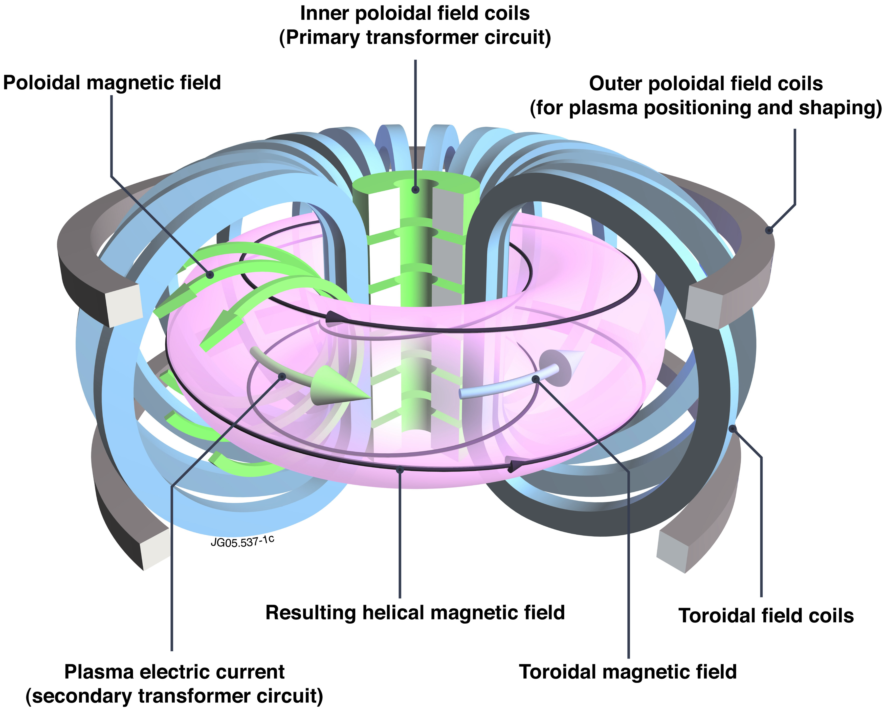
The tokamak
A plasma is contained within a chamber by using superconducting magnets. Radiowaves and microwaves as well as current in the thousands of amperes are pumped into the chamber.
“Burning Plasma” is when the plasma will heat itself and no outside energy is needed for reheating.
To achieve “burning plasma” temperatures up to 150 million degree Celsius—ten times higher than the hydrogen reaction occurring in the Sun is needed.
The ultimate goal is to get net energy of 25 or more

Slide 9
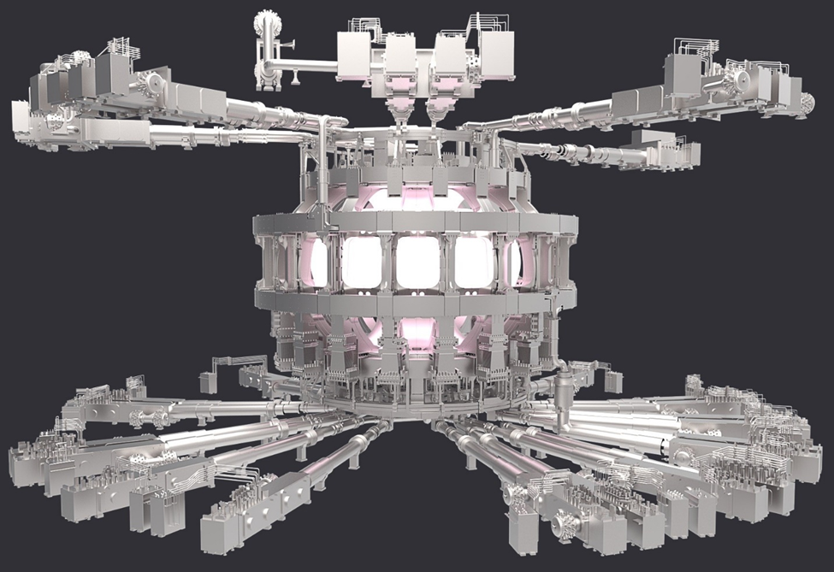
Visualizing a Fusion reactor

Slide 10
Excess heat from fusion reactions and neutrons hitting the outer layer is captured and converted to energy
The byproduct of fusion which is Helium is extracted form the chamber using the
Divertor (the bottom part of the chamber).
Inside the JET tokamak

Slide 11
ITER
The ITER stands for International Thermonuclear Experimental Reactor, will be the largest tokamak in the world which is under construction in France.
Many countries are taking part on this project including the US, EU, Russia, China, Japan, India and South Korea to make fusion a reality.

Slide 13
Advantages of fusion
Fusion doesn't emit harmful toxins like carbon dioxide or other greenhouse gases into the atmosphere. Its major by-product is helium: an inert, non-toxic gas
Fusion fuels are widely available and nearly inexhaustible. Deuterium can be distilled from all forms of water, while tritium will be produced during the fusion reaction as fusion neutrons interact with lithium. (Terrestrial reserves of lithium would permit the operation of fusion power plants for more than 1,000 years, while sea-based reserves of lithium would fulfil needs for millions of years.)
No risk of meltdown: A Fukushima-type nuclear accident is not possible in a tokamak fusion device. It is difficult enough to reach and maintain the precise conditions necessary for fusion—if any disturbance occurs, the plasma cools within seconds and the reaction stops. The quantity of fuel present in the vessel at any one time is enough for a few seconds only and there is no risk of a chain reaction.

Slide 14
Abundant energy: Fusing atoms together in a controlled way releases nearly four million times more energy than a chemical reaction such as the burning of coal, oil or gas and four times as much as nuclear fission reactions (at equal mass). Fusion has the potential to provide the kind of baseload energy needed to provide electricity to our cities and our industries.
No long-lived radioactive waste: Nuclear fusion reactors produce no high activity, long-lived nuclear waste. The activation of components in a fusion reactor is low enough for the materials to be recycled or reused within 100 years.

Slide 15
challenges
Fusion faces many challenges, the obvious being engineering challenges and as well as financial or political challenges.
Current material used in fusion reactors are not strong enough.
Fusion research and development is very expensive and fusion building fusion reactors are even more expensive.
No current fusion reactor has achieved burning plasma or has gained net energy back.
The process to fusion has been slow.
With innovation and better understating of material science, the fusion community hopes they’ll overcome the challenges

Slide 16
Abundance of energy
With climate sustainability moving to the center of todays talking points, fusion energy have gotten more attention while over the last couple of years development of fusion as an energy source have quickened.
By having an abundance of clean energy, the world will have time to focus on solving other problems around the world.
There would also be less competition between countries over natural resources and which would prevent conflicts.

