Slide 1
Energy usage in Hotel Industry
By Stefania Koziolek

Slide 2
Outline
Introduction
Importance of energy management
How Hotels can reduce energy use
Main Motivators for Hotels to take Measures
Examples of Hotels
Conclusion

Slide 3
Introduction
Nowadays, hospitality industry is facing a lot of issues which potentially have the greatest impact on our environment. One of them is high energy usage. Energy Management programs and employee awareness are essential to reduce energy costs. Energy usage impacts all organizations in the Hospitality Industry, especially Hotel Industry.

Slide 4
Why it is so important?
If the hotels make changes or start constructing their own green buildings the impact will be positive and there will be a limit on the huge damage in the environment. “According to the American Hotel & Lodging Association's energy-management sensors in rooms are at their peak overall usage; they have already been adapted by 48 percent of hotels. LED lighting has also seen an increase between 2014 and 2016 from 77 percent to 90 percent.”

Slide 5
Energy Management Programs- how Hotels can reduce energy usage
Building energy management system
Lighting-install low energy lighting
Switch off policy- raise staff awareness” Switch off your unwanted lights during day time.
Turn off lights and air-conditioning in the rooms which are not in use.

Slide 6
Main Motivators for Hotels to take Measures
Reduce Operating costs
Demand from customers
Improving hotel’s image
Reducing its environmental impacts

Slide 7
Examples of Hotels
MARRIOTT
CHOICE INTERNATIONAL
INTERNATIONAL BARCLAY

Slide 8
MARRIOTT
Marriott introduces “Sustainability Program “ which says that “Our sustainability strategy supports our business and reaches beyond the doors of our hotels to preserve and protect the planet and its resources. We focus on reducing our footprint, constructing more sustainable buildings, making our supply chain more environmentally conscious, supporting innovative conservation initiatives and inspiring our associates and guests to support these efforts .” If the hotels make changes or start constructing their own green buildings the impact will be positive and there will be a limit on the immense damage in the environment.
http://www.marriott.com/corporate-social-responsibility/corporate-environmental-responsibility.mi
http://www.marriott.com/marriott.mi?page=green_energy_star

Slide 9
Choice Hotel International
Choice Hotels International created program which requirement for all its Hotel. This program is created to reduce the hotel’s environmental impact. This program will has a lot of benefits, because it will lower operating costs by obligating hotels to utilize energy-efficient indoor lighting, to execute a reusing program and to provide visitor the alternative to reuse materials such as linens, towels etc. As a part of the program, lodgings can moreover take advantage of included alternatives, counting light dimmers and double-paned or thermopane windows.

Slide 10
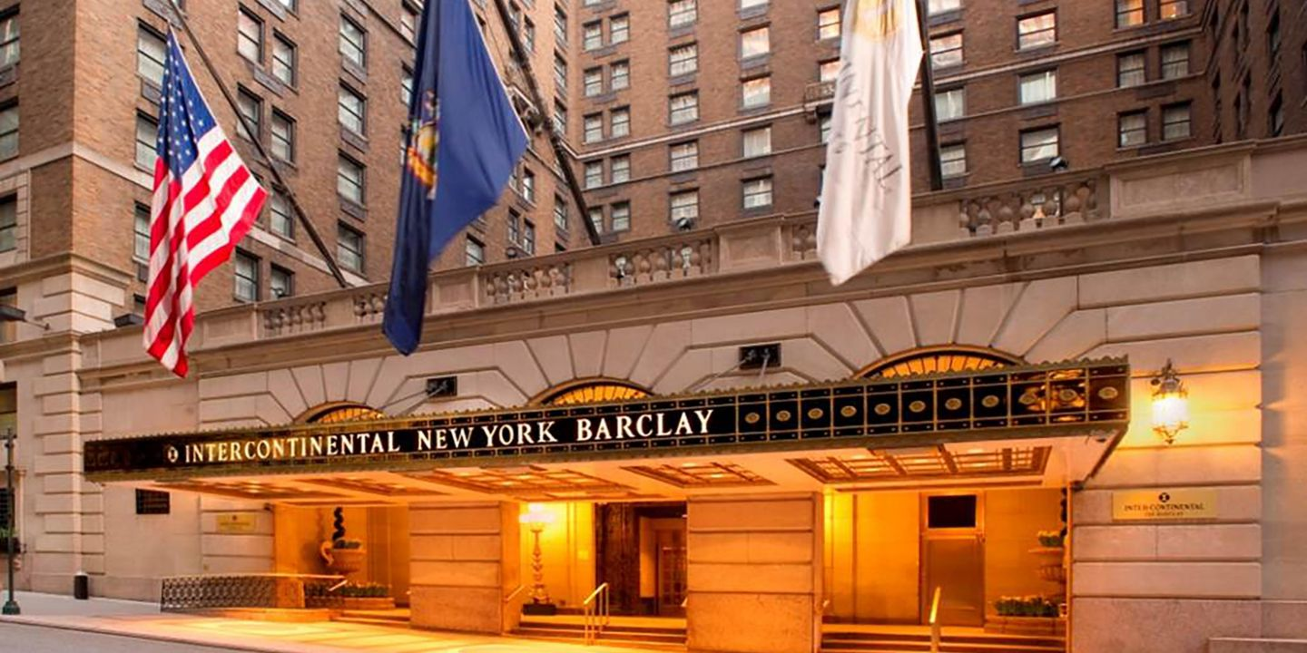
Intercontinental Barclay
New York’s InterContinental Barclay upgraded to energy-efficient windows as part of the hotel’s $180 million renovation, which was completed in April.Hervé Houdré, general manager of Intercontinental; Barclay said that “ he also suggests that hotels contact their local energy provider to inquire about “demand response” programs, in which the provider will request the hotel reduce its energy consumption at certain peak times in exchange for rebates, as well as grant programs that will offset the purchase of energy-saving equipment”. More and more hotels adopt eco-friendly practices such as energy savings.
http://intercontinentalnybarclay.com/wp-content/uploads/2017/09/UN-Presentation-September-2017.pdf

Slide 11
CONCLUSION
There are many ways to improve the business and the smallest change can make a big difference. By making simple changes and creating programs that decrease the amount of energy hotels will save money, gain guests and create a better environment for future generations. The Hospitality Industry can have positive benefits and help the environment by going green. Creating green hotel is best way to enhance the competitiveness of the hotel, will create a lot of good benefits. One of the main reasons companies should join the green revolution is because guests have shown an increasing interest in it. Hotels can increase their competitive advantage by using green practices. The hospitality industry is one of the biggest industries, and if this industry with so many hotels and companies can change, then anyone can.

