Slide 1
Effects of water pollution on aquatic ecosystem
By
Ayesha keya
econ2505ID

Slide 2
outline
What is Water Pollution?
How water is polluted (different types of pollutants)
Sources of water pollutants
Effects of water pollution on aquatic ecosystem
Effects of water pollution on economy
Some solutions

Slide 3
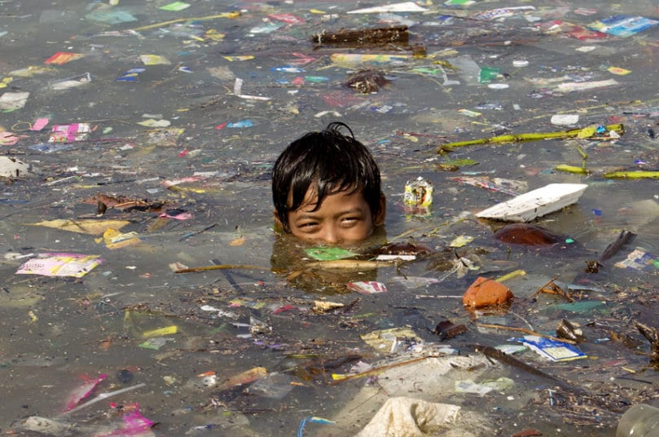
introduction
The term water pollution defines the state of water being impure due to the disposal of different kinds of waste, for example, household or industrial wastes, toxic chemicals, contaminants etc. into the water bodies such as the lakes, rivers, and ocean. It is one of the most concerned topics over the last century because of its harmful effects on aquatic life.

Slide 4
Water pollutants
Water can be polluted in many ways, either by human activities or natural resources. Some common examples of pollution include garbage from residents, city streets, and construction sites, oil from oil tankers or oil refineries, nutrients, wrong disposal of hazardous materials from garbage disposal companies, sewage leaks, toxic chemical disposal from various industries, and agricultural runoffs etc.

Slide 5
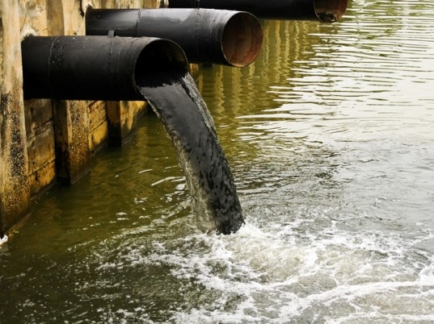
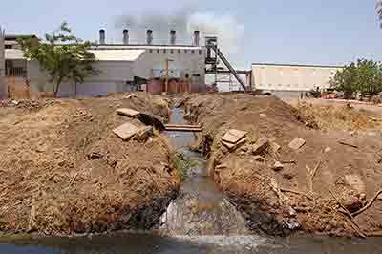
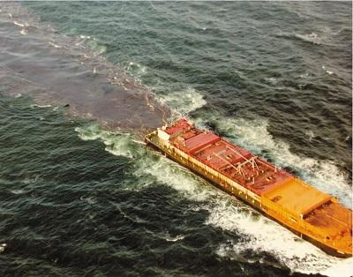
Water pollutants’ sources
Water pollutants have mainly two types of sources, point and non-point sources. Pollutants from point sources are discharged at a specific location of water body through pipelines or sewers (for example, from factories, sewage plants, underground mines, oil tankers).

Slide 6
Water pollutants’ sources (cont’d)
Non-point sources can be anything from anywhere without any traces (for example, acid deposition from the air, traffic, excess use of fertilizers from agricultural lands, animal wastes or excreta) or specific locations. This type of pollution is very hard to control because the pollutants comes from the everyday activities of humans and animals.

Slide 7
Effects on aquatic ecosystem
Water pollution increases the growth of algae that limits the sunlight amount to enter the water body. The growth of these algae and other aquatic weeds causes the release of toxins and lowers the level of oxygen causing fish death.
It can cause diseases in fish like epidermal papilloma (a tumor on fish skin), fin/tail rot, gill disease, hyperplasia(enlargement of organ tissue), liver damage.
It disrupts the food chain. Pollutants like lead and cadmium are eaten by small organisms. Then they are eaten by other fish. Thus the food chain is disrupted.

Slide 8
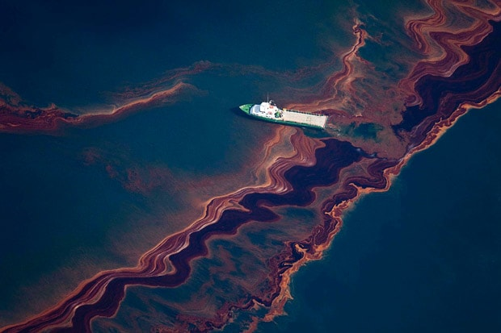
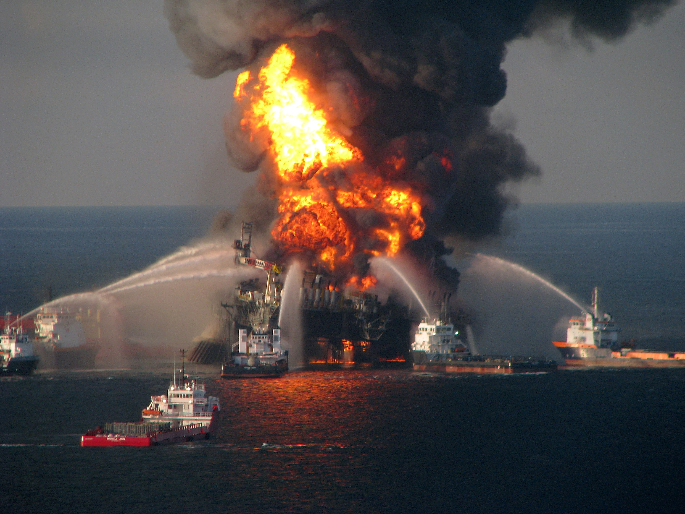
Effects on aquatic ecosystem (cont’d)
Oil spill, which is another main cause of water pollution, has a very bad effect on aquatic ecosystem. In 2010, USA witnessed the largest oil spill (more than 200 million gallons of oil) in its history which affected 16,000 miles of coastline including coasts of Texas, Louisiana, Mississippi, Alabama, and Florida.

Slide 9
Effects on aquatic ecosystem (cont’d)
It killed over 8000 animals including birds, turtles, and mammals. Around three quarters of pregnant dolphins failed to give birth and between two and five trillion larval fish and 8.3 billion oysters were estimated to have been lost.
Non-point pollutants like nitrogen and phosphorus can cause toxic algal blooms, loss of oxygen, fish kills, loss of biodiversity etc.

Slide 10
Effects on economy
Water pollution has bad impact on a country’s economy too. Many countries have beaches, river views, lake views as one of the important tourists’ spots. So, if the water is polluted, it will hamper the tourist business. For example, recently during the month of July of year 2017, tourists visiting Niagara Falls experienced smelly black water discharge into its river. It shocked all the visitors and they were moved from that place. However, the local water board afterwards apologized for this and they said the water was discharged for routine maintenance work on its sewage works.
According to Environmental Protection Agency (EPA), The U.S. tourism industry loses close to $1 billion each year, mostly from losses in fishing and recreational activities because of nutrient-polluted water bodies.

Slide 11
Solutions
The factories, industries, construction sites, households etc. should make sure that their waste materials are disposed in a proper way to a specific place.
Toxic chemicals should be disposed properly so that they do not poison the water or animals.
Industries or factories can also use various eco friendly chemicals, sprays, and other supplies so that they do not contaminate the water. Eco friendly chemicals could be the chemicals labelled ‘low’ or ‘zero’ VOC (Volatile organic compounds) by EPA.
Government has undertaken some measures by regulating factories based on laws to prevent irrelevant dumping of waste in water, by maintaining the sewerage treatment system, purifying water ways etc.

Slide 12
THE END

Slide 13
CITATION
“WATER POLLUTION FACTS, CAUSES, EFFECTS & SOLUTIONS.” Whale Facts and
Information, www.whalefacts.org/water-pollution-facts-causes-effects-solutions/.
“Water Treatment Solutions.” Lenntech Water treatment & purification,
www.lenntech.com/water-pollution-faq.htm.
Carpenter, S. R., et al. “Nonpoint Pollution of Surface Waters with Phosphorus and Nitrogen.”
Ecological Applications, vol. 8, no. 3, Aug. 1998, pp. 559–568., doi:10.2307/2641247.
Austin, B. “The effects of pollution on fish health.” Journal of Applied Microbiology, vol. 85, no. S1, Dec. 1998, pp. 234S– 242S., doi:10.1111/j.1365-2672.1998.tb05303.x.
“11 Facts About the BP Oil Spill.” DoSomething.org | Volunteer for Social Change,
www.dosomething.org/facts/11-facts-about-bp-oil-spill.

Slide 14
CITATION
“BP Oil Spill Trashed More Shoreline Than Scientists Thought.” National Geographic, National
Geographic Society, 20 Apr. 2016, news.nationalgeographic.com/2016/04/160420-bp-oil-spill-shoreline- affected-deepwater-horizon-anniversary/.
“Effects of water pollution.” Enviropol, enviropol.com/index.php/effects-of-water-pollution.
“What are the effects of water pollution.” Eschooltoday, eschooltoday.com/pollution/water-pollution/effects-of- water-pollution.html.

