Slide 1
THE ECONOMIC IMPACT OF THE FRESH FOOD APPROACH IN SENIOR LIVING TIFFANIE WASHINGTON ECON 2505 ID HD 60 12/13/17

Slide 2
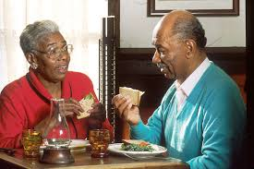
Introducing a Way of Life
“people who love to eat are always the best people” – Julia Child
Americans are eating four-hundred and fifty more calories than what was consumed in 1970
Baby boomers are dealing with the consequences of a lifetime of consuming junk food.

Slide 3
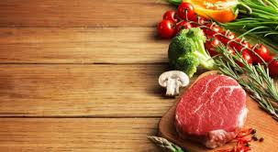
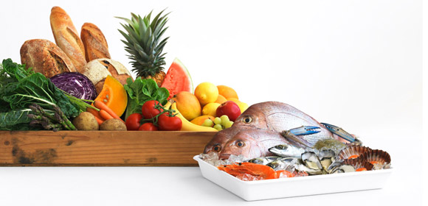
FRESH FOOD AS AN APPROACH
What is fresh food?
meals and snacks are prepared using fresh and local ingredients, and in smaller batches
Scratch cooking is done where dishes are put together using ingredients that are not previously prepared.

Slide 4
FOOD AS IT RELATES TO SENIOR HEALTHCARE
good nutrition may help seniors slow the onset of many diseases
Fresh food has significant benefits on senior health such as strengthened immune system, more energy due to adequate calorie consumption
Substantial benefits include gradual increase in bone strength, cardiovascular health, vision, and digestion using readily available ingredients

Slide 5
THE IMPLICATIONS OF AN UNHEALTHY DIET
Medical conditions such as increased dementia, blood clots, bed sores, and anemia can be attributed to poor health
under nourishment is a gradual process that leads to medical episodes and can result in untimely death
maintaining a regiment of eating can stave off and ultimately help individuals to manage their medical situations

Slide 6
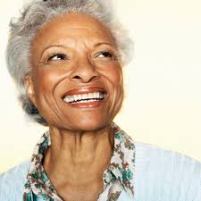
ABSTRACT VIEWS AND METHODS OF REJUVENATION
The Greater Boston Food Back is the first major food bank in the United States of America to hire a medical doctor
Dr. Brodowski created a program where patients can be prescribed food and receive approximately twenty-five pounds of produce free of charge
These positive results have the ability to offset socioeconomic and the medical costs associated with poor nutrition

Slide 7
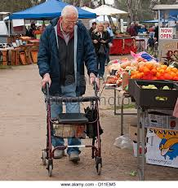
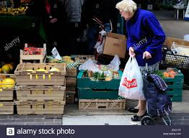
Final thought
Using simple methods such as cooking fresh green beans as opposed to canned vegetables make a world of difference in the long run on health
Healthcare facilities should use the medicinal properties of food to alleviate medical stressors and combat diseases of the mind and body due to food having natural abilities to enhance the quality of life

Slide 8
The end!

