Slide 1
Rooftop Buildings and Renewable Energy
“The greatest threat to our planet is the belief that someone else will save it”
~Robert Swan

Slide 2
Why rooftop buildings
Space is a big issue in city life. Especially, in industrial areas it is not possible to get free spaces. So, rooftop building is the perfect way of using small spaces with the help of modern technology to use renewable energy. It allows city people to use scare resources the best way possible and preserve the sustainability of the environment.

Slide 3
Brooklyn Navy yard

Slide 4
Features of the building
The first multi-story, multi-tenanted industrial green building which maintained gold standard according to LEED
Solar panel for solar renewable energy
High efficiency lighting feature
System for recycling rain water
Natural ventilation system
Solar powered trash compacter
Energy efficient window and wind solar lamp.

Slide 5
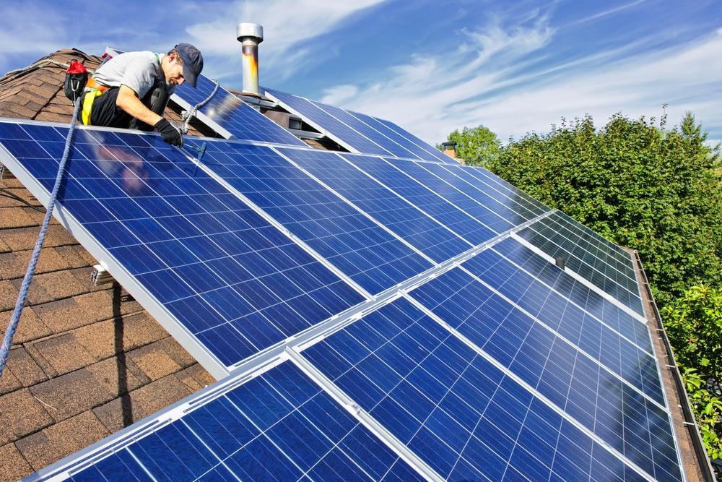
Different forms of renewable energy on rooftops
Solar panels on rooftop

Slide 6
Advantages of Solar System
Helps to slow or even stop global warming
Reduces electricity bills
Low maintenance costs
Provides energy reliability
Provides energy security
Creates energy independence
Creates new job sectors

Slide 7
Solar work force and installation

Slide 8
Disadvantages of Solar System
The major drawback of using solar renewable energy is not getting sunlight for whole 24 hours which creates a lot of problems for the consumers. Without getting sunlight system can’t produce or reserve enough energy. So, it may result lack of power supply which can create load shedding. So, the solar panels should be installed in a place where there is always plenty of sunlight available. Place where sunlight is rare is not ideal for solar panel.

Slide 9
Wind Turbines on rooftops

Slide 10
Advantages of wind power energy
Reduces fossil fuel consumptions
Reduces carbon foot-print
Creates less air and water pollution
Never releases toxics or green house gases
Helps agriculture by saving lands
Sustainable and cost effective source of energy

Slide 11
Disadvantages of wind power energy
Wind turbines need a stable constant breeze to work efficiently. So, it is not practical or suitable for all cities. New York City rooftops are not ideal for setting up turbine because of too much wind and the breeze is never steady. Typical turbine needs 10 miles per hours of steady breeze to function properly. But in New York the breeze ranges from 3-30 miles per hour and also it comes from all directions. So, it can’t produce desired energy and efficiency level drops significantly. Wind turbines also create a fair amount of noise which may lead to sound pollution.

Slide 12
Water harvesting on rooftops

Slide 13
Advantages of rooftop water harvesting
Easy to maintain
Reduces water bills
Suitable for irrigation
Reduces demand of ground water
Reduces flood and soil erosion
Can be used for non drinking purposes
Does not require electric pump

Slide 14
Disadvantages of rooftop water harvesting
Unpredictable Rainfall
Regular maintenance
Certain roof types create harmful chemicals
Limited storage

Slide 15
Conclusion
My research confirms that rooftops can be used as a source of renewable energy. But there are both advantages and disadvantages to using renewable energy in rooftop buildings. My main goal was to inform the audience about different forms of renewable energy that can take place in the rooftop buildings. The project will help a consumer to decide whether they will want to produce renewable energy in their rooftops and if so what kind what form of energy will be best for them. To maintain sustainability of nature and to utilize the scare resources of city life there is no alternative other than using renewable energy.

Slide 16
References
http://www.renewableenergyworld.com/articles/2014/01/solar-jobs-growing-ten-times-faster-than-national-average-employment-growth.html
http://lmdevpartners.com/wp/wp-content/uploads/2015/02/Pearson-Turbines-Popping-Up-on-New-York-Roofs-Along-With-Questions-of-Efficiency-The-New-York-Times-May-26-2014.pdf.
http://www.harvesth2o.com/RWH_good_bad_ugly.shtml.
http://www.conserve-energy-future.com/Advantages_WindEnergy.php.
http://cleantechnica.com/2013/10/08/advantages-disadvantages-solar-power.

