Slide 1
Can Urban Agriculture create self-sustainable cities?
Econ 2505 Environmental Economics; sec. D-227
Joshua Morton
Prof. S. MacDonald

Slide 2
Introduction(What is Urban Agriculture?)
http://www.fiveboroughfarm.org/
It is the act of growing fruit, and vegetables in cities. A process that is complemented by activities involving the processing and the distribution of food, collecting rainwater, educating, organizing and employing local residents.

Slide 3
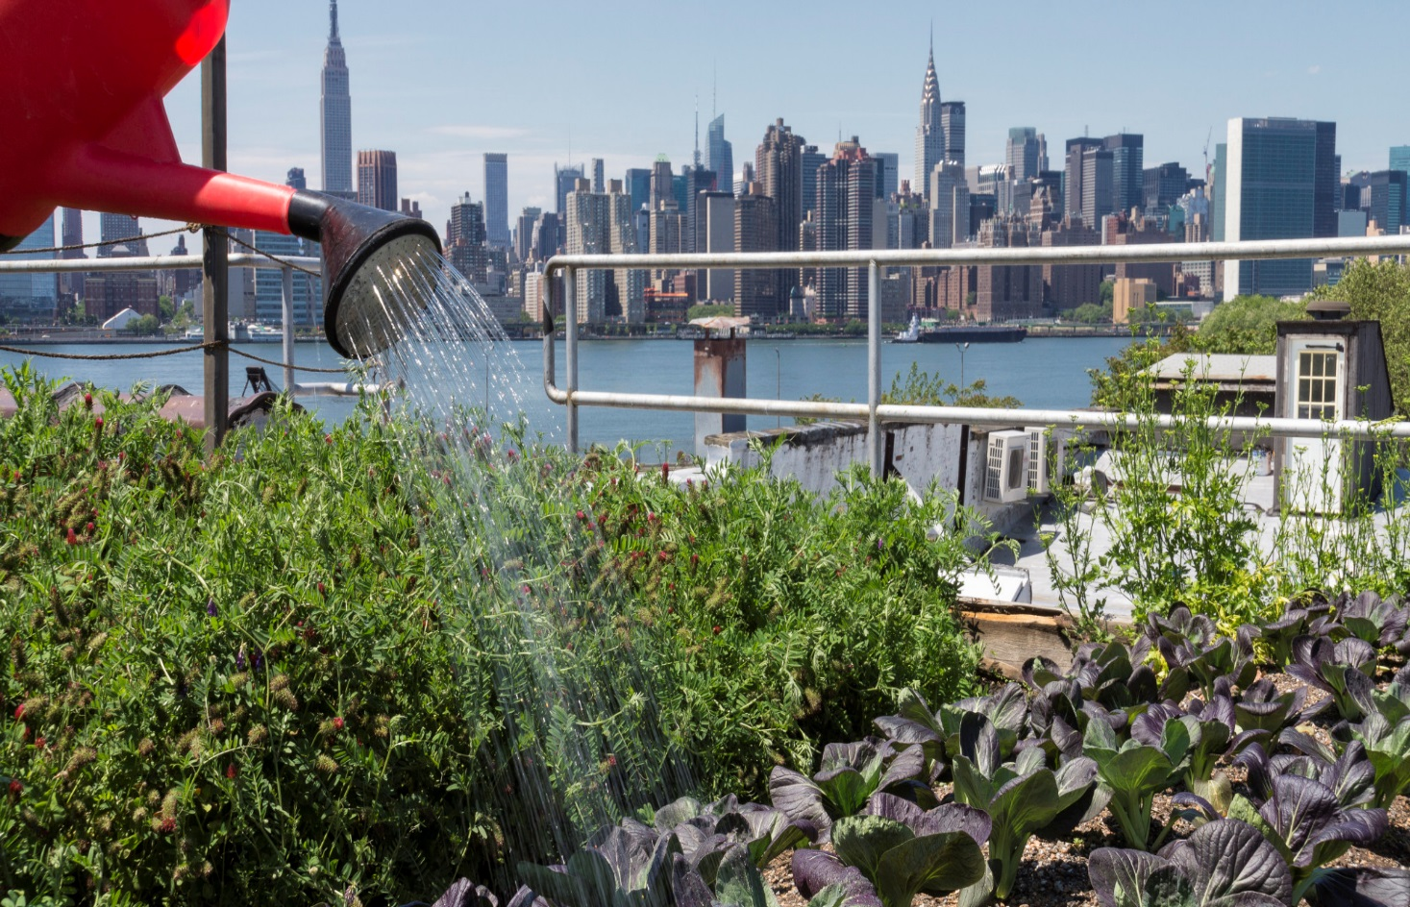
Introduction(Why choose this project?)

Slide 4
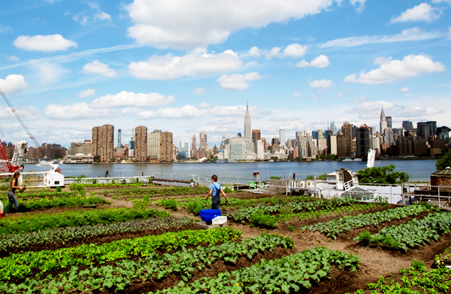
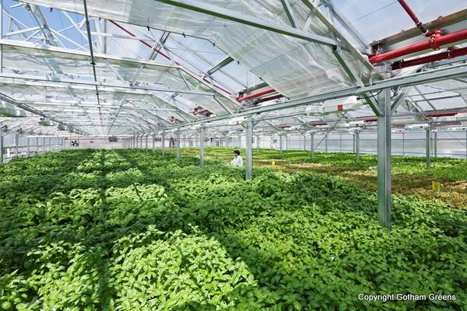
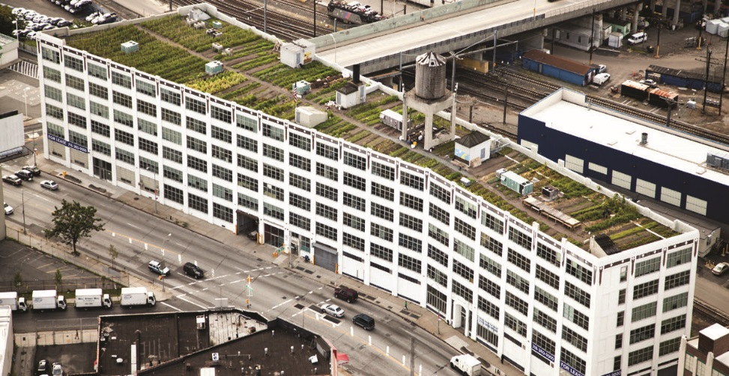
Post-Introduction(Commercial Farms
Maximize crop performance in order to achieve profitability.
Three profit farms in NYC:
Eagle street(Brooklyn)
Brooklyn Grange
Gotham Greens

Slide 5
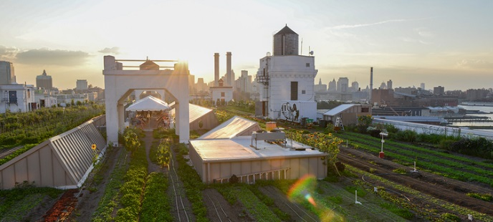
The Grange(Commercial Farming)
Rooftop farming(one of the largest in the world)
Builds green spaces that promotes sustainable living through education, events and the local ecology.
Responsible of producing 50,000 pounds of organically-cultivated produce per-year.
Distributes its food throughout the city: Churches, soup kitchens and groceries.

Slide 6
Urban farming vs. Rural pt.1

Slide 7
Urban farming vs. Rural pt.2

Slide 8
Conclusion
Urban Agriculture creates self-sustainable cites, by employing local residents as farmers.
Growing or cultivating fresh produce to later be distributed to local communities and places where there are lack of fresh produce.
Addresses the concern for the growing population of urban centers.
Not reliant on rural transportation of produce to urban centers.
Changes the ecological scape of the entire city and promote healthy climate.

Slide 9
Sources
Chou, Jerome. "Five Borough Farm." Urban Agriculture in New York City. N.p., n.d. Web. 17 May 2016.
Seton, Mary. "What Is Urban Farming?" Greens Grow. N.p., n.d. Web.
"The Grange." Brooklyn Grange. N.p., n.d. Web. 17 May 2016.

