Slide 1
How beneficial is Rainwater Harvesting
Environmental Economics 2505
By: John De Jesus
Prof. S. MacDonald

Slide 2
What is Rainwater Harvesting?
Rainwater harvesting consists of simple systems to collect, convey, and store rainwater. Rainwater capture is accomplished primarily from roof-top, surface runoff, and other surfaces.
Rainwater harvesting either captures stored rainwater for direct use (irrigation, production, washing, drinking water, etc.) or is recharged into the local ground water and is called artificial recharge.

Slide 3
Field Research
source: http://bldg92.org/visit/cafe-rental-facilities/

Slide 4
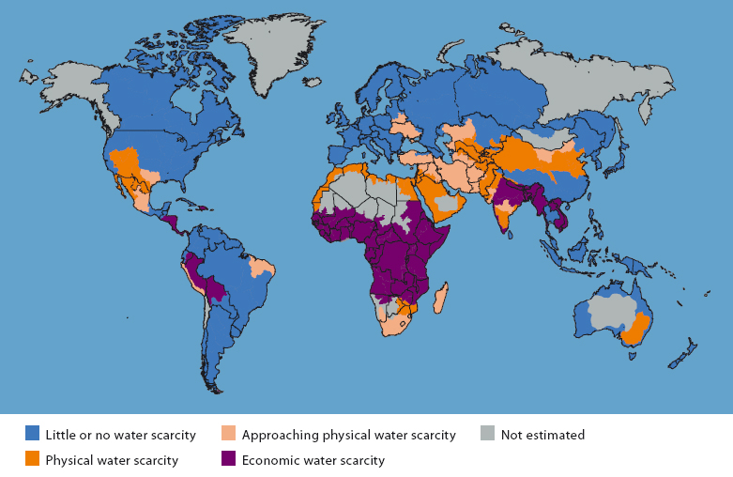
Water Scarcity
Source: http://www.wri.org/resource/physical-and-economic-water-scarcity

Slide 5
Why Harvest Rainwater?
Although close to three fourths of our planet is made of water, not all of it is suitable for use. The water in the oceans and seas cannot be used as drinking water and little of it can be utilized for other purposes.
Rainwater is free from pollutants as well as salts, minerals, and other natural and man-made contaminants due to the cleaning process.
In areas where there is excess rainfall, the surplus rainwater can be used to recharge ground water through artificial recharge techniques.

Slide 6
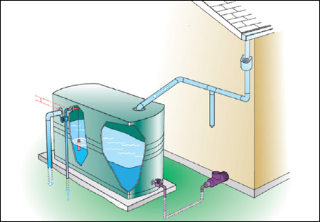
Basic Components
A catchment area to capture the rainfall (This is typically the roof of the house.)
A conveyance system to move the water from the roof to a storage area.
A storage system to hold the rainwater for future use. (barrel, cistern or a tank)
A distribution system to get the water form storage to where it is being used.
http://www.cmhc-schl.gc.ca/en/co/grho/grho_016.cfm

Slide 7
Advantages of Rainwater Harvesting
Easy to Maintain: better use of resource, helps reduce wastage, overall cost of their installation and operation is much lesser than water purifying, maintenance requires little time and energy.
Reducing Water Bills.
Suitable for Irrigation: free from many chemicals found in ground water, making it suitable for irrigation and watering gardens.
Reduces Demand on Ground Water: due to increase population demand of water increases. Which leads to depletion of ground water and is low in areas where there is a huge water scarcity.
Reduces Floods and Soil Erosion: water stored in tanks, reducing contamination of surface water with pesticides and fertilizers which results in cleaner lakes and ponds.
Can be Used for Non-drinking Purposes: flushing toilets, washing clothes, watering gardens.

Slide 8
Disadvantages of Rainwater Harvesting
Unpredictable Rainfall: Hard to predict, little to no rainfall which can limit the supply, not advisable to depend on rainwater alone in areas with limited rainfall.
Initial High Cost: depending on size and level range from $200-2000, benefit cannot be derived until ready for use.
Regular Maintenance: may get prone to rodents, mosquitoes, algae growth, insects and lizards.
Certain roof types may seep chemicals or Animal Droppings.
Storage Limits: During heavy downpour, collection system may not be able to hold all rainwater which ends going to the drains and rivers.

Slide 9
Demostration
https://www.youtube.com/watch?v=sPE9Zs7dyGc

