Slide 1
How should China handle its pollution problem?

Slide 2
China’s economic reform
In 1978, Deng Xiao Ping created the Open Door Policy, allowing foreign companies establish factories in China. Students were able to study overseas, tourism was permitted.
China’s GDP grew rapidly after the policy was enacted
Coal was the source of China’s energy
Increased productivity and worker efficiency
Linking China to international markets
Allowed foreign companies to build factories in China
Living standards improving

Slide 3
Social effects of improved living standards
Today since they spend more they prefer western products. Because they are FDA approved and certified. Usually paying three times of what we pay in the United States.
Westernizing their culture such as drinking coffee and buying certain brand name products.
Cigarette smoking has become a social norm and about 68% males smoke. A average of a third of those smokers die of cancer.
The current standing unemployment rate is 4.1%
Developing their own products to rival the rest of the world.

Slide 4
China’s accelerated economic growth was due to production factories and coal power plants polluting the air. Construction waste takes up large amount of land resulting unnatural land slides. Large smog loom over large cities such as Beijing and Shanghai. Unsafe factory production and practices because of poor regulation. Also processed food are contaminated with varies metals and bacteria. Many premature deaths each year. Average 4,400 each day. Unsafe drinking water. Contaminated rivers and coastlines.
At what cost?

Slide 5
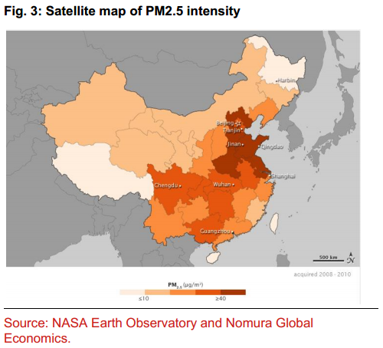
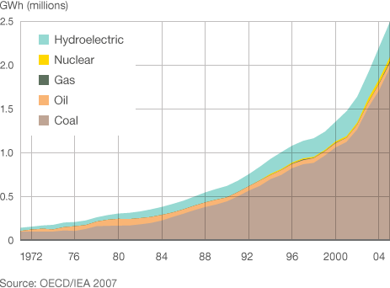
China’s Energy Consumption and Polluted areas
From 1971 to 2005. China’s Energy Consumption

Slide 6
What is China currently doing about the pollution?
Switching from burning coal to other renewable energy such as solar panels, wind mills, hydroelectric and nuclear. Currently about 80% of China’s energy is still from coal.
Closing down many coal burning mills.
In attempt to reduce carbon emissions, outdated cars are scrapped in a few parts of urban China. Also reducing the amount of cars on the road.
Newer models of cars emit lower emissions. Electric cars are available and rival Tesla’s technology.
China will bring about a national cap-and-trade program in 2017.

Slide 10
Conclusion
China’s economic growth came at the cost of damaging their environment and habitable living state.
Westernization shows to the rest of the world that China’s living standards are improving.
It is possible for China to undo the pollution within 20-30 years.
China is slowly switch energy sources.

Slide 11
Bibliography
http://www.aljazeera.com/indepth/opinion/2014/07/china-pollution-protests-2014729105632310682.html
http://www.usnews.com/opinion/blogs/world-report/2015/01/17/china-can-fix-its-severe-pollution-problem
https://www.washingtonpost.com/news/wonk/wp/2013/03/11/will-china-ever-get-its-pollution-problem-under-control/
http://www.cnn.com/2015/01/16/world/china-food-safety/
http://www.bloomberg.com/news/photo-essays/2016-04-26/beijing-auto-show-chinese-upstarts-take-on-the-electric-car-market
https://en.wikipedia.org/wiki/Pollution_in_China

