Slide 1
Sea Level Rise: Potential Economic Impacts; Preparation; Government Policy
Bahaa Judeh
Environmental Economics
ECON 2505
Prof. Sean P. MacDonald
5/17/17

Slide 2
What is Sea Level Rise?
An increase in the volume of water in the world’s oceans, resulting in an increase in global mean sea level, mainly caused by:
Thermal Expansion caused by warming of the ocean (water expands as it warms)
Increased melting of land-based ice, such as glaciers and ice sheets.
The oceans are absorbing more than 90% of the increased atmospheric heat associated with emissions from human activity.

Slide 3
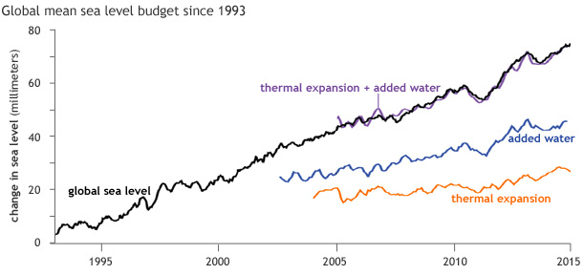
The pace of global sea level rise almost doubled from 1.7 mm/year throughout most of the twentieth century to 3.2 mm/year since 1993.

Slide 4
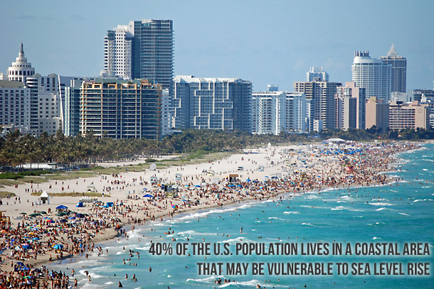
Why does it matter?
In the United States, almost 40% of the population lives in relatively high population-density coastal areas, where sea level plays a role in flooding, shoreline erosion, and hazards from storms.
Globally, 8 of the world’s 10 largest cities are near a coast, according to the U.N. Atlas of the Oceans.

Slide 5
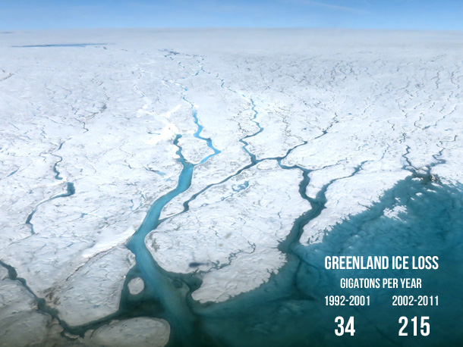
Glacier mass loss accelerated from 226 gigatons/year between 1971 and 1992 to 275 gigatons/year between 1993 and 2009.
Ice loss from the Greenland Ice Sheet increased six-fold, from 34 gigatons/year between 1992-2001 to 215 gigatons/year between 2002 and 2011.
Antarctic ice loss more than quadrupled, from 30 gigatons/year between 1992 and 2001 to 147 gigatons/year from 2002 to 2011.

Slide 6
Impact on Economic Growth
1. Permanent losses of natural capital
Sea level rise will lead to the definitive loss of land.
Land is a natural resource and matters for economic production. Land is part of natural capital, thus, a loss of land is a loss of capital with negative consequences on output.
This loss will affect particularly agricultural production. Where land is scarce (or, equivalently, where all useable land is used for agriculture), the associated economic cost can be assessed by the land market value.

Slide 7
Impact on Economic Growth
2. Permanent loss of physical capital
Sea level rise can lead to the loss of infrastructure and productive capital to a loss of physical capital. In some coastal areas, indeed, it is more rational to withdraw inland than to try to protect the area.
3. Permanent loss of social capital
Sea level rise might also affect social capital. A fraction of the population would be affected by sea level rise and would require additional protection expenditures and support. This could create political and social tensions since policies would have large redistributive effects: if large investments are made, the rest of the population can see them as inappropriate; if necessary investments are not made, the population at risk may feel unprotected by its government.

Slide 8
Impact on Economic Growth
4. Temporary floods and their impacts
Many low-lying coastal land areas are expected to be gradually submerged by rising sea levels. A rise of two feet above today's sea level would put more than $1 trillion of property and structures in the U.S. at risk of inundation.
And this effect is reinforced by existing trends, with cities especially coastal cities—growing rapidly in response to trends in economic structure and life styles. Confronted with growing population, land scarcity and infrastructure gap, more marginal and high-risk land is urbanized every year.

Slide 9
Government
Government must weigh the costs and risks of accommodating the rising seas, retreating from them, or trying to defend coastal properties and infrastructure with protective measures:
Traditional defensive approaches such as building seawalls and levees, or replenishing sand along eroded beaches, can help protect against flooding and damage but may not provide adequate or sustainable long-term protection.
Maintaining or restoring natural buffers, such as barrier islands, tidal wetlands, and mangroves, can also help defend coastlines.
Measures like elevating and flood-proofing structures can help accommodate temporary flooding and gradual inundation.
The most vulnerable coastal communities may increasingly need to consider the stark option of some form of retreat from the rising seas.
To limit the long-term risks of sea level rise and the costs of adapting to it, we must work toward deep reductions in the global warming emissions that are the primary cause of rising sea levels.

Slide 10
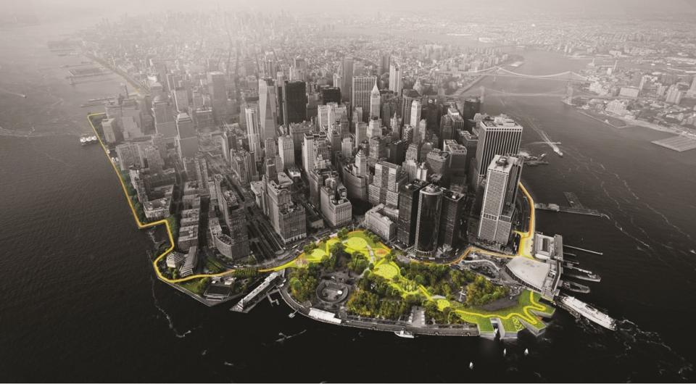
Preparation
https://www.youtube.com/watch?v=nCXScCHcrgU
Following Hurricane Sandy, local and federal officials partnered with developers in New York City to address infrastructure deficiencies in Manhattan. The result was a resiliency master plan by architect Bjarke Ingels and his firm, BIG. Named "The Big U," the Ingels plan is to raise the city's seawall and create green space along the water.

Slide 11
Works Cited
Causes of Sea Level Rise: What the Science Tells Us | Union of Concerned Scientists. (2013). Retrieved from http://www.ucsusa.org/globalwarming/science and_impacts/impacts/causes-of-sea-level-rise.html#.WRw7omgrLIX
US Department of Commerce, National Oceanic and Atmospheric Administration. (2008, October 27). Is sea level rising? Retrieved from http://oceanservice.noaa.gov/facts /sea level.html
Hallegatte, S. Insight: how will sea-level rise affect economic growth? Retrieved from http://environmentalresearchweb.org/cws/article/news/49112
Martin, D. (2016, June 20). How New York, Miami and Boston Are Preparing For Rising Sea Levels. Retrieved from https://www.forbes.com/sites/dmartin /2016/06/20/ combatting-sea-level-rise-requires-a-long-term-view/#7f121595237d
Lindsey, R. (2016, June 10). Climate Change: Global Sea Level | NOAA Climate.gov. Retrieved from https://www.climate.gov/news-features/understanding-climate/climate-change-global-sea-level

