Slide 1
Organic Agriculture:
Offering Potential Benifits for
Combating Climate Change
Yan Juan Zhao
Environmental Economics
ECON 2505
Prof. Sean P. MacDonald
May17, 2017

Slide 2
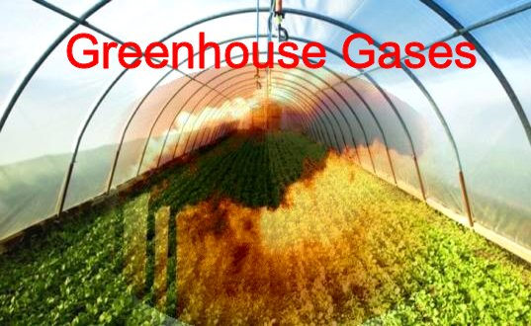
Agriculture as Cause and Victim
of Climate Change
Agriculture relies on synthetic chemical pesticides, fertilizers, machinery reliant on fossil fuel, and equipment technology.
Global warming could increase 4.7-8.6 degree above by the end of 21st century.
Agriculture within the United States accounted for 10% of U.S. greenhouse gas emission in 2014 ( USDA, 2016).
Thus …..
Agriculture contributes to climate change through significant emission of the greenhouse gas.

Slide 3
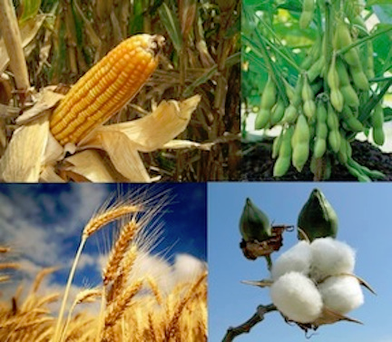
Agriculture AS Cause and Victim
of Climate Change
Increasing temperature will lead to yield declines between 2.5% and 10% across a number of agronomic species throughout the 21st century.
Particularly in Texas and Florida, reduction in precipitation may reach 20% to 25% while with strong precipitation increase in the North of 20% or more
Thus …..
Agriculture production is already being adversely affected by climate change. Climate change cause a severe threat to natural resources.
www.usda.gov

Slide 4
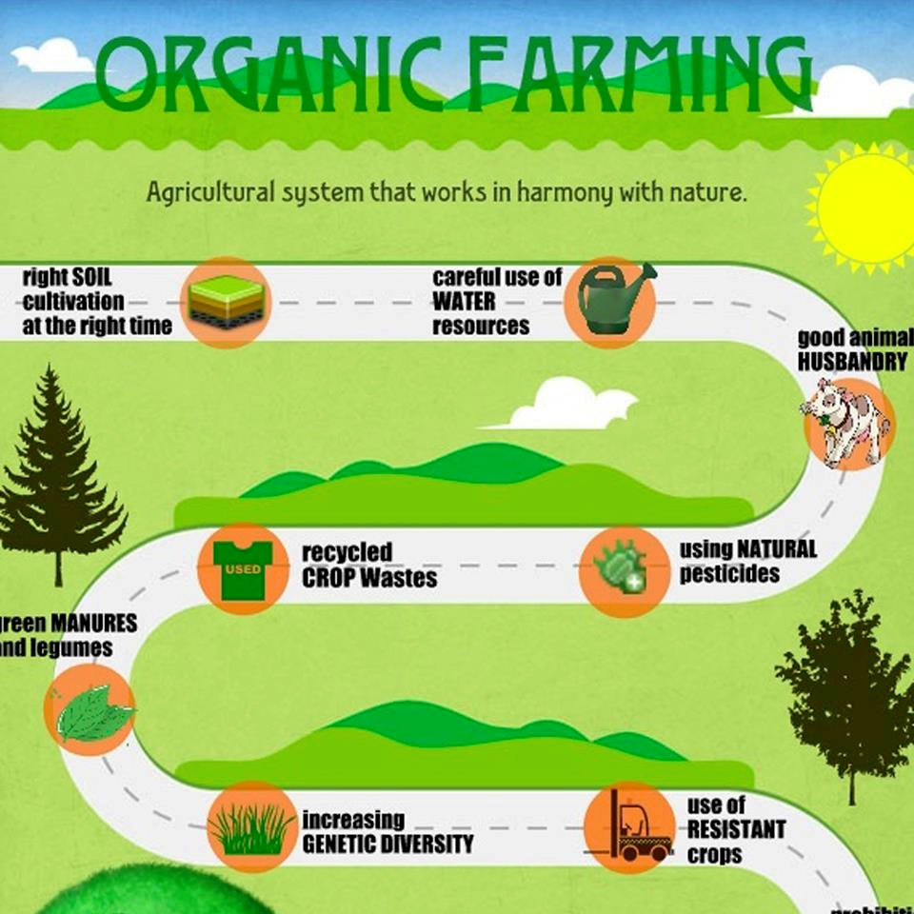
The Resaon for Choosing
Organic Agriculture
The concept of organic agriculture
Biodiversity
Biological cycles
Soil biological activity

Slide 5
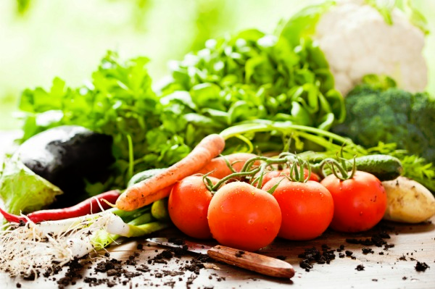
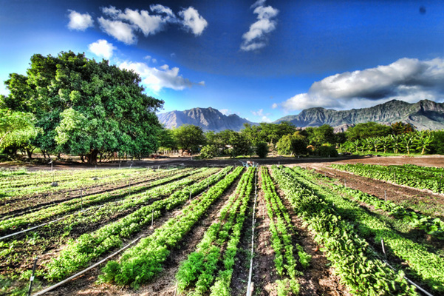
The Benifits of Organic Agriculture
Soil
Water
Biodiversity
Landscape

Slide 6
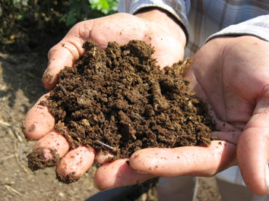
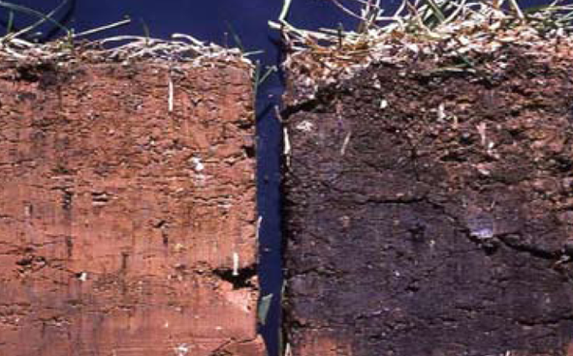
The Benifits of Organic Agriculture
Soil
Focuses on increasing soil organic matter, which increases carbon sequestered in the soil.
Relies on the management of natural cycles to keep soil micro-organisms healthy, protect biodiversity and control water pollution and soil erosion.
Organic agriculture increases long term soil productivity resulting healthier crops which are better able to survive under extreme event.

Slide 7
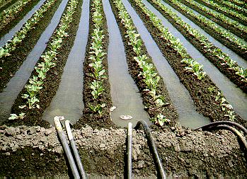
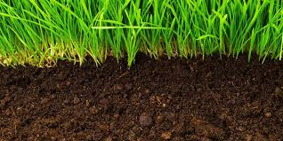
The Benifits of Organic Agriculture
Water
Under organic farming, the soil organic matter captures and retains more water in the crop root zone.
Well soil management reduce the risk of groundwater pollution
As a result…..
By increasing soil matter, the soil has a better water holding capacity during extreme rainfall, absorbing more water and experiencing less runoff and erosion.

Slide 8
The Benefits of Organic Agriculture
Biodiversity
Farmers rotate crops and livestock from one part of the farm to another, like mulching and recycling organic residues, inoculating soils for improved biological nitrogen fixation.
Famers grow different assemblages of crops in time and space enhance the ago-ecosystem resilience to external shocks.
Polyculture practice allows farmers planning to attract pollinators and pest predators.

Slide 9
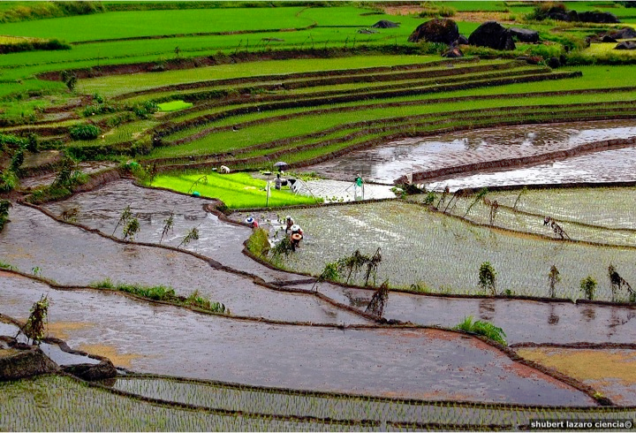
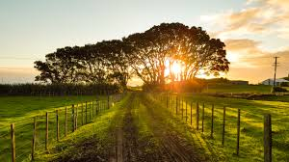
The Benifits of Organic Agriculture
Landscape preservation
Positive effects of organic agriculture on species richness and diversity appear in intensively managed agriculture ( Radu et al, 2014).
Organic agriculture is developing well in regions having good natural values and landscape amenities on small scale agricultural productions( Dunn et al, 2014).
As a result…..
While farmer practices biodiversity, the effect will strengthen the ecosystem both the farm and surrounding environment.

Slide 10
The significance of Organic Agriculture
Income Model
High quality organic food support loyal consumers who share the ecopreneurs conviction with profit making.
Sustainable Business Model
Organic agriculture is an effort addressing environmental concerns and emphasizing the need for environmental and social consequences activity.
Growth Model
Organic agriculture not only consider as eco-product, it is a balance between environmental concerns and economic gains.
Organic agriculture is the interactive nature environmental circumstances and contributes to the economic motivation in order to achieve the sustainability goal in society.

Slide 11
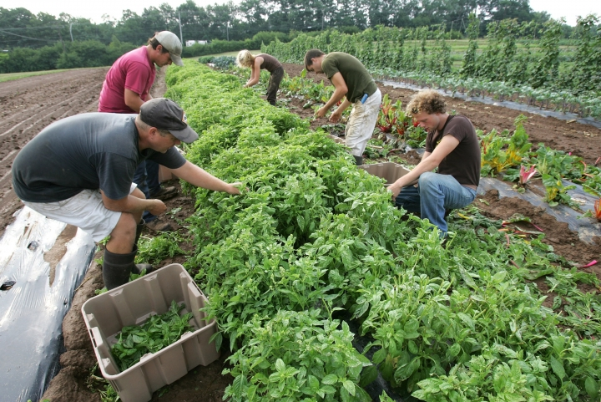
The Significance of View Points
What is the cause and what can be done to avoid and to be sustainable develop within available resources.
The practice of the organic agriculture can consider its unique features to combat the climate change.
Organic agriculture is a new form practice to optimize present and future food production and natural environmental protection.

Slide 12
Conclusion
Organic agriculture promotes agroecological resilience, biodiversity, landscape management via improved soil quality and efficient water use strengthen agroecosystem.
Organic agriculture enhances environmental quality and the natural resources base, sustain economic viability of agriculture, and society as a whole.
Organic agriculture as an effective adaptation to climate change improves understanding of the potential system wide impacts of climate change and opportunities for adaptation.

Slide 13
Works Cited
Agriculture and Climate Change. (2016). United States Department of Agriculture. Retrieved on April 15, 2017 from https://www.ers.usda.gov/topics/natural-resources-environment/climate-change/agriculture-and-climate-change/
Climate Change and Agriculture in the United States: Effects and Adaptation. (2013). United States Department of Agriculture. Retrieved on April 15, 2017 from https://www.usda.gov/oce/climate_change/effects_2012/CC%20and%20Agr iculture%20Report%20(02-04-2013) b.pdf
Dunn, J. W., Bórawski, P., & Pawlewicz, A. (2014). DEVELOPMENT OF ORGANIC FARMING IN THE USA. Acta Scientiarum Polonorum. Oeconomia, 55-68.
Jolink, A., & Niesten, E. (2015). Sustainable Development and Business Models of Entrepreneurs in the Organic Food Industry. Business Strategy & The Environment (John Wiley & Sons, Inc), 24(6), 386-401. doi:10.1002/bse.1826
RADU CĂTĂLIN, C., & SPERDEA, N. M. (2014). ORGANIC AGRICULTURE, CLIMATE CHANGE, AND FOOD SECURITY. Economics, Management & Financial Markets, 9(1), 118-123.

