Slide 1
Connecting Communities through Backyard Gardening
Let’s Make Our City Green Again!
Zhu, Mei
Environmental Economics
ECON 2505ID
Prof. Sean P. MacDonald
May 24th, 2017

Slide 2
What is my research about?
Backyard gardening is...?
Making use of the empty space available in the backyard to grow and cultivate fruits and vegetables
Purpose: promote and popularize planting in the backyard to become more connected to nature and promote a sense of community
Benefits: - saving and spending less on fresh fruits and vegetables
- reducing our carbon dioxide emissions, refreshing the air around us
- making our living environment more enjoyable and colorful

Slide 3
How does it reflect on literature?
Backyard gardening is a new way to get involved with community members, from which people will be more knowledgeable about community gardening through exchanging ideas. (Wakefield, et. al., 2007).
Gardening has a positive impact in changing gardeners’ as well as their relatives’ nutritional conditions while changing their Body Mass Index (BMI), which is referred to “...weight in kilograms divided by the square of height in meters” (Zick, et. al.2013).
Backyard gardening promotes community engagement and encourages helping others. A nine-year-old girl named Heiley Fort who spends her spare time in constructing movable shelters and growing food to help homeless people in her community, Western Washington (Dove, 2016).

Slide 4
What should we know about backyard gardening?
Cultivate seeds
Case study space limitations and weather constraints
Mostly vine-type plants: grapes, hairy squash, cucumber, and tomatoes, etc.
Harvest time

Slide 6
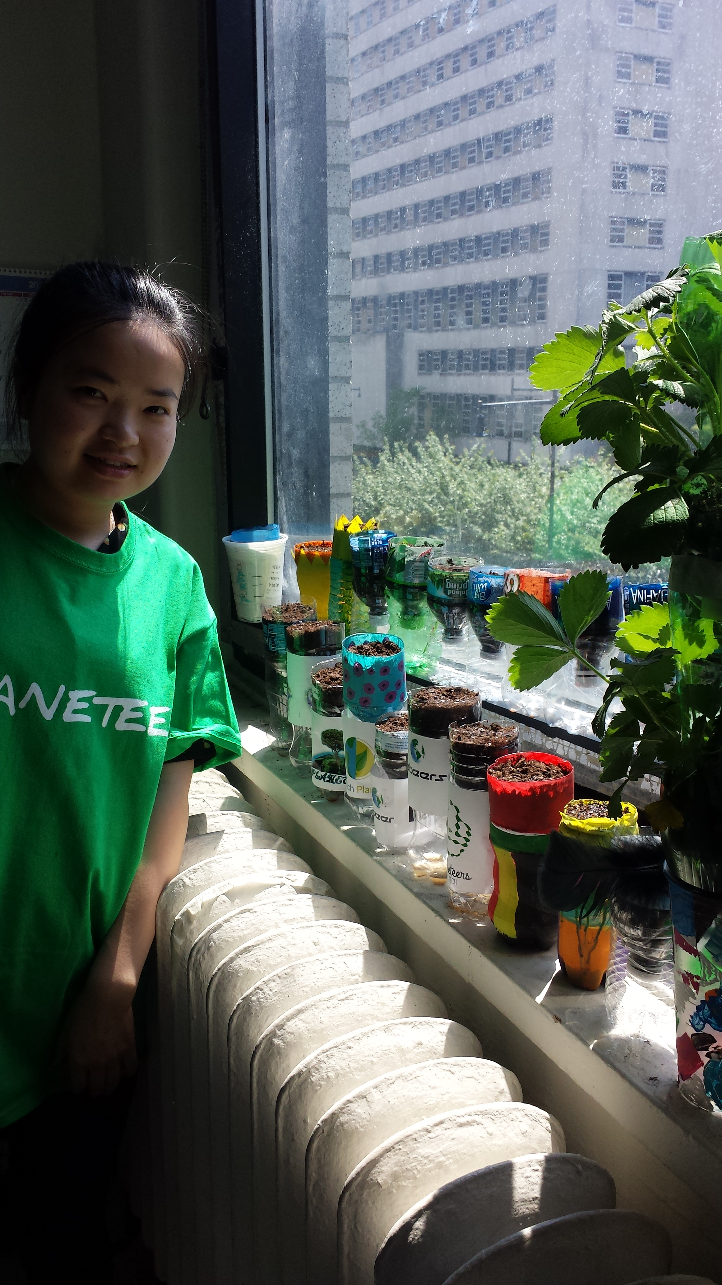
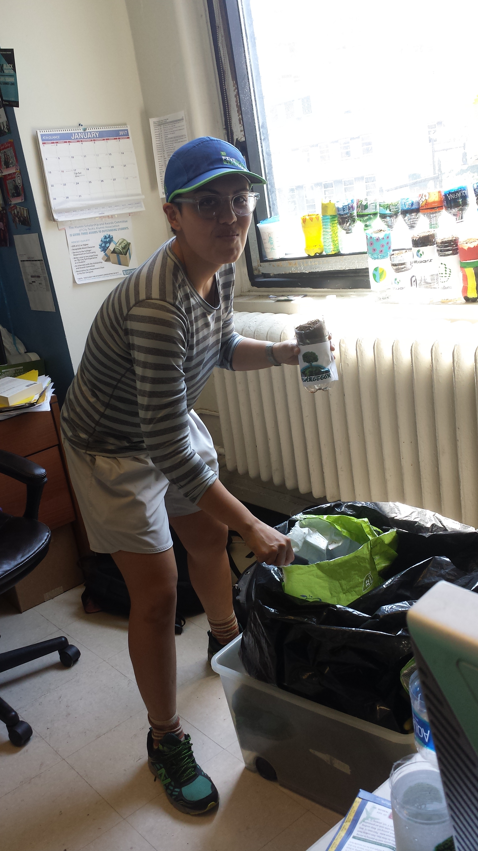
So, how can we get involved in community gardening?
Here we go...

Slide 7
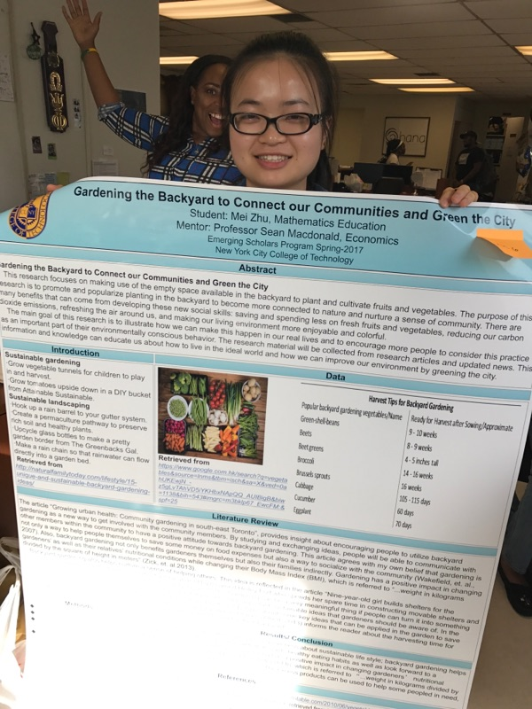
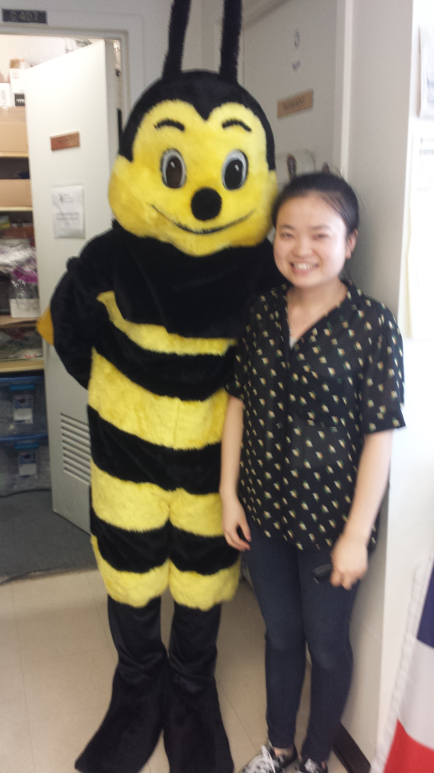
THANK YOU

Slide 8
Works Cited
Albert, S. (2013, February 05). Vegetable Harvest Times. Retrieved April 22, 2017, from http://www.harvesttotable.com/2010/06/vegetable_harvest_times/
Dove. (2016). .Nine-year-old girl builds shelters for the homeless and grows food for them, too Facebook, retrieved from http://www.boredpanda.com/helping-homeless-shelter-9-year-old-girl-harvest-hailey-fort/
Pruitt, V. (2014, April 24). 15 Unique and Sustainable Backyard Gardening Ideas. Retrieved April 22, 2017, from http://naturalfamilytoday.com/lifestyle/15-unique-and-sustainable-backyard-gardening-ideas/
Wakefield, S., Yeudall, F., Taron, C., Reynolds, J., &Skinner, A. (2007). Growing urban health: Community gardening in south-east Toronto. Journal of Health Promotion International, 22(2).
Zick, C. z., Smith, K. R., Kowaleski-Jones, L., Uno, C., & Merrill, B. J. (2013). Harvesting More Than Vegetables: The potential weight control benefits of community gardening. American Journal Of Public Health, 103(6), 1110-1115.

