Slide 1
Climate Change Facts and Fictions and Economic Realities
Colle Seck
Environmental Economics
ECON 2505
Prof. Sean P. MacDonald
5/11/17

Slide 2
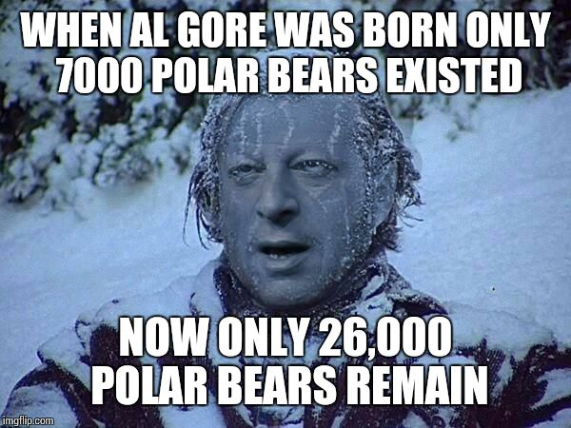
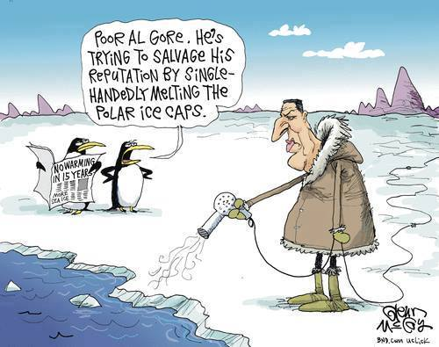
Introduction
In my presentation, I hope to shed light regarding misconceptions people have on climate change, especially the fallacies that the media and governments promote.
None of us in this room can claim that we have an objective and impartial media and certainly no one will claim that politicians are a veritable class of people.
There are SOO many falsehoods and delusions spread. There are many topics regarding this matter, I only hope that you will look into this matter yourself.

Slide 3
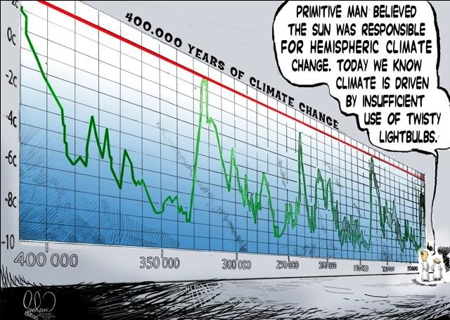
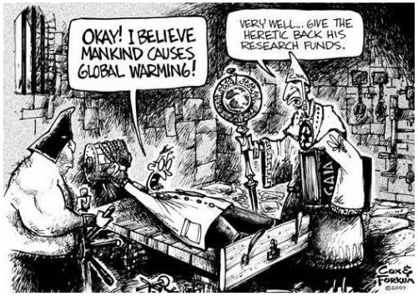
Climate Change
Now we all know that the temperature of the Earth is rising. Some will tell you that it is settled science, others will tell you that it is caused by human activity. There is no smoking gun which can state that is anthropogenic.
Within the Meteorologists Community, this topic is deeply contested with close to half of Meteorologists in America are skeptical of Anthropogenic Climate Change.
Without getting too political, when you look at the history of climate change, you’ll see many flip flops. In the 70s it was called Global cooling, and the scientist at the time believed that the whole world was going to freeze over. If their data was wrong then, is it possible it could be wrong now?

Slide 4
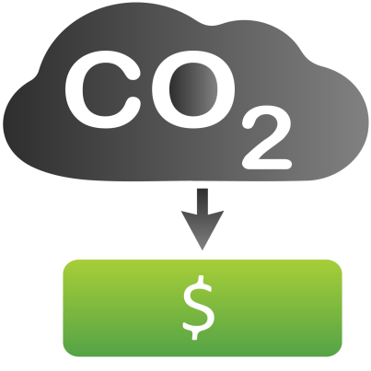
Carbon Credits
Carbon Credits are the tool that the Church of Climate change err umm, anthropogenic climate change promoters advocate will help the environment and promote economic growth. Countries are given budgets of Carbon Dioxide(CO2) that they are allowed to produce in tons. One ton of CO2 is worth One Carbon Credit. If a company’s carbon emissions fall below the allowable budget they are allowed to sell these credits. These credits can be exchanged and traded with other nations and companies, this has led to an industry which is assumed to be worth $1.2 Trillion.
Now one would assume this all sounds good and what not. Well unfortunately this can and is being abused. In Europe, the European Commission analysis, showed that by “overstating their logging targets, governments scooped up carbon credits”. In essence governments report false data and then use these carbon credits to make a profit. The costs of these credits was then left to EU member states who had to foot the bill. This resulted in over €600 million and the release of 133 million tons of CO2.

Slide 5
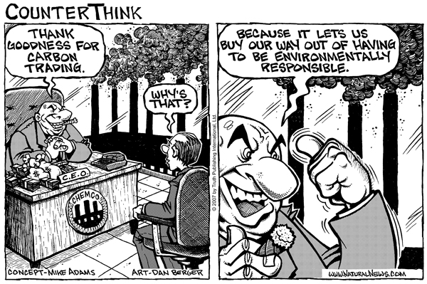
Carbon Credits Cont’d
There are other examples of this system being taken advantage of. Russia and Ukraine for example would pay for each others projects to reduce their emissions and in some cases intentionally make products that affect the climate and then destroy said products so that cash could be claimed for reducing emissions. Many of these projects did not exist at all.
This scheme is assumed to have increased carbon emissions by 872 million tons.

Slide 6
Costs of Climate Change
Now we all have heard of how costly climate change is going to be. We hear constantly of how we need to be concerned for the future of our children. We need to willing give up our money to big brother, and subject ourselves to a carbon tax for we need atonements for our carbon sins.
We merely need to look at “reputable” sources in the media to see blatant incongruity. One not “fake news” outlet will claim that inaction will lead to $44 Trillion worth of Climate change damage if no action is taken by the end of the century, another outlet will claim that there will be $200 Billion worth of damage by the end of the century.
If these outlets can’t even reach the same conclusion regarding how much it’ll cost in the future, how can we be certain of anything they claim? Now I know that this borders on an epistemological plane, but these are serious flaws that need to be pointed out. To challenge this “settled science” you will be vilified, and possibly have funding cut. Climatologist Judith A. Curry found this lesson out when she decided to suggest that climatologists should be more skeptical surrounding the “Climategate” scandal of 09. That’s debacle is a topic of it’s own.

Slide 7
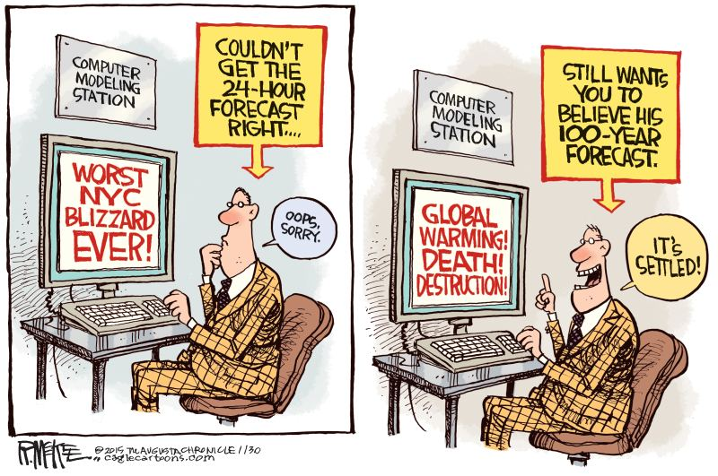
Conclusions
Now I’m sure many of you will assume “ HE DOESN’T BELIVE IN CLIMATE CHANGE, I BET HE’S A TRUMP SUPPORTER.”
Well I’ll clarify in this section. I’ve never stated that global temperatures have not risen. If you doubt me go back to the 3rd slide. What I have stated is that this is not a settled science, there are many misconceptions have regarding this, and the media does it’s best to encourage these misconceptions. I’ve demonstrated how YOUR taxpayer money is going to fund corporations and companies that abuse these climate change financial policies forced upon you by governments. I’ve shown inconsistencies regarding how much we will have to pay by the end of century if no action is committed, you can see the flux of the numbers. I viewed Judith Curry to be one of my best eye-openers regarding this matter. It was through her article I was able to open my eyes and be a little more skeptical regarding the matter. Now to wrap this up, Anthropogenic global warming is not fact. The media and politicians will deceive you in order to take your hard earned money from you. I am merely advocating that we all take a closer look, and be skeptical whenever these things are being promoted with little to no opposition.

Slide 8
Works Cited
Stillman, J. (2008, February 05). What Is Carbon Credit? Retrieved May 12, 2017, from http://www.cbsnews.com/news/what-is-carbon-credit/
Crisp, J. (2017). Leaked paper exposes EU countries’ abuse of climate loophole. EURACTIV.com. Retrieved 12 May 2017, from https://www.euractiv.com/section/climate-environment/news/leaked-paper-exposes-eu-countries-abuse-of-climate-loophole/
Richard, K. (2017). Only 53% Of Climatologists & Meteorologists, 36% Of Engineers & Geoscientists, 19% Of Agronomists Are ‘Consensus’ Believers. Notrickszone.com. Retrieved 12 May 2017, from http://notrickszone.com/2016/10/06/only-53-of-climatologists-meteorologists-36-of-engineers-geoscientists-19-of-agronomists-are-climate-consensus-believers/#sthash.uXj46TqY.dpbs
Chen, M. (2017). Are You a Millennial? Congratulations! Climate Change Will Cost Your Generation $8.8 Trillion. The Nation. Retrieved 12 May 2017, from https://www.thenation.com/article/are-you-a-millennial-congratulations-climate-change-will-cost-your-generation-8-8-trillion/
Frangoul, A. (2017). Cost of not acting on climate change $44 trillion: Citi. CNBC. Retrieved 12 May 2017, from http://www.cnbc.com/2015/08/18/cost-of-not-acting-on-climate-change-44-trillion-citi.html
Davenport, C. (2017). E.P.A. Warns of High Cost of Climate Change. Nytimes.com. Retrieved 12 May 2017, from https://www.nytimes.com/2015/06/23/us/politics/effects-of-climate-change-could-cost-billions-epa-report-says.html?_r=0
Judith, C. (2017). On the Credibility of Climate Research, Part II: Towards Rebuilding Trust. Watts Up With That?. Retrieved 12 May 2017, from https://wattsupwiththat.com/2010/02/24/on-the-credibility-of-climate-research-part-ii-towards-rebuilding-trust/

