Slide 1
Air transport & Climate change
Leo Wu
Environmental Economics
ECON 2505
Prof. Sean P. MacDonald
5/17/17

Slide 2
What will be addressed?
How does air transport affect the environment?
How can negative effects of air transport on the environment be prevented?
What are some solutions?

Slide 3
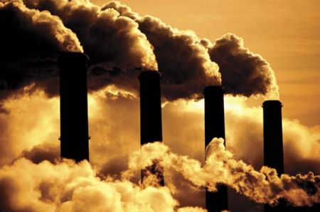
What is Greenhouse Gas?
Greenhouse gas is any gas compound in the atmosphere that is capable of absorbing radiation, which traps and holds the heat in the atmosphere.

Slide 4
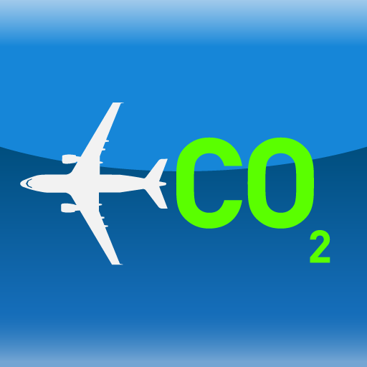
Greenhouse Gas
Human activities can send gases like CO2 into the atmosphere that enhance the greenhouse effect. Many of the gases come from fossil fuels such as oil, coal and natural gas to run vehicles, and generate electricity for industries or houses. The atmosphere can contain too much gases like CO2, which can make the atmosphere and the earth hotter. If the atmosphere holds onto these hot heat, and doesn’t release it, it can cause global warming.

Slide 5
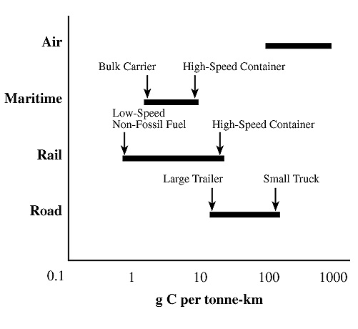
Greenhouse Gas Emission
Although the air transport industry is a small industry, it has a large impact on the climate system. Compared to other modes of transport, such as driving and taking the train or bus, travelling by air has a greater impact. Aircraft uses more greenhouse gas per passenger as shown on this picture.

Slide 6
What kind of greenhouse gas do aircraft product?
When fuel are burned from aircrafts, the carbon in the fuel is released and bonds with oxygen in the air to form carbon dioxide. Burning the fuel will also release water vapor and nitrogen dioxide.
Studies have shown that these high-altitude emissions have a more harmful climate impact because it triggers a series of chemical reactions.

Slide 7
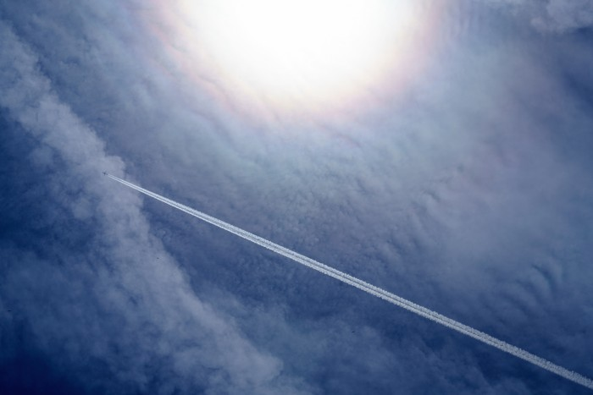
What are contrails?
Contrails are long trails of exhaust that you would see in the sky behind airplanes. Studies show that scientists have found that contrails are most harmful at night. They trap infrared radiation from earth. Contrails caused by air-travel emissions are considered to have a net warming effect.

Slide 8
What are contrails? (cont.)
Contrails is known to be more dangerous than CO2 when it comes to global warming. It was discovered that aviation contrails play a huge role in the impact on the climate change. It has a greater impact than CO2 emissions produced. While the CO₂ emissions from airplanes account for around three percent of the annual CO₂ emissions from all fossil fuels and change the radiation by 28 milliwatts per square meter, the aviation contrails are responsible for a change of around 31 milliwatts per square meter.

Slide 9
How does air transport affect the environment?
Air transport is one of the easiest ways to travel far which is why it can be debatable for climate change. It affects the environment because the aircraft engines emits heat, noise, and gases which affects the climate. Not only aircrafts can produce greenhouse gas but vehicles such as cars, bus, and trains can produce them as well. Studies have shown that between 1990 and 2006, greenhouse gas emissions from air transport have been known to increase by 87%. This shows that air transportation has an higher impact on climate change because it has increased by a high amount.

Slide 10
How can we prevent greenhouse gas?
Controlling air traffic can be optimized, which can allow planes to avoid waiting time at airports or also in the air before landing. The airport space can also be used to create space so planes don’t have to wait to reach their destination. We can also make laws to reduce carbon dioxide emissions from air transportation. There are also other simple ways to preventing greenhouse gas from air transport. One of the main reason would be reducing the use of air transport or stop using them in general.

Slide 11
What is Europe doing to try to prevent it?
Although the impact that aviation has on the climate is often neglected topic, Europe has spent the last few decades trying to decrease greenhouse gas emissions. According to Flassbeck Economics, the European Union Emissions Trading System (ETS) “set an overall legal limit on CO2 emissions of over 11,000 power stations and factories within 30 countries and accounts for almost half of the EU’s CO2 emissions.”

Slide 12
Solutions
There are simple solutions to greenhouse gas emissions. Walking and bicycle are both one of the least impact transportation. These transportations produces no carbon emissions from fossil fuels. Bicycles and bicycle parts emits carbon dioxide but not as much as other transportations. Also last but not least, avoid idling in your vehicles. This means to turn off your vehicles when you’re not moving.

Slide 13
Video

Slide 14
Works Cited
Air travel and climate change. (n.d.). Retrieved May 22, 2017, from http://www.davidsuzuki.org/issues/climate-change/science/climate-change-basics/air-travel-and-climate-change/
Airplane contrails worse than CO2 emissions for global warming: study. (n.d.). Retrieved May 22, 2017, from https://phys.org/news/2011-03-airplane-contrails-worse-co2-emissions.html
Aviation and Climate Change: Issues Both Environmentalists and Business Travelers Must Face. (n.d.). Retrieved May 22, 2017, from https://www.30secondstofly.com/corporate-traveler/business-travel-and-climate-change/
Aviation and climate change. (n.d.). Retrieved May 22, 2017, from http://aviationbenefits.org/environmental-efficiency/aviation-and-climate-change/
Clark, D. (2010, April 06). Aviation Q&A: the impact of flying on the environment. Retrieved May 22, 2017, from https://www.theguardian.com/environment/2010/apr/06/aviation-q-and-a
Impact Of Air Transport On Environment. (n.d.). Retrieved May 22, 2017, from http://www.transportleague.com/an-insight-on-impact-of.html

